Slide 1

6-7
CSCU9A1 JAVA LECTURE
ARRAYS
Copyright © 2013 by John Wiley & Sons. All rights reserved.

Slide 2
Lecture Goals
To collect values using arrays
To use for loops and enhanced for loops for traversing arrays
To learn common algorithms for processing arrays
Related reading:
Java for Everyone 2nd ed, Horstmann, 2013
  Chapter 6 (Arrays), sections 6.1 to 6.4
Copyright © 2013 by John Wiley & Sons. All rights reserved.
Page <number>

Slide 3

6.1 Arrays
A Computer Program often needs to store a list of values and then process them
For example, if you had this list of values, how many variables would you need?
  double input1, input2, input3….
Arrays to the rescue!
An array collects sequences of values of the same type.
Copyright © 2013 by John Wiley & Sons. All rights reserved.
Page <number>

Slide 4
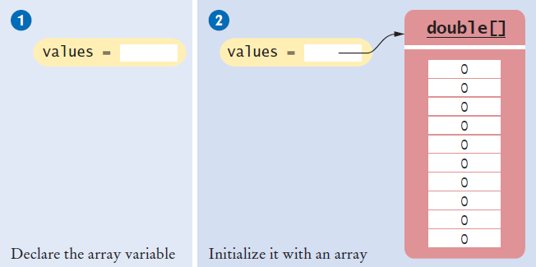
Declaring an Array
Declaring an array is a two step process
  double[] values; // declare array variable
  values = new double[10]; // initialize array
You cannot use the array until you tell the compiler the size of the array in step 2.
Copyright © 2013 by John Wiley & Sons. All rights reserved.
Page <number>

Slide 5
Declaring an Array (Step 1)
Make a named ‘list’ with the following parts:
  Type Square Braces Array name semicolon
  double [ ] values ;
  You are declaring that
    There is an array named values
    The elements inside are of type double
    You have not (YET) declared how many elements are in inside
Other Rules:
  Arrays can be declared anywhere you can declare a variable
  Do not use ‘reserved’ words or already used names
Copyright © 2013 by John Wiley & Sons. All rights reserved.
Page <number>

Slide 6
Declaring an Array (Step 2)
Reserve memory for all of the elements:
  Array name Keyword Type Size semicolon
  values = new double [10] ;
  You are reserving memory for:
    The array named values
    needs storage for [10]
    elements the size of type double
  You are also setting up the array variable
  Now the compiler knows how many elements there are
    You cannot change the size after you declare it!
values
[0] [1] [2] [3] [4] … [9]
double
double
double
double
double
double
Copyright © 2013 by John Wiley & Sons. All rights reserved.
Page <number>

Slide 7
One Line Array Declaration
Declare and Create on the same line:
Type Braces Array name Keyword Type Size semi
double [] values = new double[10] ;
  You are declaring that
    There is an array named values
    The elements inside are of type double
  You are reserving memory for the array
    Needs storage for [10]
    elements the size of type double
  You are also setting up the array variable
Copyright © 2013 by John Wiley & Sons. All rights reserved.
Page <number>

Slide 8
Declaring and Initializing an Array
You can declare and set the initial contents of all elements by:
  Type Braces Array name contents list semi
  int [ ] primes = { 2, 3, 5, 7} ;
You are declaring that
  There is an array named primes
  The elements inside are of type int
  Reserve space for four elements
    The compiler counts them for you!
  Set initial values to 2, 3, 5, and 7
  Note the curly braces around the contents list
Copyright © 2013 by John Wiley & Sons. All rights reserved.
Page <number>

Slide 9
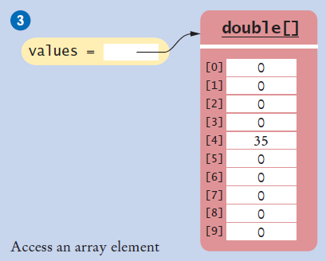
Accessing Array Elements
Each element is numbered
  We call this the index
  Access an element by:
    Name of the array
    Index number
    values[i]
Elements in the array values are accessed by an integer index i, using the notation values[i].
public static void main(String[] args)
{
double values[];
values = new double[10];
values[4] = 35;
}
Copyright © 2013 by John Wiley & Sons. All rights reserved.
Page <number>

Slide 10
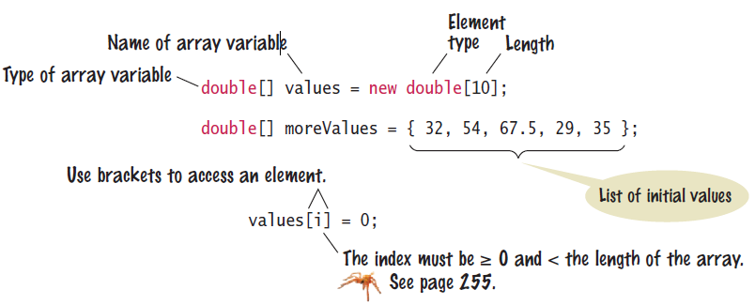
Syntax: Array
To declare an array, specify the:
  Array variable name
  Element Type
  Length (number of elements)
Copyright © 2013 by John Wiley & Sons. All rights reserved.
Page <number>

Slide 11
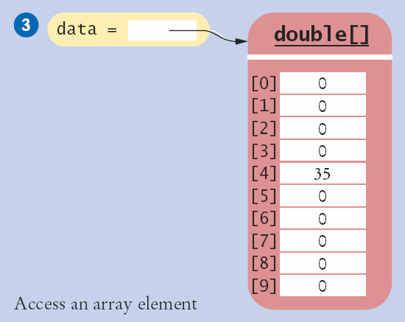
Array Index Numbers
Array index numbers start at 0
  The rest are positive integers
An 10 element array has indexes 0 through 9
  There is NO element 10!
The first element is at index 0:
public static void main(String[] args)
{
double values[];
values = new double[10];
}
The last element is at index 9:
Copyright © 2013 by John Wiley & Sons. All rights reserved.
Page <number>

Slide 12
Array Bounds Checking
An array knows how many elements it can hold
  values.length is the size of the array named values
  It is an integer value (index of the last element + 1)
Use this to range check and prevent bounds errors
public static void main(String[] args)
{
int i = 10, value = 34;
double values[];
values = new double[10];
if (0 <= i && i < values.length) // length is 10
{
value[i] = value;
}
}
Strings and arrays use different syntax to find their length:
Strings: name.length()
Arrays: values.length
Copyright © 2013 by John Wiley & Sons. All rights reserved.
Page <number>

Slide 13
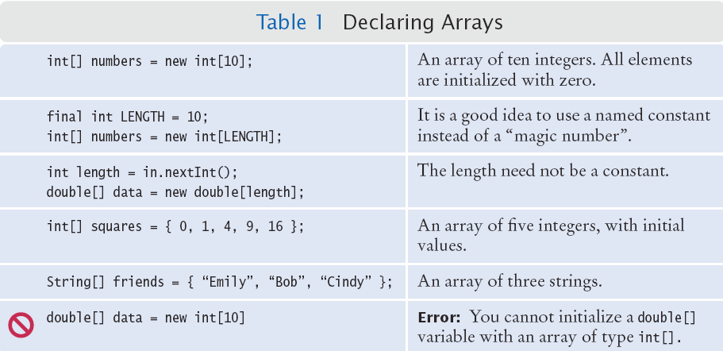
Summary: Declaring Arrays
Copyright © 2013 by John Wiley & Sons. All rights reserved.
Page <number>

Slide 14
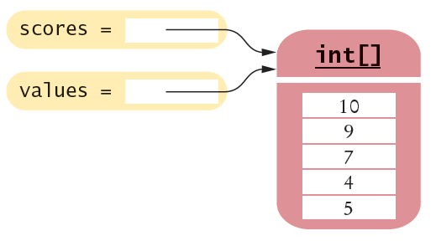
Array References
Make sure you see the difference between the:
  Array variable: The named ‘handle’ to the array
  Array contents: Memory where the values are stored
int[] scores = { 10, 9, 7, 4, 5 };
Array variable
Array contents
Reference
An array variable contains a reference to the array contents. The reference is the location of the array contents (in memory).
Values
Copyright © 2013 by John Wiley & Sons. All rights reserved.
Page <number>

Slide 15
Array Aliases
You can make one array reference refer to the same contents of another array reference:
int[] scores = { 10, 9, 7, 4, 5 };
Int[] values = scores; // Copying the array reference
Array contents
References
An array variable specifies the location of an array. Copying the reference yields a second reference to the same array.
Copyright © 2013 by John Wiley & Sons. All rights reserved.
Page <number>

Slide 16
Partially-Filled Arrays
An array cannot change size at run time
  The programmer may need to guess at the maximum number of elements required
  It is a good idea to use a constant for the size chosen
  Use a variable to track how many elements are filled
final int LENGTH = 100;
double[] values = new double[LENGTH];
int currentSize = 0;
Scanner in = new Scanner(System.in);
while (in.hasNextDouble())
{
if (currentSize < values.length)
{
values[currentSize] = in.nextDouble();
currentSize++;
}
}
Maintain the number of elements filled using a variable (currentSize in this example)
Copyright © 2013 by John Wiley & Sons. All rights reserved.
Page <number>

Slide 17
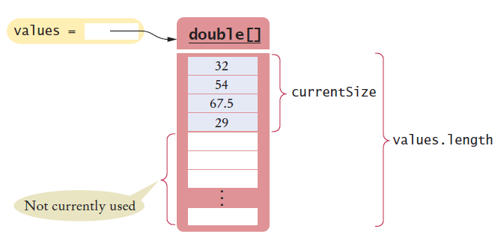
Walking a Partially Filled Array
Use currentSize, not values.length for the last element
for (int i = 0; i < currentSize; i++)
{
System.out.println(values[i]);
}
A for loop is a natural choice to walk through an array
Copyright © 2013 by John Wiley & Sons. All rights reserved.
Page <number>

Slide 18

Common Error
Array Bounds Errors
  Accessing a nonexistent element is very common error
  Array indexing starts at 0
  Your program will stop at run time
public class OutOfBounds
{
public static void main(String[] args)
{
double values[];
values = new double[10];
values[10] = 100;
}
}
There is no element 10:
java.lang.ArrayIndexOutOfBoundsException: 10
at OutOfBounds.main(OutOfBounds.java:7)
Copyright © 2013 by John Wiley & Sons. All rights reserved.
Page <number>

Slide 19
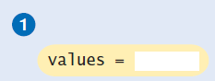

Common Error
Uninitialized Arrays
  Don’t forget to initialize the array variable!
  The compiler will catch this error
double[] values;
...
values[0] = 29.95; // Error—values not initialized
Error: D:\Java\Unitialized.java:7:
variable values might not have been initialized
double[] values;
values = new double[10];
values[0] = 29.95; // No error
Copyright © 2013 by John Wiley & Sons. All rights reserved.
Page <number>

Slide 20
The Enhanced for Loop
Using for loops to ‘walk’ arrays is very common
  The enhanced for loop simplifies the process
  Also called the “for each” loop
  Read this code as:
    “For each element in the array”
As the loop proceeds, it will:
  Access each element in order (0 to length-1)
  Copy it to the element variable
  Execute loop body
Not possible to:
  Change elements
  Get bounds error
double[] values = . . .;
double total = 0;
for (double element : values)
{
total = total + element;
}
Copyright © 2013 by John Wiley & Sons. All rights reserved.
Page <number>

Slide 21
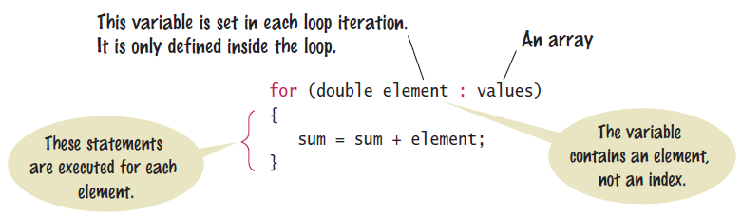
Syntax: The Enhanced for loop
Use the enhanced “for” loop when:
  You need to access every element in the array
  You do not need to change any elements of the array
Copyright © 2013 by John Wiley & Sons. All rights reserved.
Page <number>

Slide 22
Common Array Algorithms
Filling an Array
Sum and Average Values
Find the Maximum or Minimum
Output Elements with Separators
Linear Search
Copyright © 2013 by John Wiley & Sons. All rights reserved.
Page <number>

Slide 23
Common Algorithms 1 and 2:
1) Filling an Array
  Initialize an array to a set of calculated values
  Example: Fill an array with squares of 0 through 10
2) Sum and Average
  Use enhanced for loop, and avoid dividing by zero
int[] values = new int[11];
for (int i = 0; i < values.length; i++)
{
values[i] = i * i;
}
double total = 0, average = 0;
for (double element : values)
{
total = total + element;
}
if (values.length > 0) { average = total / values.length; }
Copyright © 2013 by John Wiley & Sons. All rights reserved.
Page <number>

Slide 24
Common Algorithms 3:
double largest = values[0];
for (int i = 1; i < values.length; i++)
{
if (values[i] > largest)
{
largest = values[i];
}
}
Typical for loop to find maximum
Maximum and Minimum
  Set largest to first element
  Use for or enhanced for loop
  Use the same logic for minimum
double largest = values[0];
for (double element : values)
{
if element > largest)
largest = element;
}
double smallest = values[0];
for (double element : values)
{
if element < smallest)
smallest = element;
}
Enhanced for to find maximum
Enhanced for to find minimum
Copyright © 2013 by John Wiley & Sons. All rights reserved.
Page <number>

Slide 25



Common Algorithms 4:
Element Separators
  Output all elements with separators between them
  No separator before the first or after the last element
Handy Array method: Arrays.toString()
  Useful for debugging!
for (int i = 0; i < values.length; i++)
{
if (i > 0)
{
System.out.print(" | ");
}
System.out.print(values[i]);
}
import java.util.*;
System.out.println(Arrays.toString(values));
Copyright © 2013 by John Wiley & Sons. All rights reserved.
Page <number>

Slide 26
Common Algorithms 5:
Linear Search
  Search for a specific value in an array
  Start from the beginning (left), stop if/when it is found
  Uses a boolean found flag to stop loop if found
int searchedValue = 100; int pos = 0;
boolean found = false;
while (pos < values.length && !found)
{
if (values[pos] == searchedValue)
{
found = true;
}
else
{
pos++;
}
}
Compound condition to prevent bounds error if value not found.
if (found)
{
System.out.println(“Found at position: ” + pos);
}
else { System.out.println(“Not found”); }
Copyright © 2013 by John Wiley & Sons. All rights reserved.
Page <number>

Slide 27
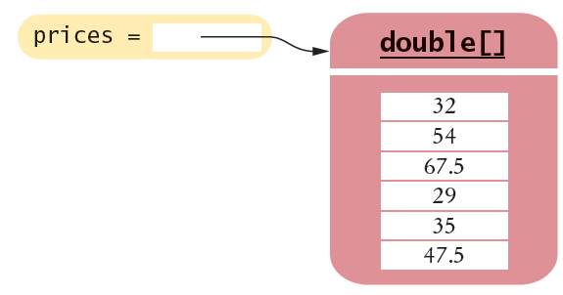

6.4 Using Arrays with Methods
Methods can be declared to receive references as parameter variables
What if we wanted to write a method to sum all of the elements in an array?
  Pass the array reference as an argument!
priceTotal = sum(prices);
reference
public static double sum(double[] values)
{
double total = 0;
for (double element : values)
total = total + element;
return total;
}
Arrays can be used as method arguments and method return values.
Copyright © 2013 by John Wiley & Sons. All rights reserved.
Page <number>

Slide 28


Passing References
Passing a reference give the called method access to all of the data elements
  It CAN change the values!
Example: Multiply each element in the passed array by the value passed in the second parameter
multiply(scores, 10);
reference
value
public static void multiply(double[] values, double factor)
{
for (int i = 0; i < values.length; i++)
values[i] = values[i] * factor;
}
Copyright © 2013 by John Wiley & Sons. All rights reserved.
Page <number>

Slide 29
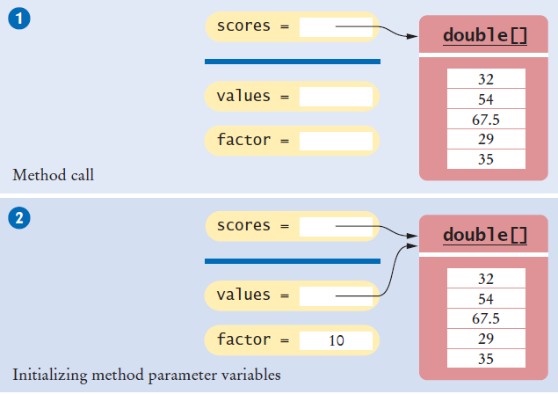

Passing References (Step 2)
Copyright © 2013 by John Wiley & Sons. All rights reserved.
Page <number>

Slide 30
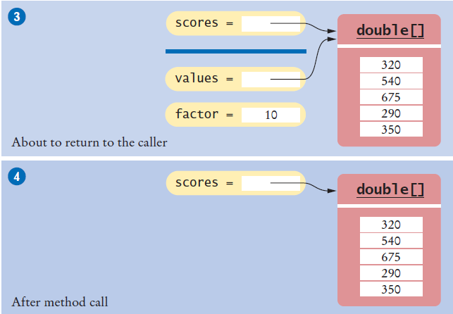
Passing References (Steps 3 & 4)
The method multiplies all array elements by 10 (Step 3)
The method returns. Its parameter variables are removed. However, scores still refers to the array with the modified values (Step 4).
Copyright © 2013 by John Wiley & Sons. All rights reserved.
Page <number>

Slide 31
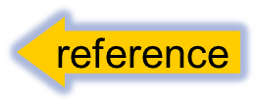
Method Returning an Array
Methods can be declared to return an array
To Call: Create a compatible array reference:
  Call the method
public static int[] squares(int n)
int[] numbers = squares(10);
value
public static int[] squares(int n)
{
int[] result = new int[n];
for (int i = 0; i < n; i++)
{
result[i] = i * i;
}
return result;
}
Copyright © 2013 by John Wiley & Sons. All rights reserved.
Page <number>

Slide 32
End of lecture
Summary slides and additional material follow: use these to help you study and as reference material for the practicals.
To deepen your understanding of the lecture, read Sections 6.1 to 6.4 of Java for Everyone.
Copyright © 2013 by John Wiley & Sons. All rights reserved.
Page <number>

Slide 33
Problem Solving
Adapting Algorithms
Consider this example problem: You are given the quiz scores of a student. You are to compute the final quiz score, which is the sum of all scores after dropping the lowest one.
  For example, if the scores are
  8 7 8.5 9.5 7 5 10
  then the final score is 50.
Copyright © 2013 by John Wiley & Sons. All rights reserved.
Page <number>

Slide 34

Adapting a Solution
What steps will we need?
  Find the minimum.
  Remove it from the array.
  Calculate the sum.
What tools do we know?
  Finding the minimum value (Section 6.3.3)
  Removing an element (Section 6.3.6)
  Calculating the sum (Section 6.3.2)
But wait… We need to find the POSITION of the minimum value, not the value itself..
  Hmmm. Time to adapt
Copyright © 2013 by John Wiley & Sons. All rights reserved.
Page <number>

Slide 35


Planning a Solution
Refined Steps:
  Find the minimum value.
  Find its position.
  Remove it from the array.
  Calculate the sum.
Let’s try it
  Find the position of the minimum:
    At position 5
  Remove it from the array
  Calculate the sum
Copyright © 2013 by John Wiley & Sons. All rights reserved.
Page <number>

Slide 36
Adapting the code
Adapt smallest value to smallest position:
double smallest = values[0];
for (int i = 1; i < values.length; i++)
{
if (values[i] < smallest)
{
smallest = values[i];
}
}
int smallestPosition = 0;
for (int i = 1; i < values.length; i++)
{
if (values[i] < values[smallestPosition] )
{
smallestPosition = i;
}
}
Copyright © 2013 by John Wiley & Sons. All rights reserved.
Page <number>

Slide 37
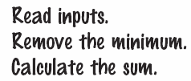
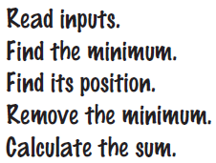

Using Arrays with Methods
1) Decompose the task into steps
2) Determine the algorithms to use
3) Use methods to structure the program
4) Assemble and Test the program
double[] scores = readInputs();
double total = sum(scores) - minimum(scores);
System.out.println("Final score: " + total);
Copyright © 2013 by John Wiley & Sons. All rights reserved.
Page <number>

Slide 38
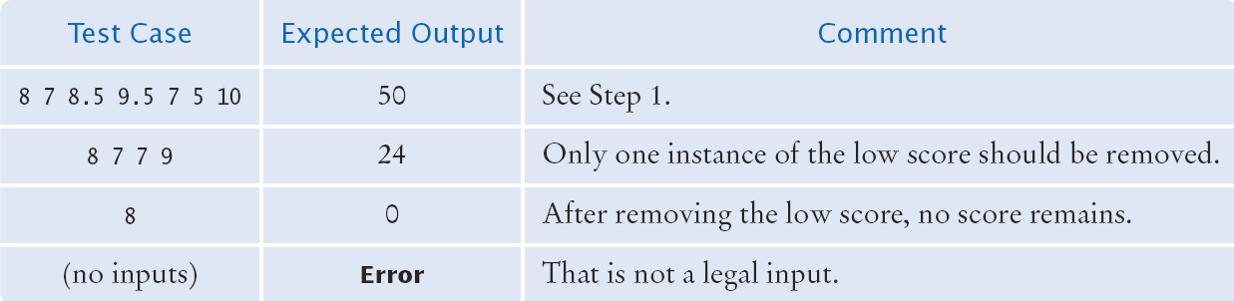
Assembling and Testing
Place methods into a class
Review your code
  Handle exceptional situations?
    Empty array?
    Single element array?
    No match?
    Multiple matches?
Copyright © 2013 by John Wiley & Sons. All rights reserved.
Page <number>

Slide 39
Summary: Arrays
An array collects a sequence of values of the same type.
Individual elements in an array values are accessed by an integer index i, using the notation values[i].
An array element can be used like any variable.
An array index must be at least zero and less than the size of the array.
A bounds error, which occurs if you supply an invalid array index, can cause your program to terminate.
Copyright © 2013 by John Wiley & Sons. All rights reserved.
Page <number>

Slide 40
Summary: Arrays
Use the expression array.length to find the number of elements in an array.
An array reference specifies the location of an array.
Copying the reference yields a second reference to the same array.
With a partially-filled array, keep a companion variable for the current size.
Copyright © 2013 by John Wiley & Sons. All rights reserved.
Page <number>

Slide 41
Summary: Arrays
You can use the enhanced for loop to visit all elements of an array.
  Use the enhanced for loop if you do not need the index values in the loop body.
A linear search inspects elements in sequence until a match is found.
Use a temporary variable when swapping elements.
Use the Arrays.copyOf method to copy the elements of an array into a new array.
Arrays can occur as method parameter variables and return values.
Copyright © 2013 by John Wiley & Sons. All rights reserved.
Page <number>

