Slide 1
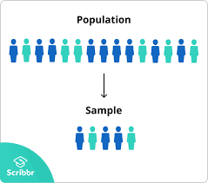
Engineering Statistics
Random
Sampling
Dr. Vvn Weian Chao (趙韋安)
https://ce.nctu.edu.tw/member/teachers/23
Department of Civil Engineering, National Yang Ming Chiao Tung University, Taiwan

Slide 2

Purpose
描述統計
進入
推論統計

Slide 3
Random Sampling
Probability

Slide 4
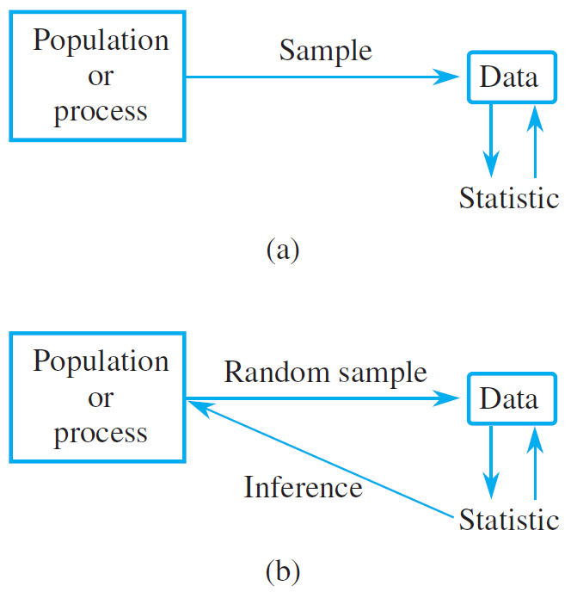
Purpose

Slide 5
Goal
To draw
conclusions
about
larger entity

Slide 6
Data from sampling
Random
Stratified

Slide 7
Advantage
Savings
in
time
and
money

Slide 8
Advantage
Testing done on
samples is often more reliable than
testing on entire populations
隨著時間疲憊

Slide 9
Data from sampling
To reduce or eliminate bias
To make precise statements

Slide 10
Random number generator
replacement
Without replacement

Slide 11
Key parameter
The sample size
used
In
Random sampling
取樣的數量n與本身的分析預算及準確率需求有關

Slide 12
R: Sampling
sample(
x,
size,
replace,
prob).

Slide 13
R: Sampling-
same random data
set.seed().

Slide 14
R: Sampling
generate random
float number
runif(
n,min,max
).

Slide 15
TRY
it
in
R

Slide 16
R: Sampling
R_sampling_a.R

Slide 17
Data from sampling
Random
Stratified

Slide 18
Advantage
Stratified sampling will generally produce estimates that are more precise

Slide 19

Stratified Sampling
先將母體分類成幾個群組➔決定各群組的隨機抽樣個數後再進行抽樣。
General Rules for Choosing Strata
Decide on a response variable y that is of interest.
Divide the entire population into nonoverlapping groups (i.e., strata) S₁, S₂, . . ., S_{k}, each of which is as homogeneous as possible.
Decide on the sample sizes n₁, n₂, . . ., n_{k} to select from the k strata.
Use SRS to obtain a sample from each stratum.

Slide 20
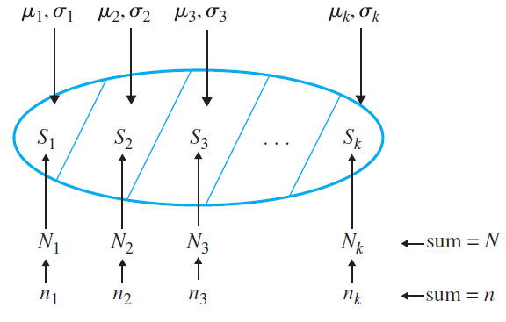
Stratified Sampling

Slide 21
Estimating a Population Mean
Given the w_{i}’s, the N_{i}’s, the σ_{i}’s, a confidence level of 95%, and B, it can be shown that the minimum necessary sample n for estimating the population mean μ to within a margin of error of ±B is
For stratified sampling, the standard error is approximated by
Where is the sample variance of the observations from stratum .
設定個母體權重、數量、母體標準差、信心水準及容許誤差➔決定最少需要的總抽樣樣本數量，才能估計母體平均

Slide 22
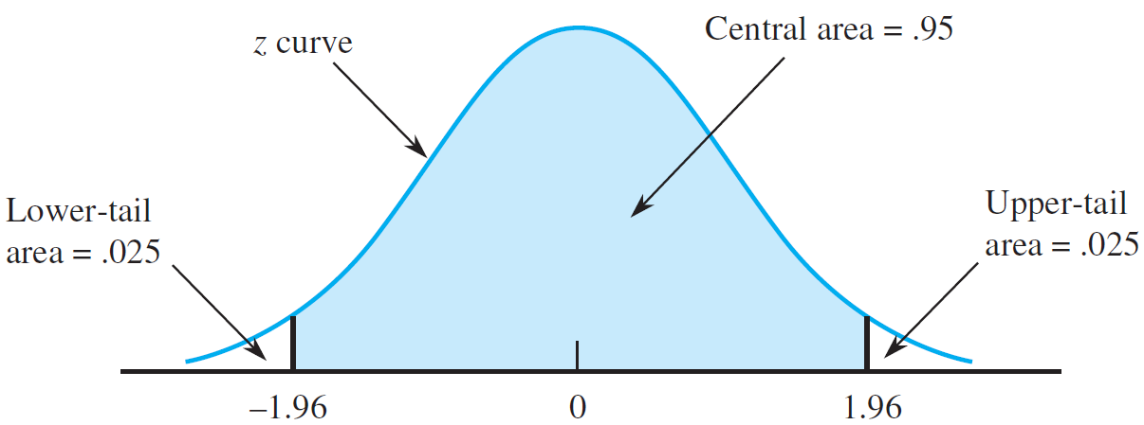
A confidence interval for μ with CL 95%

Slide 23
Estimating a Population Mean
若將容許的誤差B變小，則需要增加抽樣樣本個數n。
1.96對應95%的信心水準(基於標準化常態分布)，若要提高信心水準，亦需要增加n。

Slide 24
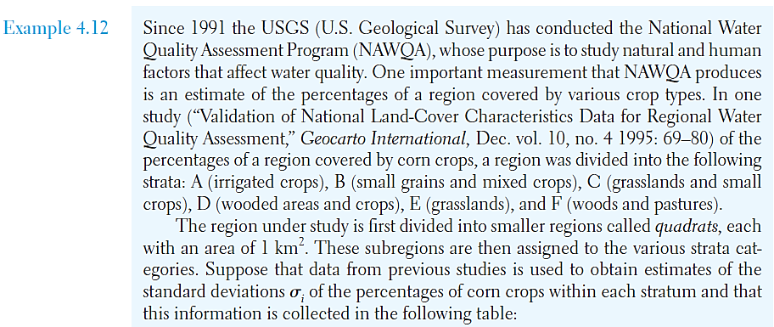
Estimating a Population Mean: Example
問題: 自然環境與人為種植對於水質的影響。其中發現與特定作物的覆蓋面積有關。

Slide 25
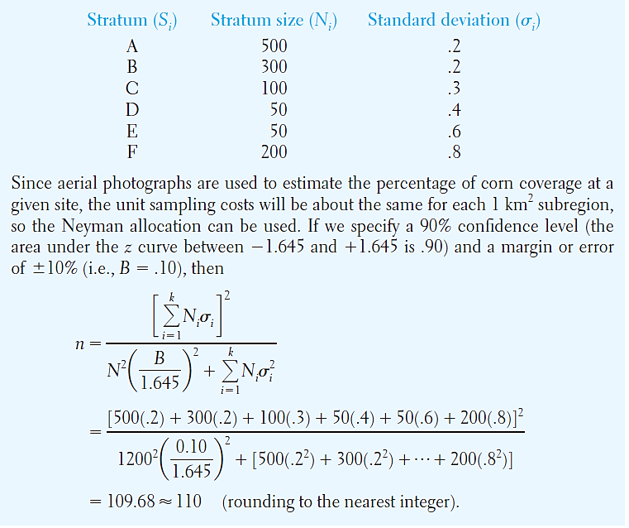
Estimating a Population Mean: Example
抽樣樣本數至少需要110

Slide 26
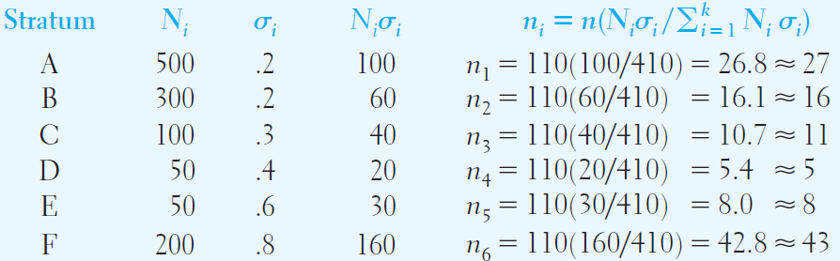
Estimating a Population Mean: Example
估計各分類下所需的抽樣樣本個數

Slide 27
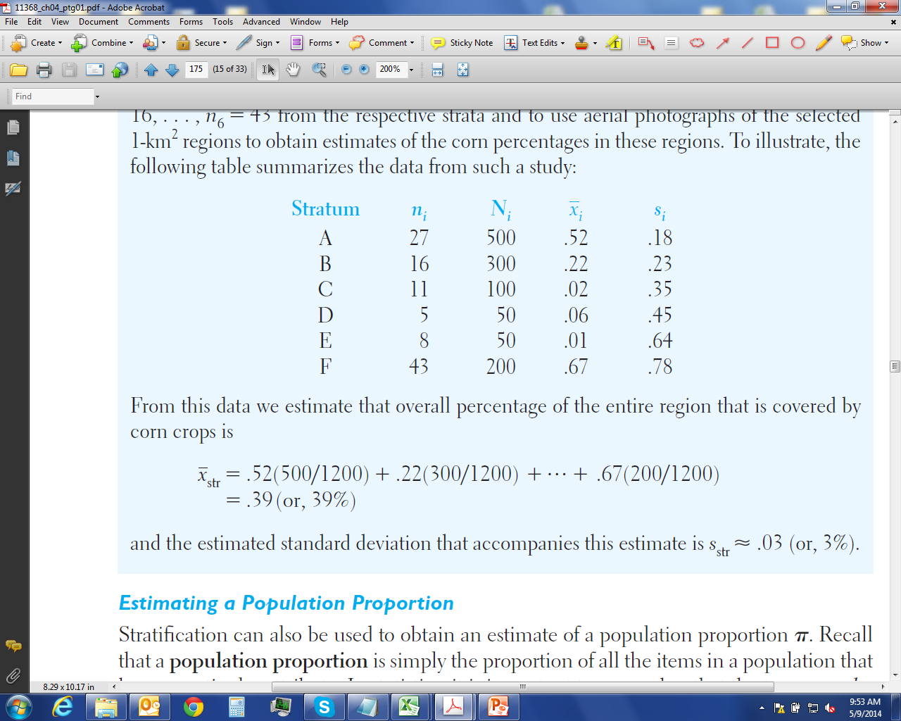
Estimating a Population Mean: Example
計算分類抽樣平均值及標準差
39%是受到人為種植影響
The estimated standard deviation that accompanies this estimate is s_{str} ≈.03 (or, 3%).

Slide 28
Sampling distributions
How sampling distribution are used
General Properties of sampling distribution

Slide 29
How Sampling Distributions Are Used
-怎樣的樣本分佈是適合的?
-一般樣本分佈主要是來表達: 從母體抽樣中的樣本可用於代表的統計意義(特徵值)
To approximate the sampling distribution of a statistic, we repeatedly select a large number of random samples of size n from a given population.
We calculate the value of the statistic for each sample and form a histogram of the results.
We get an approximate picture of the sampling distribution of the statistic.

Slide 30
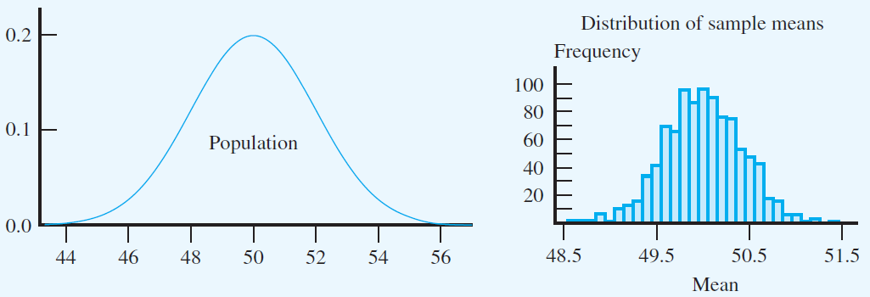
How Sampling Distributions Are Used
-從平均值為50標準差為2常態分佈(normal distribution)抽樣25個樣本，並計算其樣本平均數、中位數、樣本標準差、變異數。上述動作進行1000次。

Slide 31
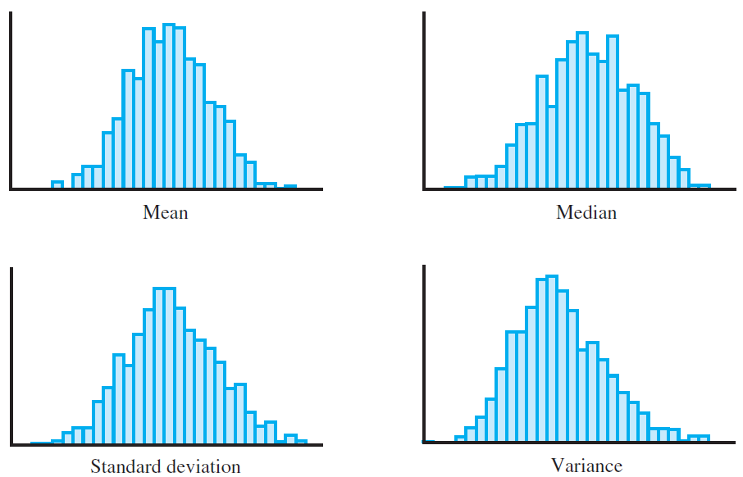
How Sampling Distributions Are Used

Slide 32
How Sampling Distributions Are Used
The sampling distribution of a statistic often tends to be centered at the value of the population parameter estimated by the statistic.
The spread of the sampling distributions of many statistics tends to grow smaller as the sample size n increases.
As the sample size increases, sampling distributions of many statistics become more and more bell-shaped (more and more like normal distributions).

Slide 33
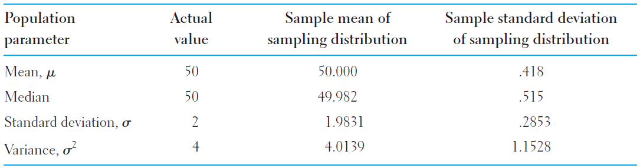
How Sampling Distributions Are Used
-樣本平均值等於母體平均值
-樣本標準差小於母體標準差: 大部份數值落在平均值±1
-用途: 在母體平均值未知的情況下，我們可以透過抽樣分析求得的平均值來代表可能的母體平均值。

Slide 34
General Properties of Sampling Dist.
-其樣本分佈特徵為何?
-若觀察道樣本抽樣分佈有集中趨勢，代表此母體的統計估計是沒有偏差的。
With reference to Table 5.1, there is a close similarity between the population parameters and the means of the sampling distributions.
As such, the center (i.e., the mean) may coincide with the corresponding population parameter.
When this happens, the statistic is said to be unbiased, or that it is an unbiased estimator of the population parameter.

Slide 35
TRY
it
in
R

Slide 36
R: Sampling
For loop in R
For(i in 1:1000)
{
}

Slide 37
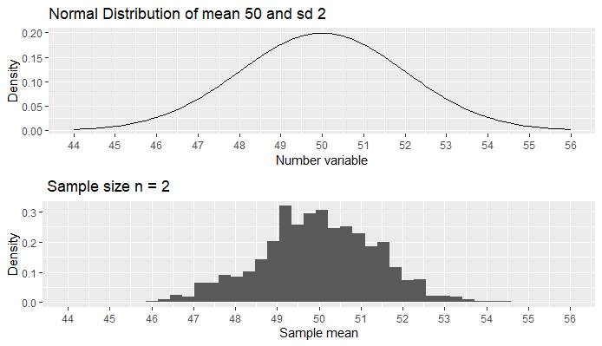
R: Sampling

Slide 38
R: Sampling
R_sampling_b.R

Slide 39
Describing Sampling Distributions
Sampling Distribution of
Sampling from a Normal Population
The Central Limit Theorem
Sampling Distribution of the Sample Proportion

Slide 40
Sampling Distribution of
-樣本平均值是否足夠推估母體平均值?
-定義樣本平均值的標準誤差(Standard Error)
Standard/Sampling Error:
標準誤差用於衡量樣本統計量的離散程度。
在參數估計與假設檢定中，它是用來衡量樣本統計量與母體參數之間差距的一個重要尺度。

Slide 41
Sampling from a Normal Population
-如果母體本身符合常態分佈，則無論樣本數量n大小，
樣本抽樣分佈應該都遵循常態分佈
Sampling Distribution of (Normal Population)
When a population distribution is normal, the sampling distribution of is also normal, regardless of the size of the sample.
With the normal distribution, probabilities of events involving reduce to straightforward calculations.

Slide 42
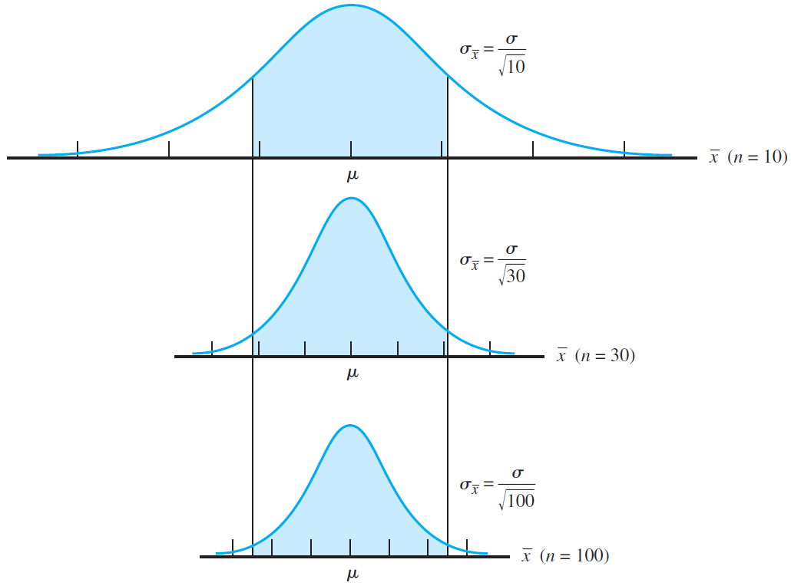
Sampling from a Normal Population

Slide 43
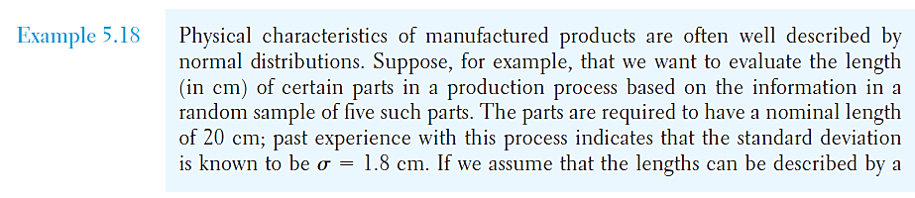
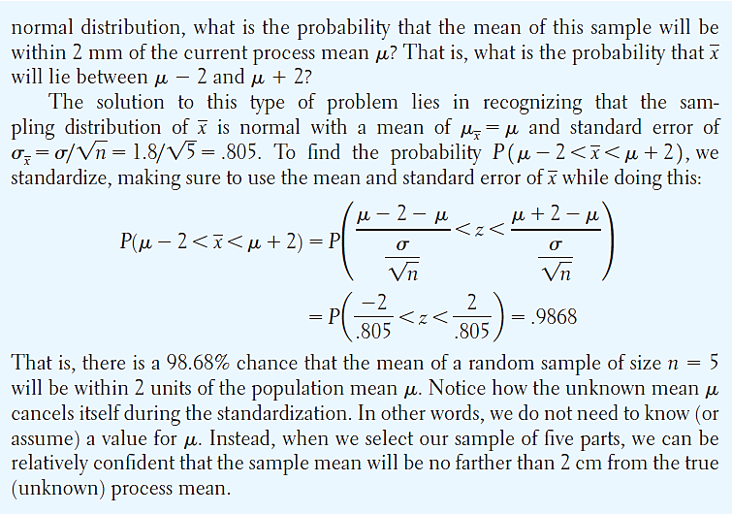
Sampling from a Normal Population
-隨機抽樣樣本數n=5，當探討樣本平均數與實際母體平均數的差異落在2 cm的機率問題。在正規化為標準常態分佈，母體平均值會被移除。n增加，機率變大。

Slide 44
The Central Limit Theorem
-無論母體分佈為何，當抽樣樣本數n夠大時，抽樣樣本平均值分佈會趨近於常態分佈。
The sampling distribution of can be approximated by a normal distribution when the sample size n is sufficiently large, irrespective of the shape of the population distribution.
The larger the value of n, the better the approximation.

Slide 45
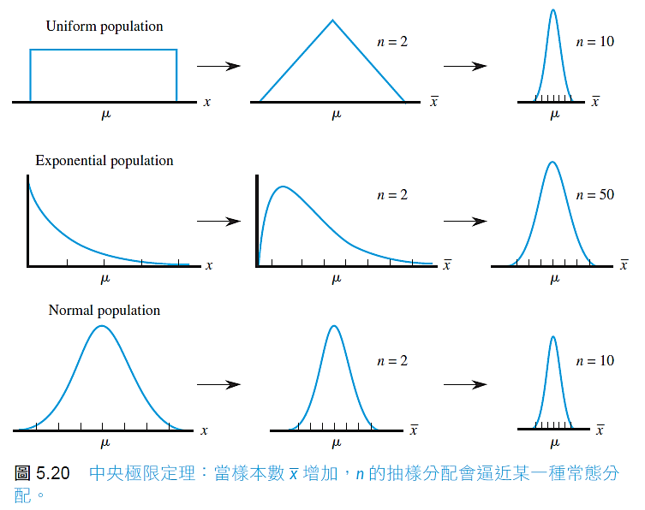
The Central Limit Theorem

Slide 46
The Central Limit Theorem
-大致上樣本數大於30，就可以滿足中央極值定理
-如果本身母體分佈對稱性差，則需要更大的抽樣樣本數量
is commonly used as a rough guide for what constitutes a “large enough” sample size for invoking the Central Limit Theorem.
However, there are cases where smaller values of will suffice, as well as cases where larger sample sizes are needed.
As a rule, the less symmetric a population is, the larger the sample size will have to be to ensure normality of .

Slide 47
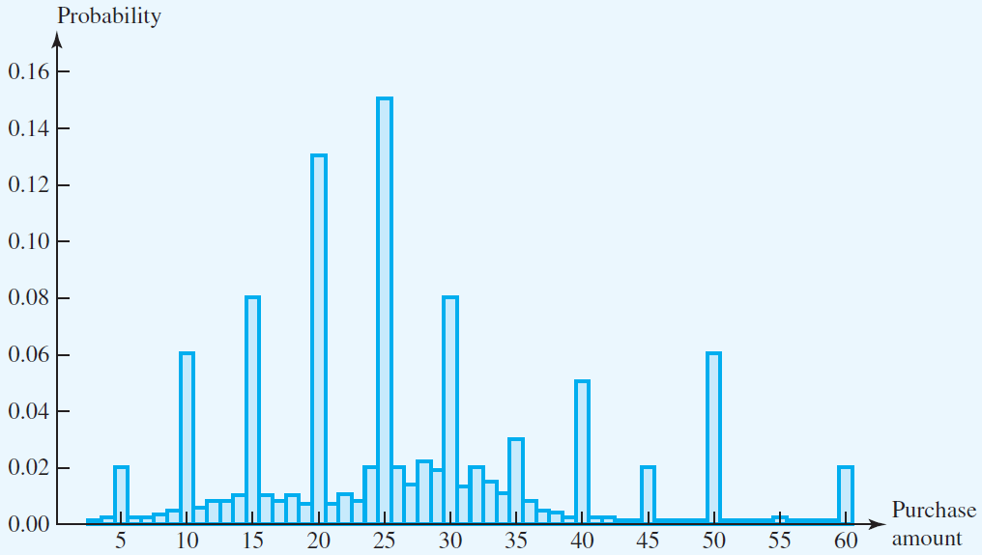
The Central Limit Theorem
-汽油購買數量的統計直方圖。
-抽樣樣本數n=15，進行1000次，並於每次計算平均值。
-觀察平均值分佈情形。

Slide 48
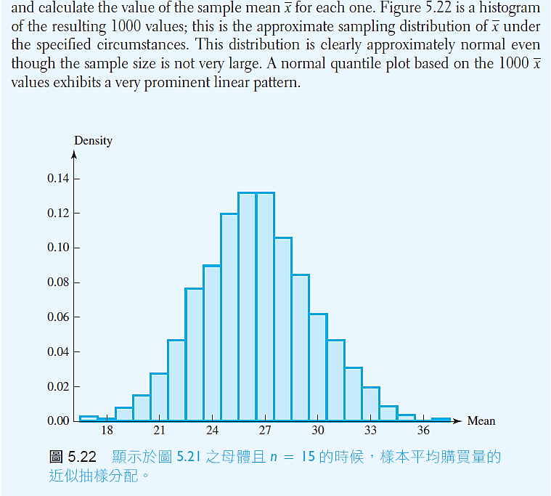
The Central Limit Theorem

Slide 49
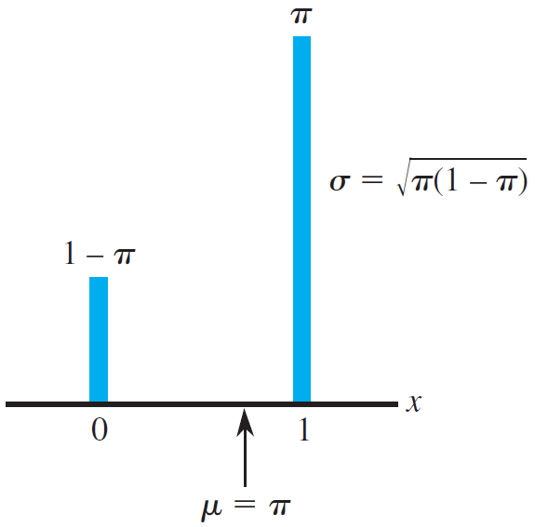
Sampling Distribution of the Sample Proportion
-樣本比例(sample proportion): 為樣本中某種元素的數量除以樣本大小。
-以樣本比例為隨機變數，其機率分佈即為樣本比例的抽樣分佈。
-滿足樣本抽樣分佈為常態分佈條件
nπ ≧ 5 and n(1- π) ≧ 5

Slide 50
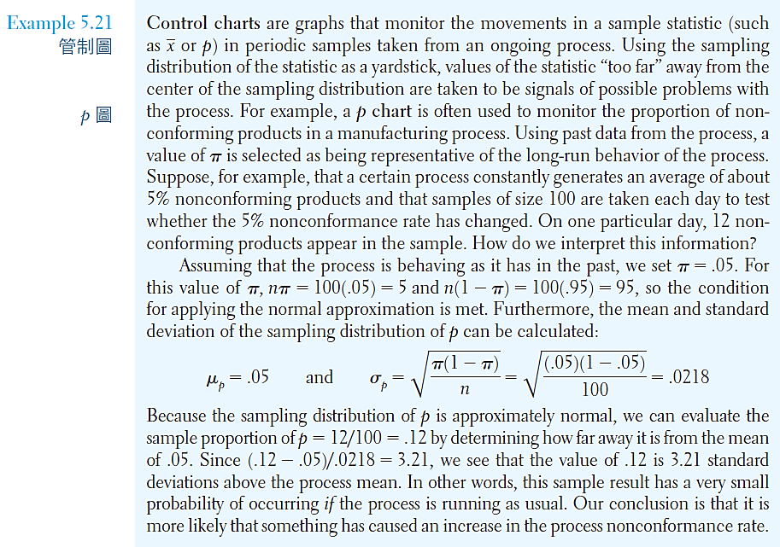
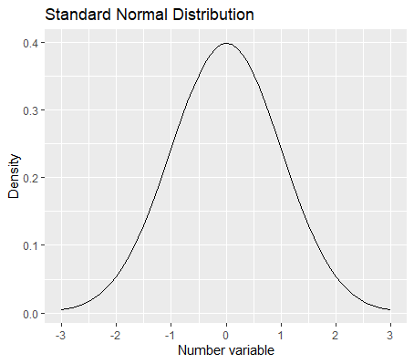
Sampling Distribution of the Sample Proportion
-一個製成的過程中，產品非符合標準的機率有5%。該公司將每日抽樣100個樣本數來檢驗是否符合5%。如果有一天檢驗結果顯示為12%，則該如何解釋? 其機率相當低
常態分布近似

Slide 51
TRY
it
in
R

Slide 52
R: Sampling
Data sorting
dplyr.
select
filter

Slide 53
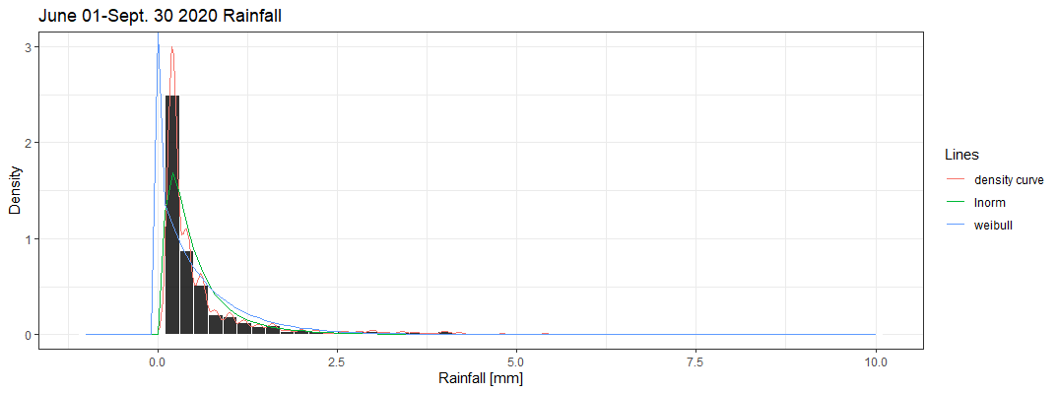
R: Sampling

Slide 54
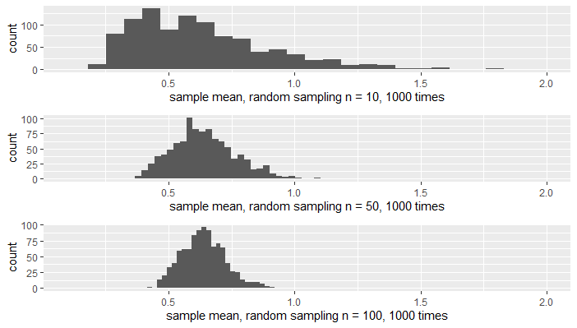
R: Sampling
分布中心應接近0.644

Slide 55
R: Sampling
R_sampling_c.R

Slide 56

課堂練習: 學號-姓名-ch7-Sampling.R
Reading temperature data in “weatherdata.xlsx”:
試著回答以下問題:
Fitting the data with“log-Normal”distribution and then comparing it with density curve. Make a description on the plotting result.
Please sampling 1,000 times with sample sizes of 10, 50, 100, and see what’s happened and make a comment.

Slide 57
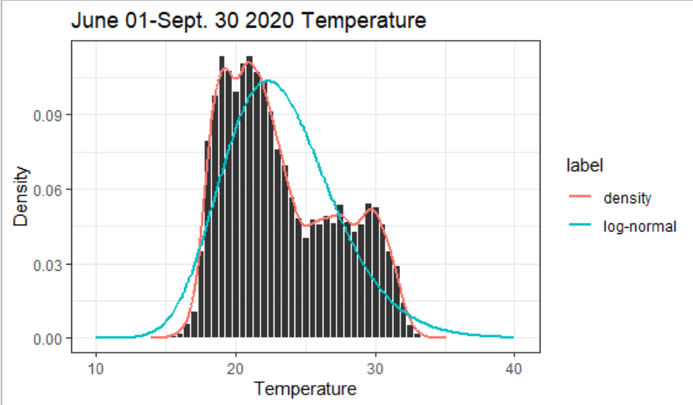
課堂練習: 學號-姓名-ch7-Sampling.R

Slide 58
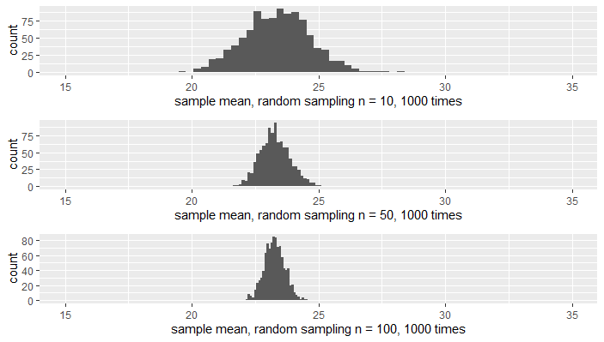
課堂練習: 學號-姓名-ch7-Sampling.R

