Slide 1

THANK YOU!

Slide 2
Firebird OLTP Test
Pavel Zotov, Firebird QA

Slide 3
ABOUT THIS TEST
Emulates work of real-life app (car service)
  Settings for init pop., warm-up & measure.
Does not require 3rd party utilities.
Workload modes: small, medium, heavy.
Main purpose: get maximal performance.
Performance report auto creating.
  Log every unit run and its result.
Author: Pavel Zotov, p519446@yandex.ru

Slide 4
WHY THIS TEST
Stress-test of Firebird stability
Logic as in real-life, workload much harder
Compare performance:
* “hardware-1” vs “hardware-2”
* Firebird 3.0 vs 2.5
* SS vs SC vs CS
* database settings: page_size, FW, etc
Create client-side app for distribution as example (planning).

Slide 5
MODEL: INTRO
Main entities:
Catalogue of products & shopping cart
Contractor
Document header
Document line
Turnover log
Aggregated remainder
FIFO distribution: source & target

Slide 6
MODEL: STOCK ENTITIES
CATALOGUE
STOCK TURNOVER LOG
Id
Name
Group
Id (1 NF)
Product_id
Operation_id
Quantity ( + / - )
Timestamp
Z
STOCK AGGREGATED REMAINDERS
SHOPPING CART
Id (random!)
QTY required
Product_id
Aggregated remainders
Aggregated turnovers
Z
1. Only INSERTS occur in turnover log
2. Aggregating is “serialized” with high frequency

Slide 7
MODEL: CONTRACTORS
CONTRACTOR
COST TURNOVER LOG
Id
Name
ID (for 1NF)
Contractor_id
Operation_id
Cost_total (+ / - )
Timestamp
flag
our firm
external
COST AGGREGATED REMAINDERS
Contractor_id
Saldo-1 (for supplier)
Saldo-2 (for customer)
1. Only INSERTS occur in turnover log
2. Aggregating is “serialized” among conns.
3. “Our firm” => NO reserve after shipping
Z

Slide 8
MODEL: DOCS & TURNOVERS
DOC_HEADER
AFFECTED ON STOCK BALANCE
AFFECTED ON CONTRACTOR BALANCE
DOC_LINE
P
P
STOCK TURNOVER LOG
CONTRACTOR TURNOVER LOG

Slide 9
DATABASE SCHEMA
Business stream (operations)
Turnovers and balances
Effect from operations
Producer - consumer logic

Slide 10
BUSINESS STREAM
Our (pre-) payments
$
START: client order
Our order to supplier
Invoice from supplier
Invoice accept ?
CLO
ORD
SUP
CLO
ORD
SUP
CLO
SUP
client reserve ?
FINISH: shipping
RES
AVL
NO
OUT
$
RES
RES
OUT
YES
OUT
RES
OUT

Slide 11
TURNOVERS AND BALANCES
STOCK BALANCES:
CLO: client order
ORD: order to supplier
SUP: invoice from suppl.
AVL: available
RES: reserve for client
STOCK TURNOVERS:
INC: total incomings
OUT: total outgoings
ACCOUNTANT BALANCE:
= INC – OUT
MONETARY BALANCE & TURNOVER:
balance of contractor as supplier or as customer:
is calculated in purchasing or retailing prices
(pre-) payment to supplier / (pre-)payment from client

Slide 12
CHANGES OF REMAINDERS
FULL CATALOGUE OF GOODS
Catalogue -> Client order
Supplier order: gather rows from client orders
Supplier invoice: gather rows from supplier orders
Check and accepting invoice: add its content to available remainders
Search for client orders that still need some goods to be reserved
Create reserve
Products shipping to customers
CLO
CLO
CLO
CLO
ORD
ORD
SUP
SUP
CHECK
Yes
No
AVL
RES
OUT

Slide 13
EFFECT FROM OPERATIONS
BUSINESS OPERATION | CLO | ORD | SUP | AVL | RES | INC | OUT
CUSTOMER ORDER | 1
OUR ORDER TO SUPPLIER | -1 | 1
WE GET INVOICE FROM SUPPLIER |  | -1 | 1
WE VERIFIED & ACCEPT INVOICE |  |  | -1 | 1 |  | 1
RESERVE FOR CLIENT |  |  |  | -1 | 1
SALE OF PRODUCTS |  |  |  |  | -1 |  | 1
Legend:
CLO = remainder in customer orders
ORD = remainder in orders to supplier
SUP = not-delivered invoices
AVL = ‘on-hand’ remainder
RES = remainder of reserved goods
INC = total incomings
OUT = total outgoings

Slide 14
Producer-Consumer: why ?
Too many row-level lock conflicts:
When need to update remainder
When need to change amount in document line
When need to change total cost in document header
Performance impact:
Earlier test versions: approx. 80% of application unit calls failed with lock conflict.
No sense to measure performance in this case.

Slide 15
Producer-Consumer: BALANCES
Attempt to apply same schema as for contractor balances:
DOC_LINES:
TURNOVER LOG
SCAN LOG &
AGGREG.
INSERT …
UPDATE …
DELETE …
do inserts only into turnover log
only one attach runs aggregation
clear turnover log after aggregation finishes
AGGREGATED REMAINDERS
Q: how to provide constraint “REMAINDER >= 0” ?

Slide 16
Producer-Consumer: QUANTITIES
Producer:
Source for future qty spreading:
INSERT INTO DOC_LINES(…, QTY)
VALUES( …, 5 );
~ “map”
ADD 5 ROWS FOR QTY = 5
Consumers:
Tx1: wants Q=3
id = 125
id = 125
Tx1: gets Q=3
id = 126
id = 126
Tx2: wants Q=2
id = 127
id = 127
id = 128
id = 128
Tx2: gets Q=2
Tx3: wants Q=4
id = 129
id = 129
FREE
LOCKED
Tx3: gets NONE
Don’t allow to take more than source can give!

Slide 17
Producer-Consumer: DOC TOTALS
Source for future cost spreading:
Producer: DOC_HEADER
~ “map”
id=1 $1000
id=4 $1000
INSERT(…, COST) VALUES(…, 5400)
id=2 $1000
Id=5 $1000
id=3 $1000
Id=6 $400
Consumers:
id=1 $1000
id=1 $1000
id=1 $1000
Tx1: wants $2100
id=2 $1000
id=2 $1000
id=2 $1000
id=3 $1000
id=3 $1000
$900
$100
Tx2: wants $1700
id=4 $1000
id=4 $1000
id=4 $1000
Tx3: wants $800
Id=5 $1000
id=5 $1000
$300
$700
Id=6 $400
id=6 $1000
$200
$800
FREE
LOCKED

Slide 18
PRODUCER–CONSUMER: OVERALL
BASE OPER.
10
SOURCE
FOR COST
“SPREADING”
DOC. HEADER
COST = P, SPLIT IT ON 10 PARTS
CONTRACTOR
10
RESULT OF COST “SPREADING”
DOC. LINES
CATALOGUE
1
MONETARY TURNOVER LOG
QTY = N
N
N
1
SOURCE FOR QUANTITY “SPREADING”
RESULT OF QUANTITY “SPREADING”
STOCK TURNOVER LOG

Slide 19
HOW TEST WORKS
Phases of test run
Sketch of measurement
Auto make performance report

Slide 20
PHASES OF TEST RUN
Read config: get “init_docs“ => save to “A”
How many docs now we have ?
=> save to “B”
“A” > “B”
YES
NO
REPORT
MEASURE
WARM-UP
Fill up to “A”
MON$ - 2
MON$ - 1

Slide 21
SKETCH OF MEASUREMENT
CHOISE APP. FUNCTION
1
ISQL
2
Save GDSCODE
in CONTEXT variable
YES
3
Was Exception ?
BLOCK WITH EXECUTE STTM
NO
Big script with ~300 transactions
Repeat this after finish (loop in .bat)
Batch checks whether one need to exit from loop and terminate itself
ADD TO ISQL LOG

Slide 22
AUTO PERFORMANCE REPORT
Read config: get %tmpdir% setting (path)
1run_oltp_emul.bat
start
worker
worker
worker
worker
1
2
3
4
ISQL
ISQL
ISQL
ISQL
Report
File: %TMPDIR% \ oltp_NN_performance
DB
Report SP

Slide 23
PERFORMANCE: RESULTS
Performance: how to measure ?
Results:
  performance overall
  dynamic change of performance
  explanation
What it was tested ?
Hardware, Firebird & database settings
Graphics

Slide 24
PERFORMANCE: IN WHAT “UNITS” ?
Performance rating: P = S / M,
where:
S = number of successfully completed actions, when gdscode is NULL
M = durability of workload period, in minutes

Slide 25
PERFORMANCE: REPORTS
Following reports can be created:
1) overall;
2) dynamic (“how Firebird gets tired”);
3) detailed;
4) exceptions occurred

Slide 26
WHAT IS WAS TESTED ?
Server:
    12 core CPU, 2GHz, RAM 32 Gb HDD IBM SCSI
    OS: Linux RHEL, kernel 2.6.39
Firebird versions: 2.5 SS, 2.5 SC, 3.0 SS, 3.0 SC
Database settings:
FW = ON and OFF
page_size = 8192
Number of attaches: 25, 50, 100, 150
Initial number of documents: 30000. Database size: ~410 Mb
Database warm-up time: 10 minutes (3.0), 15 minutes (2.5)
Measured time: mostly 180 minutes, several times 12 hours

Slide 27
Changes in firebird.conf
Following parameters need to be changed:
ExternalFileAccess = Restrict <path>
  (place when ‘STOPTEST.TXT’ will live)
DefaultDBCachePages
  increase at least to 512 for SC or CS
  increase at least to 65535 for SS
LockHashSlots
  increase to 22111
TempCacheLimit
increase at least to 256M

Slide 28
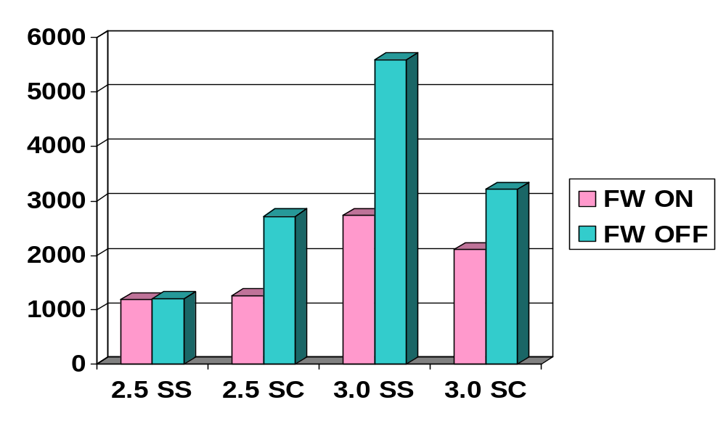
RESULTS - PERFORMANCE OVERALL
Successful business actions per minute, in average:
Number of attaches: 100
Warm-up time: 10 minutes
Measurement time: 180 minutes
DefaultDbCachePages = 512K
LockHashSlots = 22111
TempCacheLimit = 2 Gb

Slide 29
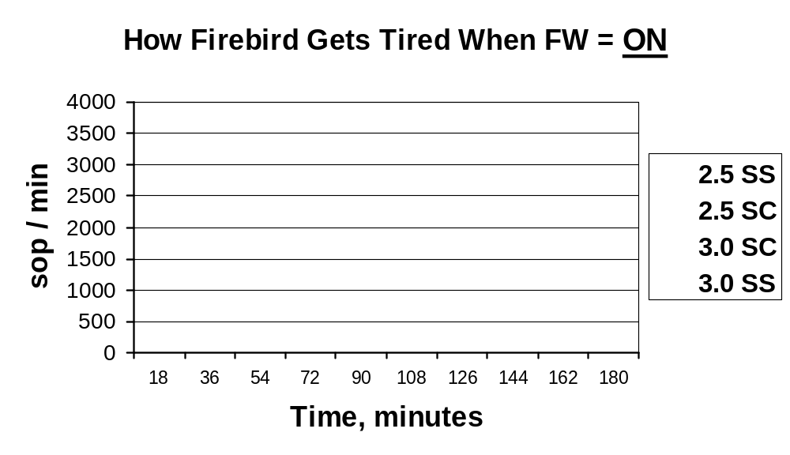
PERFORMANCE IN TIME, FW = ON
(successful business actions per minute, in average)

Slide 30

PERFORMANCE IN TIME, FW = OFF
(successful business actions per minute, in average)

Slide 31
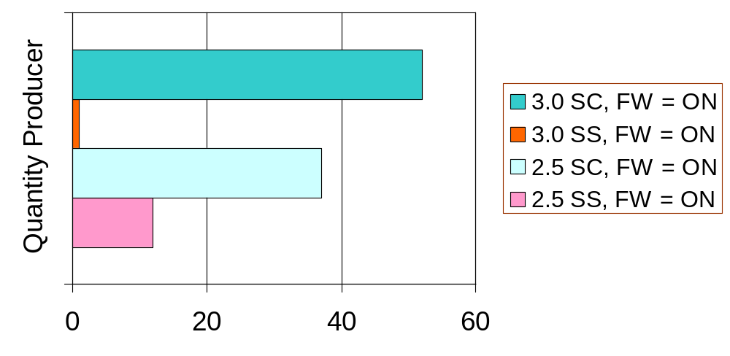
WORKLOAD & VERSIONS, FW = ON (1/2)
Attaches: 100. Warm-up: 10 min. Measure: 180 min.
Table: producer of quantity for FIFO distribution
Total Versions / Total Records, %:

Slide 32
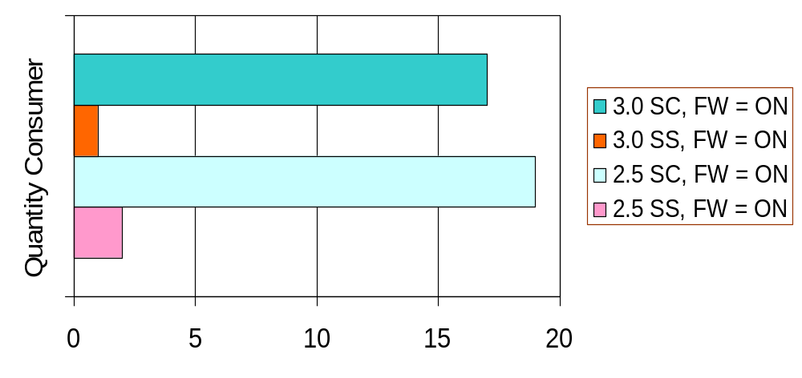
WORKLOAD & VERSIONS, FW = ON (2/2)
Attaches: 100. Warm-up: 10 min. Measure: 180 min.
Table: consumer of quantity after FIFO handling
Total Versions / Total Records, %:

Slide 33
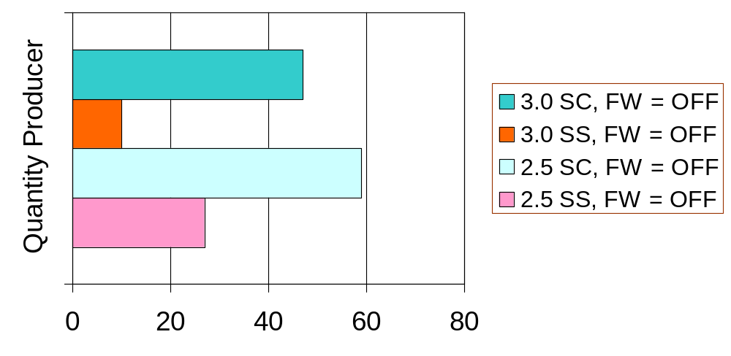
WORKLOAD & VERSIONS, FW = OFF (1/2)
Attaches: 100. Warm-up: 10 min. Measure: 180 min.
Table: producer of quantity for FIFO distribution
Total Versions / Total Records, %:

Slide 34
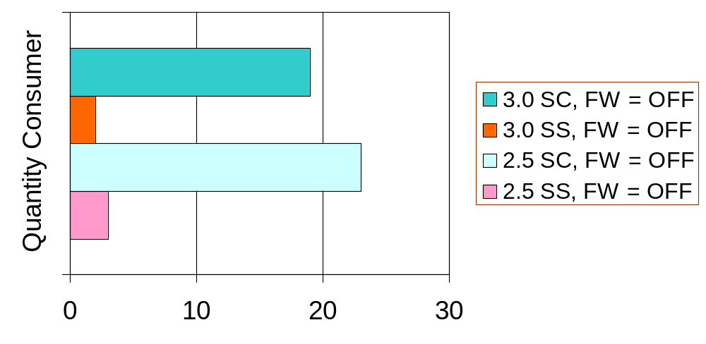
WORKLOAD & VERSIONS, FW = OFF (2/2)
Attaches: 100. Warm-up: 10 min. Measure: 180 min.
Table: consumer of quantity after FIFO handling
Total Versions / Total Records, %:

Slide 35
BUGS & ODDITIES
Total detected bugs: more than 30 (see doc & tracker).
Not fixed yet:
Spontaneous crashes, 3.0 SC, without adding any message in firebird.log. Database appears broken after this. No bugchecks.
Bugchecks with text about ‘wrong record length’, in 3.0 only
“Page type 4 (or 5) lock denied” in firebird.log, in 3.0 only
“I/O error during read file “fb_table_***”, file exists”, in 3.0 only
Standard error messages that should be shipped to client occurs in firebird.log
Attempts of PK violations where bulk of undo occurs (when one of testing machines hangs etc). Firebird 3.0 crashes when workload more than 200 attaches.

Slide 36
GOOD NEWS
Monitoring was greatly improved in 3.0;
New monitoring counters and especially table mon$table_stats - the “golden key” in search of performance bottleneck;
Overall impression about current 3.0: much stable than it was in aug. 2013
Sounds like paradox but: currently 3.0 SuperServer is more stable than all others (2.5 and 3.0 SuperClassic!)

Slide 37
QUESTIONS ?

