Slide 1
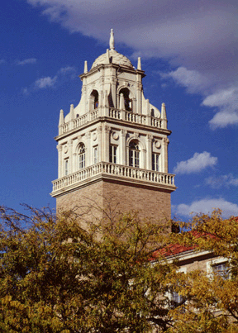
Graduate Center / Graduate Life Student Service Fee Request Fiscal Years 2019 & 2020
Jacek Jońca-Jasiński, Ph.D.
jacek.jonca@ttu.edu

Slide 2
Staff Members
Jacek Jonca-Jasinski, Director
Kristin Messuri, Associate Director, GSWC
Nicholas Hensley, Statistical Consultant .25FTE
Graduate Assistants
Wasana “Sue” Warnakulasooriya
Vacant, interviews in progress
11 Graduate Student Writing Center’s (GSWC) writing consultants from across of academic disciplines

Slide 3
What We Do
Graduate Student Services:
Graduate Student Writing Center
Library Research Assistance
Statistical Consulting
Food Pantry
Human Research Consultations
LinkedIn Photo Shots*
Graduate Student Org Posters & Research Posters**
* this services is currently being tested | ** service in early stages

Slide 4
What We Do
Graduate Student Oriented Programming:
Professional / Career / Academic Development
Social / Family-oriented Programming
Graduate Student facilities:
Computer Labs (General Use + Research Computing)
Meeting Spaces / Room Reservations
Study Spaces
Leisure Space

Slide 5
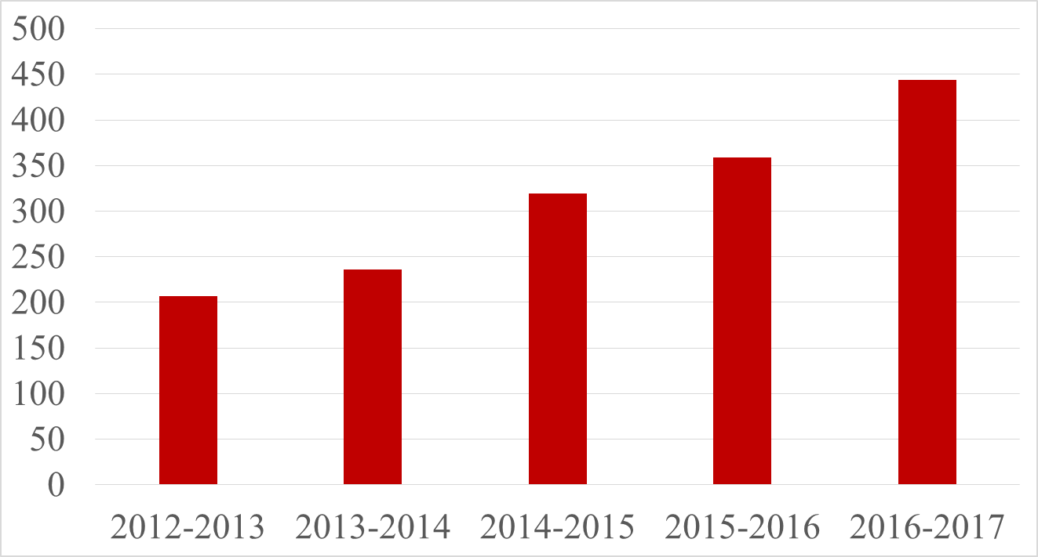
What We Do
Professional and Career Development
Number of Activities
Scope of events has increased to cover six main skills: critical thinking, communication, leadership & management, teamwork, professionalism, and ethics
Number of events has increased by 88% since fall 2013

Slide 6

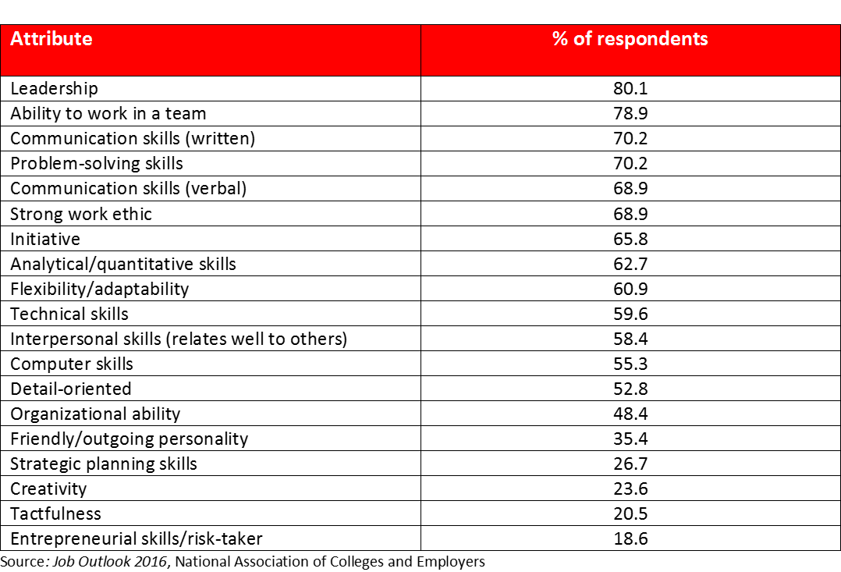
What We Do
Core Competencies

Slide 7
Promoting Student Success
Prepare students for long-term success
Career/professional development programming + services
career + communication workshops/panels/presentations
services promoting professionalism, career, & professional development (LinkedIn Photo Shots, Professional Posters)
Help achieve shorter-term success
Services helping students succeed while in Graduate School
Writing consults, statistical analysis & research design consults, human research consults, library research help

Slide 8
Promoting Student Success
Retention Efforts
Connect students with sources of help
On-campus and off-campus referrals
Food Pantry
Help build community, friendships, and support networks that span departments and colleges.
Work-life balance

Slide 9
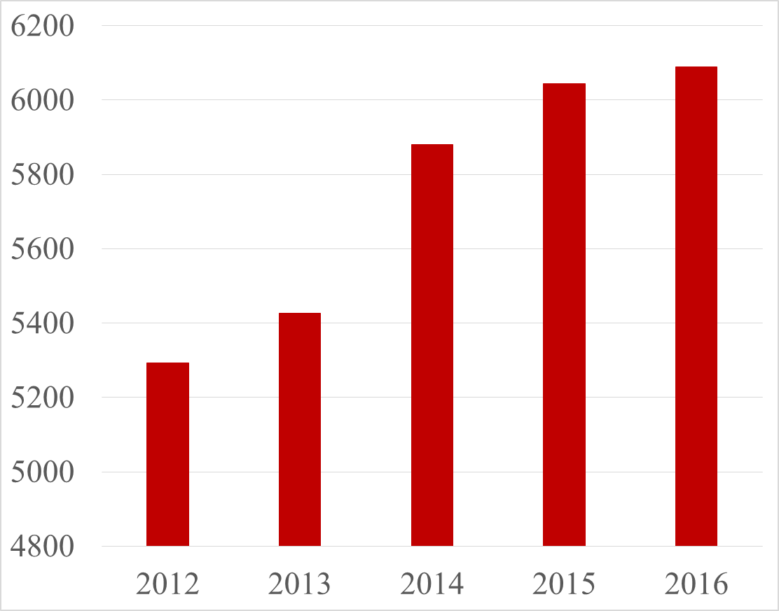
Meeting the needs of our students
Total Graduate Enrollment Growth
Graduate enrollment increased 30% between fall 2008 (4670) and fall 2016 (6058)

Slide 10
Meeting the needs of our students
Graduate Center Access Growth
FY2016 - 10,964 visits
FY2017 - 31,456 visits
Graduate Center usage effectively tripled over the last fiscal year.

Slide 11
Meeting the needs of our students
Graduate Writing Center Activity Growth
Overall usage has increased 310% between 2014-2015 and fall 2016-2017

Slide 12
Meeting the needs of our students
Students want to know more on how to secure a permanent academic position → we host expert panel on securing permanent academic jobs
Students ask for statistics help → no statistics consulting on campus → we develop statistical consulting service
International graduate students arrive in August but as TA/RA don’t get paid until October → they run hungry or on ramen → we develop grassroots food pantry run on donations
I don’t have a good picture for my LinkedIn profile → LinkedIn profiles with a picture received 30% to 400% more visits → we are testing professional photo shot service
Students away from home feel lonely around holidays → we host multi-cultural community dinner, e.g. Thanksgiving Meets Diwali, Thanksgiving Meets Hanukkah, etc.

Slide 13
FY19 & FY20 Allocation Request
Student Service fee Request: $155,000
Same amount as in FY2017

Slide 14
FY19 & FY20 Allocation Request
Staff Salaries 45,000.00
Other Salaries 35,000.00
Longevity 3,500.00
Professional Fees 15,000.00
In State Travel 1,000.00
Out of State Travel 1,000.00
Student Group Travel 5,000.00
Participant Travel 5,000.00
Supplies 20,000.00
Repairs and Maintenance 1,000.00
Rentals and Leases 5,000.00
Printing and Reproduction 2,500.00
Membership Dues 1,000.00
Food and Entertainment 15,000.00

Slide 15

1
Graduate Center
Graduate Life
Questions? Jacek.Jonca@ttu.edu
806.834.3348

