Slide 1
XPCF Cross platform component framework

Slide 2
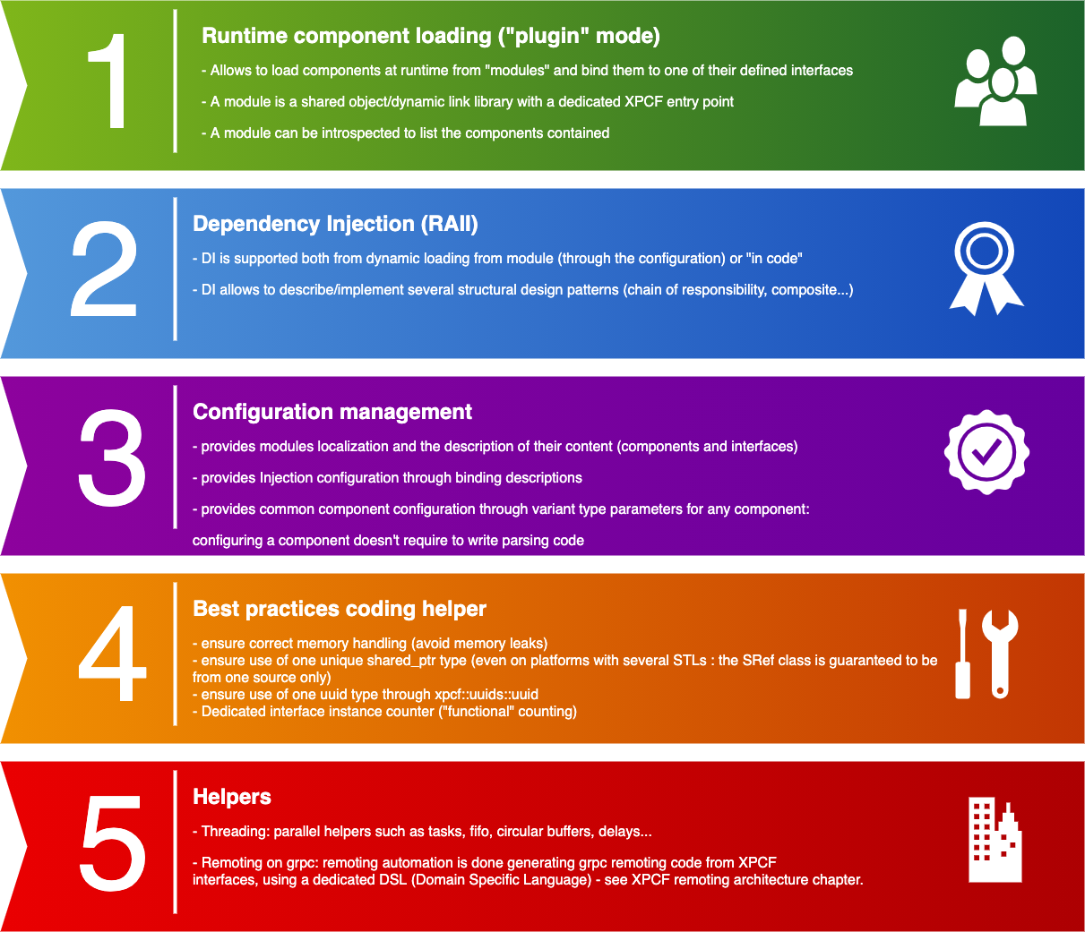
Overview

Slide 3
DEFINITIONS
Module: shared library hosting components/services. Provides a unique « xpcf entry point »
Interface: service definition. An interface have no concrete implementation
Component/service: implementation of one or several interfaces
UUID: unique identifier. Each module, interface and component have their own UUID
Introspection: ability to ask a component for the interfaces it implements
Dependency injection: ability to supply an external dependency to a software component (think about Spring in Java or Ninject in C#)

Slide 4
Runtime modules and components loading
XPCF loads module and components definitions from configuration files
XPCF supports loading several configuration files to populate the component registry
Configuration file load can occur anywhere in the application lifetime
XPCF registry can also be populated by loading the module file: in this case XPCF introspects the shared library

Slide 5
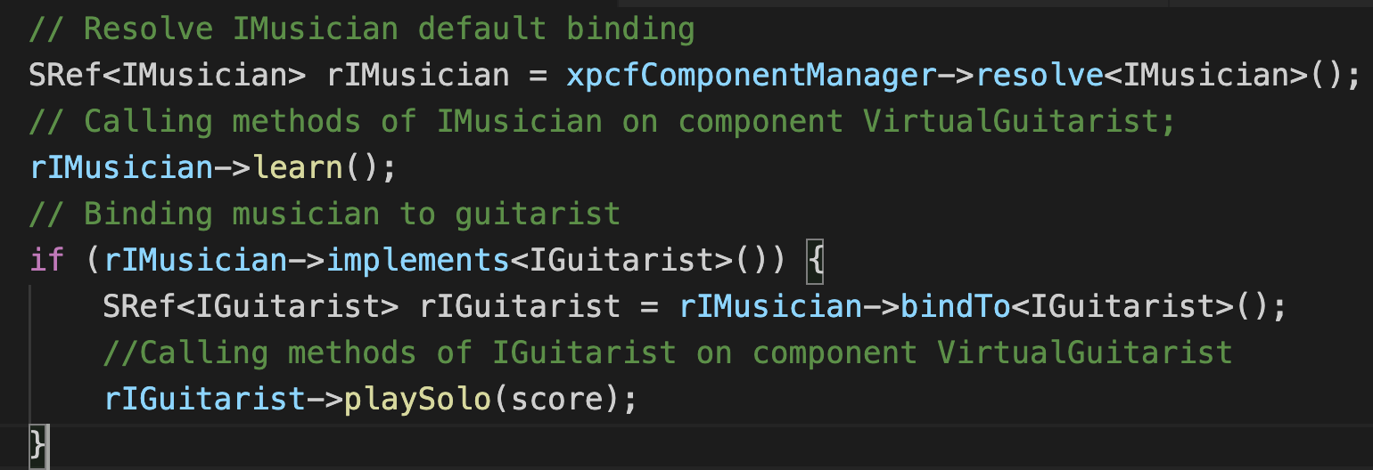
Components introspection and interface binding
XPCF provides introspection and binding of components to interfaces
Allows to discover at runtime which functionalities a component provides

Slide 6
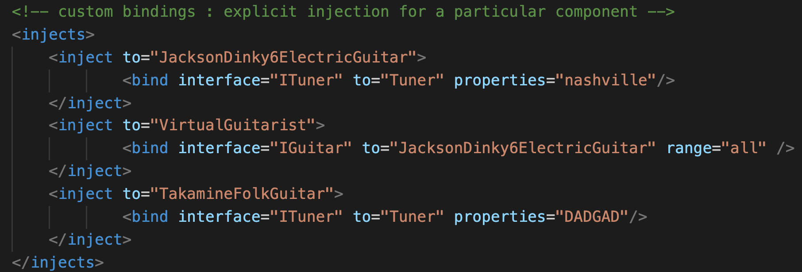
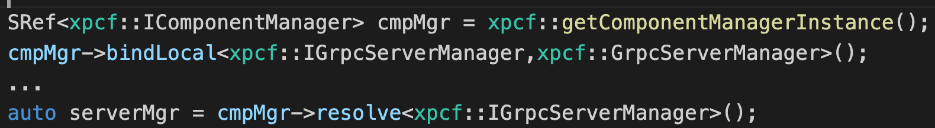
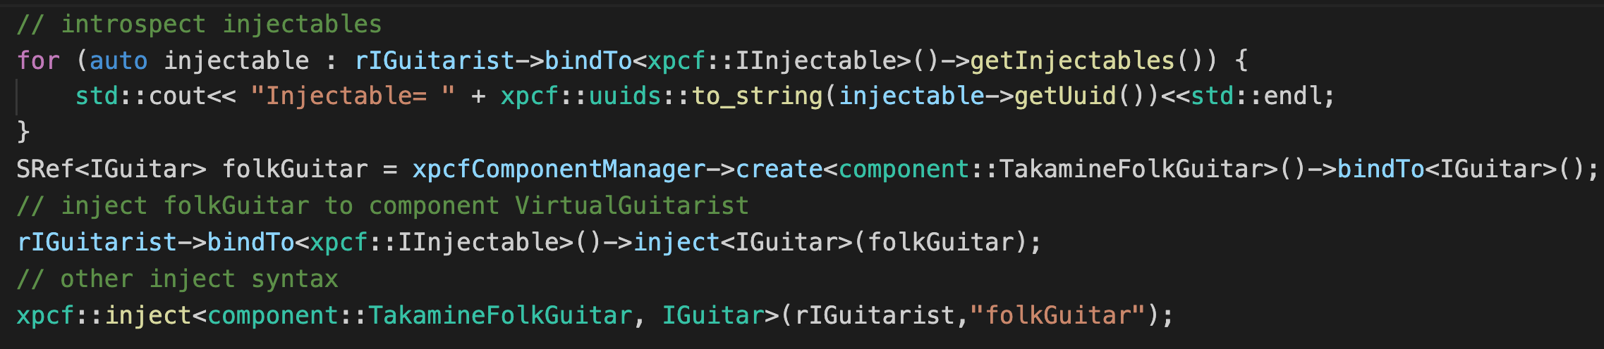
Dependency injection
XPCF supports :
Configuration based injection declaration:
Code injection declaration:
Code injection:

Slide 7
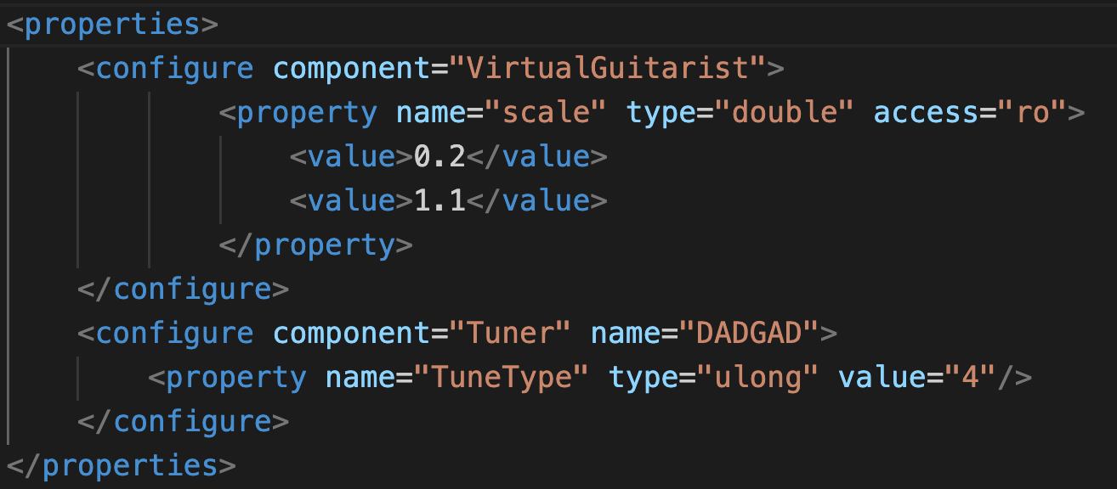
Generic components configuration
Components configuration is made through a common properties syntax
Avoids writing configuration parsing code for new applications
Based on variant properties

Slide 8
Remoting architecture
Xpcf grpc generated module
Any xpcf interface (*)
XPCF Proxy components
xpcf_grpc_gen generation
use
(*) provided the interface follows a few guidelines
A proxy and a server component is created for each interface
Each proxy component implements its corresponding « business » interface
« business » component is injected on the server side through its interface to the corresponding XPCF server component
Server components inherit from xpcf::IGrpcService
Code generation relies on a clang compilation database, generated from an IDE (QT Creator, VS using a plugin …)
GRPC messages and services code
GRPC stubs
GRPC services
Implement
XPCF server components
Client and server configuration files

Slide 9
Remoting - runtime behavior
XPCF role:
Client side :
Injects remoting proxies to interfaces
Configure proxies channel url
Server side :
Injects client components from modules to XPCF remoting server components
Registers every IGrpcService to grpc (through multibind injection)
Configure server channel url
Client application
Register
Xpcf_grpc_server application
Use
XPCF
XPCF
Run server on address:port
Client interfaces module
Inject
Call
IGrpcService
Inject
XPCF remoting generated module
XPCF Remoting proxies Components
XPCF Remoting server components
Grpc / protobuf
Inject
Call
Configure
Client components module
Configure
XPCF Client configuration file
XPCF Server configuration file

Slide 10
XPCF Remoting DSL
XPCF defines a Domain specific language
The DSL is :
Based on C++ user defined attributes
Made to assist/extend the code generation
usable in XPCF Interfaces declarations
It allows to :
Remove ambiguities
Maintain proxy and server components UUID stability
Specify interfaces to ignore
… more to come

Slide 11
REMOTING - Interfaces guidelines
An interface aiming to automatic remoting support must either :
use base c++ types only (STL containers are also supported)
use serializable datastructures (datastructures declaring one of the serialization methods available in xpcf specifications - boost serialization in XPCF 2.5.0)
Note : pointers are not handled.
Anyway, as interfaces represent contracts between a user and a service, not handling pointers should not be an issue.
Code generation
Relies on cppast (forked version with customizations around templates) and libclang

Slide 12
REMOTING - Containerisation helpers
xpcf_grpc_server:
xpcf application
hosts any IGrpcService enabled component
registers every xpcf IGrpcService component to grpc
runs grpc server on the provided address
Deployment :
configuration based
allows to have a single Docker container definition for different component deployment declarations

Slide 13
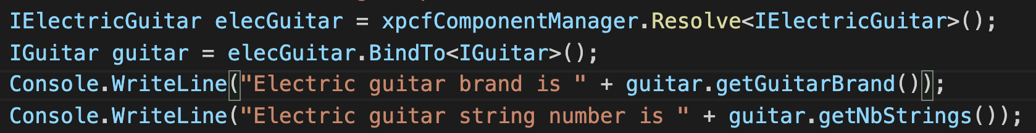
C# binding
XPCF provides a C# binding. It allows to load, create components, bind components to interfaces …

Slide 14
Foreseen features & improvements
Other remoting use cases
The previous use case can be extended : as the remoting code is hosted in a single module, a server can also be a client of another server and so on ….
Extend sample use cases
Xpcf_grpc_gen:
Enhance serialization methods support
Enhance DSL to specify different remoting modes for methods (asynchronous, streaming …)
Flatbuffer messages support
Improve c++ code parsing (class template specialization …) [cppast]
xpcf_grpc_linter :
Compile time tool
Could validate xpcf remoting DSL attributes used
Could validate interfaces datastructures serialization support

