Slide 1

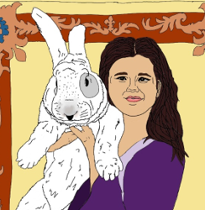
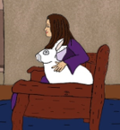
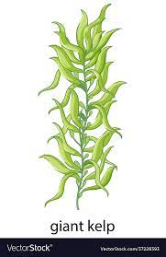
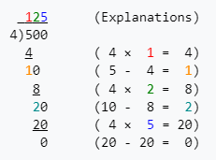
Creator Portal – My Stories
Account Summary
My Stories
Creator Account: William Wold
Number of Stories: 2
Total Payouts: $2499.57
Series Title: Princess Helen Adventures
Story Title: Princess Helen and the Chase for the Rabbit Robber Chapter 1
Author: William Wold
ISBN: Not published to Amazon
Genre: CCSS General
Audience: US 3rd Grade, 9 years old
Publication Info: Firefly games 2024, Workbook 2024, Illustrated Book 2024, T-Shirts 204
Smart Contracted: Yes
Payouts: $956.26
NFT:
Series Title: Marine Photosynthesis
Story Title: Inside the Kelp Forest - Macrocystis pyrifera and the power of the Sun
Author: William Wold
ISBN: Not published to Amazon
Genre: CCSS Science
Audience: US 3rd Grade, 9 years old
Publication Info: Firefly games 2024, Workbook 2024, Illustrated Book 2024, T-Shirts 204
Smart Contracted: Yes
Payouts: $1543.31
NFT:
9*7= | 63
56/8= | 7
4*8= | 32
48/6= | 8
7*4= | 28
72/8= | 9
9*4= | 36
36/6= | 6
8*8= | 64
49/7= | 7
6*9= | 54
42/7= | 6

Slide 2
Creator Portal – Add Story Step
Story Art
Question Art
Answer Options
Source of NFT
Story Narrative
Question
Correct Answer
Answer Explanation
Submit
See All
9*7= | 63
56/8= | 7
4*8= | 32
48/6= | 8
7*4= | 28
72/8= | 9
9*4= | 36
36/6= | 6
8*8= | 64
49/7= | 7
6*9= | 54
42/7= | 6

