Slide 1

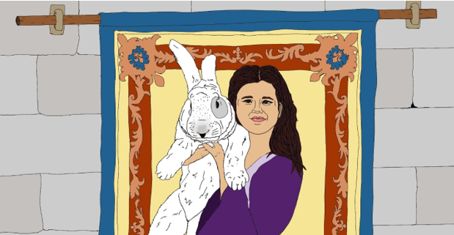
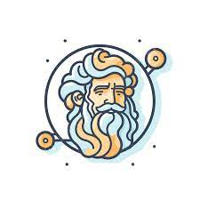
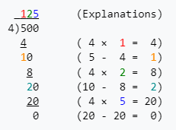
Princess Helen and the Chase for the Rabbit Robber Chapter 1
The first indication of trouble came almost immediately when the stable master John shouted that Spinnaker (the fastest horse in the castle) and a saddle were missing. However, Gallagher’s cart was present, but there was no sign of him. A chill went through Helen’s heart that Heather may have been stolen.
Papa quickly said “go to your studies” we have enough hands and effort on this task. Helen felt a surge of anger at being sent to do something as unimportant as studies, especially given all the math that Stephen constantly spouted, and tested.
DECISION: What does
Helen do next?
Helen Runs away
from the Castle to
rescue Heather
Helen Does the
Multiplication and
Division Problems
Ask Joseph,
the Court Advisor
How do I long division?
Long division problems are step up in a tableau with the divisor separated from the dividend by a parenthesis. The dividend is separated from the quotient or answer by a bar. Here is an example of the tableau setup and follow on calculation:
TALE SO FAR: In a faraway castle in the land of Mistral in the Kingdom of Provence there once lived a little girl named Helen and her giant Flemish Rabbit named Heather. The people far and wide were blessed with good fortune and bounteous harvests. The court astrologer Joseph once surveyed the harvests, and stars, and calendar, and discovered an amazing fact. After a visit by the Helen and Heather, to any farm, creamery, windmill, or fishing village, in short, a visit to anywhere associated with the growing and harvesting of nature’s bounty, that place would flourish in the coming year. In fact, Helen spent most of her time trotting her mother’s elderly pony and buggy to and fro to visit these sites. She even helped in moving important tools, the mail, and inventions to these places, but she always left enough space for Heather to come along. Before long the fame of Helen, Heather, and Oats (the pony) spread beyond Provence and visitors came with offers to purchase Heather’s kits. Physically, Helen, despite being a princess was a strong girl, much of this had to do with her upbringing. Helen’s chores, which were not princess like in the least, included chopping firewood in Fall, milking two goats in the morning for breakfast, and using the tread pump filling the castle water tank daily (this involved pumping 300 liters up 3 meters) so that the kitchen and bathrooms had pressure. Also, Mistral was a hotbed of invention, as Joseph and Papa, the lord of Mistral, were always looking for ways to improve life, sometimes Helen would be directed to help on the newest idea.
9*7= | 63
56/8= | 7
4*8= | 32
48/6= | 8
7*4= | 28
72/8= | 9
9*4= | 36
36/6= | 6
8*8= | 64
49/7= | 7
6*9= | 54
42/7= | 6

