Slide 1

Prototype Business Technology
In conjunction with MLH Month Long Hackathon January 2024

Slide 2
Step 1
Art - StoryArt
Art – QuestionArt
Helen-Wold-01-S
Helen-Wold-01-Q
Question Narrative
Answer Options
Narrative Paragraph
Correct Answer
Step 2
Toaster say consult with AI Tutor stay here answer
Step 0

Slide 3
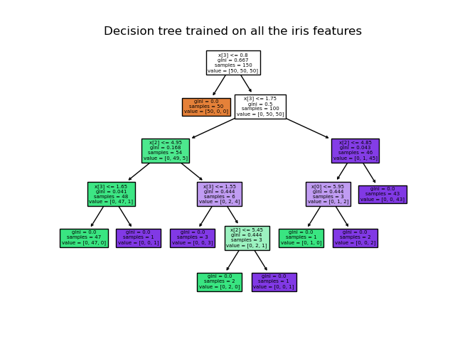
Decision Trees

Slide 4
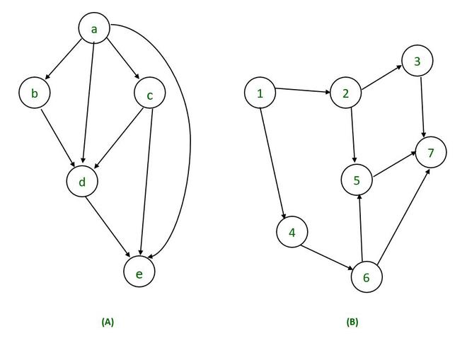
Acyclic Graphs

