Slide 1
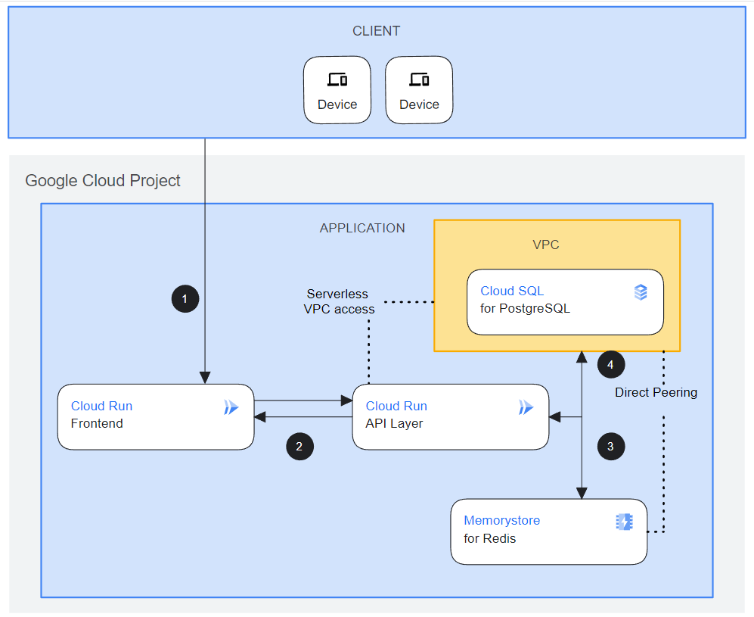
SYSTEM ARCHITECTURE
Built using React, .NET, Python, SQL
Designed to use Google Gemini
Designed for Google Cloud
Dynamic React webpage
STATIC WEBPAGE START
www.firefly-adventures.com
Cloudflare
Static Front
1A
MS SQL Server
Local Development
1B
Github
2A
Mid-Tier
.NET/C#
NEXT
Extend multimodal interaction with Gemini
Build out administrative aspects of the App, Google Identity, etc
2B
Cloud Run
API Layer
Mid-Tier Python
Cloud Storage
Gemini

Slide 2
SYSTEM ARCHITECTURE
(Github Organization and Repo Guide)
https://github.com/FireflyAdventures
PLAN, CODE TALKS
(1) 00-devops-documents = Concept and working documents
FRONTEND
(1A) 03C-fe-minimalist-static-CF =
Website for home & static code
(1B) 03B-fe-react-dynamic =
Website for database & AI dependent code
MIDTIER
(2A) 02B-mid-dotnet-julian = .NET/C# Midtier
(2B) 02B-mid-python = Python Midtier
BACKEND
(3) Art object data definitions in 00-devops-documents
(4A) 01A-be-sqlserver = SQL database scripts
STATIC WEBPAGE
www.firefly-adventures.com
Cloudflare
Static Front
1A
MS SQL Server
1B
2A
Local Development
Github
Mid-Tier
.NET/C#
2B
Cloud Run
API Layer
Mid-Tier Python
GOOGLE CLOUD PLATFORM THREE TIER PROJECT:
https://console.cloud.google.com/home/dashboard?project=sincere-pen-411305
Cloud Storage
Gemini

Slide 3
