Slide 1

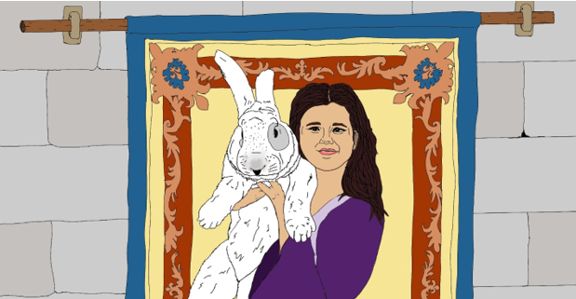

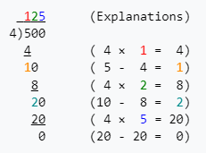
Princess Helen and the Chase for the Rabbit Robber
The first indication of trouble came almost immediately when the stable master John shouted that Spinnaker (the fastest horse in the castle) and a saddle were missing. However, Gallagher’s cart was present, but there was no sign of him. A chill went through Helen’s heart that Heather may have been stolen.
Papa quickly said “go to your studies” we have enough hands and effort on this task. Helen felt a surge of anger at being sent to do something as unimportant as studies, especially given all the math that Stephen constantly spouted, and tested.
DECISION: What does
Helen do next?
Helen Runs away
from the Castle to
rescue Heather
Helen Does the
Multiplication and
Division Problems
Ask Joseph,
the Court Advisor
How do I long division?
Long division problems are step up in a tableau with the divisor separated from the dividend by a parenthesis. The dividend is separated from the quotient or answer by a bar. Here is an example of the tableau setup and follow on calculation:
TALE SO FAR: In a faraway castle in the land of Mistral in the Kingdom of Provence there once lived a little girl named Helen and her giant Flemish Rabbit named Heather. The people far and wide were blessed with good fortune and bounteous harvests. The court astrologer Joseph once surveyed the harvests, and stars, and calendar, and discovered an amazing fact. After a visit by the Helen and Heather, to any farm, creamery, windmill, or fishing village, in short, a visit to anywhere associated with the growing and harvesting of nature’s bounty, that place would flourish in the coming year. In fact, Helen spent most of her time trotting her mother’s elderly pony and buggy to and fro to visit these sites. She even helped in moving important tools, the mail, and inventions to these places, but she always left enough space for Heather to come along. Before long the fame of Helen, Heather, and Oats (the pony) spread beyond Provence and visitors came with offers to purchase Heather’s kits. Physically, Helen, despite being a princess was a strong girl, much of this had to do with her upbringing. Helen’s chores, which were not princess like in the least, included chopping firewood in Fall, milking two goats in the morning for breakfast, and using the tread pump filling the castle water tank daily (this involved pumping 300 liters up 3 meters) so that the kitchen and bathrooms had pressure. Also, Mistral was a hotbed of invention, as Joseph and Papa, the lord of Mistral, were always looking for ways to improve life, sometimes Helen would be directed to help on the newest idea.
9*7= | 63
56/8= | 7
4*8= | 32
48/6= | 8
7*4= | 28
72/8= | 9
9*4= | 36
36/6= | 6
8*8= | 64
49/7= | 7
6*9= | 54
42/7= | 6

Slide 2
FEATURE | Backend | API / Model / Interface / SVC | Frontend
StoryRender | Select by Step Stored Procedure
Gemini Chat | Done for US by Gemini | Chat MT | React popout

Slide 3
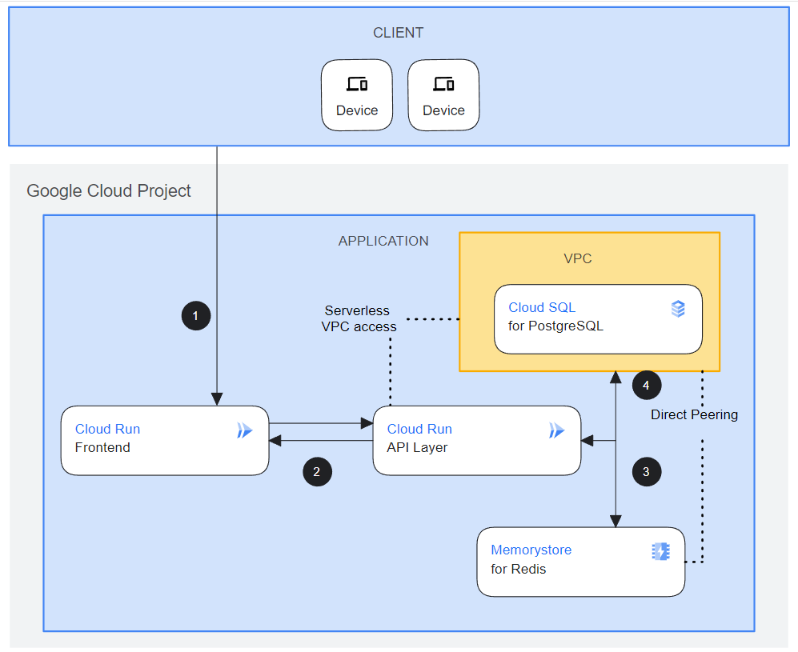
Local
Github
MS SQL Server
Mid-Tier
.NET/C#
Cloud Run
API Layer
Mid-Tier Python
Cloud Storage
https://console.cloud.google.com/products/solutions/details/three-tier-web-app?project=sincere-pen-411305
Gemini

Slide 4

Code to Consider
Interface
Istories.cs
Ichat.cs
Gemini
Client
Python
API Container
Controller
Services
Database
Function Specific
Stories.jsx
storiesService.js
Chat.jsx
chatService.js
Function Specific
storiesService.cs
chatService.cs
Function Specific
StoriesAPIController.cs
ChatAPIController.cs
Dependency Injection
Model
Domain
Requests
Notes:
# Connectiong to DB with .Net
You should use the Console application in this project (Open Sabio.Db.ConsoleApp.sln)
and write code using the included projects to call all the procs in the `/SqlInit/Sabio_Address.sql` file.
The instructors will help you with the first couple of procs and then you finish the rest on your own using the resources available to you.
> :star: Be sure to get instructor help to run the `/SqlInit/Sabio_Address.sql` file.
Use the following Page to help you.
- [Working .Net Services Classes](https://github.com/sabiocode/wiki/blob/master/dotnet/data-access/service-class.md)
- [Data Service CRUD Operations Videos](https://training.sabio.la/courses/516025/lectures/10839166) to go with Data Access via Service Classes
- [How to Use DataProvider (ExecuteCmd)](https://github.com/sabiocode/wiki/blob/master/dotnet/data-access/DataProvider/DataProvider-ExecuteCmd.md)
- [How to Use DataProvider (ExecuteNonQuery)](https://github.com/sabiocode/wiki/blob/master/dotnet/data-access/DataProvider/DataProvider-ExecuteNonQuery.md)
---
# Background on Models
## Models
Models serve to carry data from one place to an other.
In many applications, Models are used in a variety of ways including partial updates, inserts and deletes.
In our application we will create a more refined architecture and create 4 different types of Models.
These four types will be named according to their utility or purpose
### Request Models
- These models will be used to pass data into a Controller or Service method
- These models will participate in Model Binding where data from an incoming request will be mapped to the properties of the given Model.
- They will be used to perform updates, inserts or deletes. More often than not, they will contain partial list of all the properties of the entities that they represent.
> Located in `Sabio.Models.Requests`
> :key: They are **PASSED* into Service Method calls or Controller Methods
### Response Models
- These Models will be the objects passed **out** of Api Controllers.
- Often times these Models will be used to wrap Domain models as they are passed out of the web application.
- All Response Models must inherit from BaseResponse.
> Located in `Sabio.Models.Responses`
> :key: They are returned from Controllers
### Domain Models
- These models will be used to most accurately represent the entities we store in our database.
- When returned, they should be fully hydrated with the data in the database.
- These files are located here at the following path. You should inspect the files there for more information.
> Located in `Sabio.Models.Domain`
> :key: They are returned from Service Method calls

Slide 5
Custom Chat Settings for ChatGPT
What would you like ChatGPT to know about you to provide better responses?
How would you like ChatGPT to respond?

Slide 6
Straight
3 nodes (steps)
2 edges
CYOA
9 nodes
20 edges
Start
Finish

Slide 7
Straight
3 nodes (steps)
2 edges
CYOA
9 nodes
16 edges
Start
Finish

