Slide 1
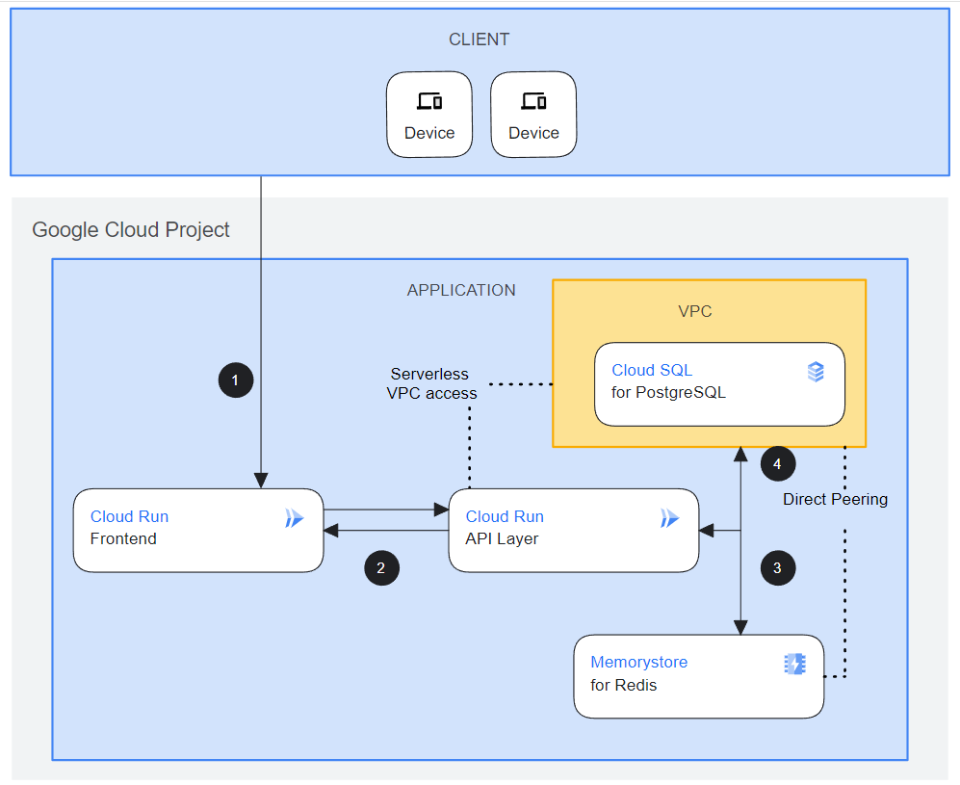
SYSTEM ARCHITECTURE
Built using React, .NET, Python, SQL
Designed to use Google Gemini
Designed for Google Cloud
Dynamic React webpage interaction with .NET and Python APIs
Cloudflare
Static Front
1A
MS SQL Server
Local Development
1B
Github
2A
Mid-Tier
.NET/C#
NEXT
Extend multimodal interaction with Gemini
Build out administrative aspects of the App, Google Identity, etc
2B
Cloud Run
API Layer
Mid-Tier Python
Cloud Storage
Gemini

