Slide 1
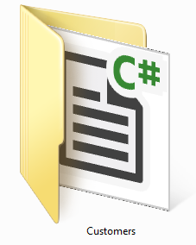
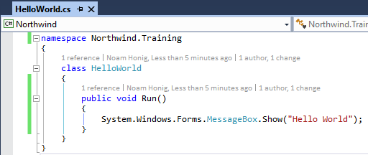
The C# (csharp) Language
C# is case sensitive
Every execution statement ends with a ;
The code is organized in classes
Classes have members (Methods, fields, properties, events etc…)
Classes are organized in namespaces (like folders)

