Slide 1
Firefly Training

Slide 2
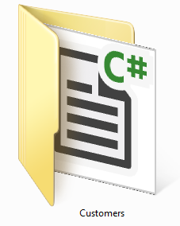
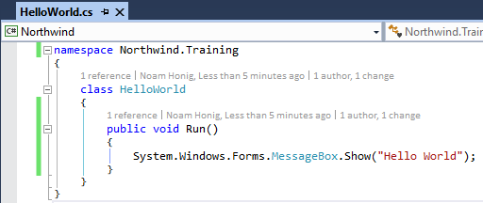
The C# (csharp) Language
C# is case sensitive
Every execution statement ends with a ;
The code is organized in classes
Classes have members (Methods, fields, properties, events etc…)
Classes are organized in namespaces (like folders)

Slide 3
Access Modifiers
Access modifiers are keywords used to specify the declared accessibility of a member or a type. It determines which code can use this class or method. There are four access modifiers:
private – only visible to code within class and inner classes
protected – also visible to code within class that inherit from this class
Internal – visible to any code within my assembly (dll/exe)
public – visible to any code
Defaults:
Classes are “internal”
Members (methods, fields etc…) and inner classes are “private”

Slide 4
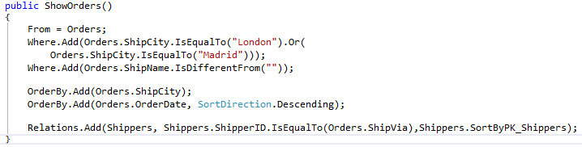
Calling a controller
Calls the constructor and creates an instance

Slide 5

Controller life cycle
When the Execute() method is called the controller runs and performs the following events:
OnLoad
OnStart
Load data and for each row:
OnEnterRow
OnLeaveRow
OnSavingRow – if the row was changed
Save changes to the database
OnEnd
OnUnLoad

Slide 6
Migrated Data Types

Slide 7
Number
Similar to: int, decimal, float, double etc….
Can be null as opposed to int, decimal etc….
Can hold any int or decimal value
When divided by Zero – returns Zero
Usage:
Number n = 1;
Number n2 = -1.5;

Slide 8
Text
Similar to - string
Can be null
When performing comparison it ignores spaces.
For string: “a “== “a” return false
For Text: “a “==“a” return true
Usage:
Text a = “.NET”;

Slide 9
Bool
Similar to - bool
Can be null as opposed to bool
Usage:
Bool a = true;
Bool b = null;

Slide 10
Date
Resembles - DateTime
Resolution - days
Can be null as opposed to DateTime
Can have Empty (Zero) date – as opposed to DateTime
Usage:
Date d = Date.Now
Date bd = new Date(1976,6,16)
If (d==Date.Empty)

Slide 11
Time
Remotely Resembles - TimeSpan
Resolution: Seconds
Can be null
Usage:
Time t = Time.Now;
Time t1 = new Time(8,35,25);
Time t2 = Time.StartOfDay;

Slide 12
TypedColumnBase<dataType>
A column with the same specifc type
TypedColumnBase<Date> => DateColumn
TypedColumnBase<Time> => TimeColumn
TypedColumnBase<Number> => NumberColumn
TypedColumnBase<Text> => TextColumn
TypedColumnBase<Bool> => BoolColumn
….

Slide 13
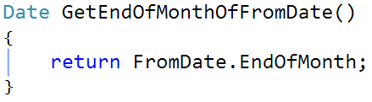
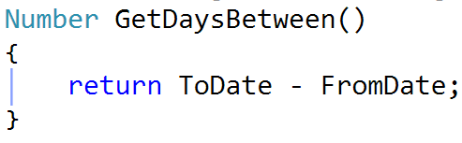
Func<dataType>
A method that returns the same specifc type
Func<Date> => a method that returns Date
Func<Number> => a method that returns Number
Func<Time> => a method that returns Time
Func<Text> => a method that returns Text
Func<Bool> => a method that returns Bool
….
CSharp 6 style:
CSharp 6 style:

Slide 14
Large Migrated Project Structure and AbstractFactory.Create method

Slide 15
Migrated code structure
Northwind - application startup code
Program.Main – the entry point code
The ApplicationCore class – (Main Program)
The MDI and the main menues
List of programs & Entities
Northwind.Products – Programs that are in the Products module
Northwind.Customers – Programs that are in the Customers module
Northwind.Orders – Programs that are in the Orders module
NorthwindBase – everything that is shared by the entire project
Tables, Types, Rights etc…

Slide 16
Northwind Project
Northwind
Northwind.Products
Northwind.Customers
Northwind.Orders
NorthwindBase

Slide 17
Northwind.Products
Northwind
Northwind.Products
Northwind.Customers
Northwind.Orders
NorthwindBase

Slide 18
NorthwinD.Customers
Northwind
Northwind.Products
Northwind.Customers
Northwind.Orders
NorthwindBase

Slide 19
NorthwinD.Orders
Northwind
Northwind.Products
Northwind.Customers
Northwind.Orders
NorthwindBase

Slide 20






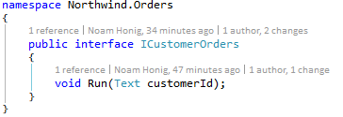
Adding and calling Customer Orders
Window title
Northwind.Products
Northwind.Customers
Northwind.Orders
Northwind.Customers
Northwind.Orders
NorthwindBase
button

Slide 21
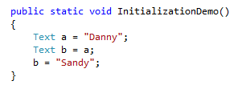
Initialization Demo - Text
Danny
a
Sandy
b

Slide 22
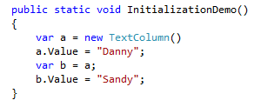
Initialization Demo - Column
Danny
Column
a
Value
Sandy
b

Slide 23
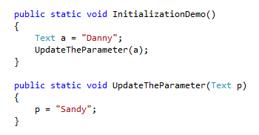
Initialization Demo – Text parameter
Danny
a
Danny
Sandy
p

Slide 24
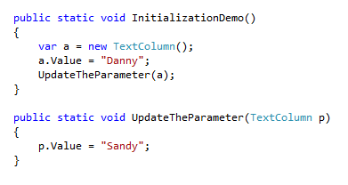
Initialization Demo - Column parameter
Danny
Column
a
Value
Sandy
P

