Slide 1
Large Migrated Project Structure and AbstractFactory.Create method

Slide 2
Migrated code structure
Northwind - application startup code
Program.Main – the entry point code
The ApplicationCore class – (Main Program)
The MDI and the main menues
List of programs & Entities
Northwind.Products – Programs that are in the Products module
Northwind.Customers – Programs that are in the Customers module
Northwind.Orders – Programs that are in the Orders module
NorthwindBase – everything that is shared by the entire project
Tables, Types, Rights etc…

Slide 3
Northwind Project
Northwind
Northwind.Products
Northwind.Customers
Northwind.Orders
NorthwindBase

Slide 4
Northwind.Products
Northwind
Northwind.Products
Northwind.Customers
Northwind.Orders
NorthwindBase

Slide 5
NorthwinD.Customers
Northwind
Northwind.Products
Northwind.Customers
Northwind.Orders
NorthwindBase

Slide 6
NorthwinD.Orders
Northwind
Northwind.Products
Northwind.Customers
Northwind.Orders
NorthwindBase

Slide 7









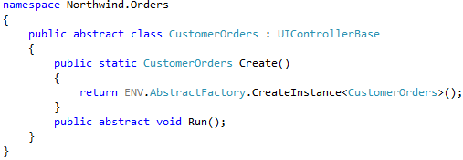
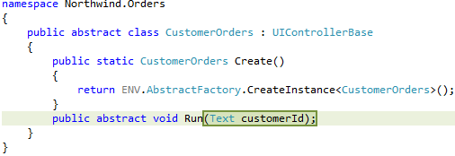
Adding and calling Customer Orders
Northwind.Products
Northwind.Customers
Northwind.Orders
Northwind.Customers
Northwind.Orders
NorthwindBase

