Slide 1
A Gromacs MD Study of Hen Egg-White Lysozyme in Orthorombic Form at 1.5 Å resolution
A Gromacs Tutorial

Slide 2
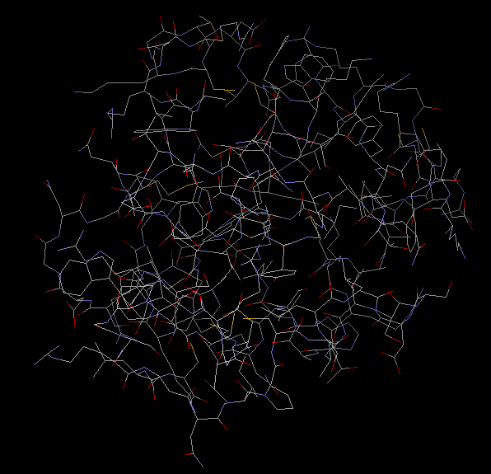
The Hen Egg-White Lysozyme (1AKI)

Slide 3
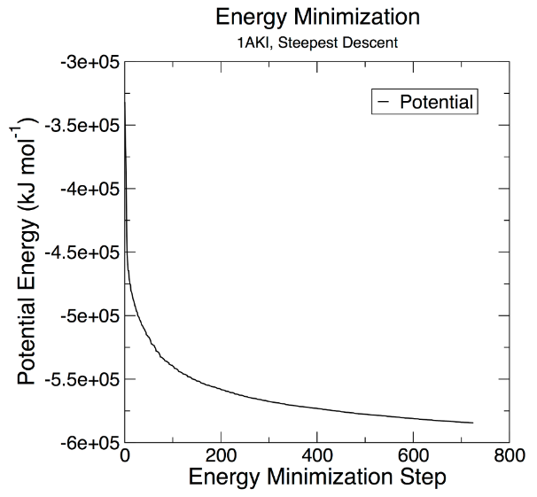
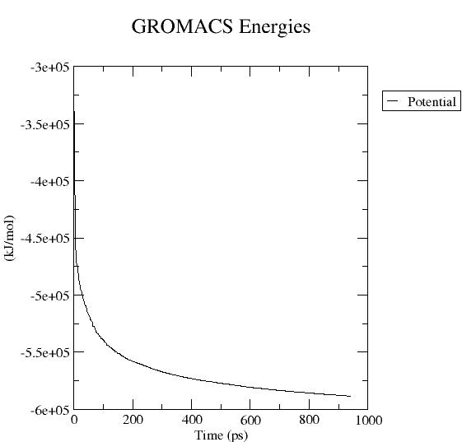
Energy Minimization
AS GIVEN IN TUTORIAL
OBTAINED THROUGH SIMULATION

Slide 4
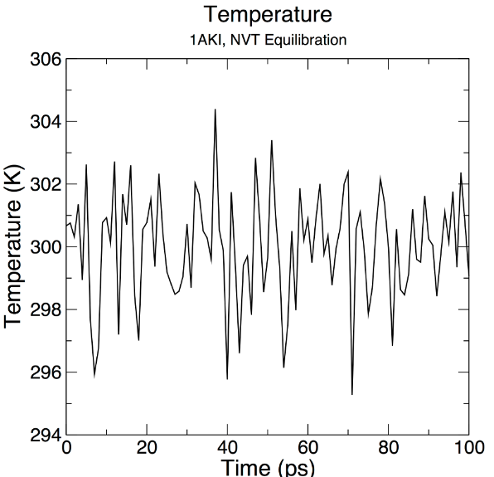
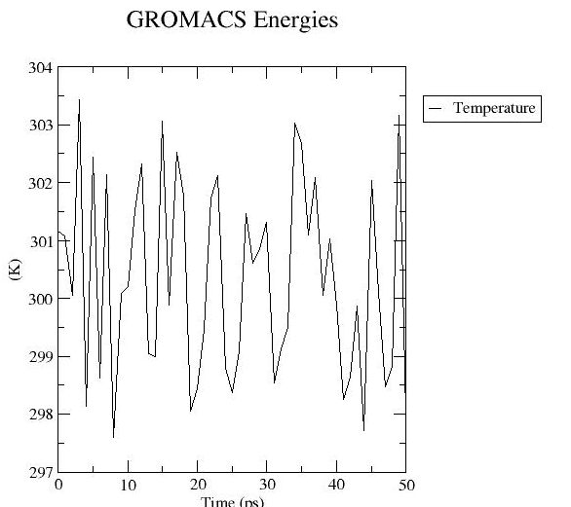
NVT Equilibriation [50 ps]
AS GIVEN IN TUTORIAL
OBTAINED THROUGH SIMULATION

Slide 5
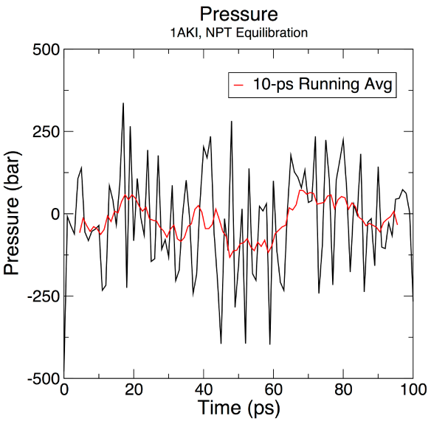
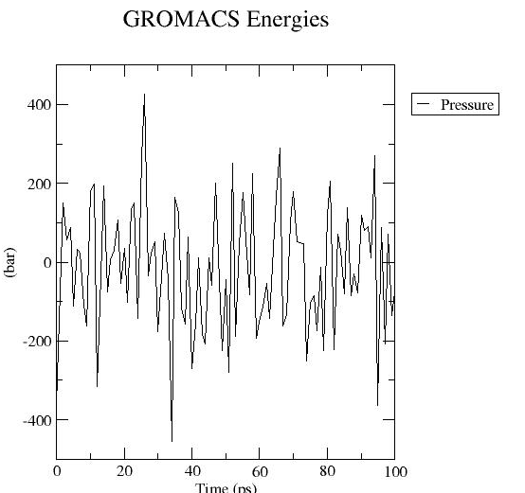
NPT Equilibriation (Pressure Variation) [100 ps]
AS GIVEN IN TUTORIAL
OBTAINED THROUGH SIMULATION

Slide 6
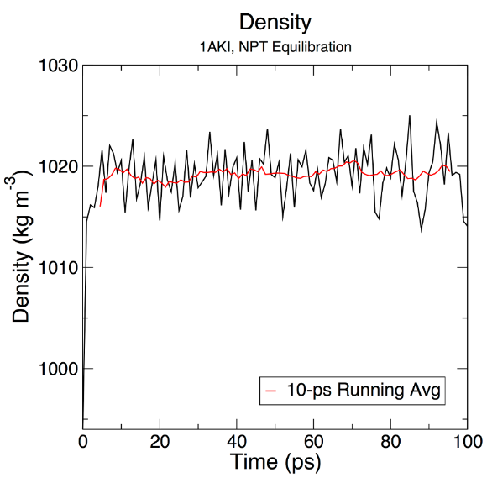
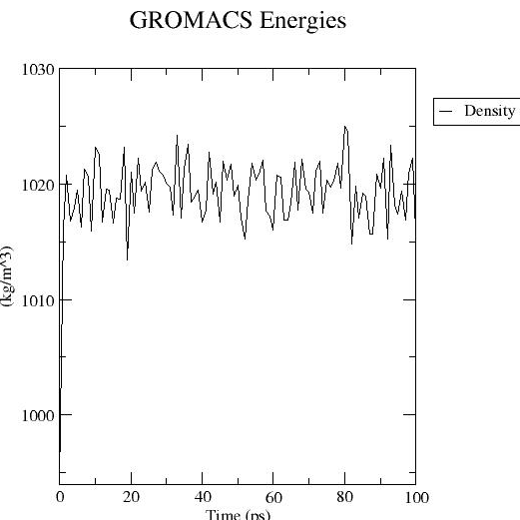
NPT Equilibriation (Density Variation) [100 ps]
AS GIVEN IN TUTORIAL
OBTAINED THROUGH SIMULATION

Slide 7
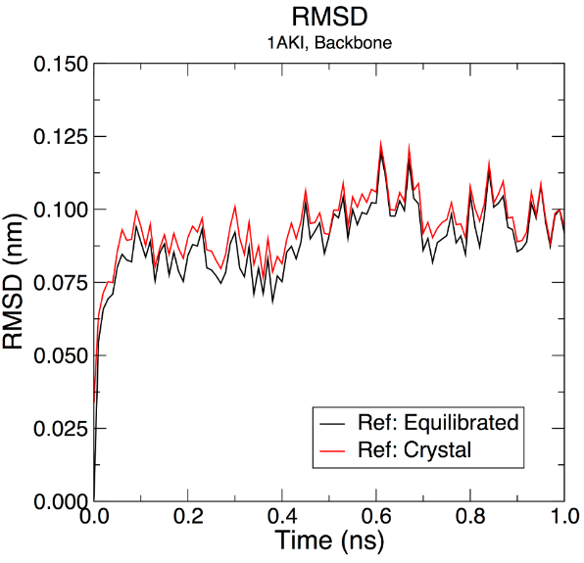
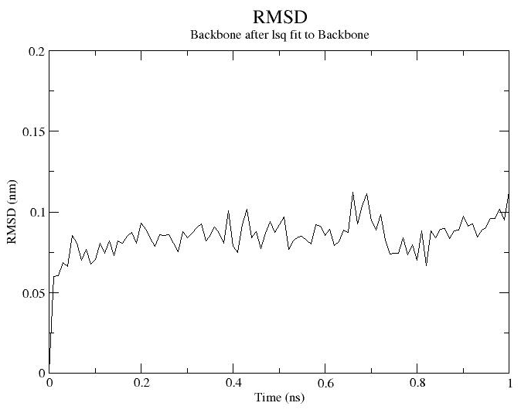
Structural Stability: RMSD
RMSD obtained after simulation
(w.r.t Equilibriated structure)
RMSD (tutorial)

Slide 8
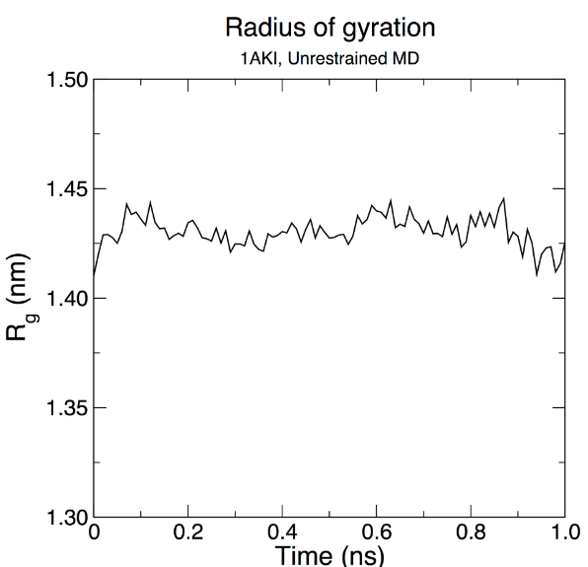
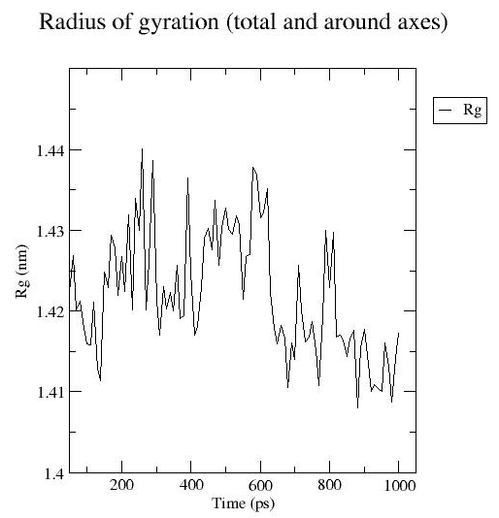
Structural Stability: Radius of Gyration (Rg)
Radius of Gyration (Tutorial)
RMSD obtained after simulation
(w.r.t Equilibriated structure)

Slide 9
References
Justin A. Lemkul; GROMACS Tutorial; Lemkul Lab, Virginia Tech.
D. Frenkel, B. Smith; Understanding Molecular Simulation: From Algorithms to Applications; Academic Press (2002); ISBN: 0-12-267351-4.
RCSB Protein Data Bank (www.rcsb.org)
Gromacs Documentation (https://manual.gromacs.org)

Slide 10
Thank You!

