Slide 1
Computer Operating System Experiment

Slide 2
Process
Lab 2

Slide 3
Roadmap
What is Linux?
How to create a process in Linux?
Commands
Q&A

Slide 4
Objective:
Learn to work with Linux system calls related to process creation and control. Including:
  process create and data sharing between parent and child
  the execution order of parent and child process
  Create the specified num of child processes
  Process termination
  Zombie process
  process create a child process and load a new program

Slide 5

Lifecycle of a Process
As a process executes, it changes state:
  new: The process is being created
  ready: The process is waiting to run
  running: Instructions are being executed
  waiting: Process waiting for some event to occur
  terminated: The process has finished execution

Slide 6
Can a process create a process ?
fork() system call creates a copy of current process with a new PID
Return value from fork(): integer
  When > 0:
    Running in (original) Parent process
    return value is pid of new child
  When = 0:
    Running in new Child process
  When < 0:
    Error! Must handle somehow
    Running in original process

Slide 7

Process Creation (Cont.)
Address space
  Child duplicate of parent
  Child has a program loaded into it
UNIX examples
  fork() system call creates new process
  exec() system call used after a fork() to replace the process’ memory space with a new program

Slide 8
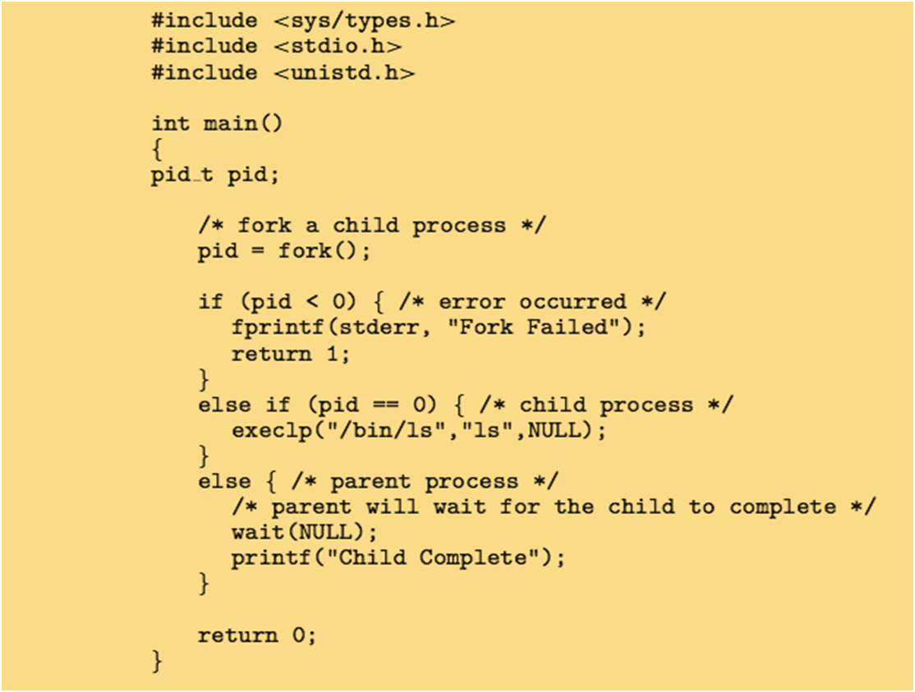
Process creation with C
POSIX

Slide 9
Process termination
Child → Parent
  Process’ resources are deallocated when:
    exit(n)
    return() in main()
  Catch exit status → wait()
    pid = wait(&status);
Parent → Child
  terminate child
  Why?
    Child has exceeded allocated resources
    Task assigned to child is no longer required
    The parent is exiting and the operating systems does not allow a child to continue if its parent terminates
Notes:
Process executes last statement and then asks the operating system to delete it using the exit() system call.
Returns status data from child to parent (via wait())
Process’ resources are deallocated by operating system
Parent may terminate the execution of children processes using the abort() system call. Some reasons for doing so:
Child has exceeded allocated resources
Task assigned to child is no longer required
The parent is exiting and the operating systems does not allow a child to continue if its parent terminates

Slide 10

Problems of process termination
zombie process
  A process which has finished the execution but still has entry in the process table to report to its parent process is known as a zombie process.
orphan process
  A process whose parent process no more exists i.e. either finished or terminated without waiting for its child process to terminate is called an orphan process.
Notes:
A process which has finished the execution but still has entry in the process table to report to its parent process is known as a zombie process.
A process whose parent process no more exists i.e. either finished or terminated without waiting for its child process to terminate is called an orphan process.
Some operating systems do not allow child to exists if its parent has terminated. If a process terminates, then all its children must also be terminated.
cascading termination. All children, grandchildren, etc. are terminated.
The termination is initiated by the operating system.
The parent process may wait for termination of a child process by using the wait()system call. The call returns status information and the pid of the terminated process
pid = wait(&status);
If no parent waiting (did not invoke wait()) process is a zombie
If parent terminated without invoking wait , process is an orphan
Many web browsers ran as single process (some still do)
If one web site causes trouble, entire browser can hang or crash
Google Chrome Browser is multiprocess with 3 different types of processes:
Browser process manages user interface, disk and network I/O
Renderer process renders web pages, deals with HTML, Javascript. A new renderer created for each website opened
Runs in sandbox restricting disk and network I/O, minimizing effect of security exploits
Plug-in process for each type of plug-in

Slide 11
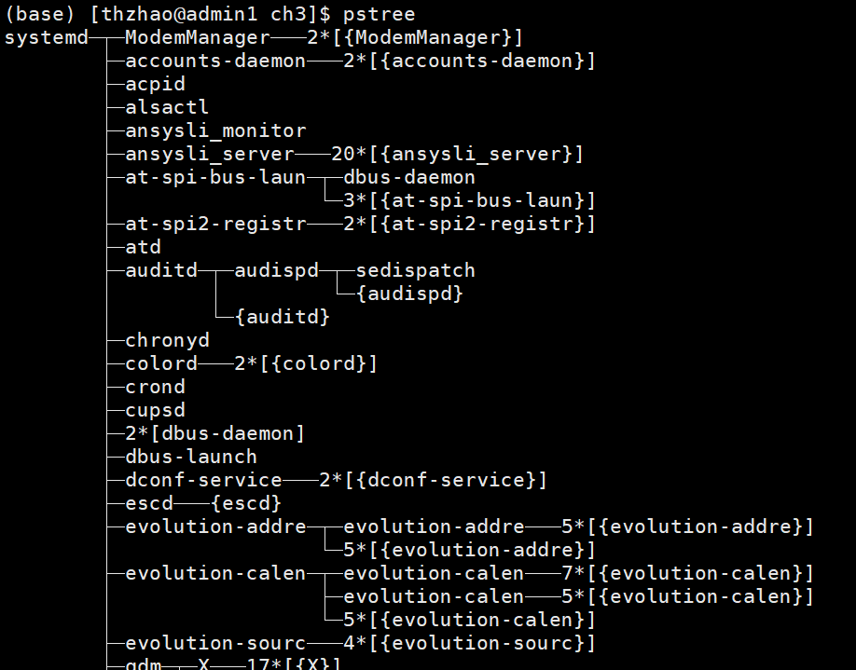
pstree
shows the running processes as a tree.
in BSD systems, a similar output is created using ps -d,
in Linux ps axjfproduces similar output.

Slide 12


