Slide 1
Empowering the community through AI
GROUP A2 MEMBERS: CALLUM FU YU, YEO JUN LONG JEREMY, MARCUS ONG JIAN XIANG

Slide 2
Table of contents
01
02
Introduction
Problem Statement
03
04
05
Our solution
Live Demo
Conclusion
Introduction of hackathon theme
What community issue are we solving?
How our solution was created and how it works
Demonstration of our solution
Recap and future of our solution

Slide 3
01
Introduction
Introduction of hackathon theme

Slide 4

Empowering the community through AI:
AI has advanced to a level where it is making a difference in people’s daily lives and in our own communities.
This project will focus on addressing a real issue faced by a community in Singapore, showing how technologies like AI can empower people and create lasting impacts
Source: UCF

Slide 5
02
Problem Statement
What community issue are we solving?

Slide 6
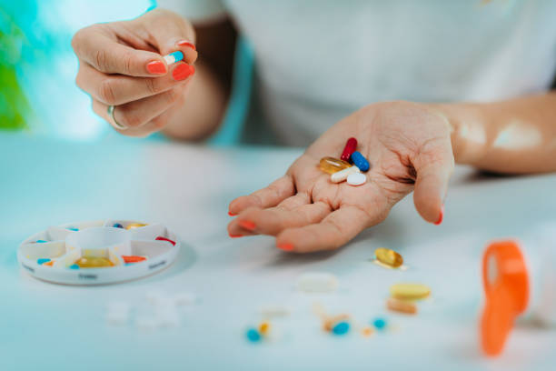
Problem Statement:
Many elderly individuals in Singapore face difficulties reading and remembering medication labels due to language barriers.
These challenges increase the risk of medication misuse and medication non-adherence, leading to adverse health outcomes, reduced independence, and higher healthcare burdens. [1]
Source: iStock

Slide 7
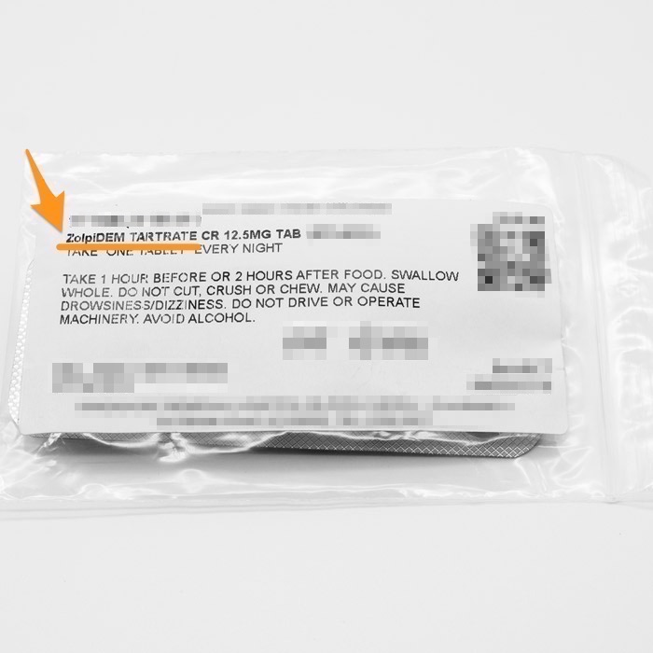
Analysis of Problem Statement:
Problem:
Many medication labels in Singapore are in English, but older Singaporeans have lower English literacy compared to younger generations (OECD Survey in 2023) [2], making it difficult to understand label instructions.
Evidence:
Research by Duke-NUS and Monash University shows that many older adults in Singapore struggle with understanding medical instructions due to low health literacy. [3]
1. 66% struggle with medical instructions [3]
2. 58.4% face difficulty understanding written health info.[3]
Result:
This leads to confusion, misuse of medication, and reduced independence.
Source: HSA

Slide 8
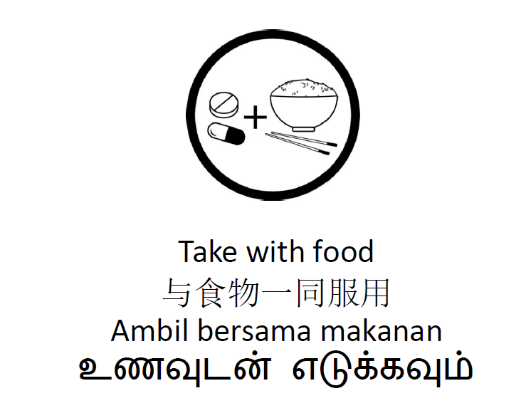
Further Analysis Of Problem Statement:
Background:
Earlier pictograms on medication labels were often unclear, especially for seniors with limited English in Singapore. [5]
Improvements Made:
Duke NUS developed 35 validated pictograms in 2024 to supplement medication instructions, making them clearer and easier to understand, especially for seniors and non-English speakers. [4]
Impacts:
Over 66% of older adults were able to interpret the pictograms and 85% agreed that it effectively conveyed instructions [4]
Why ongoing improvement matters:
While pictograms help, many seniors still rely on written text. Our solution uses simple translated text to make instructions easier to understand and reduce medication errors.
Source: Duke NUS

Slide 9
03
Our solution
How our solution was created and how it works

Slide 10
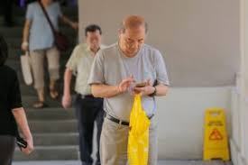
Our Solution:
Our solution description:
Improves accessibility for elderly users by using simplified English and translated keywords, making medication instructions easier to read, understand, and follow.
Evidence of Elderly Using Mobile Devices:
Smartphone ownership has also become prevalent among seniors, rising from 74% in 2017 to 89% in 2022. [6]
Benefits of solution:
Easier to understand instructions
Lesser chances of using wrong medicine
Better independence
Lesser chances of medical non-adherence
Source : NUS

Slide 11
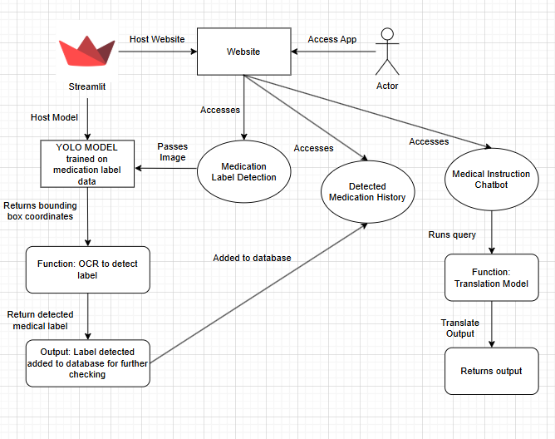
Solution Overview:
How was solution created:
We used Streamlit to host an interface combining a YOLO model for medication label detection, the Gemini API for instruction interpretation, and Tesseract OCR to extract and translate key medication instructions into multiple languages using Google Translator.
Solution Features:
Chatbot that explains medical instructions with inbuilt translator.
MediMatch Model extracts medication info from medication label and adds to a database for user to check.
Allows user to check their medication history
Source: Draw.io

Slide 12
Solution Technology Used:
Technologies Used:
Streamlit: Streamlit was used to host both the machine learning model and the website. It offers a responsive interface, making the application accessible on both mobile devices and laptops.
Tesseract OCR: Tesseract Optical Character Recognition was utilized to extract text from medication labels, enabling further processing and interpretation.
YOLOv11: YOLOv11 was the object detection model employed to identify and detect relevant components on medication packaging and labels.
Gemini API: The Gemini API was used to simplify medical instructions, making them more understandable—especially for elderly users.
Google Translate:Google Translate was integrated to provide multilingual support, enabling users to translate medication labels into various languages using Google's robust translation capabilities.

Slide 13
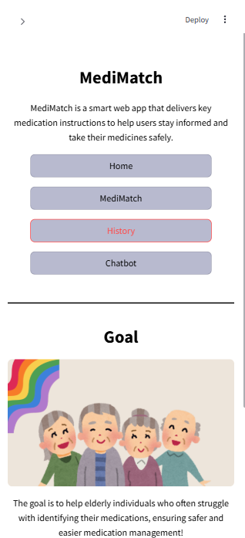
Solution Overview:
How solution tackles the main issue:
It addresses the current language and English literacy barriers by using simplified English or translated keywords, making medication instructions easier for seniors and non-English speakers to understand and follow the instructions.
Our unique selling point:
Unlike medication pictograms, our solution enhances comprehension through translated keywords for the multilingual elderly community in Singapore, maintaining medical instruction accuracy while being accessible, scalable, and easy to integrate with existing medication labels.

Slide 14
04
Demo
Demonstration of our solution

Slide 15
05
Conclusion
Recap and future of our solution

Slide 16

Conclusion:
Recap:
Our solution improves accessibility and understanding of medical instructions for elderly users by using simplified English and translated keywords.
Future Improvements:
Future collaboration with HPB to integrate with the current HealthHub to reach out to more people.
Need to get access to more data for better results on our model
Notifications or medication reminders.
Use another programming language to get more creative freedom compared to Streamlit like Flutter etc.
Source: HealthHub

Slide 17
Thank You

Slide 18
References
Jimmy, B. and Jose, J. (2011) Patient medication adherence: Measures in daily practice, Oman medical journal. Available at: https://pmc.ncbi.nlm.nih.gov/articles/PMC3191684/#:~:text=The%20consequence%20of%20non%20adherence,hospital%20visits%20and%20hospital%20admissions. (Accessed: 13 June 2025).
(No date) Survey of adults skills 2023: Singapore | OECD. Available at: https://www.oecd.org/en/publications/survey-of-adults-skills-2023-country-notes_ab4f6b8c-en/singapore_382e963a-en.html (Accessed: 13 June 2025).
(No date a) Duke. Available at: https://www.duke-nus.edu.sg/care/news-events/news/interviews//interviews/do-you-frequently-take-the-wrong-medication-nation’s-weak-medical-literacy (Accessed: 13 June 2025).
Duke-NUS launches new pictograms to clarify medication instructions, enhancing patient care (2024) National Institute of Education (NIE). Available at: https://www.ntu.edu.sg/nie/news-events/news/detail/duke-nus-launches-new-pictograms-to-clarify-medication-instructions--enhancing-patient-care#:~:text=Duke%2DNUS%20introduces%2035%20innovative,of%20improving%20overall%20health%20outcomes. (Accessed: 13 June 2025).
(No date a) A case for innovating prescription medication labels in ... Available at: https://www.singhealthdukenus.com.sg/acp/familymedicine/Documents/Grand%20Rounds/RGR_20210121/RGR%20slides_Dr%20Rahul%20Malhotra_for%20circulation.pdf (Accessed: 13 June 2025).
Tham, D. and Bookmark Bookmark Share WhatsApp Telegra (no date) Almost all Singapore households have internet access, smartphone ownership at 97%, CNA. Available at: https://www.channelnewsasia.com/singapore/digital-access-smartphone-ownership-imda-3894676 (Accessed: 13 June 2025).

