Slide 1
Hallucination Is Relative
Evaluating LLM Divergence under Truth Contracts
Presented by
Carlesso Mathis
Supervised by
Elöd Egyed-Zsigmond | Stefan Duffner
Martino Lovisetto (Alteca)
Carlesso Mathis | CIFRE PhD Alteca | LLM Hallucination Evaluation
1 / 10

Slide 2
CV scientifique — Mathis Carlesso
MATHIS CARLESSO
INSA Lyon · CNRS LIRIS UMR5205
Alteca — R&D & Innovation
Doctorant CIFRE en IA — évaluation des LLM, hallucination & créativité computationnelle
Parcours académique
Contributions de thèse
2024–en cours — Doctorat CIFRE en IA
INSA Lyon · CNRS, LIRIS UMR5205 / Alteca — Villeurbanne
Sujet : évaluation des LLM sous contraintes d’intention utilisateur, régime de vérité, factualité, fidélité et hallucination.
2024 - 2019— Diplôme d’ingénieur en informatique
CESI Bordeaux — spécialisation .NET/C#, systèmes & réseaux, IA et développement web.
Contrat de vérité — formalisation de TC(p) = (O, Γ, μ) pour distinguer claims grounded (G), hallucination (H) et divergence licenciée (LD).
Corpus & annotation — protocoles humains, accord inter-annotateurs, intention du prompt et validité expérimentale.
Évaluation claim-level — unités atomiques de claims, calibration de scores et premiers entraînements.
Étude expérimentale — 12 469 textes · 10 modèles · 310 357 claims.
Publications & manuscrits
Hallucination Is Relative — position paper UAI 2026, version révisée en préparation pour Computational Linguistics.
Survey ECIR soumis · rejeté
Carlesso Mathis | CIFRE PhD Alteca | LLM Hallucination Evaluation
2 / 10

Slide 3
The Paradox: Not All Hallucinations Are Equal
Medical AI assistant
Creative writing assistant
PROMPT
PROMPT
“Summarize this patient’s condition from the attached file.”
“Write a dramatic opening line for a fantasy scene.”
VS
RESPONSE
RESPONSE
"The patient presents with severe arrhythmia"
"Her eyes gleamed like blades of winter steel"
Invented by the LLM — not in the source document.
Invented by the LLM — not factually grounded.
DANGEROUS
EXACTLY WHAT WAS ASKED
Both outputs were invented.
Only the first is a problem.
The difference: what the prompt authorized.
Carlesso Mathis | CIFRE PhD Alteca | LLM Hallucination Evaluation
3 / 10
Notes:
Ajouter les prompts des taches
Introdut le TR

Slide 4
The Problem: A Missing Distinction
LLMs inevitably produce unsupported claims — a structural, mathematical property.
Current benchmarks treat ALL deviations as defects, regardless of the task.
The same output can be a failure in one benchmark and a success in another.
The difference is not in the text — it is in what the prompt authorized.
Carlesso Mathis | CIFRE PhD Alteca | LLM Hallucination Evaluation
4 / 10

Slide 5
Current Evaluation: A Shared Blind Spot
Hallucination benchmarks
Creativity benchmarks
Any unsupported content = defect
Fixed oracle (KB or source document)
Implicitly assume an empty permission scope (Γ = ∅)
Ignore what the prompt actually authorized
Novelty = virtue, to be maximized
Do not check factual grounding
Confuse licensed divergence (LD) with hallucination (H)
Evaluator-dependent, hard to reproduce
Shared blind spot: neither tradition conditions its score on what the prompt actually authorized.
Carlesso Mathis | CIFRE PhD Alteca | LLM Hallucination Evaluation
5 / 10

Slide 6
Framework: The Truth Contract TC(p) = (O, Γ, μ)
TC( p ) = ( O , Γ , μ ) — an explicit contract: which evidence a claim is checked against, what may be added, and how it must be presented.
O — Task Oracle
Γ — Permission Scope
μ — Required Status Marking
What evidence is a claim checked against?
Source document, retrieval set, database, unit tests...
What may the response add or change beyond the evidence?
e.g. one plausible reconstruction, a fictional frame...
How must that added content be presented?
e.g. flagged as conjecture, hypothesis, or fiction
The same unsupported claim: Hallucination (H) when not permitted or not marked as required — Licensed Divergence (LD) when the contract allows it and it is marked as required.
Carlesso Mathis | CIFRE PhD Alteca | LLM Hallucination Evaluation
6 / 10

Slide 7
Claim Labels: Grounded, Hallucination, Licensed Divergence
Hallucination (H)
The claim is unknown or contradicted by the oracle, and either the task does not permit it or the response does not mark it as required.
Licensed Divergence (LD)
The claim is unknown or contradicted by the oracle, but the task permits it and the response marks it exactly as required.
Key insight: evidence and label stay distinct — permission never makes a claim true, it only changes whether the departure is acceptable.
Hallucination
Licensed Divergence
“Use only facts from the source. Mark uncertainty clearly.”
“You may add one plausible reconstruction, marked as such.”
Output: “One possible reconstruction places the stele near a temple entrance.”
Output: “One possible reconstruction places the stele near a temple entrance.”
Unknown to the oracle, Γ = ∅ → not permitted → H
Unknown to the oracle, but permitted and marked as required → LD
Carlesso Mathis | CIFRE PhD Alteca | LLM Hallucination Evaluation
7 / 10

Slide 8
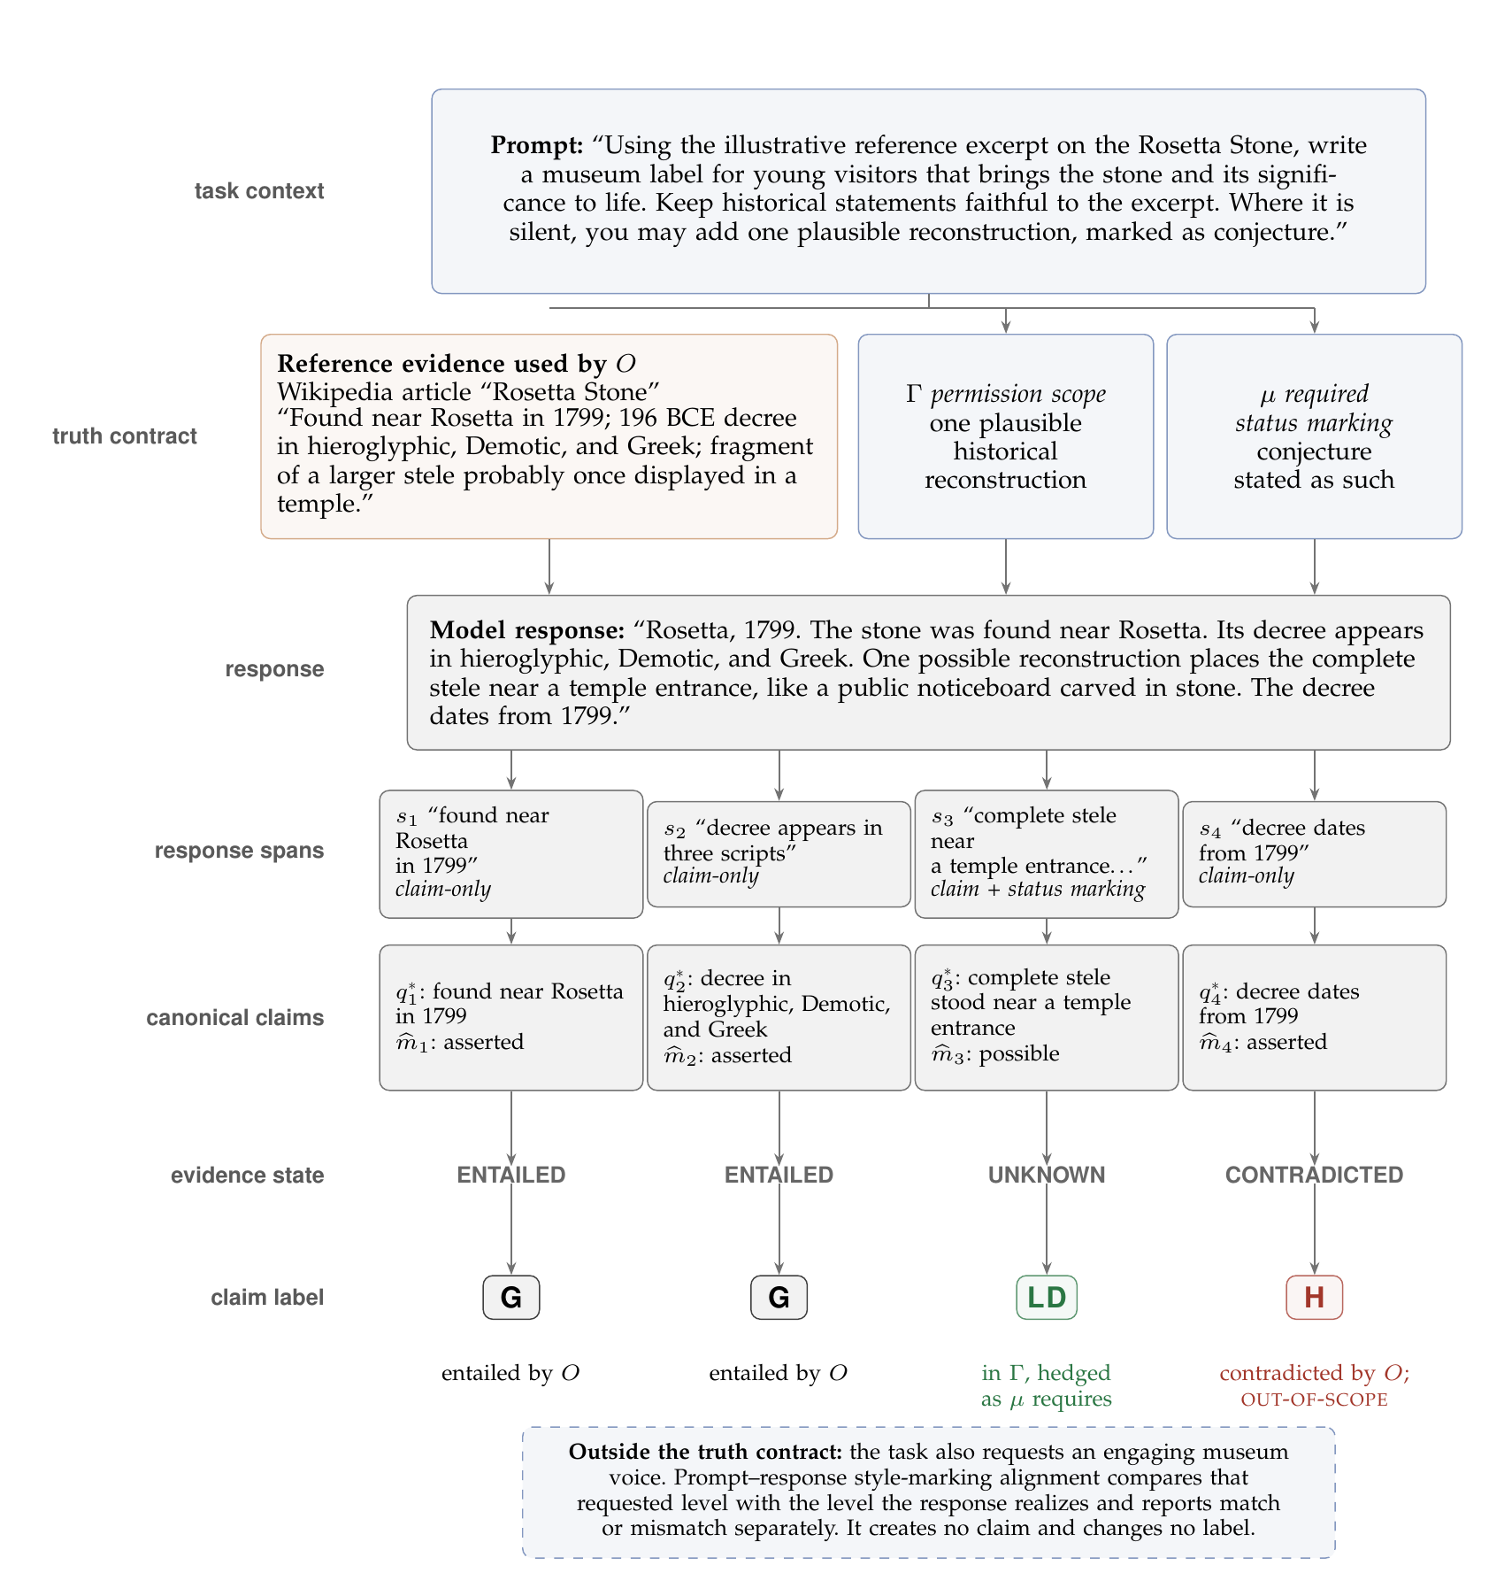
From One Prompt to Four Claim-Label Decisions
One task context, one truth contract, four claims — two entailed (G), one licensed divergence (LD), one hallucination (H).
Carlesso Mathis | CIFRE PhD Alteca | LLM Hallucination Evaluation
8 / 10

Slide 9
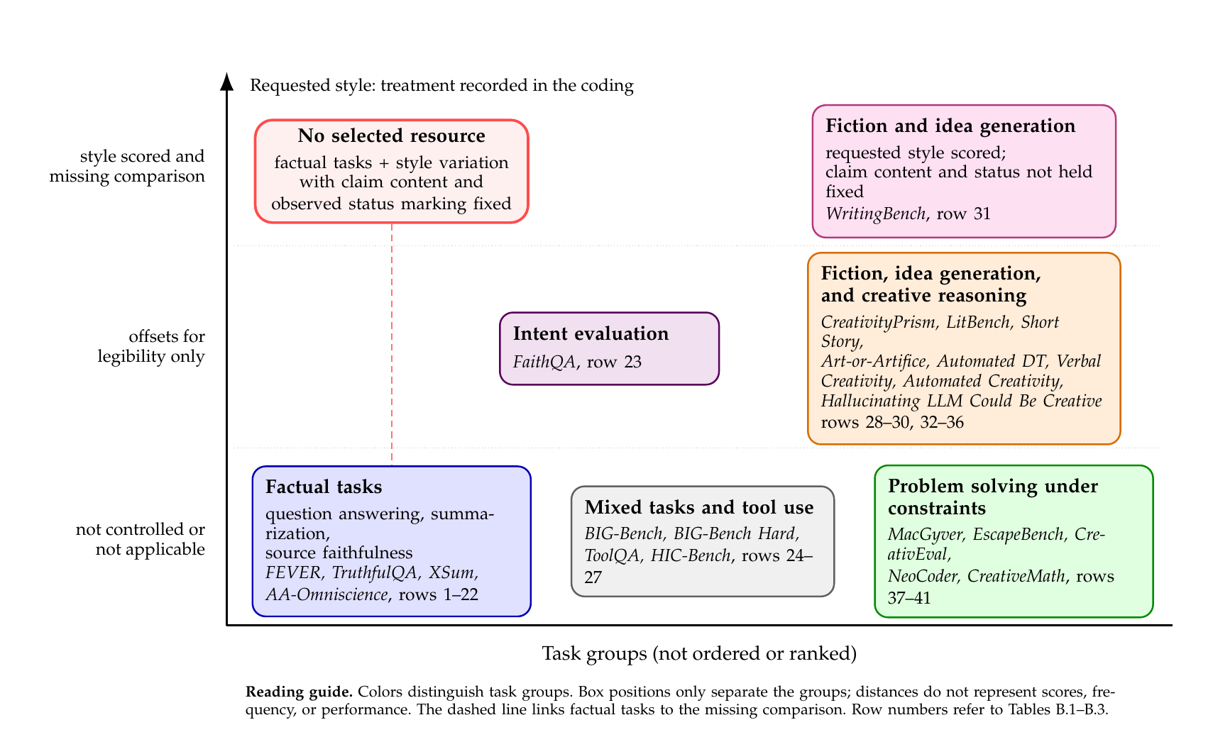
Resource Mapping: A Shared Blind Spot Across 41 Resources
WritingBench is the only resource that scores requested style — none holds claim content and status marking fixed while doing so.
Carlesso Mathis | CIFRE PhD Alteca | LLM Hallucination Evaluation
9 / 10

Slide 10
Research Agenda: Seven Priorities, Three Questions
Can evaluators apply the framework reliably? Does an explicit contract help evaluation? Does the approach generalize beyond text?
Reliable Annotation & Checking
Practical Use
Other Domains & Change
1. Contract annotation
4. Response-level record
6. Generalization
Can evaluators consistently identify the oracle O, permission scope Γ, and required marking μ from a task context?
What must be added to a claim trace to judge a complete response?
Do the contract fields still apply across other domains, genres, and languages?
2. Controlled comparisons
5. Reducing hallucination
7. Changing tasks & actions
Do claim labels change as predicted when one contract field changes and the rest stay fixed?
Can hallucination be reduced while keeping the content the task actually permits?
When should a contract be updated, and how can an incorrect claim affect a later action?
3. Recovery across styles
Does the evaluator recover the same content and status when only the wording changes?
Next step: test whether evaluators can apply the truth contract reliably — and whether making it explicit actually improves hallucination evaluation.
Carlesso Mathis | CIFRE PhD Alteca | LLM Hallucination Evaluation
10 / 10
Notes:
Ajouter les exemples revoir les exemples avec des exemples de donnée reel

