Slide 1
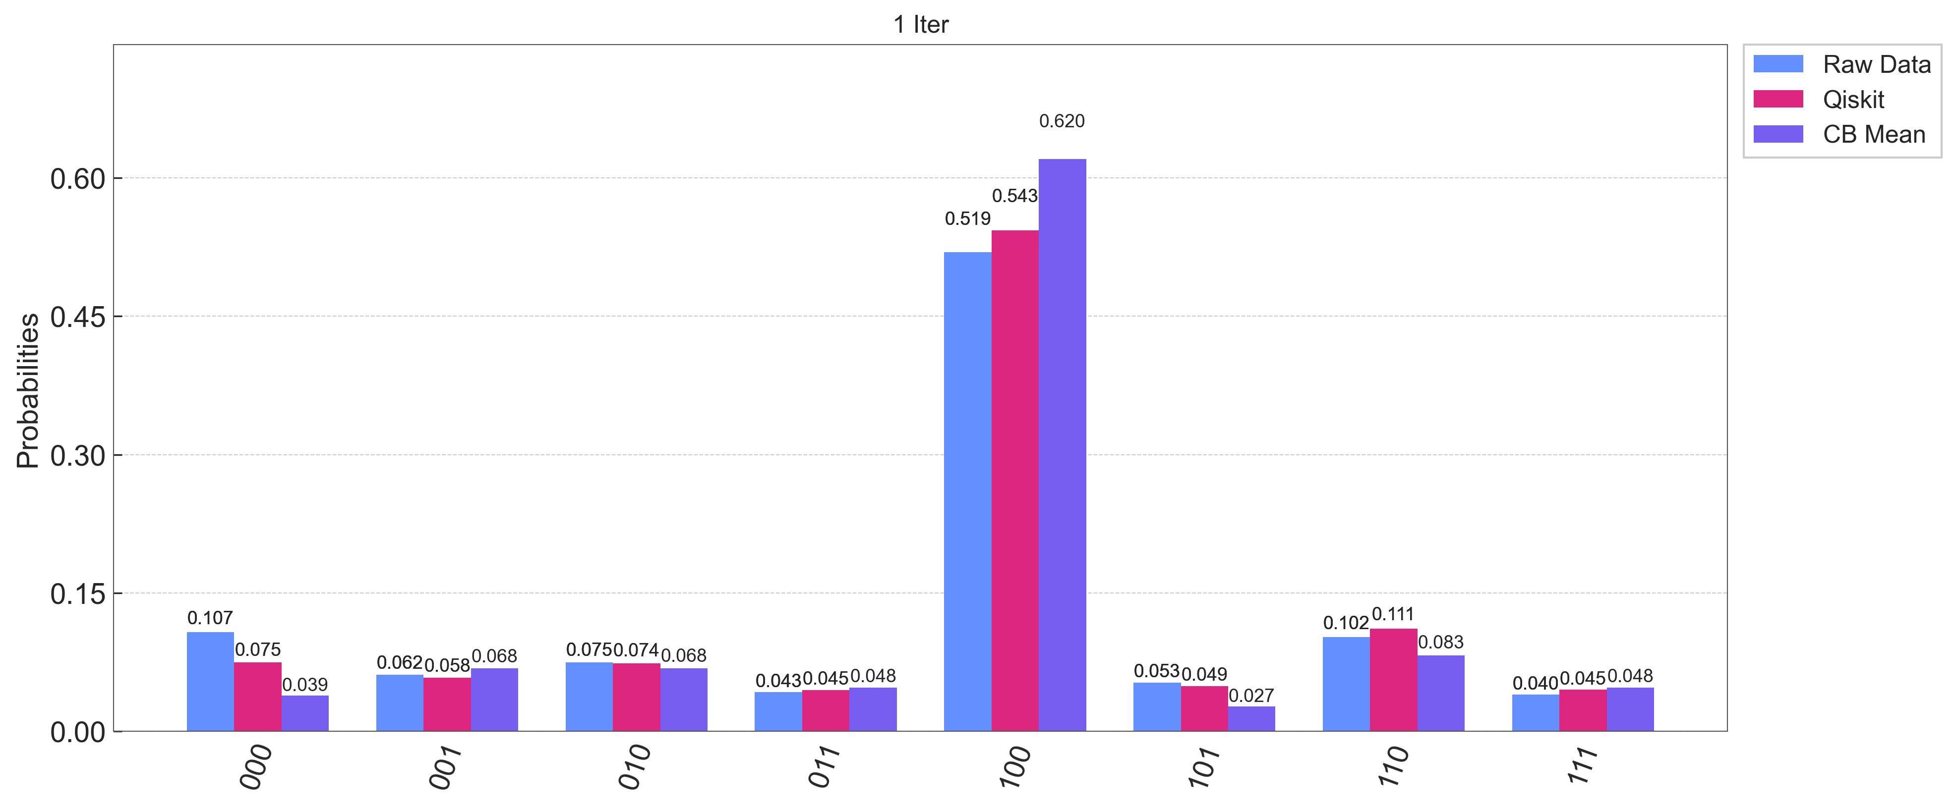
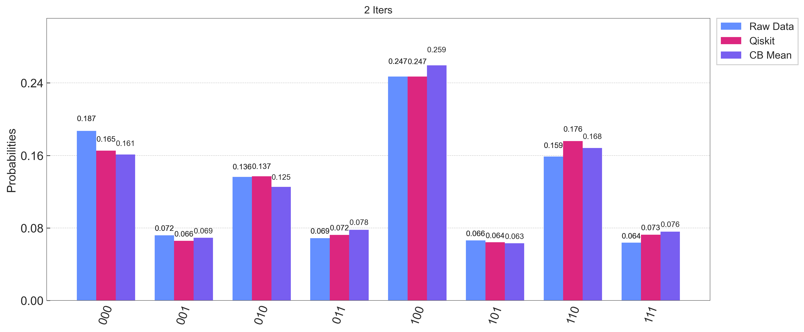
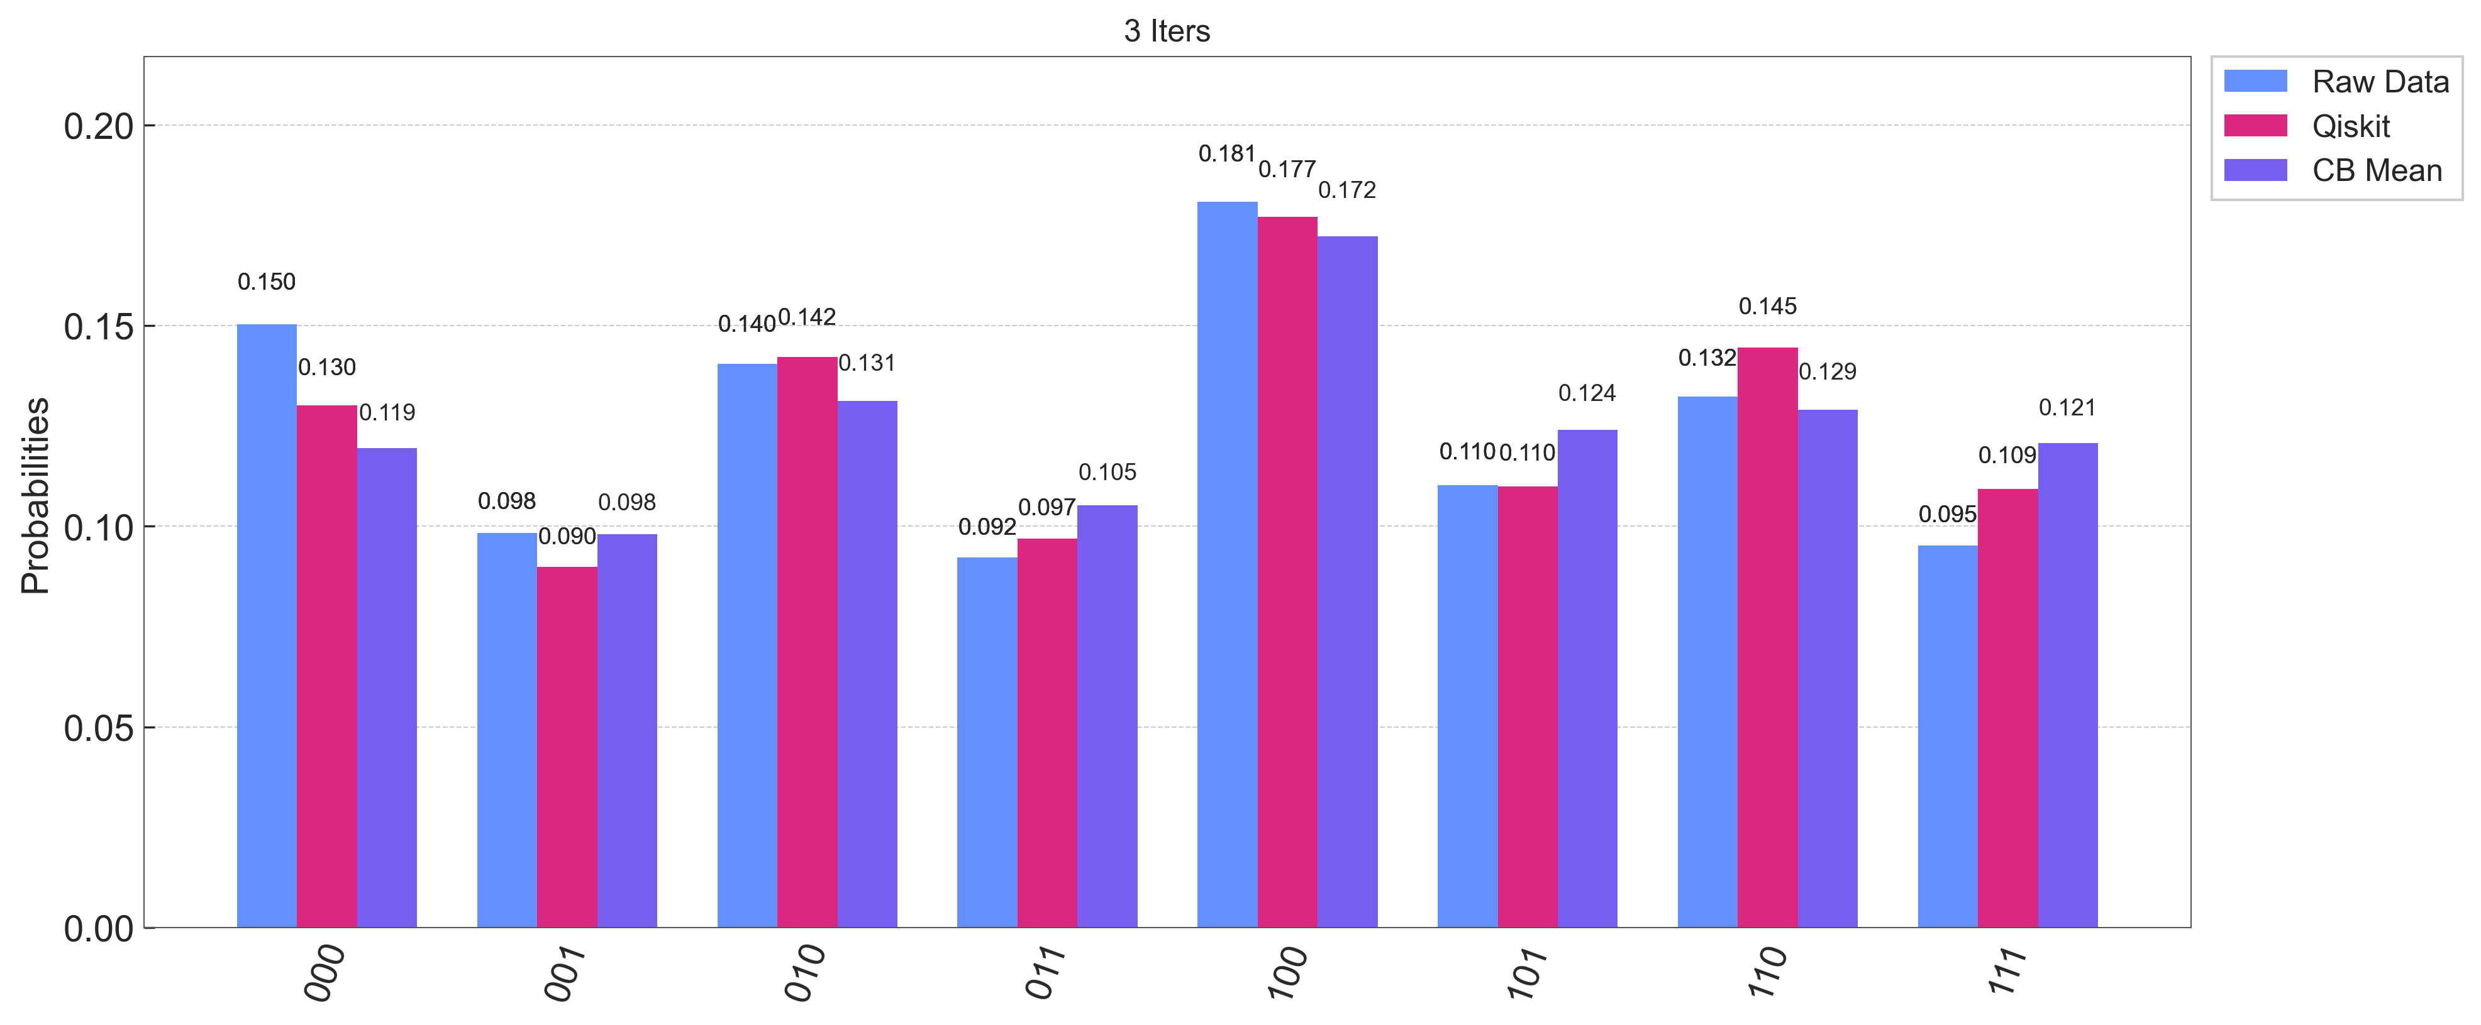
Target Basis is 100
(The last 0 is an ancillary qubit)
Lower bound of the success probability is 0.8
The ideal probabilities for the target basis in 1, 2, and 3 iterations are 0.8883, 0.9254, 0.8156
Circuit Depth are 67, 114, 179
Virtual and physical qubits mapping is adjusted to prevent the SWAP operations, so the gate noise is smaller.

