Slide 1
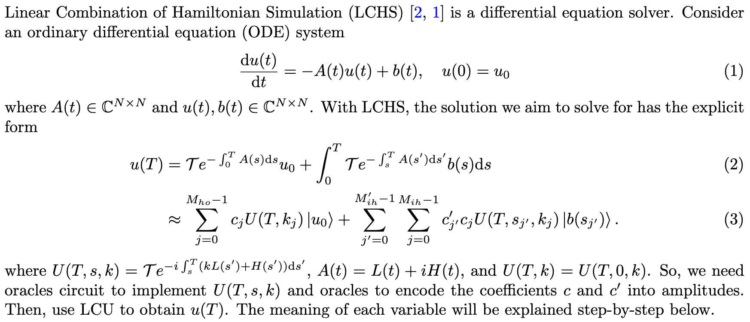
Homogeneous
Inhomogeneous
Solution at time T
Classical Computation
Quantum Computation

Slide 2
LCHS
Classically Computed Coefficients
Quantumly Computed Unitaries and Summation
Unitaries:
Hamiltonian Simulation for Schrödinger's Equation
Summation: Linear Combination of Unitaries
Number of Qubits =
log(dimension of unitaries)
log(Number of terms in the summation)

