Slide 1
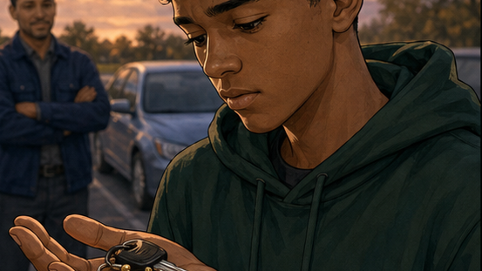
RC3 • LIFE IN CHRIST
FOUND
SESSION 2
HOW DID WE
BECOME LOST?
Choosing Self-Rule Instead
of Life with God
Fireproof Studies • James J. Burke
Notes:
Open with the title question. Do not answer it yet; the opening activity and illustration will establish the difference between received authority and self-rule.
[Sources]
- /Volumes/T7 Shield/neocities-fireprooofcommentaries/rc3/09_Youth_Resources/Found/Leader_Guides/RC3-Found-Leader-02-HowDidWeBecomeLost.pdf
- /Volumes/T7 Shield/neocities-fireprooofcommentaries/rc3/09_Youth_Resources/Found/Video_Plans/Session_02_Assets/Found-02-Borrowed-Car-Storyboard-v1.png

Slide 2
OPENING ACTIVITY
Who gets the final word?
Name one rule you would change—and explain why.
SCHOOL RULE
GAME RULE
HOUSEHOLD ROUTINE
AGE RESTRICTION
Human rules may be foolish or unjust.
God is the Creator, the source of life, and perfectly good.
His Word defines what His creation is for.
The deeper question is not merely, “Which rule?” but, “Whose authority?”
FOUND • SESSION 2
02
Notes:
Invite harmless examples. Distinguish fallible human rules from God's authority as Creator. Then ask the deeper question: whose word defines good and evil?
[Sources]
- /Volumes/T7 Shield/neocities-fireprooofcommentaries/rc3/09_Youth_Resources/Found/Leader_Guides/RC3-Found-Leader-02-HowDidWeBecomeLost.pdf

Slide 3
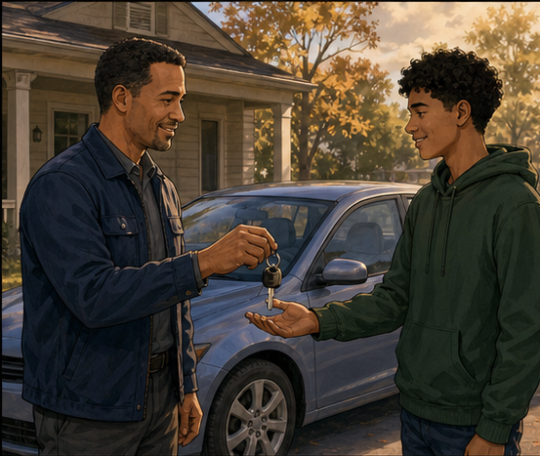
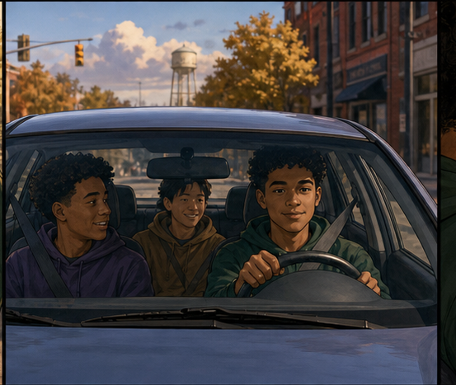
THE BORROWED CAR
A gift can be received and enjoyed—
and still belong to another.
FOUND • SESSION 2
03
Notes:
Tell the ordinary beginning: the owner gives a real gift and real authority to use it. Enjoying the car is not rebellion. The issue will be whether the borrower receives authority or claims ownership.
[Sources]
- /Volumes/T7 Shield/neocities-fireprooofcommentaries/rc3/09_Youth_Resources/Found/Video_Plans/Found-02-Illustrative-Video-Plan.md
- /Volumes/T7 Shield/neocities-fireprooofcommentaries/rc3/09_Youth_Resources/Found/Video_Plans/Session_02_Assets/Found-02-Borrowed-Car-Storyboard-v1.png

Slide 4
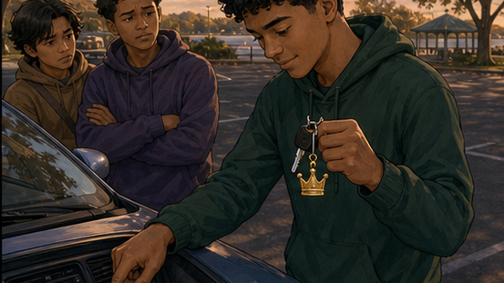
WHAT CHANGED?
The borrower began
acting like the owner.
He did not merely use the gift badly.
He claimed the right to decide its purpose.
Self-rule is the creature claiming the Creator’s authority.
FOUND • SESSION 2
04
Notes:
Make the analogy explicit but limited. The car illustration raises the authority question; Genesis 3 defines sin. Adam did not merely make a poor choice. He claimed the right to judge and seize good for himself.
[Sources]
- /Volumes/T7 Shield/neocities-fireprooofcommentaries/rc3/09_Youth_Resources/Found/Video_Plans/Found-02-Illustrative-Video-Plan.md
- /Volumes/T7 Shield/neocities-fireprooofcommentaries/rc3/09_Youth_Resources/Found/Leader_Guides/RC3-Found-Leader-02-HowDidWeBecomeLost.pdf
- /Volumes/T7 Shield/neocities-fireprooofcommentaries/rc3/09_Youth_Resources/Found/Video_Plans/Session_02_Assets/Found-02-Borrowed-Car-Storyboard-v1.png

Slide 5

BIG IDEA
God made humanity for life
under His Word.
Adam seized self-rule, and every accountable sinner confirms that rebellion.
We inherit the world Adam ordered. We become personally guilty when we choose his rebellion.
FOUND • SESSION 2
05
Notes:
State the distinction carefully. Do not teach that Adam's personal guilt is transferred to every child. We inherit the rebellious order he established; each accountable sinner becomes personally guilty by choosing rebellion.
[Sources]
- /Volumes/T7 Shield/neocities-fireprooofcommentaries/rc3/09_Youth_Resources/Found/Leader_Guides/RC3-Found-Leader-02-HowDidWeBecomeLost.pdf
- /Volumes/T7 Shield/neocities-fireprooofcommentaries/rc3/09_Youth_Resources/Found/Student_Handouts/RC3-Found-Handout-02-HowDidWeBecomeLost.pdf

Slide 6
GENESIS 3
The movement of self-rule
Watch whose word is trusted, who defines good, what the humans take, and what follows.
1
2
3
4
GOD SPEAKS
WORD QUESTIONED
DESIRE JUDGES
CREATURE SEIZES
Genesis 2:16–17
Genesis 3:1
Genesis 3:6
Genesis 3:6–7
Sin is deeper than breaking a rule. It is the creature claiming the Creator’s authority.
FOUND • SESSION 2
06
Notes:
Open Genesis 3:1-19. Trace the movement one stage at a time. Emphasize that Adam actively rebelled; he did not merely fail to prevent Eve's action.
[Sources]
- /Volumes/T7 Shield/neocities-fireprooofcommentaries/rc3/09_Youth_Resources/Found/Leader_Guides/RC3-Found-Leader-02-HowDidWeBecomeLost.pdf
- /Volumes/T7 Shield/neocities-fireprooofcommentaries/rc3/09_Youth_Resources/Found/Student_Handouts/RC3-Found-Handout-02-HowDidWeBecomeLost.pdf

Slide 7
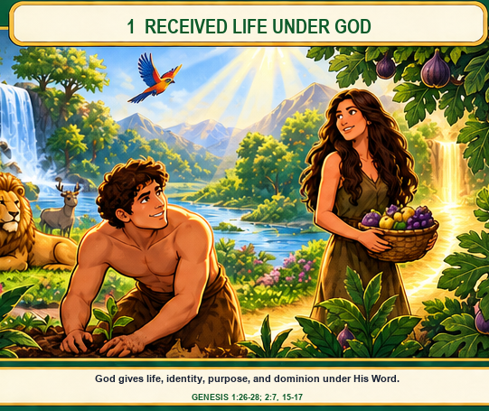
TRUTH 1
Dependence was
created good.
Humanity received life, identity, dominion, and purpose from God. Adam’s authority was real—but it remained entrusted authority under God’s Word.
Dependence was not a defect.
FOUND • SESSION 2
07
Notes:
Begin before the fall. God gave life and genuine human authority. Dependence upon the Creator was part of humanity's good design, not a weakness Adam needed to escape.
[Sources]
- /Volumes/T7 Shield/neocities-fireprooofcommentaries/rc3/09_Youth_Resources/Found/Leader_Guides/RC3-Found-Leader-02-HowDidWeBecomeLost.pdf
- /Volumes/T7 Shield/neocities-fireprooofcommentaries/rc3/09_Youth_Resources/Found/Visual_Theology/Found-02-Visual-Theology.png

Slide 8
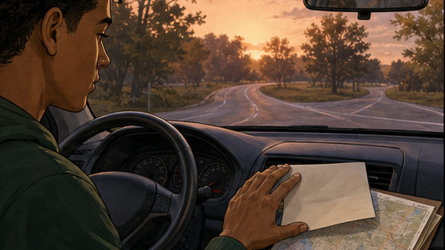
TRUTH 2
Adam actively
seized self-rule.
The serpent questioned God’s Word. Adam and Eve judged the tree by their own desire, took what God withheld, and claimed the right to define good and evil.
Adam began the rebellion.
FOUND • SESSION 2
08
Notes:
Keep Adam's agency clear. He did not merely permit rebellion. He actively chose the creature's word and desire over the Creator's Word.
[Sources]
- /Volumes/T7 Shield/neocities-fireprooofcommentaries/rc3/09_Youth_Resources/Found/Leader_Guides/RC3-Found-Leader-02-HowDidWeBecomeLost.pdf
- /Volumes/T7 Shield/neocities-fireprooofcommentaries/rc3/09_Youth_Resources/Found/Video_Plans/Session_02_Assets/Found-02-Borrowed-Car-Storyboard-v1.png

Slide 9

TRUTH 3
Rebellion reordered
the human world.
Fellowship gave way to hiding. Trust gave way to accusation. Stewardship became conflict. Mortal life moved inevitably toward death.
The rebellion did not make death possible; it made death inevitable.
FOUND • SESSION 2
09
Notes:
Trace Genesis 3:8-19: hiding, blame, conflict, and death. Preserve the lesson's exact emphasis that Adam's rebellion made death inevitable in the world he ordered.
[Sources]
- /Volumes/T7 Shield/neocities-fireprooofcommentaries/rc3/09_Youth_Resources/Found/Leader_Guides/RC3-Found-Leader-02-HowDidWeBecomeLost.pdf
- /Volumes/T7 Shield/neocities-fireprooofcommentaries/rc3/09_Youth_Resources/Found/Visual_Theology/Found-02-Visual-Theology.png

Slide 10
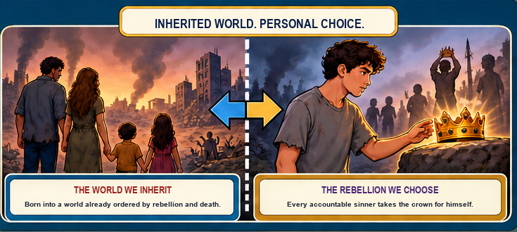
TRUTH 4
We inherit Adam’s world. We choose Adam’s rebellion.
FOUND • SESSION 2
10
Notes:
Distinguish inherited condition and personal guilt. We are born into a world already ordered by rebellion and death. Romans 1 shows every accountable sinner suppressing truth, exchanging God for the creature, and personally choosing self-rule.
[Sources]
- /Volumes/T7 Shield/neocities-fireprooofcommentaries/rc3/09_Youth_Resources/Found/Leader_Guides/RC3-Found-Leader-02-HowDidWeBecomeLost.pdf
- /Volumes/T7 Shield/neocities-fireprooofcommentaries/rc3/09_Youth_Resources/Found/Student_Handouts/RC3-Found-Handout-02-HowDidWeBecomeLost.pdf
- /Volumes/T7 Shield/neocities-fireprooofcommentaries/rc3/09_Youth_Resources/Found/Visual_Theology/Found-02-Visual-Theology.png

Slide 11
DISCUSSION
Let’s think it through
1
What good things did Adam receive before Genesis 3?
2
Where do you see the choice of self-rule in Genesis 3?
3
Why is sin deeper than breaking a rule?
4
How does Romans 1 show people repeating Adam’s choice?
Listen honestly. Trace the authority being claimed.
FOUND • SESSION 2
11
Notes:
Use follow-ups as needed: Why does received authority differ from self-rule? Whose word controlled the decision? What changed after rebellion? What truth is suppressed or exchanged in Romans 1?
[Sources]
- /Volumes/T7 Shield/neocities-fireprooofcommentaries/rc3/09_Youth_Resources/Found/Leader_Guides/RC3-Found-Leader-02-HowDidWeBecomeLost.pdf

Slide 12
MEMORY VERSE • ROMANS 1:25a
“Who changed the truth of God into a lie,
and worshipped and served the creature
more than the Creator...”
Adam began the rebellion. Every accountable sinner chooses to join it.
THIS WEEK
YOU MAY TALK WITH US
Notice one moment when your desire and God’s Word point different ways. Record which authority you choose.
If you recognize that you have been living under your own authority, a leader will privately open the Bible and help you understand surrender to Christ.
FOUND • SESSION 2
12
Notes:
Read the verse together. Give the weekly reflection. Offer private conversation without a public gesture or pressured response. Point ahead to the faithful Christ rather than ending only with human rebellion.
[Sources]
- /Volumes/T7 Shield/neocities-fireprooofcommentaries/rc3/09_Youth_Resources/Found/Leader_Guides/RC3-Found-Leader-02-HowDidWeBecomeLost.pdf
- /Volumes/T7 Shield/neocities-fireprooofcommentaries/rc3/09_Youth_Resources/Found/Student_Handouts/RC3-Found-Handout-02-HowDidWeBecomeLost.pdf

