Slide 1

RC3 • LIFE IN CHRIST
FOUND
SESSION 3
WHY CAN'T WE
SAVE OURSELVES?
Why Effort, Religion, and Good Intentions
Cannot Bring Us Home
Fireproof Studies • James J. Burke
Notes:
Open with the title question. Let the students feel the contrast between a toolbox full of useful things and tasks no human tool can accomplish.
[Sources]
- /Volumes/T7 Shield/neocities-fireprooofcommentaries/rc3/09_Youth_Resources/Found/Leader_Guides/RC3-Found-Leader-03-WhyCantWeSaveOurselves.pdf
- /Volumes/T7 Shield/neocities-fireprooofcommentaries/rc3/09_Youth_Resources/Found/Video_Plans/Session_03_Assets/Found-03-Wrong-Toolbox-Storyboard-v1.png

Slide 2
OPENING ACTIVITY
Which tool could actually do this?
Choose a tool—or admit that the task needs something more.
1
2
3
4
ERASE GUILT
DEFEAT DEATH
RESTORE FELLOWSHIP
CREATE LIFE
Make past rebellion untrue
Produce resurrection life
Declare peace with God
Cause your own new birth
Effort can improve habits. Religion can change routines. Neither can accomplish these four tasks.
The question is not, “How hard will I try?” but, “What must God do?”
FOUND • SESSION 3
02
Notes:
Write or name the four tasks. Let students offer ordinary solutions such as trying harder, doing good, becoming religious, or meaning well. Then expose the mismatch.
[Sources]
- /Volumes/T7 Shield/neocities-fireprooofcommentaries/rc3/09_Youth_Resources/Found/Leader_Guides/RC3-Found-Leader-03-WhyCantWeSaveOurselves.pdf

Slide 3
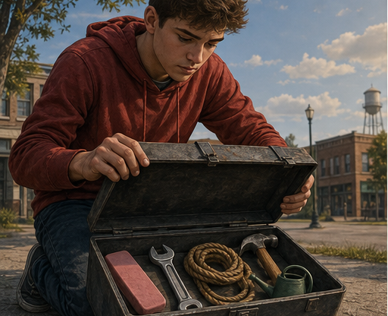

THE WRONG TOOLBOX
A useful tool is still useless
when it cannot match the task.
FOUND • SESSION 3
03
Notes:
The student's tools are real and useful. The problem is not laziness or sincerity. The problem is that the tools are unequal to the tasks.
[Sources]
- /Volumes/T7 Shield/neocities-fireprooofcommentaries/rc3/09_Youth_Resources/Found/Video_Plans/Found-03-Illustrative-Video-Plan.md
- /Volumes/T7 Shield/neocities-fireprooofcommentaries/rc3/09_Youth_Resources/Found/Video_Plans/Session_03_Assets/Found-03-Wrong-Toolbox-Storyboard-v1.png

Slide 4
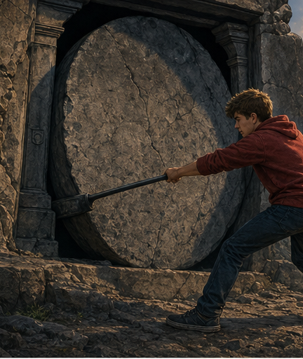
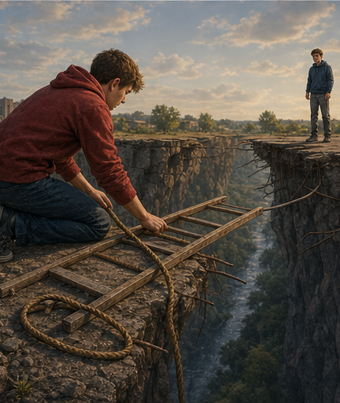
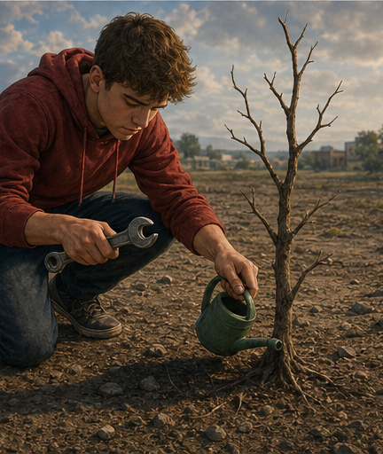
DEATH
SEPARATION
LIFE
The task is not difficult. It is impossible on our terms.
FOUND • SESSION 3
04
Notes:
Name the mismatch: mortal life cannot produce resurrection life; religion cannot declare fellowship restored; no person can cause his own birth.
[Sources]
- /Volumes/T7 Shield/neocities-fireprooofcommentaries/rc3/09_Youth_Resources/Found/Video_Plans/Found-03-Illustrative-Video-Plan.md
- /Volumes/T7 Shield/neocities-fireprooofcommentaries/rc3/09_Youth_Resources/Found/Leader_Guides/RC3-Found-Leader-03-WhyCantWeSaveOurselves.pdf
- /Volumes/T7 Shield/neocities-fireprooofcommentaries/rc3/09_Youth_Resources/Found/Video_Plans/Session_03_Assets/Found-03-Wrong-Toolbox-Storyboard-v1.png

Slide 5

BIG IDEA
The lost cannot repair their own
relationship with God.
Salvation must accomplish what human effort cannot.
Salvation is not self-improvement. God must do what the lost cannot do.
FOUND • SESSION 3
05
Notes:
State the central claim plainly. The lesson does not insult effort; it identifies the limits of every creaturely effort before guilt, death, estrangement, and spiritual death.
[Sources]
- /Volumes/T7 Shield/neocities-fireprooofcommentaries/rc3/09_Youth_Resources/Found/Leader_Guides/RC3-Found-Leader-03-WhyCantWeSaveOurselves.pdf
- /Volumes/T7 Shield/neocities-fireprooofcommentaries/rc3/09_Youth_Resources/Found/Student_Handouts/RC3-Found-Handout-03-WhyCantWeSaveOurselves.pdf

Slide 6
EPHESIANS 2 • ROMANS 3
Four things we cannot do
Each problem requires more than improvement.
1
GUILT
cannot erase
2
DEATH
cannot overthrow
3
FELLOWSHIP
cannot restore
4
LIFE
cannot create
Grace is God acting for those who cannot rescue themselves.
FOUND • SESSION 3
06
Notes:
Use this as the transition into the four teaching movements. Ask students to listen for what people were, what God did, and where works belong in Ephesians 2.
[Sources]
- /Volumes/T7 Shield/neocities-fireprooofcommentaries/rc3/09_Youth_Resources/Found/Leader_Guides/RC3-Found-Leader-03-WhyCantWeSaveOurselves.pdf
- /Volumes/T7 Shield/neocities-fireprooofcommentaries/rc3/09_Youth_Resources/Found/Student_Handouts/RC3-Found-Handout-03-WhyCantWeSaveOurselves.pdf

Slide 7
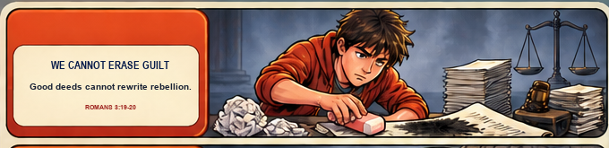
TRUTH 1
We cannot erase guilt.
Good deeds do not reverse rebellion or make past guilt disappear. God's law reveals and names sin; it cannot turn the guilty person into one who never rebelled.
Works cannot rewrite the truth about our rebellion. • Romans 3:19-20
FOUND • SESSION 3
07
Notes:
Good deeds do not reverse rebellion or make past guilt disappear. God's law reveals and names sin; it cannot turn the guilty person into one who never rebelled. Works cannot rewrite the truth about our rebellion. • Romans 3:19-20
[Sources]
- /Volumes/T7 Shield/neocities-fireprooofcommentaries/rc3/09_Youth_Resources/Found/Leader_Guides/RC3-Found-Leader-03-WhyCantWeSaveOurselves.pdf
- /Volumes/T7 Shield/neocities-fireprooofcommentaries/rc3/09_Youth_Resources/Found/Visual_Theology/Found-03-Visual-Theology.png

Slide 8
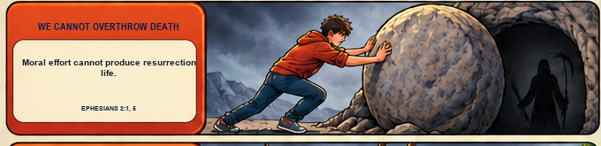
TRUTH 2
We cannot overthrow death.
Human life already stands under death's dominion. Discipline may delay decline, but mortal life cannot produce resurrection or free itself from separation from God.
Life under death cannot create deathless life. • Ephesians 2:1-5
FOUND • SESSION 3
08
Notes:
Human life already stands under death's dominion. Discipline may delay decline, but mortal life cannot produce resurrection or free itself from separation from God. Life under death cannot create deathless life. • Ephesians 2:1-5
[Sources]
- /Volumes/T7 Shield/neocities-fireprooofcommentaries/rc3/09_Youth_Resources/Found/Leader_Guides/RC3-Found-Leader-03-WhyCantWeSaveOurselves.pdf
- /Volumes/T7 Shield/neocities-fireprooofcommentaries/rc3/09_Youth_Resources/Found/Visual_Theology/Found-03-Visual-Theology.png

Slide 9
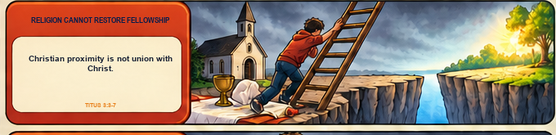
TRUTH 3
Religion cannot restore fellowship.
Religion may create proximity to Christian things, but the offender cannot declare the relationship restored. God's kindness and grace must act to reconcile us and make us heirs.
Reconciliation begins with God's saving action. • Titus 3:3-7
FOUND • SESSION 3
09
Notes:
Religion may create proximity to Christian things, but the offender cannot declare the relationship restored. God's kindness and grace must act to reconcile us and make us heirs. Reconciliation begins with God's saving action. • Titus 3:3-7
[Sources]
- /Volumes/T7 Shield/neocities-fireprooofcommentaries/rc3/09_Youth_Resources/Found/Leader_Guides/RC3-Found-Leader-03-WhyCantWeSaveOurselves.pdf
- /Volumes/T7 Shield/neocities-fireprooofcommentaries/rc3/09_Youth_Resources/Found/Visual_Theology/Found-03-Visual-Theology.png

Slide 10
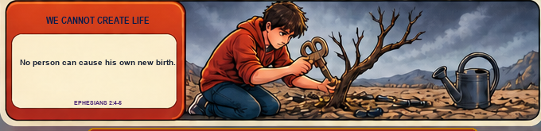
TRUTH 4
We cannot give ourselves life.
A person cannot cause his own birth. In salvation, God gives life by grace; the new life then produces the good works for which God created it.
Good works are fruit of new life, never its root. • Ephesians 2:4-10
FOUND • SESSION 3
10
Notes:
A person cannot cause his own birth. In salvation, God gives life by grace; the new life then produces the good works for which God created it. Good works are fruit of new life, never its root. • Ephesians 2:4-10
[Sources]
- /Volumes/T7 Shield/neocities-fireprooofcommentaries/rc3/09_Youth_Resources/Found/Leader_Guides/RC3-Found-Leader-03-WhyCantWeSaveOurselves.pdf
- /Volumes/T7 Shield/neocities-fireprooofcommentaries/rc3/09_Youth_Resources/Found/Visual_Theology/Found-03-Visual-Theology.png

Slide 11

GRACE
God acts for those
who cannot rescue themselves.
The sinner does not achieve salvation. The sinner receives Christ through faith; the Spirit gives life.
“For by grace are ye saved through faith...”
Ephesians 2:8
FOUND • SESSION 3
11
Notes:
Turn from inability to God's action. Preserve the curriculum's order: the sinner believes; the Spirit gives life. Faith receives Christ; it is not another saving work.
[Sources]
- /Volumes/T7 Shield/neocities-fireprooofcommentaries/rc3/09_Youth_Resources/Found/Leader_Guides/RC3-Found-Leader-03-WhyCantWeSaveOurselves.pdf
- /Volumes/T7 Shield/neocities-fireprooofcommentaries/rc3/09_Youth_Resources/Found/Student_Handouts/RC3-Found-Handout-03-WhyCantWeSaveOurselves.pdf
- /Volumes/T7 Shield/neocities-fireprooofcommentaries/rc3/09_Youth_Resources/Found/Visual_Theology/Found-03-Visual-Theology.png

Slide 12
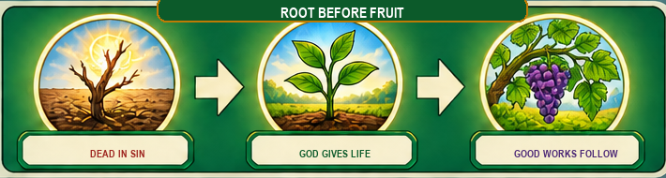
EPHESIANS 2:8-10
Good works are fruit—not the root.
NOT: good works → life
YES: new life → good works
Works never manufacture new birth.
God creates life that bears fruit.
FOUND • SESSION 3
12
Notes:
Compare Ephesians 2:8-9 with verse 10. Good works matter greatly, but their place is after salvation as the fruit of life in Christ, not before salvation as its cause.
[Sources]
- /Volumes/T7 Shield/neocities-fireprooofcommentaries/rc3/09_Youth_Resources/Found/Leader_Guides/RC3-Found-Leader-03-WhyCantWeSaveOurselves.pdf
- /Volumes/T7 Shield/neocities-fireprooofcommentaries/rc3/09_Youth_Resources/Found/Student_Handouts/RC3-Found-Handout-03-WhyCantWeSaveOurselves.pdf
- /Volumes/T7 Shield/neocities-fireprooofcommentaries/rc3/09_Youth_Resources/Found/Visual_Theology/Found-03-Visual-Theology.png

Slide 13
DISCUSSION
Let's think it through
1
Why can't later good deeds erase earlier guilt?
2
What is the difference between improving life and defeating death?
3
Why can religion leave someone far from God?
4
Why can't anyone cause his own new birth?
5
Where do good works belong according to Ephesians 2?
Listen honestly. Name the task you cannot complete.
FOUND • SESSION 3
13
Notes:
Use the follow-up questions from the leader guide as needed. Keep the discussion centered on the difference between improvement and salvation.
[Sources]
- /Volumes/T7 Shield/neocities-fireprooofcommentaries/rc3/09_Youth_Resources/Found/Leader_Guides/RC3-Found-Leader-03-WhyCantWeSaveOurselves.pdf

Slide 14
MEMORY VERSE • EPHESIANS 2:8-9
“For by grace are ye saved through faith...
Not of works, lest any man should boast.”
If salvation depends on what only God can do, it must be received—not achieved.
THIS WEEK
YOU MAY TALK WITH US
Notice when you treat salvation like a project. Name the task you cannot accomplish and ask what grace means there.
If you have trusted your goodness, religion, baptism, or effort, a leader will privately show you what Scripture means by grace and faith in Christ.
FOUND • SESSION 3
14
Notes:
Read the memory verse together. Invite honest reflection and private conversation. Do not use a public gesture or manufactured emotional response.
[Sources]
- /Volumes/T7 Shield/neocities-fireprooofcommentaries/rc3/09_Youth_Resources/Found/Leader_Guides/RC3-Found-Leader-03-WhyCantWeSaveOurselves.pdf
- /Volumes/T7 Shield/neocities-fireprooofcommentaries/rc3/09_Youth_Resources/Found/Student_Handouts/RC3-Found-Handout-03-WhyCantWeSaveOurselves.pdf

