Slide 1
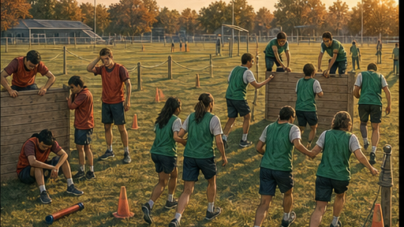
RC3 • LIFE IN CHRIST
FOUND
SESSION 4
THE TWO
ADAMS
Two Humanities, Two Allegiances,
Two Destinies
Fireproof Studies • James J. Burke
Notes:
Introduce the lesson's controlling contrast: Scripture tells the human story through two representative heads, Adam and Christ. The team-captain illustration is an analogy only.
[Sources]
- /Volumes/T7 Shield/neocities-fireprooofcommentaries/rc3/09_Youth_Resources/Found/Leader_Guides/RC3-Found-Leader-04-TheTwoAdams.pdf
- /Volumes/T7 Shield/neocities-fireprooofcommentaries/rc3/09_Youth_Resources/Found/Video_Plans/Session_04_Assets/Found-04-Two-Team-Captains-Storyboard-v1.png

Slide 2
OPENING ACTIVITY
Trace the two lines
As the lesson unfolds, listen for where each line begins—and where it ends.
ADAM
CHRIST
1
receives, then seizes
1
receives and obeys
2
self-rule
2
faithful dependence
3
rebellion reigns
3
grace reigns
4
death
4
resurrection life
Two lines. Two humanities. Two futures.
FOUND • SESSION 4
02
Notes:
Draw two columns or ask students to follow the contrasts verbally. Do not treat this as a contest between equal captains; Christ is the obedient Son and risen Lord.
[Sources]
- /Volumes/T7 Shield/neocities-fireprooofcommentaries/rc3/09_Youth_Resources/Found/Leader_Guides/RC3-Found-Leader-04-TheTwoAdams.pdf

Slide 3
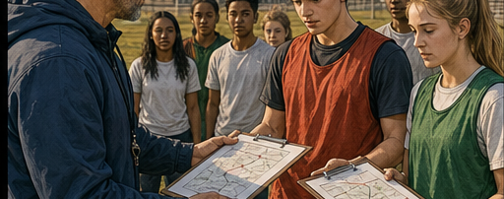
THE SAME TRUST
Both captains receive a task.
What they do with it shapes everyone who follows.
FOUND • SESSION 4
03
Notes:
The coach gives both captains a map and responsibility. The analogy helps students see how a leader's allegiance and action can establish a culture for those who follow.
[Sources]
- /Volumes/T7 Shield/neocities-fireprooofcommentaries/rc3/09_Youth_Resources/Found/Video_Plans/Found-04-Illustrative-Video-Plan.md
- /Volumes/T7 Shield/neocities-fireprooofcommentaries/rc3/09_Youth_Resources/Found/Video_Plans/Session_04_Assets/Found-04-Two-Team-Captains-Storyboard-v1.png

Slide 4

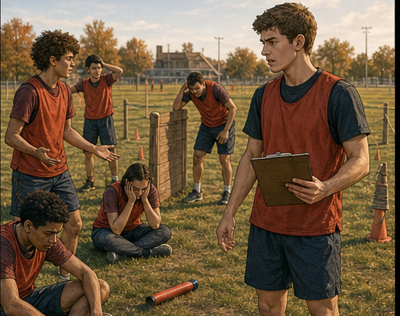
SEIZES
FRACTURES
A captain's self-rule becomes a team's culture.
FOUND • SESSION 4
04
Notes:
Captain A treats entrusted authority as possession. Control, blame, rivalry, and collapse follow. This illustrates culture, not a mechanical transfer of personal guilt.
[Sources]
- /Volumes/T7 Shield/neocities-fireprooofcommentaries/rc3/09_Youth_Resources/Found/Video_Plans/Found-04-Illustrative-Video-Plan.md
- /Volumes/T7 Shield/neocities-fireprooofcommentaries/rc3/09_Youth_Resources/Found/Video_Plans/Session_04_Assets/Found-04-Two-Team-Captains-Storyboard-v1.png
- /Volumes/T7 Shield/neocities-fireprooofcommentaries/rc3/09_Youth_Resources/Found/Leader_Guides/RC3-Found-Leader-04-TheTwoAdams.pdf

Slide 5


RECEIVES
SERVES
Faithful dependence becomes a team's culture too.
FOUND • SESSION 4
05
Notes:
Captain B listens, receives the task, and leads through service. Cooperation and shared victory follow. Use the contrast to prepare for Adam and Christ without equating either student with them.
[Sources]
- /Volumes/T7 Shield/neocities-fireprooofcommentaries/rc3/09_Youth_Resources/Found/Video_Plans/Found-04-Illustrative-Video-Plan.md
- /Volumes/T7 Shield/neocities-fireprooofcommentaries/rc3/09_Youth_Resources/Found/Video_Plans/Session_04_Assets/Found-04-Two-Team-Captains-Storyboard-v1.png

Slide 6

BIG IDEA
The Bible tells the human story
through two men.
Adam begins the old humanity.
Christ begins the new.
Adam's line ends in death. Those joined to Christ share His resurrection life and future.
FOUND • SESSION 4
06
Notes:
State the big idea. Clarify that 'in Christ' describes those joined to Him; the comparison does not teach universal salvation.
[Sources]
- /Volumes/T7 Shield/neocities-fireprooofcommentaries/rc3/09_Youth_Resources/Found/Leader_Guides/RC3-Found-Leader-04-TheTwoAdams.pdf
- /Volumes/T7 Shield/neocities-fireprooofcommentaries/rc3/09_Youth_Resources/Found/Student_Handouts/RC3-Found-Handout-04-TheTwoAdams.pdf

Slide 7
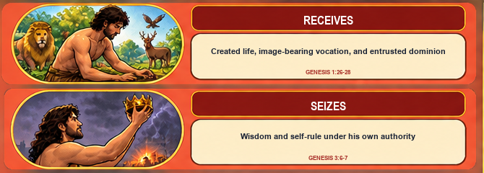
THE FIRST ADAM
Adam received—and then seized.
He received created life, an image-bearing vocation, and entrusted dominion. He seized wisdom and self-rule under his own authority.
FOUND • SESSION 4
07
Notes:
Genesis presents Adam as a creature who receives life and vocation from God. His rebellion is an attempt to possess wisdom and rule autonomously.
[Sources]
- /Volumes/T7 Shield/neocities-fireprooofcommentaries/rc3/09_Youth_Resources/Found/Leader_Guides/RC3-Found-Leader-04-TheTwoAdams.pdf
- /Volumes/T7 Shield/neocities-fireprooofcommentaries/rc3/09_Youth_Resources/Found/Visual_Theology/Found-04-Visual-Theology.png

Slide 8
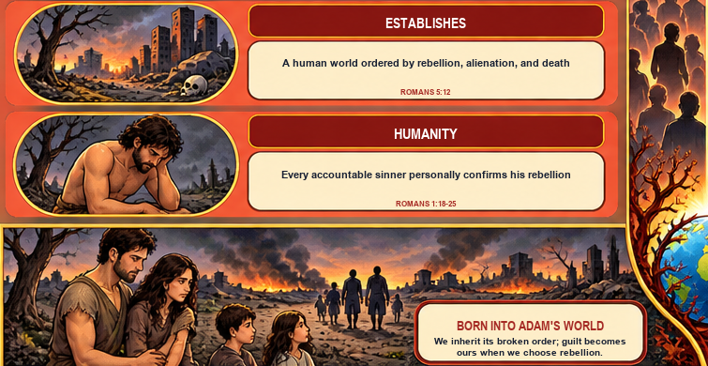
ROMANS 5:12-21
Adam begins the old humanity
We inherit his broken order; guilt becomes ours when we choose rebellion.
FOUND • SESSION 4
08
Notes:
Use precise language. Adam establishes a human world ordered by rebellion, alienation, and death. Every accountable sinner personally confirms that rebellion. Do not describe Adam's private guilt as mechanically transferred.
[Sources]
- /Volumes/T7 Shield/neocities-fireprooofcommentaries/rc3/09_Youth_Resources/Found/Leader_Guides/RC3-Found-Leader-04-TheTwoAdams.pdf
- /Volumes/T7 Shield/neocities-fireprooofcommentaries/rc3/09_Youth_Resources/Found/Student_Handouts/RC3-Found-Handout-04-TheTwoAdams.pdf
- /Volumes/T7 Shield/neocities-fireprooofcommentaries/rc3/09_Youth_Resources/Found/Visual_Theology/Found-04-Visual-Theology.png

Slide 9
THE LAST ADAM
Christ fulfills the
human vocation.
1
2
3
4
RECEIVES
OBEYS
SERVES
IS EXALTED
from the Father
even unto death
rather than seizes
as the risen Lord
Philippians 2:5-11
FOUND • SESSION 4
09
Notes:
Christ does what Adam failed to do. He lives in faithful dependence, obeys the Father, serves unto death, and is exalted. His obedience is not merely an example; it establishes the new humanity in Him.
[Sources]
- /Volumes/T7 Shield/neocities-fireprooofcommentaries/rc3/09_Youth_Resources/Found/Leader_Guides/RC3-Found-Leader-04-TheTwoAdams.pdf

Slide 10
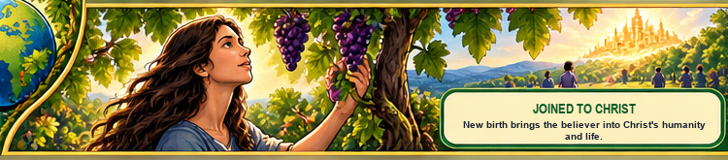
1 CORINTHIANS 15:20-49
Christ begins the new humanity
The last Adam does not repair Adam's humanity.
He begins another humanity in Himself.
Natural birth places us in Adam's world. New birth brings the believer into Christ.
FOUND • SESSION 4
10
Notes:
Make the newness explicit. Salvation is not the successful renovation of the old humanity. By new birth, believers are joined to Christ and share His life.
[Sources]
- /Volumes/T7 Shield/neocities-fireprooofcommentaries/rc3/09_Youth_Resources/Found/Leader_Guides/RC3-Found-Leader-04-TheTwoAdams.pdf
- /Volumes/T7 Shield/neocities-fireprooofcommentaries/rc3/09_Youth_Resources/Found/Student_Handouts/RC3-Found-Handout-04-TheTwoAdams.pdf
- /Volumes/T7 Shield/neocities-fireprooofcommentaries/rc3/09_Youth_Resources/Found/Visual_Theology/Found-04-Visual-Theology.png

Slide 11
TWO HUMANITIES
Two heads. Two orders. Two futures.
IN ADAM
IN CHRIST
ALLEGIANCE
self-rule
ALLEGIANCE
obedient dependence
ORDER
rebellion reigns
ORDER
grace reigns
HUMANITY
the old
HUMANITY
the new
FUTURE
inevitable death
FUTURE
resurrection life
These are not merely two examples. They are two human orders.
FOUND • SESSION 4
11
Notes:
Walk line by line through the comparison. Keep the categories relational and historical: allegiance, reigning order, humanity, and future.
[Sources]
- /Volumes/T7 Shield/neocities-fireprooofcommentaries/rc3/09_Youth_Resources/Found/Leader_Guides/RC3-Found-Leader-04-TheTwoAdams.pdf
- /Volumes/T7 Shield/neocities-fireprooofcommentaries/rc3/09_Youth_Resources/Found/Student_Handouts/RC3-Found-Handout-04-TheTwoAdams.pdf

Slide 12

RESURRECTION CHANGES THE FUTURE
Christ is not simply
a better beginning.
He is the risen beginning
of a new humanity.
Those in Christ share His life now and await resurrection life in fullness.
1 Corinthians 15:20-23
FOUND • SESSION 4
12
Notes:
Christ's resurrection is the firstfruits and guarantee of the future of those who belong to Him. Do not flatten 'all' into universal salvation; Paul's two humanities are defined by relation to Adam and to Christ.
[Sources]
- /Volumes/T7 Shield/neocities-fireprooofcommentaries/rc3/09_Youth_Resources/Found/Leader_Guides/RC3-Found-Leader-04-TheTwoAdams.pdf
- /Volumes/T7 Shield/neocities-fireprooofcommentaries/rc3/09_Youth_Resources/Found/Student_Handouts/RC3-Found-Handout-04-TheTwoAdams.pdf
- /Volumes/T7 Shield/neocities-fireprooofcommentaries/rc3/09_Youth_Resources/Found/Visual_Theology/Found-04-Visual-Theology.png

Slide 13
DISCUSSION
Let's think it through
1
What did Adam receive before he seized?
2
How does a leader's allegiance shape a people?
3
What did Christ do that Adam failed to do?
4
Why is new birth more than self-improvement?
5
What future belongs to those who are in Christ?
Which line describes your allegiance and future?
FOUND • SESSION 4
13
Notes:
Invite students to connect the categories without pressuring a public response. Use the leader-guide follow-ups to clarify representative headship, personal rebellion, union with Christ, and resurrection.
[Sources]
- /Volumes/T7 Shield/neocities-fireprooofcommentaries/rc3/09_Youth_Resources/Found/Leader_Guides/RC3-Found-Leader-04-TheTwoAdams.pdf

Slide 14
MEMORY VERSE • 1 CORINTHIANS 15:22
“For as in Adam all die, even so in Christ
shall all be made alive.”
The question is not only, “What do I imitate?” but, “To whom do I belong?”
THIS WEEK
YOU MAY TALK WITH US
Notice moments when you seize control. Practice receiving God's Word and obeying in faithful dependence.
If you want to understand what it means to belong to Christ, a leader will privately open Scripture with you. The sinner believes; the Spirit gives life.
FOUND • SESSION 4
14
Notes:
Read the memory verse together. Clarify that 'in Christ' names those united to Him, not every person without distinction. Offer private conversation, preserving the curriculum's order: the sinner believes; the Spirit gives life.
[Sources]
- /Volumes/T7 Shield/neocities-fireprooofcommentaries/rc3/09_Youth_Resources/Found/Leader_Guides/RC3-Found-Leader-04-TheTwoAdams.pdf
- /Volumes/T7 Shield/neocities-fireprooofcommentaries/rc3/09_Youth_Resources/Found/Student_Handouts/RC3-Found-Handout-04-TheTwoAdams.pdf

