Slide 1
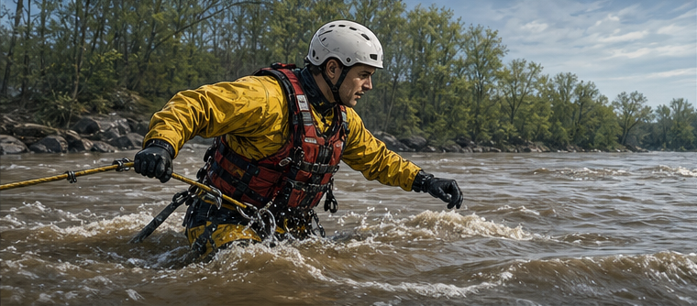
RC3 • LIFE IN CHRIST
FOUND
SESSION 5
WHO IS
JESUS CHRIST?
The Son of God Who Became
the Faithful Human
Fireproof Studies • James J. Burke
Notes:
Introduce the central question. The illustration asks what kind of rescuer could reach humanity; Scripture supplies the answer. The pictured rescuer is an ordinary professional, not a depiction of Jesus.
[Sources]
- /Volumes/T7 Shield/neocities-fireprooofcommentaries/rc3/09_Youth_Resources/Found/Leader_Guides/RC3-Found-Leader-05-WhoIsJesusChrist.pdf
- /Volumes/T7 Shield/neocities-fireprooofcommentaries/rc3/09_Youth_Resources/Found/Video_Plans/Session_05_Assets/Found-05-Who-Must-the-Rescuer-Be-Storyboard-v1.png

Slide 2
OPENING QUESTION
Who must the Rescuer be?
Humanity is separated from its Creator. Name what a true Savior must be able to do.
1
2
3
4
REVEAL GOD
ENTER HUMAN LIFE
FULFILL OUR CALLING
PASS THROUGH DEATH
without distortion
truly—not as an appearance
without self-rule
and bring humanity through
A merely human teacher cannot reveal the Father perfectly or give resurrection life.
A distant appearance would not truly become human, obey, suffer, or die as man.
FOUND • SESSION 5
02
Notes:
Draw GOD on one side and HUMANITY on the other. Let students name what is required. Reject the two wrong answers: a merely human teacher and a distant divine appearance.
[Sources]
- /Volumes/T7 Shield/neocities-fireprooofcommentaries/rc3/09_Youth_Resources/Found/Leader_Guides/RC3-Found-Leader-05-WhoIsJesusChrist.pdf
- /Volumes/T7 Shield/neocities-fireprooofcommentaries/rc3/09_Youth_Resources/Found/Student_Handouts/RC3-Found-Handout-05-WhoIsJesusChrist.pdf

Slide 3
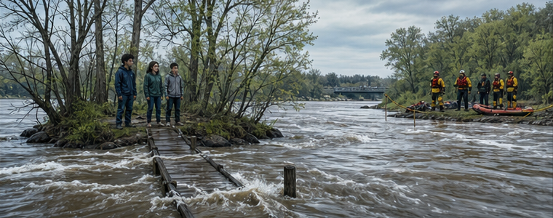
THE DIVIDE IS REAL
The stranded cannot create a safe path
back to the shore.
FOUND • SESSION 5
03
Notes:
Let the flooded divide establish the problem. The students can see safety but cannot manufacture a path to it.
[Sources]
- /Volumes/T7 Shield/neocities-fireprooofcommentaries/rc3/09_Youth_Resources/Found/Video_Plans/Found-05-Illustrative-Video-Plan.md
- /Volumes/T7 Shield/neocities-fireprooofcommentaries/rc3/09_Youth_Resources/Found/Video_Plans/Session_05_Assets/Found-05-Who-Must-the-Rescuer-Be-Storyboard-v1.png

Slide 4
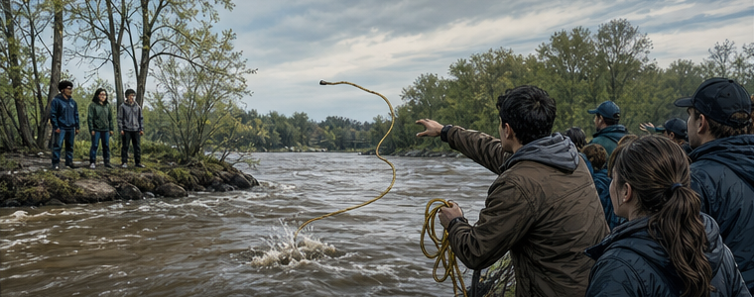
GOOD INTENTIONS ARE NOT ENOUGH
Advice from safety cannot rescue someone
whose danger you never enter.
FOUND • SESSION 5
04
Notes:
The failed rope represents every insufficient answer. A created helper or merely human teacher cannot cross the full divide or give resurrection life.
[Sources]
- /Volumes/T7 Shield/neocities-fireprooofcommentaries/rc3/09_Youth_Resources/Found/Video_Plans/Found-05-Illustrative-Video-Plan.md
- /Volumes/T7 Shield/neocities-fireprooofcommentaries/rc3/09_Youth_Resources/Found/Video_Plans/Session_05_Assets/Found-05-Who-Must-the-Rescuer-Be-Storyboard-v1.png
- /Volumes/T7 Shield/neocities-fireprooofcommentaries/rc3/09_Youth_Resources/Found/Leader_Guides/RC3-Found-Leader-05-WhoIsJesusChrist.pdf

Slide 5


FROM SAFETY
ENTERS THE DANGER
BRINGS THEM THROUGH
The Rescuer comes from the safe side—and truly enters theirs.
FOUND • SESSION 5
05
Notes:
This is an analogy, not an explanation of the incarnation. The point is the question it creates: who can come from God, truly enter our humanity, and bring humanity through?
[Sources]
- /Volumes/T7 Shield/neocities-fireprooofcommentaries/rc3/09_Youth_Resources/Found/Video_Plans/Found-05-Illustrative-Video-Plan.md
- /Volumes/T7 Shield/neocities-fireprooofcommentaries/rc3/09_Youth_Resources/Found/Video_Plans/Session_05_Assets/Found-05-Who-Must-the-Rescuer-Be-Storyboard-v1.png

Slide 6

BIG IDEA
Jesus is the eternal Son
who truly became human.
He revealed the Father, obeyed where Adam rebelled, and alone can bring humanity to its appointed end.
The One who saves is truly God the Son and truly one of us.
FOUND • SESSION 5
06
Notes:
State the session's controlling claim. Keep the Person central: Jesus is not a created helper or an idea but the eternal Son who became flesh.
[Sources]
- /Volumes/T7 Shield/neocities-fireprooofcommentaries/rc3/09_Youth_Resources/Found/Leader_Guides/RC3-Found-Leader-05-WhoIsJesusChrist.pdf
- /Volumes/T7 Shield/neocities-fireprooofcommentaries/rc3/09_Youth_Resources/Found/Student_Handouts/RC3-Found-Handout-05-WhoIsJesusChrist.pdf

Slide 7

JOHN 1:1-3
He is the
eternal Son.
Before creation, the Word already was.
He was with God—and was God.
Everything that came into being came through Him.
THE SAVIOR IS THE CREATOR—NOT A CREATED HELPER.
FOUND • SESSION 5
07
Notes:
John begins before creation. The Word is not part of the creation He came to save. He is the eternal Son and Creator.
[Sources]
- /Volumes/T7 Shield/neocities-fireprooofcommentaries/rc3/09_Youth_Resources/Found/Leader_Guides/RC3-Found-Leader-05-WhoIsJesusChrist.pdf
- /Volumes/T7 Shield/neocities-fireprooofcommentaries/rc3/09_Youth_Resources/Found/Student_Handouts/RC3-Found-Handout-05-WhoIsJesusChrist.pdf
- /Volumes/T7 Shield/neocities-fireprooofcommentaries/rc3/09_Youth_Resources/Found/Visual_Theology/Found-05-Visual-Theology.png

Slide 8
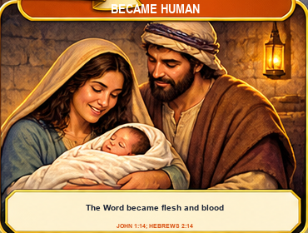
JOHN 1:14 • HEBREWS 2:14
He truly became human
The Word became flesh.
The eternal Son took to Himself a true and complete human nature:
•
embodied
•
dependent
•
tempted without sin
•
mortal
•
capable of bodily death
He did not cease to be God or merely appear human.
FOUND • SESSION 5
08
Notes:
Teach true incarnation. The Son assumed a complete human nature and entered real mortal life. Avoid saying divinity changed into humanity or that He merely wore a human body.
[Sources]
- /Volumes/T7 Shield/neocities-fireprooofcommentaries/rc3/09_Youth_Resources/Found/Leader_Guides/RC3-Found-Leader-05-WhoIsJesusChrist.pdf
- /Volumes/T7 Shield/neocities-fireprooofcommentaries/rc3/09_Youth_Resources/Found/Student_Handouts/RC3-Found-Handout-05-WhoIsJesusChrist.pdf
- /Volumes/T7 Shield/neocities-fireprooofcommentaries/rc3/09_Youth_Resources/Found/Visual_Theology/Found-05-Visual-Theology.png

Slide 9
JOHN 1:18 • COLOSSIANS 1:15-20
He reveals the Father.
Jesus does not merely offer ideas about God.
The eternal Image makes the invisible God known in His character, words, works, and faithful human life.
TO SEE THE SON IS TO KNOW WHAT THE FATHER IS LIKE.
FOUND • SESSION 5
09
Notes:
The Son reveals the Father because He is the eternal Image, not merely a religious teacher. His revelation includes His faithful humanity.
[Sources]
- /Volumes/T7 Shield/neocities-fireprooofcommentaries/rc3/09_Youth_Resources/Found/Leader_Guides/RC3-Found-Leader-05-WhoIsJesusChrist.pdf
- /Volumes/T7 Shield/neocities-fireprooofcommentaries/rc3/09_Youth_Resources/Found/Student_Handouts/RC3-Found-Handout-05-WhoIsJesusChrist.pdf

Slide 10
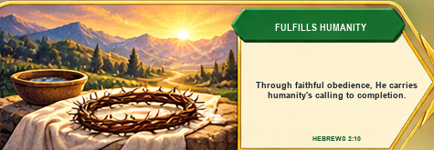
HEBREWS 2:5-18
He is the faithful human Son
He entered Adam's mortal humanity without joining Adam's rebellion.
FOUND • SESSION 5
10
Notes:
Jesus lived embodied dependence, suffered, died, and became the merciful and faithful high priest. His sinlessness is humanity's faithfulness perfected, not a lack of humanity. His obedience establishes; ours follows as fruit.
[Sources]
- /Volumes/T7 Shield/neocities-fireprooofcommentaries/rc3/09_Youth_Resources/Found/Leader_Guides/RC3-Found-Leader-05-WhoIsJesusChrist.pdf
- /Volumes/T7 Shield/neocities-fireprooofcommentaries/rc3/09_Youth_Resources/Found/Student_Handouts/RC3-Found-Handout-05-WhoIsJesusChrist.pdf
- /Volumes/T7 Shield/neocities-fireprooofcommentaries/rc3/09_Youth_Resources/Found/Visual_Theology/Found-05-Visual-Theology.png

Slide 11
ONE PERSON • TWO NATURES
Fully God and truly human
FULLY GOD
TRULY HUMAN
•
eternal Son
•
flesh and blood
•
Creator
•
dependent life
•
life in Himself
•
tempted without sin
•
true Image
•
able to suffer and die
ONE PERSON—WITHOUT CONFUSION OR DIVISION.
FOUND • SESSION 5
11
Notes:
Keep one Person central. Do not describe Jesus as half God and half man, a human body worn by God, or a created Son promoted to deity. Do not mix or divide the natures. His divine nature did not become mortal; He truly died in His humanity.
[Sources]
- /Volumes/T7 Shield/neocities-fireprooofcommentaries/rc3/09_Youth_Resources/Found/Leader_Guides/RC3-Found-Leader-05-WhoIsJesusChrist.pdf
- /Volumes/T7 Shield/neocities-fireprooofcommentaries/rc3/09_Youth_Resources/Found/Student_Handouts/RC3-Found-Handout-05-WhoIsJesusChrist.pdf

Slide 12

ENTERS THEIR CONDITION
BRINGS THEM THROUGH
The eternal Son entered Adam's mortal world
to redeem humanity from within.
FOUND • SESSION 5
12
Notes:
Return to the analogy only after the doctrine is clear. Jesus is not simply standing at a distance offering advice. The eternal Son truly entered our condition, fulfilled humanity's calling, suffered, died, and brings His people through.
[Sources]
- /Volumes/T7 Shield/neocities-fireprooofcommentaries/rc3/09_Youth_Resources/Found/Leader_Guides/RC3-Found-Leader-05-WhoIsJesusChrist.pdf
- /Volumes/T7 Shield/neocities-fireprooofcommentaries/rc3/09_Youth_Resources/Found/Video_Plans/Found-05-Illustrative-Video-Plan.md
- /Volumes/T7 Shield/neocities-fireprooofcommentaries/rc3/09_Youth_Resources/Found/Video_Plans/Session_05_Assets/Found-05-Who-Must-the-Rescuer-Be-Storyboard-v1.png

Slide 13
DISCUSSION
Let's think it through
1
What does John 1 say Jesus was before creation?
2
What does it mean that the Word became flesh?
3
How does Jesus reveal the Father?
4
Why must the Savior be truly human?
5
Why does His sinlessness make Him fully faithful—not less human?
Do I trust this Person—or merely admire His ideas?
FOUND • SESSION 5
13
Notes:
Use the follow-up questions in the leader guide. Keep the discussion personal but unpressured: Christian faith is trust in this Person, not admiration of an idea.
[Sources]
- /Volumes/T7 Shield/neocities-fireprooofcommentaries/rc3/09_Youth_Resources/Found/Leader_Guides/RC3-Found-Leader-05-WhoIsJesusChrist.pdf

Slide 14
MEMORY VERSE • JOHN 1:14a
“And the Word was made flesh,
and dwelt among us...”
The One who saves is truly God the Son and truly one of us.
THIS WEEK
YOU MAY TALK WITH US
Read one Gospel scene. Notice what Jesus reveals about the Father and about faithful human life.
Christian faith is trust in this Person. If you are unsure who Jesus is or whether you belong to Him, ask a leader to talk privately.
FOUND • SESSION 5
14
Notes:
Read the verse together. Invite a week of attentive Gospel reading and offer private conversation. Do not manufacture a decision or imply that emotion proves conversion. If discussing new life, preserve the order: the sinner believes; the Spirit gives life.
[Sources]
- /Volumes/T7 Shield/neocities-fireprooofcommentaries/rc3/09_Youth_Resources/Found/Leader_Guides/RC3-Found-Leader-05-WhoIsJesusChrist.pdf
- /Volumes/T7 Shield/neocities-fireprooofcommentaries/rc3/09_Youth_Resources/Found/Student_Handouts/RC3-Found-Handout-05-WhoIsJesusChrist.pdf

