Slide 1
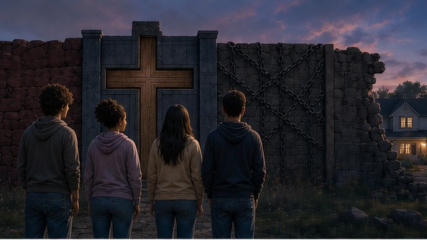
RC3 • LIFE IN CHRIST
FOUND
SESSION 6
WHY DID JESUS
GIVE HIMSELF
FOR US?
The Cross and Everything Standing
Between Us and God
Fireproof Studies • James J. Burke
Notes:
Open with the main question. The wall and doorway are symbolic; the lesson will explain what Christ accomplished through the cross.
[Sources]
- /Volumes/T7 Shield/neocities-fireprooofcommentaries/rc3/09_Youth_Resources/Found/Leader_Guides/RC3-Found-Leader-06-WhyDidJesusGiveHimself.pdf
- /Volumes/T7 Shield/neocities-fireprooofcommentaries/rc3/09_Youth_Resources/Found/Video_Plans/Session_06_Assets/Found-06-Barrier-Wall-Storyboard-v1.png

Slide 2
OPENING ACTIVITY
What stands between us?
Name each barrier—and what would have to happen for it to be removed.
1
2
3
4
GUILT
JUDGMENT
BONDAGE
ESTRANGEMENT
must be removed
must be borne
captives reclaimed
peace established
The cross answers every barrier toward one end: to bring us to God.
1 Peter 3:18
FOUND • SESSION 6
02
Notes:
Draw GOD and SINNERS on opposite sides with a wide barrier. Review guilt, judgment and death, estrangement, and bondage. Ask what each requires.
[Sources]
- /Volumes/T7 Shield/neocities-fireprooofcommentaries/rc3/09_Youth_Resources/Found/Leader_Guides/RC3-Found-Leader-06-WhyDidJesusGiveHimself.pdf
- /Volumes/T7 Shield/neocities-fireprooofcommentaries/rc3/09_Youth_Resources/Found/Student_Handouts/RC3-Found-Handout-06-WhyDidJesusGiveHimself.pdf

Slide 3
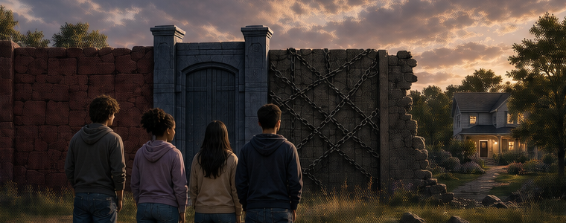
THE BARRIER IS REAL
Guilt, judgment, bondage, and estrangement
are not imaginary problems.
FOUND • SESSION 6
03
Notes:
Let the wall make the problem concrete. The barriers correspond to real dimensions of sin's condition before God.
[Sources]
- /Volumes/T7 Shield/neocities-fireprooofcommentaries/rc3/09_Youth_Resources/Found/Video_Plans/Found-06-Illustrative-Video-Plan.md
- /Volumes/T7 Shield/neocities-fireprooofcommentaries/rc3/09_Youth_Resources/Found/Video_Plans/Session_06_Assets/Found-06-Barrier-Wall-Storyboard-v1.png
- /Volumes/T7 Shield/neocities-fireprooofcommentaries/rc3/09_Youth_Resources/Found/Leader_Guides/RC3-Found-Leader-06-WhyDidJesusGiveHimself.pdf

Slide 4
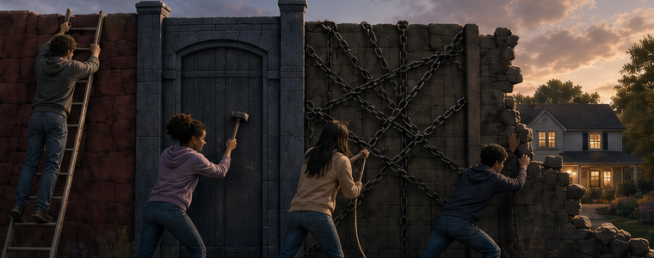
SELF-RESCUE FAILS
No human effort can erase guilt, answer judgment,
break bondage, and establish peace with God.
FOUND • SESSION 6
04
Notes:
Ordinary tools are unequal to these tasks. The cross is not one helpful technique among others; it is God's saving action in Christ.
[Sources]
- /Volumes/T7 Shield/neocities-fireprooofcommentaries/rc3/09_Youth_Resources/Found/Video_Plans/Found-06-Illustrative-Video-Plan.md
- /Volumes/T7 Shield/neocities-fireprooofcommentaries/rc3/09_Youth_Resources/Found/Video_Plans/Session_06_Assets/Found-06-Barrier-Wall-Storyboard-v1.png
- /Volumes/T7 Shield/neocities-fireprooofcommentaries/rc3/09_Youth_Resources/Found/Leader_Guides/RC3-Found-Leader-06-WhyDidJesusGiveHimself.pdf

Slide 5

ONE WAY THROUGH
The just One gave Himself for the unjust
in order to bring us to God.
FOUND • SESSION 6
05
Notes:
Read 1 Peter 3:18. Circle 'the just for the unjust' and underline 'that he might bring us to God.' The purpose controls every dimension of the lesson.
[Sources]
- /Volumes/T7 Shield/neocities-fireprooofcommentaries/rc3/09_Youth_Resources/Found/Leader_Guides/RC3-Found-Leader-06-WhyDidJesusGiveHimself.pdf
- /Volumes/T7 Shield/neocities-fireprooofcommentaries/rc3/09_Youth_Resources/Found/Student_Handouts/RC3-Found-Handout-06-WhyDidJesusGiveHimself.pdf
- /Volumes/T7 Shield/neocities-fireprooofcommentaries/rc3/09_Youth_Resources/Found/Video_Plans/Session_06_Assets/Found-06-Barrier-Wall-Storyboard-v1.png

Slide 6

BIG IDEA
The cross is one coherent
saving accomplishment.
Substitution, sacrifice, propitiation, redemption, reconciliation, and atonement describe complementary dimensions of the same saving act.
One cross. One saving purpose. One goal: communion with God in Christ.
FOUND • SESSION 6
06
Notes:
Do not present the terms as competing theories or detachable benefits. They belong together within the Father's and Son's united saving purpose.
[Sources]
- /Volumes/T7 Shield/neocities-fireprooofcommentaries/rc3/09_Youth_Resources/Found/Leader_Guides/RC3-Found-Leader-06-WhyDidJesusGiveHimself.pdf
- /Volumes/T7 Shield/neocities-fireprooofcommentaries/rc3/09_Youth_Resources/Found/Student_Handouts/RC3-Found-Handout-06-WhyDidJesusGiveHimself.pdf

Slide 7
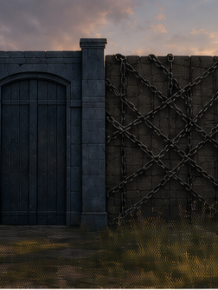
1 PETER 3:18
Christ willingly stands
for sinners.
SUBSTITUTION
The just One stands for the unjust.
SACRIFICE
The obedient Son willingly gives Himself.
PERSONAL • WILLING • PURPOSEFUL
FOUND • SESSION 6
07
Notes:
Christ is not a third party forced into another's dispute. The obedient Son acts with the Father to save. Substitution is personal, willing, and purposeful.
[Sources]
- /Volumes/T7 Shield/neocities-fireprooofcommentaries/rc3/09_Youth_Resources/Found/Leader_Guides/RC3-Found-Leader-06-WhyDidJesusGiveHimself.pdf
- /Volumes/T7 Shield/neocities-fireprooofcommentaries/rc3/09_Youth_Resources/Found/Student_Handouts/RC3-Found-Handout-06-WhyDidJesusGiveHimself.pdf

Slide 8
ROMANS 3:21-26
Christ bears judgment.
God's wrath is His holy opposition to rebellion—not uncontrolled temper.
The sinless Son bears judgment for sinners and answers God's righteous wrath.
PENAL SUBSTITUTION IS SUBSTITUTION UNTO PROPITIATION.
FOUND • SESSION 6
08
Notes:
Distinguish wrath from human temper. Propitiation names righteous judgment answered through the willing, sinless substitute. Do not portray the Father as hostile and the Son as loving.
[Sources]
- /Volumes/T7 Shield/neocities-fireprooofcommentaries/rc3/09_Youth_Resources/Found/Leader_Guides/RC3-Found-Leader-06-WhyDidJesusGiveHimself.pdf
- /Volumes/T7 Shield/neocities-fireprooofcommentaries/rc3/09_Youth_Resources/Found/Student_Handouts/RC3-Found-Handout-06-WhyDidJesusGiveHimself.pdf

Slide 9
THE SAME CROSS REMOVES CLAIMS
Guilt forgiven. Captives reclaimed.
FORGIVENESS
REDEMPTION
The claim of guilt is removed.
Those under bondage are reclaimed.
Christ's saving work answers the truth of our guilt without pretending rebellion never mattered.
The cross does not merely improve captives. Christ purchases freedom and reclaims those held under sin's rule.
These are complementary results of the same cross.
FOUND • SESSION 6
09
Notes:
Forgiveness removes guilt's claim; redemption reclaims those under bondage. Keep both tied to the one work of Christ.
[Sources]
- /Volumes/T7 Shield/neocities-fireprooofcommentaries/rc3/09_Youth_Resources/Found/Leader_Guides/RC3-Found-Leader-06-WhyDidJesusGiveHimself.pdf
- /Volumes/T7 Shield/neocities-fireprooofcommentaries/rc3/09_Youth_Resources/Found/Student_Handouts/RC3-Found-Handout-06-WhyDidJesusGiveHimself.pdf

Slide 10
RECONCILIATION
Christ makes peace with God
Reconciliation is more than a truce.
It establishes real peace and a restored relationship with God.
Enemies are not merely left alone. In Christ, they are brought near.
Ephesians 1:7 • Romans 5:1
FOUND • SESSION 6
10
Notes:
Reconciliation establishes actual peace and restored relationship, not a temporary ceasefire. This is another result of the same saving work.
[Sources]
- /Volumes/T7 Shield/neocities-fireprooofcommentaries/rc3/09_Youth_Resources/Found/Leader_Guides/RC3-Found-Leader-06-WhyDidJesusGiveHimself.pdf
- /Volumes/T7 Shield/neocities-fireprooofcommentaries/rc3/09_Youth_Resources/Found/Student_Handouts/RC3-Found-Handout-06-WhyDidJesusGiveHimself.pdf

Slide 11

ATONEMENT
The cross removes every obstacle
so that Christ may bring us to God in Him.
FOUND • SESSION 6
11
Notes:
Atonement is the uniting work of Christ. It does not distribute detached benefits; it removes every obstacle so those who trust Christ share life with God in Him. Communion in Christ is the goal.
[Sources]
- /Volumes/T7 Shield/neocities-fireprooofcommentaries/rc3/09_Youth_Resources/Found/Leader_Guides/RC3-Found-Leader-06-WhyDidJesusGiveHimself.pdf
- /Volumes/T7 Shield/neocities-fireprooofcommentaries/rc3/09_Youth_Resources/Found/Student_Handouts/RC3-Found-Handout-06-WhyDidJesusGiveHimself.pdf
- /Volumes/T7 Shield/neocities-fireprooofcommentaries/rc3/09_Youth_Resources/Found/Video_Plans/Session_06_Assets/Found-06-Barrier-Wall-Storyboard-v1.png

Slide 12
ONE CROSS • MANY DIMENSIONS
The terms belong together
SUBSTITUTION
SACRIFICE
PROPITIATION
the just for the unjust
He gives Himself
judgment answered
REDEMPTION
RECONCILIATION
ATONEMENT
captives reclaimed
peace established
brought to God
One saving work • One united purpose • Communion with God in Christ
FOUND • SESSION 6
12
Notes:
Review all six terms rapidly. They describe the one cross from complementary angles. No division within the Trinity; no automatic universal reception; resurrection completes the saving work.
[Sources]
- /Volumes/T7 Shield/neocities-fireprooofcommentaries/rc3/09_Youth_Resources/Found/Leader_Guides/RC3-Found-Leader-06-WhyDidJesusGiveHimself.pdf
- /Volumes/T7 Shield/neocities-fireprooofcommentaries/rc3/09_Youth_Resources/Found/Student_Handouts/RC3-Found-Handout-06-WhyDidJesusGiveHimself.pdf
- /Volumes/T7 Shield/neocities-fireprooofcommentaries/rc3/09_Youth_Resources/Found/Visual_Theology/Found-06-Visual-Theology.png

Slide 13
DISCUSSION
Let's think it through
1
What does “the just for the unjust” mean?
2
Why is God's wrath not the same as human temper?
3
How do substitution and propitiation differ?
4
Why is reconciliation more than a truce?
5
What purpose does 1 Peter 3:18 name?
Do I want Christ Himself—or only the benefits He gives?
FOUND • SESSION 6
13
Notes:
Use the leader-guide follow-ups. Keep returning from individual terms to the unified saving purpose and the goal of communion with God in Christ.
[Sources]
- /Volumes/T7 Shield/neocities-fireprooofcommentaries/rc3/09_Youth_Resources/Found/Leader_Guides/RC3-Found-Leader-06-WhyDidJesusGiveHimself.pdf

Slide 14
MEMORY VERSE • 1 PETER 3:18a
“For Christ also hath once suffered for sins,
the just for the unjust, that he might bring us to God...”
The goal of the cross is not detached benefits—but God Himself in Christ.
THIS WEEK
YOU MAY TALK WITH US
Read Isaiah 53 and 1 Peter 3:18. List what Christ does—and the purpose for which He does it.
Saving faith entrusts the whole self to the crucified and risen Christ. If you are unsure whether you belong to Him, ask a leader privately.
FOUND • SESSION 6
14
Notes:
Read the memory verse together. Do not offer automatic reassurance or manufacture a decision. Point to the crucified and risen Christ and invite private conversation. Preserve the order: the sinner believes; the Spirit gives life.
[Sources]
- /Volumes/T7 Shield/neocities-fireprooofcommentaries/rc3/09_Youth_Resources/Found/Leader_Guides/RC3-Found-Leader-06-WhyDidJesusGiveHimself.pdf
- /Volumes/T7 Shield/neocities-fireprooofcommentaries/rc3/09_Youth_Resources/Found/Student_Handouts/RC3-Found-Handout-06-WhyDidJesusGiveHimself.pdf

