Slide 1
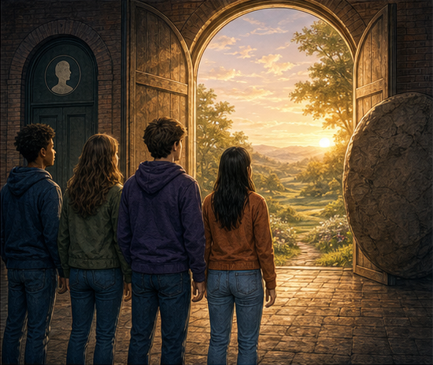
RC3 • LIFE IN CHRIST
FOUND
SESSION 7
RESURRECTION:
THE LIFE DEATH
CANNOT DEFEAT
Why a Dead Saviour Could Not Save Us
Fireproof Studies • James J. Burke
Notes:
Open with the central contrast: Christ did not merely return to mortal life. He rose bodily into transformed human life over which death has no dominion.
[Sources]
- /Volumes/T7 Shield/neocities-fireprooofcommentaries/rc3/09_Youth_Resources/Found/Leader_Guides/RC3-Found-Leader-07-Resurrection.pdf
- /Volumes/T7 Shield/neocities-fireprooofcommentaries/rc3/09_Youth_Resources/Found/Video_Plans/Session_07_Assets/Found-07-Forward-Not-Backward-Storyboard-v1.png

Slide 2
OPENING ACTIVITY
Three claims sound alike. They are not.
Ask what happens to the person—and what happens to the body.
1
2
3
SURVIVAL
RESUSCITATION
RESURRECTION
The person continues;
the body remains dead.
Mortal bodily life returns
and may die again.
The body is raised and
transformed beyond death.
Resurrection is not survival—and it is not a return to the old mortal condition.
FOUND • SESSION 7
02
Notes:
Write survival, resuscitation, and resurrection across the board. Ask students whether they describe the same thing. Define each carefully before moving forward.
[Sources]
- /Volumes/T7 Shield/neocities-fireprooofcommentaries/rc3/09_Youth_Resources/Found/Leader_Guides/RC3-Found-Leader-07-Resurrection.pdf
- /Volumes/T7 Shield/neocities-fireprooofcommentaries/rc3/09_Youth_Resources/Found/Student_Handouts/RC3-Found-Handout-07-Resurrection.pdf

Slide 3
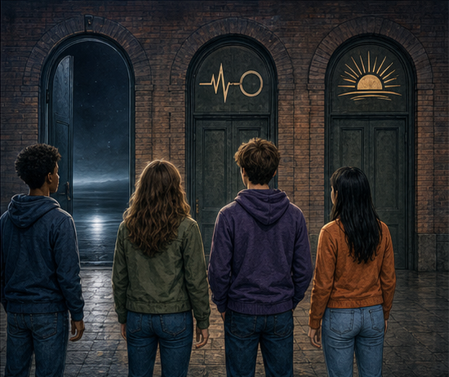
SURVIVAL
The person may continue—
but the body remains dead.
This is real, but it is not yet resurrection.
Christian hope is not merely that the soul survives. It includes the body Christ will raise.
SURVIVAL DOES NOT DEFEAT DEATH.
FOUND • SESSION 7
03
Notes:
Survival means the person continues after bodily death while the body remains dead. It must not be confused with the bodily hope announced by the Gospel.
[Sources]
- /Volumes/T7 Shield/neocities-fireprooofcommentaries/rc3/09_Youth_Resources/Found/Leader_Guides/RC3-Found-Leader-07-Resurrection.pdf
- /Volumes/T7 Shield/neocities-fireprooofcommentaries/rc3/09_Youth_Resources/Found/Video_Plans/Found-07-Illustrative-Video-Plan.md
- /Volumes/T7 Shield/neocities-fireprooofcommentaries/rc3/09_Youth_Resources/Found/Video_Plans/Session_07_Assets/Found-07-Forward-Not-Backward-Storyboard-v1.png

Slide 4
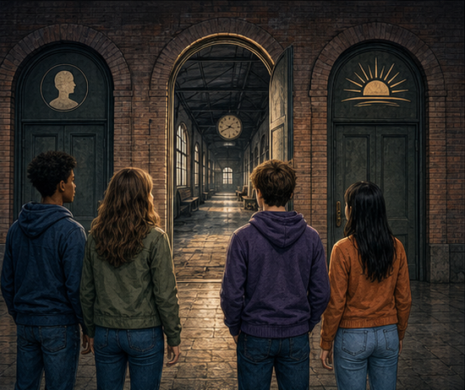
RESUSCITATION
Mortal bodily life returns—
and may die again.
Lazarus came back into ordinary mortal life.
Resuscitation moves backward into the old condition. Death still waits ahead.
BACK TO MORTAL LIFE
FOUND • SESSION 7
04
Notes:
Resuscitation is a real return to mortal bodily life, as with Lazarus, but it is not Christ's resurrection. The restored mortal body may die again.
[Sources]
- /Volumes/T7 Shield/neocities-fireprooofcommentaries/rc3/09_Youth_Resources/Found/Leader_Guides/RC3-Found-Leader-07-Resurrection.pdf
- /Volumes/T7 Shield/neocities-fireprooofcommentaries/rc3/09_Youth_Resources/Found/Student_Handouts/RC3-Found-Handout-07-Resurrection.pdf
- /Volumes/T7 Shield/neocities-fireprooofcommentaries/rc3/09_Youth_Resources/Found/Video_Plans/Session_07_Assets/Found-07-Forward-Not-Backward-Storyboard-v1.png

Slide 5
RESURRECTION
The body is raised—
and transformed beyond death.
Jesus moved forward into life death can never rule again.
Not a ghost. Not a symbol. Not a return to Adam's mortal condition.
FORWARD INTO INCORRUPTIBLE LIFE
FOUND • SESSION 7
05
Notes:
Resurrection moves forward, not backward. The same embodied Jesus who died was raised and transformed into human life over which death has no dominion.
[Sources]
- /Volumes/T7 Shield/neocities-fireprooofcommentaries/rc3/09_Youth_Resources/Found/Leader_Guides/RC3-Found-Leader-07-Resurrection.pdf
- /Volumes/T7 Shield/neocities-fireprooofcommentaries/rc3/09_Youth_Resources/Found/Student_Handouts/RC3-Found-Handout-07-Resurrection.pdf
- /Volumes/T7 Shield/neocities-fireprooofcommentaries/rc3/09_Youth_Resources/Found/Video_Plans/Session_07_Assets/Found-07-Forward-Not-Backward-Storyboard-v1.png

Slide 6

BIG IDEA
Christ rose bodily into
incorruptible human life.
Death has no dominion over Him.
He is the source, promise, and pattern of life for all who belong to Him.
Bodily • Transformed • Firstfruits • Living Saviour
FOUND • SESSION 7
06
Notes:
State the lesson's full claim. Christ rose bodily into incorruptible human life over which death has no dominion. He is the source, promise, and pattern of life for all who belong to Him.
[Sources]
- /Volumes/T7 Shield/neocities-fireprooofcommentaries/rc3/09_Youth_Resources/Found/Leader_Guides/RC3-Found-Leader-07-Resurrection.pdf
- /Volumes/T7 Shield/neocities-fireprooofcommentaries/rc3/09_Youth_Resources/Found/Student_Handouts/RC3-Found-Handout-07-Resurrection.pdf

Slide 7
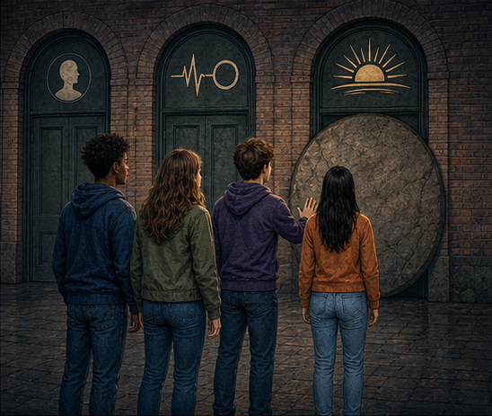
1 CORINTHIANS 15:3-8
The same embodied Jesus who died was raised.
TRULY DIED
The embodied Jesus entered death.
BODILY RAISED
The same Person was raised and seen alive.
Resurrection is not a private feeling, moral recovery, or vision of a dead teacher.
FOUND • SESSION 7
07
Notes:
The Gospel announces public events: Jesus died, was buried, rose the third day, and was seen alive. Resurrection is not a symbol of hope or the soul's survival.
[Sources]
- /Volumes/T7 Shield/neocities-fireprooofcommentaries/rc3/09_Youth_Resources/Found/Leader_Guides/RC3-Found-Leader-07-Resurrection.pdf
- /Volumes/T7 Shield/neocities-fireprooofcommentaries/rc3/09_Youth_Resources/Found/Student_Handouts/RC3-Found-Handout-07-Resurrection.pdf
- /Volumes/T7 Shield/neocities-fireprooofcommentaries/rc3/09_Youth_Resources/Found/Video_Plans/Session_07_Assets/Found-07-Forward-Not-Backward-Storyboard-v1.png

Slide 8
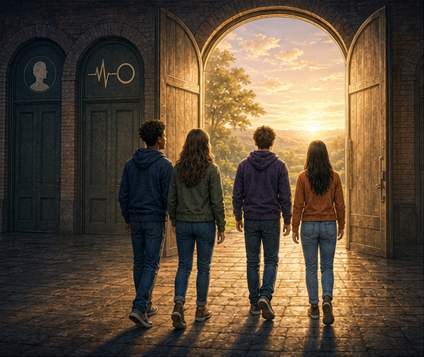
ROMANS 6:9
Death has no more
dominion over Him.
Christ did not return to ordinary mortal life.
He rose transformed and incorruptible. He will never die again.
NOT BACKWARD. FORWARD.
FOUND • SESSION 7
08
Notes:
Emphasize the direction of resurrection: not backward into ordinary mortal existence, but forward into transformed life death cannot reclaim.
[Sources]
- /Volumes/T7 Shield/neocities-fireprooofcommentaries/rc3/09_Youth_Resources/Found/Leader_Guides/RC3-Found-Leader-07-Resurrection.pdf
- /Volumes/T7 Shield/neocities-fireprooofcommentaries/rc3/09_Youth_Resources/Found/Student_Handouts/RC3-Found-Handout-07-Resurrection.pdf
- /Volumes/T7 Shield/neocities-fireprooofcommentaries/rc3/09_Youth_Resources/Found/Video_Plans/Session_07_Assets/Found-07-Forward-Not-Backward-Storyboard-v1.png

Slide 9
RESURRECTION IS...
Transformed human life—not a different Jesus.
1
BODILY
The body that died is raised.
2
TRANSFORMED
Christ will never die again.
3
CREATED
His human life remains truly human and dependent upon God.
His risen humanity is immortal by God's gift—and remains truly human.
FOUND • SESSION 7
09
Notes:
Guard Christ's true humanity. His risen human life remains created and dependent upon God; deathlessness in His humanity is not divine aseity. He is the same Person, bodily raised and transformed.
[Sources]
- /Volumes/T7 Shield/neocities-fireprooofcommentaries/rc3/09_Youth_Resources/Found/Leader_Guides/RC3-Found-Leader-07-Resurrection.pdf
- /Volumes/T7 Shield/neocities-fireprooofcommentaries/rc3/09_Youth_Resources/Found/Visual_Theology/Found-07-Visual-Theology.png

Slide 10
1 CORINTHIANS 15:20-23
Christ is the firstfruits of a new humanity.
1
2
3
4
CHRIST RISEN
NEW HUMANITY
THOSE WHO ARE HIS
AT HIS COMING
The first part of the harvest
His resurrection begins the pattern
The promise belongs to Christ's people
Their bodies will be raised
The firstfruits guarantee the harvest that belongs to Him: those who belong to Christ.
FOUND • SESSION 7
10
Notes:
The firstfruits are the beginning and guarantee of the harvest. Christ begins the new humanity, and those who belong to Him will be raised at His coming. Verse 23 guards against automatic universalism.
[Sources]
- /Volumes/T7 Shield/neocities-fireprooofcommentaries/rc3/09_Youth_Resources/Found/Leader_Guides/RC3-Found-Leader-07-Resurrection.pdf
- /Volumes/T7 Shield/neocities-fireprooofcommentaries/rc3/09_Youth_Resources/Found/Student_Handouts/RC3-Found-Handout-07-Resurrection.pdf

Slide 11
REVELATION 1:17-18
A living Saviour gives life.
Salvation is not a benefit left behind by a dead hero.
The risen Christ Himself is the believer's life—its source, pattern, and promise.
PRESENT UNION • FUTURE BODY
FOUND • SESSION 7
11
Notes:
A dead Saviour would have no life to share. The risen Christ Himself is the believer's life. His bodily resurrection is the source and pattern of present life in Him and the promise of believers' bodily future.
[Sources]
- /Volumes/T7 Shield/neocities-fireprooofcommentaries/rc3/09_Youth_Resources/Found/Leader_Guides/RC3-Found-Leader-07-Resurrection.pdf
- /Volumes/T7 Shield/neocities-fireprooofcommentaries/rc3/09_Youth_Resources/Found/Student_Handouts/RC3-Found-Handout-07-Resurrection.pdf
- /Volumes/T7 Shield/neocities-fireprooofcommentaries/rc3/09_Youth_Resources/Found/Video_Plans/Session_07_Assets/Found-07-Forward-Not-Backward-Storyboard-v1.png

Slide 12
1 CORINTHIANS 15:12-28
Everything changes if Christ is risen.
IF CHRIST WERE NOT RISEN
BECAUSE CHRIST IS RISEN
•
Preaching would be vain
•
Faith rests upon a living Person
•
Faith would be vain
•
His people share life in Him now
•
We would still be in our sins
•
Their bodily future is promised
•
There would be no life in Christ to share
•
Death cannot finally keep those in Christ
The risen Christ gives life now—and promises the resurrection of the body.
FOUND • SESSION 7
12
Notes:
Follow Paul's if-then argument. Without resurrection, Christian proclamation and faith collapse. Because Christ is risen, believers share His life now and await bodily resurrection at His coming.
[Sources]
- /Volumes/T7 Shield/neocities-fireprooofcommentaries/rc3/09_Youth_Resources/Found/Leader_Guides/RC3-Found-Leader-07-Resurrection.pdf
- /Volumes/T7 Shield/neocities-fireprooofcommentaries/rc3/09_Youth_Resources/Found/Student_Handouts/RC3-Found-Handout-07-Resurrection.pdf

Slide 13
DISCUSSION
Let's think it through
1
How is resurrection different from survival after death?
2
How is Christ's resurrection different from Lazarus?
3
Why does Paul call Christ the firstfruits?
4
Why could a dead Saviour not save us?
5
Who does Paul say will be raised in Christ?
Is my hope merely survival—or life in the risen Christ?
FOUND • SESSION 7
13
Notes:
Use the follow-up questions in the leader guide: What happens to the body? Can death ever claim Jesus again? What does the first part of the harvest promise? How does verse 23 guard against automatic universalism?
[Sources]
- /Volumes/T7 Shield/neocities-fireprooofcommentaries/rc3/09_Youth_Resources/Found/Leader_Guides/RC3-Found-Leader-07-Resurrection.pdf

Slide 14
MEMORY VERSE • ROMANS 6:9
“Knowing that Christ being raised from the dead dieth no more;
death hath no more dominion over him.”
Christ is alive forevermore—and death cannot keep those who belong to Him.
THIS WEEK
YOU MAY TALK WITH US
Read 1 Corinthians 15:12-28. List what would be true without the resurrection—and what is true because Christ is risen.
Christian faith is trust in the living Christ—not agreement with facts about an absent hero. Questions are welcome; ask a leader privately.
FOUND • SESSION 7
14
Notes:
Read the memory verse together. Invite honest reflection and private conversation without manufacturing a decision. Salvation is in the living Christ. Preserve the order of faith and life: the sinner believes; the Spirit gives life.
[Sources]
- /Volumes/T7 Shield/neocities-fireprooofcommentaries/rc3/09_Youth_Resources/Found/Leader_Guides/RC3-Found-Leader-07-Resurrection.pdf
- /Volumes/T7 Shield/neocities-fireprooofcommentaries/rc3/09_Youth_Resources/Found/Student_Handouts/RC3-Found-Handout-07-Resurrection.pdf

