Slide 1

RC3 • LIFE IN CHRIST
FOUND
SESSION 8
HOW THE SPIRIT
BRINGS THE
GOSPEL HOME
Drawing, Conviction, and the Moment
Truth Becomes Personal
Fireproof Studies • James J. Burke
Notes:
Open with the question: why can a person know the Gospel as a fact and still keep it safely distant? This lesson explains the Spirit's preparatory work through truth concerning Christ.
[Sources]
- /Volumes/T7 Shield/neocities-fireprooofcommentaries/rc3/09_Youth_Resources/Found/Leader_Guides/RC3-Found-Leader-08-SpiritBringsGospelHome.pdf
- /Volumes/T7 Shield/neocities-fireprooofcommentaries/rc3/09_Youth_Resources/Found/Video_Plans/Session_08_Assets/Found-08-From-Headline-to-Summons-Storyboard-v1.png

Slide 2
OPENING ACTIVITY
Distant fact—or personal claim?
Read both statements aloud. What changed?
DISTANT FACT
PERSONAL CLAIM
JESUS CHRIST
DIED AND ROSE.
THIS RISEN CHRIST IS
MY RIGHTFUL LORD.
The facts did not change. The hearer's own allegiance is now addressed.
FOUND • SESSION 8
02
Notes:
Write the first statement, then add the second. A person may understand and agree with the first while keeping it distant. The second makes the risen Christ's claim personal.
[Sources]
- /Volumes/T7 Shield/neocities-fireprooofcommentaries/rc3/09_Youth_Resources/Found/Leader_Guides/RC3-Found-Leader-08-SpiritBringsGospelHome.pdf
- /Volumes/T7 Shield/neocities-fireprooofcommentaries/rc3/09_Youth_Resources/Found/Student_Handouts/RC3-Found-Handout-08-SpiritBringsGospelHome.pdf

Slide 3
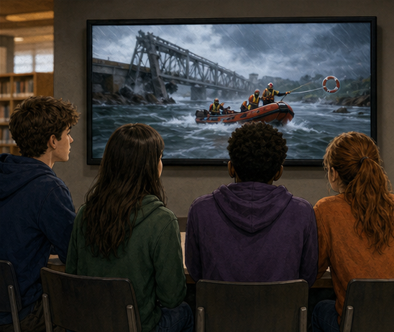
A DISTANT HEADLINE
Truth can be clear—and still kept safely distant.
The rescue is real. The report is understandable.
Yet the hearer can still treat it as someone else's problem and someone else's deliverance.
I HEAR ABOUT IT
FOUND • SESSION 8
03
Notes:
Use the rescue headline as an analogy. Factual clarity alone does not mean the hearer has faced Christ's personal claim.
[Sources]
- /Volumes/T7 Shield/neocities-fireprooofcommentaries/rc3/09_Youth_Resources/Found/Video_Plans/Found-08-Illustrative-Video-Plan.md
- /Volumes/T7 Shield/neocities-fireprooofcommentaries/rc3/09_Youth_Resources/Found/Video_Plans/Session_08_Assets/Found-08-From-Headline-to-Summons-Storyboard-v1.png
- /Volumes/T7 Shield/neocities-fireprooofcommentaries/rc3/09_Youth_Resources/Found/Leader_Guides/RC3-Found-Leader-08-SpiritBringsGospelHome.pdf

Slide 4
THE SUMMONS BECOMES PERSONAL
The same truth now addresses me.
My own danger, allegiance, and response are now addressed.
Enlightenment says, “I see it.” Conviction says, “This truth is addressing me.”
I MUST ANSWER
FOUND • SESSION 8
04
Notes:
The content remains the same, but its personal significance becomes unavoidable. The Spirit works through truth rather than bypassing understanding or will.
[Sources]
- /Volumes/T7 Shield/neocities-fireprooofcommentaries/rc3/09_Youth_Resources/Found/Video_Plans/Found-08-Illustrative-Video-Plan.md
- /Volumes/T7 Shield/neocities-fireprooofcommentaries/rc3/09_Youth_Resources/Found/Video_Plans/Session_08_Assets/Found-08-From-Headline-to-Summons-Storyboard-v1.png
- /Volumes/T7 Shield/neocities-fireprooofcommentaries/rc3/09_Youth_Resources/Found/Leader_Guides/RC3-Found-Leader-08-SpiritBringsGospelHome.pdf

Slide 5

BIG IDEA
The Spirit makes Christ's Gospel
understood and personal.
He presses Christ's claim upon the human will.
He does not perform the hearer's response or give life before faith.
Drawing • Enlightenment • Conviction • Response
FOUND • SESSION 8
05
Notes:
State the distinction carefully. The Spirit brings people toward Christ, makes the Gospel understood, and applies its truth to the will without believing for the hearer or regenerating before faith.
[Sources]
- /Volumes/T7 Shield/neocities-fireprooofcommentaries/rc3/09_Youth_Resources/Found/Leader_Guides/RC3-Found-Leader-08-SpiritBringsGospelHome.pdf
- /Volumes/T7 Shield/neocities-fireprooofcommentaries/rc3/09_Youth_Resources/Found/Student_Handouts/RC3-Found-Handout-08-SpiritBringsGospelHome.pdf

Slide 6
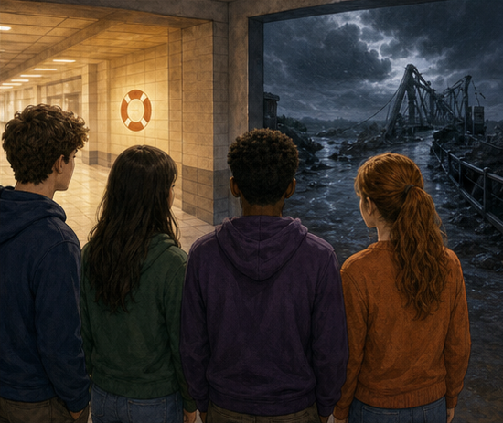
JOHN 6:44-45 • DRAWING
Drawing brings a person toward Christ.
God acts first, bringing people toward light, the Gospel, and His risen Son.
Drawing is real divine initiative without coercion. It answers: Toward whom am I being brought?
TOWARD CHRIST
FOUND • SESSION 8
06
Notes:
Drawing concerns direction. God acts first and providentially brings people toward the Gospel; through the Gospel, drawing becomes explicit movement toward the crucified and risen Son. Do not portray coercion.
[Sources]
- /Volumes/T7 Shield/neocities-fireprooofcommentaries/rc3/09_Youth_Resources/Found/Leader_Guides/RC3-Found-Leader-08-SpiritBringsGospelHome.pdf
- /Volumes/T7 Shield/neocities-fireprooofcommentaries/rc3/09_Youth_Resources/Found/Student_Handouts/RC3-Found-Handout-08-SpiritBringsGospelHome.pdf
- /Volumes/T7 Shield/neocities-fireprooofcommentaries/rc3/09_Youth_Resources/Found/Video_Plans/Session_08_Assets/Found-08-From-Headline-to-Summons-Storyboard-v1.png

Slide 7
HEBREWS 6:4-6 • ENLIGHTENMENT
Enlightenment makes the Gospel understood.
WHAT TRUTH DO I NOW UNDERSTAND?
The Gospel comes into intelligible and personally significant view.
A hearer may understand, assent, and experience its power without yet entrusting himself to Christ.
SEEING TRUTH IS NOT YET TRUSTING CHRIST.
FOUND • SESSION 8
07
Notes:
Enlightenment concerns understanding. A hearer can genuinely understand, assent, and experience the Gospel's power without yet entrusting himself to Christ. Do not collapse enlightenment into regeneration.
[Sources]
- /Volumes/T7 Shield/neocities-fireprooofcommentaries/rc3/09_Youth_Resources/Found/Leader_Guides/RC3-Found-Leader-08-SpiritBringsGospelHome.pdf
- /Volumes/T7 Shield/neocities-fireprooofcommentaries/rc3/09_Youth_Resources/Found/Student_Handouts/RC3-Found-Handout-08-SpiritBringsGospelHome.pdf
- /Volumes/T7 Shield/neocities-fireprooofcommentaries/rc3/09_Youth_Resources/Found/Video_Plans/Session_08_Assets/Found-08-From-Headline-to-Summons-Storyboard-v1.png

Slide 8

JOHN 16:8-11 • CONVICTION
Conviction applies the Gospel to the will.
Through truth concerning Christ, the Spirit exposes unbelief and overturns the world's verdict.
Conviction presses the need to respond. Without the Gospel there may be regret or fear—but not spiritual conviction.
WHAT CLAIM MUST I ANSWER?
FOUND • SESSION 8
08
Notes:
Conviction is more than emotion, guilt, regret, or fear. Through the Gospel, the Spirit confronts the hearer with sin, righteousness, and judgment as each is centered on Christ.
[Sources]
- /Volumes/T7 Shield/neocities-fireprooofcommentaries/rc3/09_Youth_Resources/Found/Leader_Guides/RC3-Found-Leader-08-SpiritBringsGospelHome.pdf
- /Volumes/T7 Shield/neocities-fireprooofcommentaries/rc3/09_Youth_Resources/Found/Student_Handouts/RC3-Found-Handout-08-SpiritBringsGospelHome.pdf
- /Volumes/T7 Shield/neocities-fireprooofcommentaries/rc3/09_Youth_Resources/Found/Video_Plans/Session_08_Assets/Found-08-From-Headline-to-Summons-Storyboard-v1.png

Slide 9
JOHN 16:8-11
Every part of conviction concerns Christ.
SIN
RIGHTEOUSNESS
JUDGMENT
“Because they believe not on me.”
“Because I go to my Father.”
“The prince of this world is judged.”
Unbelief rejects Christ.
God vindicates Christ.
Christ overturns the world's verdict.
Conviction is Gospel-shaped: Christ is the center, not the hearer's feelings.
FOUND • SESSION 8
09
Notes:
Read John 16:8-11. Sin, righteousness, and judgment are not generic moral categories here; each is explained through Jesus Christ and His vindication.
[Sources]
- /Volumes/T7 Shield/neocities-fireprooofcommentaries/rc3/09_Youth_Resources/Found/Leader_Guides/RC3-Found-Leader-08-SpiritBringsGospelHome.pdf
- /Volumes/T7 Shield/neocities-fireprooofcommentaries/rc3/09_Youth_Resources/Found/Student_Handouts/RC3-Found-Handout-08-SpiritBringsGospelHome.pdf

Slide 10
THREE QUESTIONS • DISTINCT WORKS
Direction, understanding, and personal claim.
1
DRAWING
Toward whom am I being brought?
2
ENLIGHTENMENT
What truth do I now understand?
3
CONVICTION
What claim is this truth making upon my will?
THESE WORKS MAY OVERLAP—BUT THEY DO NOT PERFORM FAITH.
FOUND • SESSION 8
10
Notes:
The works may overlap; do not turn them into a rigid timeline. The distinctions identify direction, understanding, and the Gospel's claim upon the will. None of them is the hearer's act of faith.
[Sources]
- /Volumes/T7 Shield/neocities-fireprooofcommentaries/rc3/09_Youth_Resources/Found/Leader_Guides/RC3-Found-Leader-08-SpiritBringsGospelHome.pdf
- /Volumes/T7 Shield/neocities-fireprooofcommentaries/rc3/09_Youth_Resources/Found/Visual_Theology/Found-08-Visual-Theology.png

Slide 11
ACTS 2:36-41
A real response remains.
The Spirit does not repent or believe for the hearer.
The person may yield, evade, resist, suppress, or harden himself.
PREPARATORY GRACE BRINGS THE WILL TO DECIDE.
FOUND • SESSION 8
11
Notes:
Acts 2:37 and Acts 7:54 show truth reaching the heart with different responses. Conviction presses the necessity of response but does not remove human choice or perform repentance and faith.
[Sources]
- /Volumes/T7 Shield/neocities-fireprooofcommentaries/rc3/09_Youth_Resources/Found/Leader_Guides/RC3-Found-Leader-08-SpiritBringsGospelHome.pdf
- /Volumes/T7 Shield/neocities-fireprooofcommentaries/rc3/09_Youth_Resources/Found/Student_Handouts/RC3-Found-Handout-08-SpiritBringsGospelHome.pdf
- /Volumes/T7 Shield/neocities-fireprooofcommentaries/rc3/09_Youth_Resources/Found/Video_Plans/Session_08_Assets/Found-08-From-Headline-to-Summons-Storyboard-v1.png

Slide 12
DO NOT CONFUSE THESE
Not every strong experience is conversion.
1
REGRET
I wish the consequences were different.
2
ASSENT
I agree that the Gospel is true.
3
CONVICTION
This true Gospel confronts my own allegiance.
4
CONVERSION
I entrust myself to Christ; the Spirit gives life.
Strong emotion, sincere agreement, or spiritual experience is not itself union with Christ.
FOUND • SESSION 8
12
Notes:
Reserve regeneration and 'gives life' for conversion. Strong feeling, sincere assent, and profound spiritual experience are not themselves union with Christ. Preserve the order: the sinner believes; the Spirit gives life.
[Sources]
- /Volumes/T7 Shield/neocities-fireprooofcommentaries/rc3/09_Youth_Resources/Found/Leader_Guides/RC3-Found-Leader-08-SpiritBringsGospelHome.pdf
- /Volumes/T7 Shield/neocities-fireprooofcommentaries/rc3/09_Youth_Resources/Found/Student_Handouts/RC3-Found-Handout-08-SpiritBringsGospelHome.pdf

Slide 13
DISCUSSION
Let's think it through
1
How is drawing different from enlightenment?
2
Why must conviction include the Gospel?
3
What does John 16 say the Spirit exposes?
4
Can someone understand and assent without surrendering?
5
Why does conviction not remove human choice?
What truth about Christ do I understand—and what claim is it making upon me?
FOUND • SESSION 8
13
Notes:
Use the leader-guide follow-ups. Keep the discussion centered on Christ and the Gospel, not on measuring emotion or narrating an invisible sequence.
[Sources]
- /Volumes/T7 Shield/neocities-fireprooofcommentaries/rc3/09_Youth_Resources/Found/Leader_Guides/RC3-Found-Leader-08-SpiritBringsGospelHome.pdf

Slide 14
MEMORY VERSE • JOHN 16:8
“And when he is come, he will reprove the world of sin,
and of righteousness, and of judgment.”
The Spirit makes Christ's Gospel clear, personal, and impossible to treat as neutral.
THIS WEEK
YOU MAY TALK WITH US
Read John 16:7-15. Notice how sin, righteousness, and judgment are each explained through Jesus Christ.
If the Gospel feels personally confronting, do not manufacture a public moment. Ask a leader privately, open Scripture, and let Christ answer honestly.
FOUND • SESSION 8
14
Notes:
Read the memory verse together. Invite honest reflection or private conversation. Do not offer emotion as proof, bypass the will, or manufacture a decision. Christ and His Gospel remain central.
[Sources]
- /Volumes/T7 Shield/neocities-fireprooofcommentaries/rc3/09_Youth_Resources/Found/Leader_Guides/RC3-Found-Leader-08-SpiritBringsGospelHome.pdf
- /Volumes/T7 Shield/neocities-fireprooofcommentaries/rc3/09_Youth_Resources/Found/Student_Handouts/RC3-Found-Handout-08-SpiritBringsGospelHome.pdf

