Slide 1
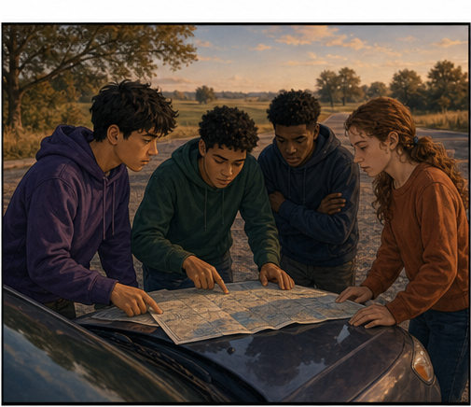
RC3 • LIFE IN CHRIST
FOUND
SESSION 9
REPENTANCE:
SURRENDERING SELF-RULE
Turning to God Means Abandoning
Your Claim to Yourself
Fireproof Studies • James J. Burke
Notes:
Introduce repentance as a real change of direction, not merely a change of mood. Keep repentance and faith together as one surrender.
[Sources]
- /Volumes/T7 Shield/neocities-fireprooofcommentaries/rc3/09_Youth_Resources/Found/Leader_Guides/RC3-Found-Leader-09-Repentance.pdf
- /Volumes/T7 Shield/neocities-fireprooofcommentaries/rc3/09_Youth_Resources/Found/Video_Plans/Session_09_Assets/Found-09-The-U-Turn-Storyboard-v1.png

Slide 2
OPENING ACTIVITY
Sorry—or turned?
Which statement describes a real change of direction?
1
2
3
4
I hate the consequences.
I feel terrible.
I will try harder.
I no longer claim the right to rule myself.
Regret can be sincere while the same authority and direction remain.
FOUND • SESSION 9
02
Notes:
Read the four statements slowly. Regret, sorrow, and promises may be sincere while the person remains under the same authority.
[Sources]
- /Volumes/T7 Shield/neocities-fireprooofcommentaries/rc3/09_Youth_Resources/Found/Leader_Guides/RC3-Found-Leader-09-Repentance.pdf
- /Volumes/T7 Shield/neocities-fireprooofcommentaries/rc3/09_Youth_Resources/Found/Student_Handouts/RC3-Found-Handout-09-Repentance.pdf

Slide 3
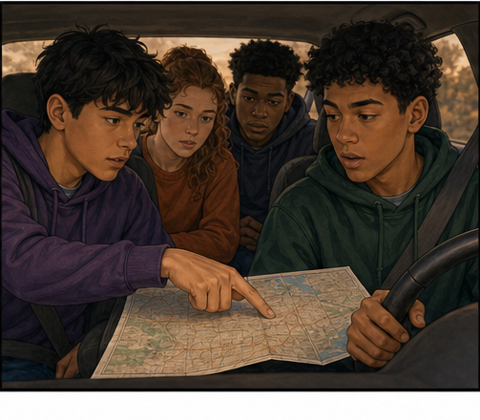
THE U-TURN
Regret can name the wrong road—and keep driving.
An apology without a turn leaves direction unchanged.
Feeling different is not yet surrendering the right to define and direct life.
SORRY IS NOT YET TURNED
FOUND • SESSION 9
03
Notes:
Use the driving illustration to expose the difference between admitting a mistake and actually turning. The analogy serves the biblical text.
[Sources]
- /Volumes/T7 Shield/neocities-fireprooofcommentaries/rc3/09_Youth_Resources/Found/Video_Plans/Found-09-Illustrative-Video-Plan.md
- /Volumes/T7 Shield/neocities-fireprooofcommentaries/rc3/09_Youth_Resources/Found/Video_Plans/Session_09_Assets/Found-09-The-U-Turn-Storyboard-v1.png
- /Volumes/T7 Shield/neocities-fireprooofcommentaries/rc3/09_Youth_Resources/Found/Leader_Guides/RC3-Found-Leader-09-Repentance.pdf

Slide 4
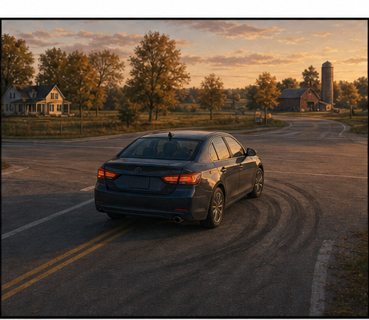
A REAL CHANGE OF DIRECTION
Repentance abandons the old route.
The traveler relinquishes self-direction and turns toward home.
The Gospel summons a real turn from sin and self-rule toward the God who was rejected.
ONE TURN • TWO DIRECTIONS
FOUND • SESSION 9
04
Notes:
Let the U-turn make direction visible. Repentance abandons self-rule and turns toward the God who was rejected.
[Sources]
- /Volumes/T7 Shield/neocities-fireprooofcommentaries/rc3/09_Youth_Resources/Found/Video_Plans/Found-09-Illustrative-Video-Plan.md
- /Volumes/T7 Shield/neocities-fireprooofcommentaries/rc3/09_Youth_Resources/Found/Video_Plans/Session_09_Assets/Found-09-The-U-Turn-Storyboard-v1.png
- /Volumes/T7 Shield/neocities-fireprooofcommentaries/rc3/09_Youth_Resources/Found/Leader_Guides/RC3-Found-Leader-09-Repentance.pdf

Slide 5

BIG IDEA
Repentance turns from sin and
self-rule to God.
It is the willing abandonment of rival allegiance in trusting surrender to Christ.
Repentance and saving faith are one turning—not two transactions.
FOUND • SESSION 9
05
Notes:
State the big idea carefully. Repentance does not purchase grace; it belongs to the same trusting surrender by which the sinner receives Christ.
[Sources]
- /Volumes/T7 Shield/neocities-fireprooofcommentaries/rc3/09_Youth_Resources/Found/Leader_Guides/RC3-Found-Leader-09-Repentance.pdf
- /Volumes/T7 Shield/neocities-fireprooofcommentaries/rc3/09_Youth_Resources/Found/Student_Handouts/RC3-Found-Handout-09-Repentance.pdf

Slide 6
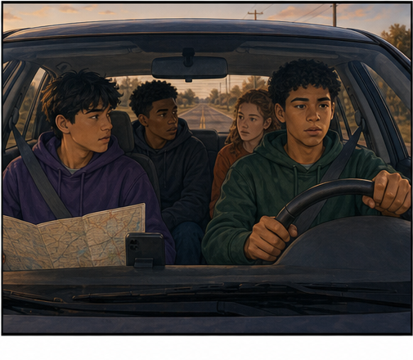
MARK 1:14-15
The Gospel calls for a turn.
Jesus announces God's good news and rightful authority.
Repentance is not vague self-improvement. It answers Christ and His Gospel.
THE SUMMONS RESTS ON WHAT GOD HAS DONE
FOUND • SESSION 9
06
Notes:
Read Mark 1:14-15. The command rests on God's good news and Christ's rightful authority, not on human achievement.
[Sources]
- /Volumes/T7 Shield/neocities-fireprooofcommentaries/rc3/09_Youth_Resources/Found/Leader_Guides/RC3-Found-Leader-09-Repentance.pdf
- /Volumes/T7 Shield/neocities-fireprooofcommentaries/rc3/09_Youth_Resources/Found/Student_Handouts/RC3-Found-Handout-09-Repentance.pdf
- /Volumes/T7 Shield/neocities-fireprooofcommentaries/rc3/09_Youth_Resources/Found/Video_Plans/Session_09_Assets/Found-09-The-U-Turn-Storyboard-v1.png

Slide 7
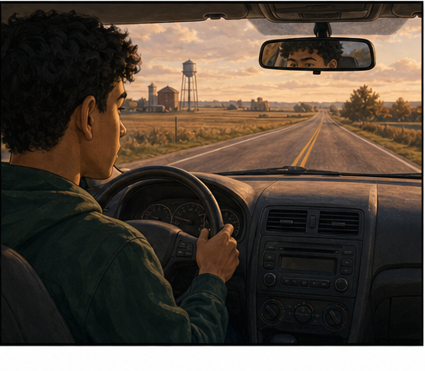
ACTS 17:22-31
Repentance abandons self-rule.
Sin grows from the claim that life belongs to us.
To repent is to surrender the right to define good, truth, and direction apart from God.
AUTHORITY—not merely selected habits
FOUND • SESSION 9
07
Notes:
Use Acts 17 to expose self-rule as a claim of authority. The central surrender is deeper than selected habits.
[Sources]
- /Volumes/T7 Shield/neocities-fireprooofcommentaries/rc3/09_Youth_Resources/Found/Leader_Guides/RC3-Found-Leader-09-Repentance.pdf
- /Volumes/T7 Shield/neocities-fireprooofcommentaries/rc3/09_Youth_Resources/Found/Student_Handouts/RC3-Found-Handout-09-Repentance.pdf
- /Volumes/T7 Shield/neocities-fireprooofcommentaries/rc3/09_Youth_Resources/Found/Video_Plans/Session_09_Assets/Found-09-The-U-Turn-Storyboard-v1.png

Slide 8
LUKE 15:17-24
Repentance turns to God.
The lost son recognizes, rises, leaves, and returns.
His turn is a real change of direction toward the father and restored relationship.
RETURNING TO THE ONE REJECTED
FOUND • SESSION 9
08
Notes:
Trace the son's recognition, rising, leaving, and return. Repentance is a real relational turn, not private remorse.
[Sources]
- /Volumes/T7 Shield/neocities-fireprooofcommentaries/rc3/09_Youth_Resources/Found/Leader_Guides/RC3-Found-Leader-09-Repentance.pdf
- /Volumes/T7 Shield/neocities-fireprooofcommentaries/rc3/09_Youth_Resources/Found/Student_Handouts/RC3-Found-Handout-09-Repentance.pdf
- /Volumes/T7 Shield/neocities-fireprooofcommentaries/rc3/09_Youth_Resources/Found/Video_Plans/Session_09_Assets/Found-09-The-U-Turn-Storyboard-v1.png

Slide 9
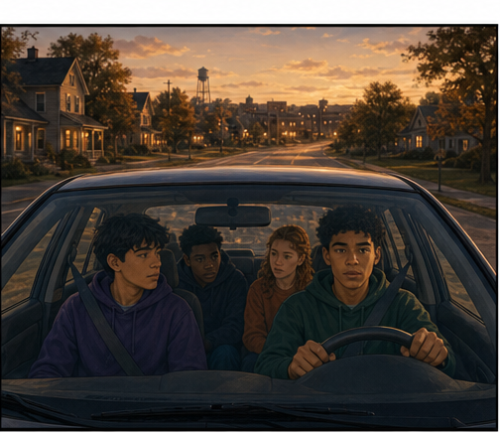
ACTS 20:20-21
Repentance and faith are one turn.
Repentance names what is abandoned; faith names whom is trusted.
Both belong to the same trusting surrender of the whole self to Jesus Christ.
DO NOT SEPARATE WHAT SCRIPTURE HOLDS TOGETHER
FOUND • SESSION 9
09
Notes:
Keep repentance and faith united. Repentance names the old allegiance abandoned; faith names the Christ trusted.
[Sources]
- /Volumes/T7 Shield/neocities-fireprooofcommentaries/rc3/09_Youth_Resources/Found/Leader_Guides/RC3-Found-Leader-09-Repentance.pdf
- /Volumes/T7 Shield/neocities-fireprooofcommentaries/rc3/09_Youth_Resources/Found/Student_Handouts/RC3-Found-Handout-09-Repentance.pdf
- /Volumes/T7 Shield/neocities-fireprooofcommentaries/rc3/09_Youth_Resources/Found/Video_Plans/Session_09_Assets/Found-09-The-U-Turn-Storyboard-v1.png

Slide 10
SYNTHESIS
One surrender viewed in two directions.
REPENTANCE
FAITH
Turning from sin, falsehood, and self-rule.
Turning to Jesus Christ in trusting reliance.
AUTHORITY
FRUIT
The claim to direct life apart from God is abandoned.
Changed conduct follows because the direction changed.
FOUND • SESSION 9
10
Notes:
Use the two-direction summary without treating repentance and faith as separate transactions. One surrender has both aspects.
[Sources]
- /Volumes/T7 Shield/neocities-fireprooofcommentaries/rc3/09_Youth_Resources/Found/Leader_Guides/RC3-Found-Leader-09-Repentance.pdf
- /Volumes/T7 Shield/neocities-fireprooofcommentaries/rc3/09_Youth_Resources/Found/Student_Handouts/RC3-Found-Handout-09-Repentance.pdf
- /Volumes/T7 Shield/neocities-fireprooofcommentaries/rc3/09_Youth_Resources/Found/Visual_Theology/Found-09-Visual-Theology.png

Slide 11
KEEP THE ORDER CLEAR
Repentance is not a price paid for grace.
It does not clean us up before Christ or earn forgiveness.
Surrender receives Christ. Fruit follows the root; it never purchases grace.
TURNING FROM SELF-RULE • TRUSTING CHRIST
FOUND • SESSION 9
11
Notes:
Guard grace here. Repentance is not cleaning up before Christ, an emotional display, or a meritorious price paid for forgiveness.
[Sources]
- /Volumes/T7 Shield/neocities-fireprooofcommentaries/rc3/09_Youth_Resources/Found/Leader_Guides/RC3-Found-Leader-09-Repentance.pdf
- /Volumes/T7 Shield/neocities-fireprooofcommentaries/rc3/09_Youth_Resources/Found/Student_Handouts/RC3-Found-Handout-09-Repentance.pdf
- /Volumes/T7 Shield/neocities-fireprooofcommentaries/rc3/09_Youth_Resources/Found/Video_Plans/Session_09_Assets/Found-09-The-U-Turn-Storyboard-v1.png

Slide 12
KEEP THESE DISTINCT
Repentance is more than a strong reaction.
1
REGRET
Wishing the consequences were different.
2
SORROW
Feeling terrible while keeping the same authority.
3
PROMISES
Vowing to try harder in your own strength.
4
RELIGION
Performing acts meant to purchase forgiveness.
5
A REAL TURN
Recognizing truth, abandoning self-rule, and entrusting the whole life to Christ.
FOUND • SESSION 9
12
Notes:
Distinguish regret, sorrow, promises, and religion from a real turn. Fruit follows the change of allegiance; it does not cause grace.
[Sources]
- /Volumes/T7 Shield/neocities-fireprooofcommentaries/rc3/09_Youth_Resources/Found/Leader_Guides/RC3-Found-Leader-09-Repentance.pdf
- /Volumes/T7 Shield/neocities-fireprooofcommentaries/rc3/09_Youth_Resources/Found/Student_Handouts/RC3-Found-Handout-09-Repentance.pdf

Slide 13
DISCUSSION
Let's think it through
1
Why is feeling sorry not the same as repentance?
2
What does self-rule claim about your life?
3
What actions show the son's turn in Luke 15?
4
How are repentance and faith one turning?
5
Does repentance earn forgiveness by reforming life?
FOUND • SESSION 9
13
Notes:
Use follow-up questions to keep the discussion centered on authority, direction, and Christ rather than measuring emotion.
[Sources]
- /Volumes/T7 Shield/neocities-fireprooofcommentaries/rc3/09_Youth_Resources/Found/Leader_Guides/RC3-Found-Leader-09-Repentance.pdf

Slide 14
MEMORY VERSE • MARK 1:15
“Repent ye, and believe the gospel.”
The Gospel calls for one real turning: from self-rule to trusting surrender to Christ.
THIS WEEK
YOU MAY TALK WITH US
Read Luke 15:11-24. Mark what the son recognizes, decides, leaves, and returns to.
If you are ready to turn, speak honestly to God and entrust yourself to Christ. No formula performs surrender.
FOUND • SESSION 9
14
Notes:
Read the memory verse together. Offer honest reflection and private conversation without a public gesture or manufactured decision.
[Sources]
- /Volumes/T7 Shield/neocities-fireprooofcommentaries/rc3/09_Youth_Resources/Found/Leader_Guides/RC3-Found-Leader-09-Repentance.pdf
- /Volumes/T7 Shield/neocities-fireprooofcommentaries/rc3/09_Youth_Resources/Found/Student_Handouts/RC3-Found-Handout-09-Repentance.pdf

