Slide 1
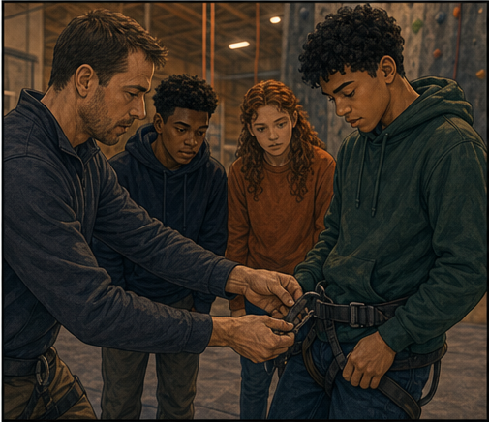
RC3 • LIFE IN CHRIST
FOUND
SESSION 10
FAITH:
ENTRUSTING YOURSELF TO CHRIST
More Than Agreeing That
the Gospel Is True
Fireproof Studies • James J. Burke
Notes:
Introduce saving faith as chosen, life-surrendering trust in Jesus Christ. Keep the Person and His authority central.
[Sources]
- /Volumes/T7 Shield/neocities-fireprooofcommentaries/rc3/09_Youth_Resources/Found/Leader_Guides/RC3-Found-Leader-10-Faith.pdf
- /Volumes/T7 Shield/neocities-fireprooofcommentaries/rc3/09_Youth_Resources/Found/Video_Plans/Session_10_Assets/Found-10-Chair-and-Climber-Storyboard-v1.png

Slide 2
OPENING ACTIVITY
Who has the final word?
Where does the self still reserve the right to overrule Christ?
1
2
3
4
TRUTH
GUILT
DIRECTION
FUTURE
Agreement recognizes Christ's claim. Faith entrusts the self to the One making it.
FOUND • SESSION 10
02
Notes:
Use truth, guilt, direction, and future to expose where the self still reserves the final word. Agreement may stop short of trust.
[Sources]
- /Volumes/T7 Shield/neocities-fireprooofcommentaries/rc3/09_Youth_Resources/Found/Leader_Guides/RC3-Found-Leader-10-Faith.pdf
- /Volumes/T7 Shield/neocities-fireprooofcommentaries/rc3/09_Youth_Resources/Found/Student_Handouts/RC3-Found-Handout-10-Faith.pdf

Slide 3
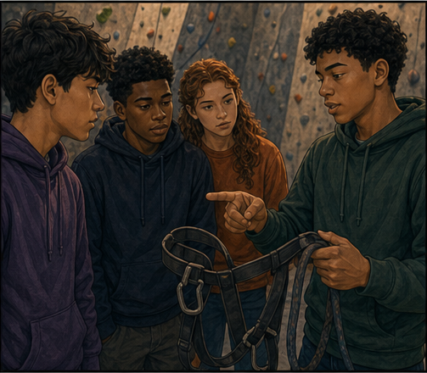
THE CHAIR AND THE CLIMBER
Knowing the harness is not yet trusting it.
A person may describe every buckle and still keep his weight to himself.
Accurate knowledge matters—but knowledge and assent are not the whole act of faith.
I KNOW WHAT IT DOES
FOUND • SESSION 10
03
Notes:
The climbing illustration distinguishes accurate understanding from entrusting one's weight. Knowledge is necessary but not sufficient.
[Sources]
- /Volumes/T7 Shield/neocities-fireprooofcommentaries/rc3/09_Youth_Resources/Found/Video_Plans/Found-10-Illustrative-Video-Plan.md
- /Volumes/T7 Shield/neocities-fireprooofcommentaries/rc3/09_Youth_Resources/Found/Video_Plans/Session_10_Assets/Found-10-Chair-and-Climber-Storyboard-v1.png
- /Volumes/T7 Shield/neocities-fireprooofcommentaries/rc3/09_Youth_Resources/Found/Leader_Guides/RC3-Found-Leader-10-Faith.pdf

Slide 4
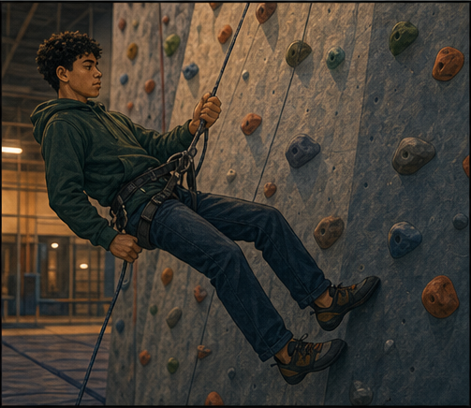
THE WEIGHT IS ENTRUSTED
Trust gives the harness your weight.
The climber deliberately rests himself on what he has judged reliable.
Saving faith says: Because the Gospel is true, I entrust my whole self to Christ.
I GIVE MYSELF TO HIM
FOUND • SESSION 10
04
Notes:
Emphasize the deliberate transfer of weight. Faith receives Christ because the Gospel reveals Him as true and worthy.
[Sources]
- /Volumes/T7 Shield/neocities-fireprooofcommentaries/rc3/09_Youth_Resources/Found/Video_Plans/Found-10-Illustrative-Video-Plan.md
- /Volumes/T7 Shield/neocities-fireprooofcommentaries/rc3/09_Youth_Resources/Found/Video_Plans/Session_10_Assets/Found-10-Chair-and-Climber-Storyboard-v1.png
- /Volumes/T7 Shield/neocities-fireprooofcommentaries/rc3/09_Youth_Resources/Found/Leader_Guides/RC3-Found-Leader-10-Faith.pdf

Slide 5

BIG IDEA
Faith believes the Gospel and
gives the whole self to Christ.
Saving faith receives the Person revealed in the Gospel and His rightful authority.
Faith receives Christ; it does not purchase Him or create life by its own power.
FOUND • SESSION 10
05
Notes:
State the big idea without making faith a meritorious work. Faith receives Christ; it does not purchase Him or manufacture life.
[Sources]
- /Volumes/T7 Shield/neocities-fireprooofcommentaries/rc3/09_Youth_Resources/Found/Leader_Guides/RC3-Found-Leader-10-Faith.pdf
- /Volumes/T7 Shield/neocities-fireprooofcommentaries/rc3/09_Youth_Resources/Found/Student_Handouts/RC3-Found-Handout-10-Faith.pdf

Slide 6
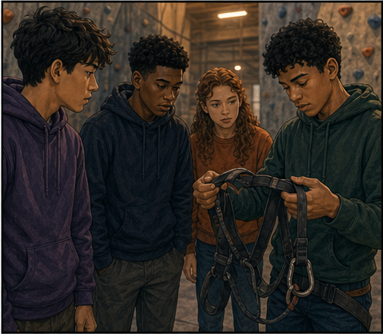
JOHN 3:14-18
Faith trusts the Christ revealed.
Faith is not confidence in confidence or a leap toward an unknown object.
The Gospel reveals the crucified and risen Son; faith judges Him true and worthy of reliance.
CHRIST IS THE PERSON AND OBJECT OF FAITH
FOUND • SESSION 10
06
Notes:
Read John 3:14-18. Saving faith has Jesus Christ as its revealed Person and object, not faith itself.
[Sources]
- /Volumes/T7 Shield/neocities-fireprooofcommentaries/rc3/09_Youth_Resources/Found/Leader_Guides/RC3-Found-Leader-10-Faith.pdf
- /Volumes/T7 Shield/neocities-fireprooofcommentaries/rc3/09_Youth_Resources/Found/Student_Handouts/RC3-Found-Handout-10-Faith.pdf
- /Volumes/T7 Shield/neocities-fireprooofcommentaries/rc3/09_Youth_Resources/Found/Video_Plans/Session_10_Assets/Found-10-Chair-and-Climber-Storyboard-v1.png

Slide 7
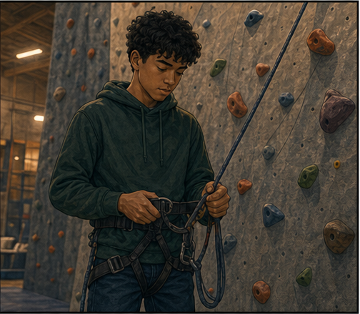
JOHN 1:10-13
Faith is more than assent.
A hearer may understand the Gospel and still withhold himself.
Receiving Christ moves from “I see this is true” to “I entrust myself to Him.”
ASSENT IS INCLUDED—NOT SUFFICIENT
FOUND • SESSION 10
07
Notes:
Read John 1:10-13. Receiving Christ completes knowledge and assent in personal trust.
[Sources]
- /Volumes/T7 Shield/neocities-fireprooofcommentaries/rc3/09_Youth_Resources/Found/Leader_Guides/RC3-Found-Leader-10-Faith.pdf
- /Volumes/T7 Shield/neocities-fireprooofcommentaries/rc3/09_Youth_Resources/Found/Student_Handouts/RC3-Found-Handout-10-Faith.pdf
- /Volumes/T7 Shield/neocities-fireprooofcommentaries/rc3/09_Youth_Resources/Found/Video_Plans/Session_10_Assets/Found-10-Chair-and-Climber-Storyboard-v1.png

Slide 8
ROMANS 10:8-13
Faith gives the whole self.
Truth, guilt, allegiance, identity, future, and hope are placed in Christ's hands.
Calling Him Lord receives His rightful authority rather than preserving autonomous self-rule.
SURRENDER IS FAITH'S PERSONAL CHARACTER
FOUND • SESSION 10
08
Notes:
Use Romans 10 to show that saving faith entrusts the whole self and receives Christ's rightful authority.
[Sources]
- /Volumes/T7 Shield/neocities-fireprooofcommentaries/rc3/09_Youth_Resources/Found/Leader_Guides/RC3-Found-Leader-10-Faith.pdf
- /Volumes/T7 Shield/neocities-fireprooofcommentaries/rc3/09_Youth_Resources/Found/Student_Handouts/RC3-Found-Handout-10-Faith.pdf
- /Volumes/T7 Shield/neocities-fireprooofcommentaries/rc3/09_Youth_Resources/Found/Video_Plans/Session_10_Assets/Found-10-Chair-and-Climber-Storyboard-v1.png

Slide 9
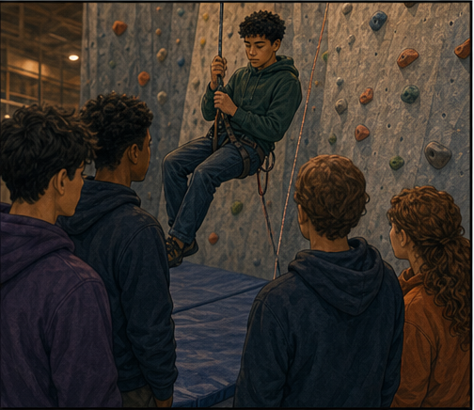
ACTS 16:30-34
Faith receives; it does not earn.
Faith does not purchase grace or create life by its own power.
When the sinner believes, the Spirit joins him to the risen Son and gives life.
THE SINNER BELIEVES • THE SPIRIT GIVES LIFE
FOUND • SESSION 10
09
Notes:
Read Acts 16. The answer is a Person, not a technique. Preserve the order: the sinner believes; the Spirit gives life.
[Sources]
- /Volumes/T7 Shield/neocities-fireprooofcommentaries/rc3/09_Youth_Resources/Found/Leader_Guides/RC3-Found-Leader-10-Faith.pdf
- /Volumes/T7 Shield/neocities-fireprooofcommentaries/rc3/09_Youth_Resources/Found/Student_Handouts/RC3-Found-Handout-10-Faith.pdf
- /Volumes/T7 Shield/neocities-fireprooofcommentaries/rc3/09_Youth_Resources/Found/Video_Plans/Session_10_Assets/Found-10-Chair-and-Climber-Storyboard-v1.png

Slide 10
SYNTHESIS
Assent becomes saving faith in personal trust.
KNOWLEDGE
ASSENT
I understand what the Gospel announces.
I agree that the Gospel is true.
TRUST
AUTHORITY
Because it is true, I entrust myself to Christ.
I receive Jesus as Lord rather than reserving self-rule.
FOUND • SESSION 10
10
Notes:
Trace knowledge, assent, trust, and authority without turning them into separate saving transactions.
[Sources]
- /Volumes/T7 Shield/neocities-fireprooofcommentaries/rc3/09_Youth_Resources/Found/Leader_Guides/RC3-Found-Leader-10-Faith.pdf
- /Volumes/T7 Shield/neocities-fireprooofcommentaries/rc3/09_Youth_Resources/Found/Student_Handouts/RC3-Found-Handout-10-Faith.pdf
- /Volumes/T7 Shield/neocities-fireprooofcommentaries/rc3/09_Youth_Resources/Found/Visual_Theology/Found-10-Visual-Theology.png

Slide 11
KEEP THE ORDER CLEAR
Christ—not faith itself—is the anchor.
Saving faith rests on the crucified and risen Son.
Its strength is not intense emotion, perfect certainty, complete understanding, or confidence in confidence.
THE PERSON RECEIVED • THE AUTHORITY CONFESSED
FOUND • SESSION 10
11
Notes:
Do not make assurance of faith depend on emotion, perfect certainty, a remembered moment, or complete understanding. Christ is the anchor.
[Sources]
- /Volumes/T7 Shield/neocities-fireprooofcommentaries/rc3/09_Youth_Resources/Found/Leader_Guides/RC3-Found-Leader-10-Faith.pdf
- /Volumes/T7 Shield/neocities-fireprooofcommentaries/rc3/09_Youth_Resources/Found/Student_Handouts/RC3-Found-Handout-10-Faith.pdf
- /Volumes/T7 Shield/neocities-fireprooofcommentaries/rc3/09_Youth_Resources/Found/Video_Plans/Session_10_Assets/Found-10-Chair-and-Climber-Storyboard-v1.png

Slide 12
KEEP THESE DISTINCT
What does faith entrust to Christ?
1
TRUTH
Christ has the final word over what is true.
2
GUILT
Christ's saving work—not self-defense—is my hope.
3
AUTHORITY
Jesus is Lord; I no longer reserve self-rule.
4
IDENTITY
I receive belonging and purpose from Him.
5
FUTURE
My life, death, and destiny are placed in His hands.
FOUND • SESSION 10
12
Notes:
Invite students to name what faith entrusts to Christ. Surrender is faith's personal character, not an additional work.
[Sources]
- /Volumes/T7 Shield/neocities-fireprooofcommentaries/rc3/09_Youth_Resources/Found/Leader_Guides/RC3-Found-Leader-10-Faith.pdf
- /Volumes/T7 Shield/neocities-fireprooofcommentaries/rc3/09_Youth_Resources/Found/Student_Handouts/RC3-Found-Handout-10-Faith.pdf

Slide 13
DISCUSSION
Let's think it through
1
Why must faith include knowing the Gospel?
2
Why is agreement alone not saving faith?
3
What does it mean to believe on the Lord Jesus?
4
What parts of the self does faith entrust to Christ?
5
Why is faith not a meritorious work?
FOUND • SESSION 10
13
Notes:
Use the leader-guide follow-ups and keep the discussion centered on whom faith receives and what self-rule releases.
[Sources]
- /Volumes/T7 Shield/neocities-fireprooofcommentaries/rc3/09_Youth_Resources/Found/Leader_Guides/RC3-Found-Leader-10-Faith.pdf

Slide 14
MEMORY VERSE • ACTS 16:31
“Believe on the Lord Jesus Christ, and thou shalt be saved.”
Faith receives the revealed Christ and entrusts the whole self to His rightful authority.
THIS WEEK
YOU MAY TALK WITH US
Read John 1:10-13 and Romans 10:8-13. Notice the Person received and confessed.
If you want to trust Christ, address God honestly. No prescribed words perform surrender; prayer may express real faith.
FOUND • SESSION 10
14
Notes:
Read the memory verse. Invite private conversation without prescribed words, public pressure, or a manufactured emotional response.
[Sources]
- /Volumes/T7 Shield/neocities-fireprooofcommentaries/rc3/09_Youth_Resources/Found/Leader_Guides/RC3-Found-Leader-10-Faith.pdf
- /Volumes/T7 Shield/neocities-fireprooofcommentaries/rc3/09_Youth_Resources/Found/Student_Handouts/RC3-Found-Handout-10-Faith.pdf

