Slide 1
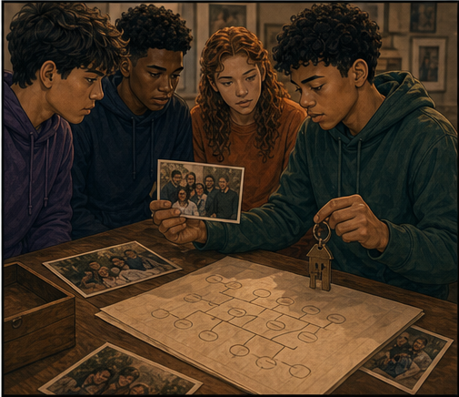
RC3 • LIFE IN CHRIST
FOUND
SESSION 11
NEW BIRTH:
WHEN CHRIST'S LIFE BECOMES YOURS
The Sinner Believes;
the Spirit Gives Life
Fireproof Studies • James J. Burke
Notes:
Introduce new birth by holding the sinner's faith and the Spirit's life-giving action together. In conversion, the distinct actions meet.
[Sources]
- /Volumes/T7 Shield/neocities-fireprooofcommentaries/rc3/09_Youth_Resources/Found/Leader_Guides/RC3-Found-Leader-11-NewBirth.pdf
- /Volumes/T7 Shield/neocities-fireprooofcommentaries/rc3/09_Youth_Resources/Found/Video_Plans/Session_11_Assets/Found-11-One-Birth-Many-Realities-Storyboard-v1.png

Slide 2
OPENING ACTIVITY
One new life—many realities
Does birth create six unrelated transactions—or one life with many dimensions?
1
2
3
4
5
ORIGIN
FAMILY
IDENTITY
INHERITANCE
FUTURE
One beginning establishes several inseparable realities at the same moment.
FOUND • SESSION 11
02
Notes:
Ask whether origin, family, identity, inheritance, and future arrive as unrelated benefits or as dimensions of one new life.
[Sources]
- /Volumes/T7 Shield/neocities-fireprooofcommentaries/rc3/09_Youth_Resources/Found/Leader_Guides/RC3-Found-Leader-11-NewBirth.pdf
- /Volumes/T7 Shield/neocities-fireprooofcommentaries/rc3/09_Youth_Resources/Found/Student_Handouts/RC3-Found-Handout-11-NewBirth.pdf

Slide 3
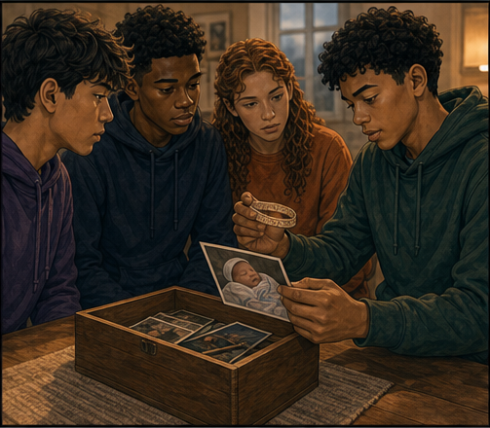
ONE BIRTH • MANY REALITIES
One beginning establishes more than one fact.
A single birth brings a real origin into view.
Name, family, home, inheritance, and future belong together because one new life exists.
ONE EVENT • MANY DIMENSIONS
FOUND • SESSION 11
03
Notes:
Use the keepsake illustration to establish one real beginning. Do not let the analogy replace Jesus' language of birth by the Spirit.
[Sources]
- /Volumes/T7 Shield/neocities-fireprooofcommentaries/rc3/09_Youth_Resources/Found/Video_Plans/Found-11-Illustrative-Video-Plan.md
- /Volumes/T7 Shield/neocities-fireprooofcommentaries/rc3/09_Youth_Resources/Found/Video_Plans/Session_11_Assets/Found-11-One-Birth-Many-Realities-Storyboard-v1.png
- /Volumes/T7 Shield/neocities-fireprooofcommentaries/rc3/09_Youth_Resources/Found/Leader_Guides/RC3-Found-Leader-11-NewBirth.pdf

Slide 4
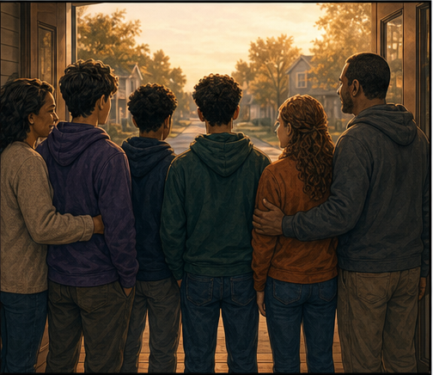
A NEW ORIGIN AND FUTURE
The same person now belongs within a new story.
Birth does not add disconnected benefits to a person.
It establishes a living relationship, identity, belonging, and future that unfold from one beginning.
LIFE CONNECTS EVERY REALITY
FOUND • SESSION 11
04
Notes:
Show how one birth establishes several connected realities. The point is unity, not sentiment about family memories.
[Sources]
- /Volumes/T7 Shield/neocities-fireprooofcommentaries/rc3/09_Youth_Resources/Found/Video_Plans/Found-11-Illustrative-Video-Plan.md
- /Volumes/T7 Shield/neocities-fireprooofcommentaries/rc3/09_Youth_Resources/Found/Video_Plans/Session_11_Assets/Found-11-One-Birth-Many-Realities-Storyboard-v1.png
- /Volumes/T7 Shield/neocities-fireprooofcommentaries/rc3/09_Youth_Resources/Found/Leader_Guides/RC3-Found-Leader-11-NewBirth.pdf

Slide 5

BIG IDEA
The Spirit gives new life by joining
the believing sinner to Christ.
Christ's risen life becomes the believer's life without erasing the believer's created personhood.
The sinner believes; the Spirit gives life. In conversion, these distinct actions meet.
FOUND • SESSION 11
05
Notes:
State the big idea with the curriculum's exact order: the sinner believes; the Spirit gives life.
[Sources]
- /Volumes/T7 Shield/neocities-fireprooofcommentaries/rc3/09_Youth_Resources/Found/Leader_Guides/RC3-Found-Leader-11-NewBirth.pdf
- /Volumes/T7 Shield/neocities-fireprooofcommentaries/rc3/09_Youth_Resources/Found/Student_Handouts/RC3-Found-Handout-11-NewBirth.pdf

Slide 6
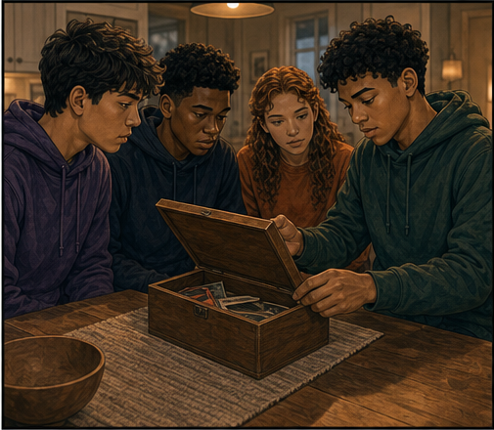
JOHN 1:12-13
The sinner believes; the Spirit gives life.
The sinner genuinely receives Christ in trusting surrender.
The Spirit genuinely gives what faith cannot produce. Neither performs the other's action.
IN CONVERSION, THE DISTINCT ACTIONS MEET
FOUND • SESSION 11
06
Notes:
Faith does not regenerate, and the Spirit does not believe. The sinner receives Christ; the Spirit gives what faith cannot produce.
[Sources]
- /Volumes/T7 Shield/neocities-fireprooofcommentaries/rc3/09_Youth_Resources/Found/Leader_Guides/RC3-Found-Leader-11-NewBirth.pdf
- /Volumes/T7 Shield/neocities-fireprooofcommentaries/rc3/09_Youth_Resources/Found/Student_Handouts/RC3-Found-Handout-11-NewBirth.pdf
- /Volumes/T7 Shield/neocities-fireprooofcommentaries/rc3/09_Youth_Resources/Found/Video_Plans/Session_11_Assets/Found-11-One-Birth-Many-Realities-Storyboard-v1.png

Slide 7
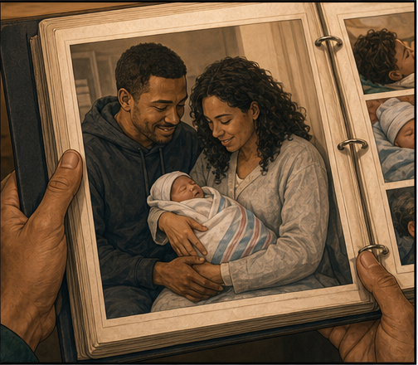
ROMANS 6:4-11
The Spirit joins the believer to Christ.
Regeneration is not a detachable substance implanted apart from Jesus.
The Spirit joins the believer to the risen Son so that Christ's life becomes his life.
UNION NAMES THE RELATIONSHIP
FOUND • SESSION 11
07
Notes:
Regeneration is inseparable from union with Christ. Life is not a detachable substance placed inside someone apart from Jesus.
[Sources]
- /Volumes/T7 Shield/neocities-fireprooofcommentaries/rc3/09_Youth_Resources/Found/Leader_Guides/RC3-Found-Leader-11-NewBirth.pdf
- /Volumes/T7 Shield/neocities-fireprooofcommentaries/rc3/09_Youth_Resources/Found/Student_Handouts/RC3-Found-Handout-11-NewBirth.pdf
- /Volumes/T7 Shield/neocities-fireprooofcommentaries/rc3/09_Youth_Resources/Found/Video_Plans/Session_11_Assets/Found-11-One-Birth-Many-Realities-Storyboard-v1.png

Slide 8
2 CORINTHIANS 5:17
A new origin and existence begin.
New birth names origin, family, identity, inheritance, and future.
New creation names the resulting existence in Christ—not improvement of Adam's old life.
THE SAME PERSON • A NEW HUMANITY
FOUND • SESSION 11
08
Notes:
Distinguish new birth as new origin from new creation as new existence. The same person remains but belongs to Christ's new humanity.
[Sources]
- /Volumes/T7 Shield/neocities-fireprooofcommentaries/rc3/09_Youth_Resources/Found/Leader_Guides/RC3-Found-Leader-11-NewBirth.pdf
- /Volumes/T7 Shield/neocities-fireprooofcommentaries/rc3/09_Youth_Resources/Found/Student_Handouts/RC3-Found-Handout-11-NewBirth.pdf
- /Volumes/T7 Shield/neocities-fireprooofcommentaries/rc3/09_Youth_Resources/Found/Video_Plans/Session_11_Assets/Found-11-One-Birth-Many-Realities-Storyboard-v1.png

Slide 9
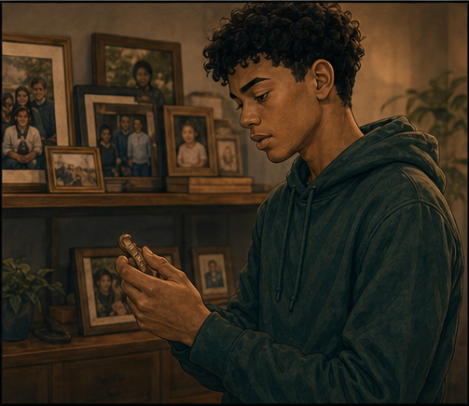
1 JOHN 5:11-12
Eternal life begins now.
The believer possesses the risen Son's life now through the Spirit.
The mortal body may die, but death cannot sever him from Christ. Resurrection completes what began.
PRESENT LIFE • FUTURE BODY
FOUND • SESSION 11
09
Notes:
Eternal life is the risen Son's life shared now. The mortal body may die, but resurrection will bodily complete what began.
[Sources]
- /Volumes/T7 Shield/neocities-fireprooofcommentaries/rc3/09_Youth_Resources/Found/Leader_Guides/RC3-Found-Leader-11-NewBirth.pdf
- /Volumes/T7 Shield/neocities-fireprooofcommentaries/rc3/09_Youth_Resources/Found/Student_Handouts/RC3-Found-Handout-11-NewBirth.pdf
- /Volumes/T7 Shield/neocities-fireprooofcommentaries/rc3/09_Youth_Resources/Found/Video_Plans/Session_11_Assets/Found-11-One-Birth-Many-Realities-Storyboard-v1.png

Slide 10
SYNTHESIS
One saving event has many dimensions.
CONVERSION
REGENERATION
The decisive passage from Adam into Christ.
The Spirit's act of giving life.
UNION WITH CHRIST
NEW BIRTH
The living relationship established.
A new origin, family, identity, and future.
ETERNAL LIFE
NEW CREATION
Christ's risen life possessed now and forever.
The believer's resulting existence in Christ.
FOUND • SESSION 11
10
Notes:
Review the six dimensions as one saving event. Do not turn them into a stopwatch sequence or separate transactions.
[Sources]
- /Volumes/T7 Shield/neocities-fireprooofcommentaries/rc3/09_Youth_Resources/Found/Leader_Guides/RC3-Found-Leader-11-NewBirth.pdf
- /Volumes/T7 Shield/neocities-fireprooofcommentaries/rc3/09_Youth_Resources/Found/Student_Handouts/RC3-Found-Handout-11-NewBirth.pdf
- /Volumes/T7 Shield/neocities-fireprooofcommentaries/rc3/09_Youth_Resources/Found/Visual_Theology/Found-11-Visual-Theology.png

Slide 11
KEEP THE ORDER CLEAR
Christ Himself remains the believer's life.
Life is in the Son—not detached from Him as a spiritual substance.
Union does not absorb the believer into God. Received life remains creaturely and dependent upon God.
HE THAT HATH THE SON HATH LIFE
FOUND • SESSION 11
11
Notes:
Guard union carefully. Believers share Christ's risen human life without being absorbed into God or receiving divine aseity.
[Sources]
- /Volumes/T7 Shield/neocities-fireprooofcommentaries/rc3/09_Youth_Resources/Found/Leader_Guides/RC3-Found-Leader-11-NewBirth.pdf
- /Volumes/T7 Shield/neocities-fireprooofcommentaries/rc3/09_Youth_Resources/Found/Student_Handouts/RC3-Found-Handout-11-NewBirth.pdf
- /Volumes/T7 Shield/neocities-fireprooofcommentaries/rc3/09_Youth_Resources/Found/Video_Plans/Session_11_Assets/Found-11-One-Birth-Many-Realities-Storyboard-v1.png

Slide 12
KEEP THESE DISTINCT
What new birth does—and does not—mean.
1
FAITH
The sinner genuinely entrusts himself to Christ; faith does not generate life.
2
THE SPIRIT
The Spirit gives life; He does not believe for a passive sinner.
3
ORDER
Regeneration is not placed secretly before saving faith.
4
UNION
The believer is joined to Christ without becoming divine or self-existent.
5
BODY
Eternal life begins now; bodily resurrection still awaits Christ's coming.
FOUND • SESSION 11
12
Notes:
Correct both errors: faith does not create life, and the Spirit does not perform faith. Do not place regeneration before saving faith.
[Sources]
- /Volumes/T7 Shield/neocities-fireprooofcommentaries/rc3/09_Youth_Resources/Found/Leader_Guides/RC3-Found-Leader-11-NewBirth.pdf
- /Volumes/T7 Shield/neocities-fireprooofcommentaries/rc3/09_Youth_Resources/Found/Student_Handouts/RC3-Found-Handout-11-NewBirth.pdf

Slide 13
DISCUSSION
Let's think it through
1
What does the sinner do, and what does the Spirit do?
2
Why is regeneration inseparable from union with Christ?
3
How do new birth and new creation differ in emphasis?
4
Why is eternal life more than endless existence?
5
What has begun now, and what still awaits resurrection?
FOUND • SESSION 11
13
Notes:
Use the leader-guide follow-ups to distinguish each doctrine while preserving their unity in Christ.
[Sources]
- /Volumes/T7 Shield/neocities-fireprooofcommentaries/rc3/09_Youth_Resources/Found/Leader_Guides/RC3-Found-Leader-11-NewBirth.pdf

Slide 14
MEMORY VERSE • 1 JOHN 5:12
“He that hath the Son hath life; and he that hath not the Son of God hath not life.”
Christ Himself remains the believer's life—possessed now and completed bodily in resurrection.
THIS WEEK
YOU MAY TALK WITH US
Read Romans 6:1-11 and 1 John 5:11-12. Mark every phrase connecting life to Christ.
Do not pronounce new birth merely because a student repeated words. Ask whom he trusts and return him to the Son in whom life is found.
FOUND • SESSION 11
14
Notes:
Read the memory verse together. Offer private conversation without automatic reassurance or a manufactured decision.
[Sources]
- /Volumes/T7 Shield/neocities-fireprooofcommentaries/rc3/09_Youth_Resources/Found/Leader_Guides/RC3-Found-Leader-11-NewBirth.pdf
- /Volumes/T7 Shield/neocities-fireprooofcommentaries/rc3/09_Youth_Resources/Found/Student_Handouts/RC3-Found-Handout-11-NewBirth.pdf

