Slide 1
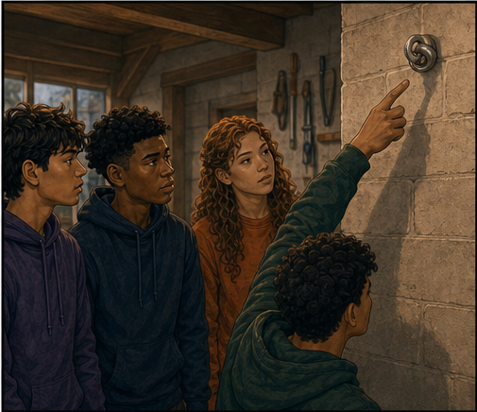
RC3 • LIFE IN CHRIST
FOUND
SESSION 12
HOW CAN I KNOW
I AM SAVED?
Assurance Without Pretending,
Panic, or Empty Confidence
Fireproof Studies • James J. Burke
Notes:
Introduce assurance without automatic reassurance or panic. The foundation is Christ's work and God's trustworthy testimony.
[Sources]
- /Volumes/T7 Shield/neocities-fireprooofcommentaries/rc3/09_Youth_Resources/Found/Leader_Guides/RC3-Found-Leader-12-Assurance.pdf
- /Volumes/T7 Shield/neocities-fireprooofcommentaries/rc3/09_Youth_Resources/Found/Video_Plans/Session_12_Assets/Found-12-What-Can-Hold-the-Weight-Storyboard-v1.png

Slide 2
OPENING ACTIVITY
What can hold your confidence?
Which foundation remains steady outside your changing experience?
1
2
3
4
I remember praying.
I was baptized.
I feel certain.
Christ finished His work, and God promised life in His Son.
Memories blur and feelings change. Christ and God's testimony remain trustworthy.
FOUND • SESSION 12
02
Notes:
Test the four proposed foundations. Memories, feelings, and religious acts can change or exist without surrender; Christ's work stands outside us.
[Sources]
- /Volumes/T7 Shield/neocities-fireprooofcommentaries/rc3/09_Youth_Resources/Found/Leader_Guides/RC3-Found-Leader-12-Assurance.pdf
- /Volumes/T7 Shield/neocities-fireprooofcommentaries/rc3/09_Youth_Resources/Found/Student_Handouts/RC3-Found-Handout-12-Assurance.pdf

Slide 3
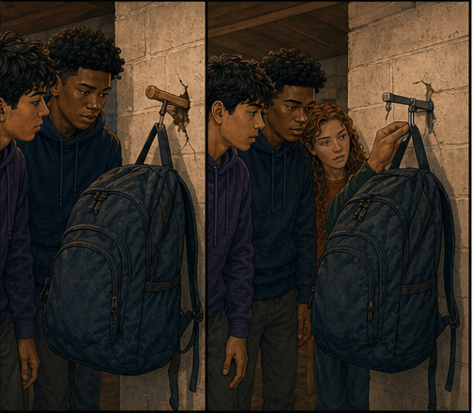
WHAT CAN HOLD THE WEIGHT?
Changing supports cannot carry assurance.
Memory, feeling, and performance may bend or fail under pressure.
A person's changing experience cannot finally bear the full weight of belonging to Christ.
FRAGILE SUPPORTS CANNOT BECOME THE FOUNDATION
FOUND • SESSION 12
03
Notes:
Use the failing hooks to show why changing experience cannot carry the full weight of assurance. Keep the demonstration safe and ordinary.
[Sources]
- /Volumes/T7 Shield/neocities-fireprooofcommentaries/rc3/09_Youth_Resources/Found/Video_Plans/Found-12-Illustrative-Video-Plan.md
- /Volumes/T7 Shield/neocities-fireprooofcommentaries/rc3/09_Youth_Resources/Found/Video_Plans/Session_12_Assets/Found-12-What-Can-Hold-the-Weight-Storyboard-v1.png
- /Volumes/T7 Shield/neocities-fireprooofcommentaries/rc3/09_Youth_Resources/Found/Leader_Guides/RC3-Found-Leader-12-Assurance.pdf

Slide 4
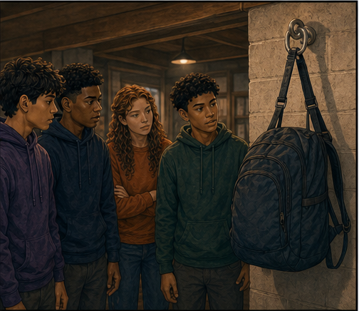
THE FIXED ANCHOR
The weight rests on what does not move.
The load is held by the fixed anchor—not by anyone's grip.
Assurance begins with Christ's finished work and God's trustworthy promise concerning His Son.
HELD BY CHRIST
FOUND • SESSION 12
04
Notes:
Let the fixed anchor carry the metaphor. Assurance begins with Christ and God's promise, not with the strength of introspection.
[Sources]
- /Volumes/T7 Shield/neocities-fireprooofcommentaries/rc3/09_Youth_Resources/Found/Video_Plans/Found-12-Illustrative-Video-Plan.md
- /Volumes/T7 Shield/neocities-fireprooofcommentaries/rc3/09_Youth_Resources/Found/Video_Plans/Session_12_Assets/Found-12-What-Can-Hold-the-Weight-Storyboard-v1.png
- /Volumes/T7 Shield/neocities-fireprooofcommentaries/rc3/09_Youth_Resources/Found/Leader_Guides/RC3-Found-Leader-12-Assurance.pdf

Slide 5

BIG IDEA
Assurance rests first in Christ
and God's trustworthy promise.
It then recognizes the Spirit's witness and the rooted life He produces.
Fruit confirms the root; it never replaces Christ or purchases salvation.
FOUND • SESSION 12
05
Notes:
State the order clearly: foundation first, then confirming witnesses. Fruit strengthens confidence but never replaces Christ.
[Sources]
- /Volumes/T7 Shield/neocities-fireprooofcommentaries/rc3/09_Youth_Resources/Found/Leader_Guides/RC3-Found-Leader-12-Assurance.pdf
- /Volumes/T7 Shield/neocities-fireprooofcommentaries/rc3/09_Youth_Resources/Found/Student_Handouts/RC3-Found-Handout-12-Assurance.pdf

Slide 6

1 JOHN 5:9-13
Begin with God's testimony concerning His Son.
God has given eternal life, and this life is in His Son.
Assurance begins outside changing emotion: Christ accomplished salvation, and God promises life to believers.
CHRIST AND GOD'S WORD ARE THE FOUNDATION
FOUND • SESSION 12
06
Notes:
Read 1 John 5:9-13. Eternal life is in God's Son, and God promises life to those who believe on Him.
[Sources]
- /Volumes/T7 Shield/neocities-fireprooofcommentaries/rc3/09_Youth_Resources/Found/Leader_Guides/RC3-Found-Leader-12-Assurance.pdf
- /Volumes/T7 Shield/neocities-fireprooofcommentaries/rc3/09_Youth_Resources/Found/Student_Handouts/RC3-Found-Handout-12-Assurance.pdf
- /Volumes/T7 Shield/neocities-fireprooofcommentaries/rc3/09_Youth_Resources/Found/Video_Plans/Session_12_Assets/Found-12-What-Can-Hold-the-Weight-Storyboard-v1.png

Slide 7
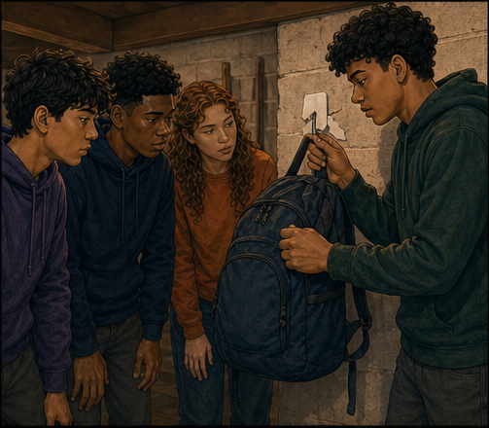
JOHN 10:27-30
Look for present trust in the living Shepherd.
Christ's sheep hear His voice and follow Him as the One to whom they belong.
Their safety rests in His knowledge, gift, and keeping hands—not a past moment detached from present trust.
HELD BY CHRIST—not the strength of our grip
FOUND • SESSION 12
07
Notes:
Use John 10 to ask whom the student trusts now. Christ's sheep are held by His knowledge, gift, and keeping hands.
[Sources]
- /Volumes/T7 Shield/neocities-fireprooofcommentaries/rc3/09_Youth_Resources/Found/Leader_Guides/RC3-Found-Leader-12-Assurance.pdf
- /Volumes/T7 Shield/neocities-fireprooofcommentaries/rc3/09_Youth_Resources/Found/Student_Handouts/RC3-Found-Handout-12-Assurance.pdf
- /Volumes/T7 Shield/neocities-fireprooofcommentaries/rc3/09_Youth_Resources/Found/Video_Plans/Session_12_Assets/Found-12-What-Can-Hold-the-Weight-Storyboard-v1.png

Slide 8
ROMANS 8:14-17
Receive the Spirit's witness and seal.
The Spirit marks believers as God's own and bears witness to adoption.
He works within them the cry of children toward their Father; His witness is deeper than a constant feeling.
GOD GIVES HIS OWN SPIRIT AS A PLEDGE
FOUND • SESSION 12
08
Notes:
The Spirit's witness and seal are God's work, deeper than a constant emotional feeling. Do not reduce His witness to mood.
[Sources]
- /Volumes/T7 Shield/neocities-fireprooofcommentaries/rc3/09_Youth_Resources/Found/Leader_Guides/RC3-Found-Leader-12-Assurance.pdf
- /Volumes/T7 Shield/neocities-fireprooofcommentaries/rc3/09_Youth_Resources/Found/Student_Handouts/RC3-Found-Handout-12-Assurance.pdf
- /Volumes/T7 Shield/neocities-fireprooofcommentaries/rc3/09_Youth_Resources/Found/Video_Plans/Session_12_Assets/Found-12-What-Can-Hold-the-Weight-Storyboard-v1.png

Slide 9
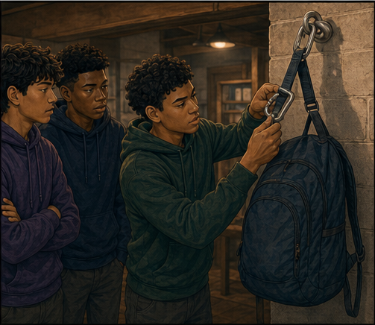
1 JOHN 3:18-24
Recognize rooted life by its fruit.
Continuing faith, love, obedience, fruit, and endurance do not purchase salvation.
They are Christ's risen life becoming visible and therefore strengthen confidence that the Word took root.
FRUIT CONFIRMS THE ROOT • IT NEVER REPLACES IT
FOUND • SESSION 12
09
Notes:
Faith, love, obedience, fruit, and endurance confirm rooted life without purchasing salvation.
[Sources]
- /Volumes/T7 Shield/neocities-fireprooofcommentaries/rc3/09_Youth_Resources/Found/Leader_Guides/RC3-Found-Leader-12-Assurance.pdf
- /Volumes/T7 Shield/neocities-fireprooofcommentaries/rc3/09_Youth_Resources/Found/Student_Handouts/RC3-Found-Handout-12-Assurance.pdf
- /Volumes/T7 Shield/neocities-fireprooofcommentaries/rc3/09_Youth_Resources/Found/Video_Plans/Session_12_Assets/Found-12-What-Can-Hold-the-Weight-Storyboard-v1.png

Slide 10
SYNTHESIS
Foundation first. Confirming witnesses second.
FOUNDATION
SPIRIT
Christ's finished work and God's promise of life in His Son.
God's presence, witness, and seal.
FAITH
LOVE
Continuing reliance upon the living Christ.
Christ's life becoming visible toward others.
OBEDIENCE
ENDURANCE
His authority received in the believer's life.
Rooted life that remains through trial and dryness.
FOUND • SESSION 12
10
Notes:
Keep foundation and confirmation distinct. Christ and God's promise ground assurance; the Spirit's rooted work confirms it.
[Sources]
- /Volumes/T7 Shield/neocities-fireprooofcommentaries/rc3/09_Youth_Resources/Found/Leader_Guides/RC3-Found-Leader-12-Assurance.pdf
- /Volumes/T7 Shield/neocities-fireprooofcommentaries/rc3/09_Youth_Resources/Found/Student_Handouts/RC3-Found-Handout-12-Assurance.pdf
- /Volumes/T7 Shield/neocities-fireprooofcommentaries/rc3/09_Youth_Resources/Found/Visual_Theology/Found-12-Visual-Theology.png

Slide 11
KEEP THE ORDER CLEAR
The believer is held by Christ.
His keeping hands—not the strength of today's grip—carry the believer.
Doubt calls for truth, not panic. Empty certainty without present trust and rooted life should be tested.
PROMISE BEFORE FEELING • CHRIST BEFORE INTROSPECTION
FOUND • SESSION 12
11
Notes:
Doubt is not itself proof of lostness, and certainty is not itself proof of life. Return the student to Christ, Scripture, and present trust.
[Sources]
- /Volumes/T7 Shield/neocities-fireprooofcommentaries/rc3/09_Youth_Resources/Found/Leader_Guides/RC3-Found-Leader-12-Assurance.pdf
- /Volumes/T7 Shield/neocities-fireprooofcommentaries/rc3/09_Youth_Resources/Found/Student_Handouts/RC3-Found-Handout-12-Assurance.pdf
- /Volumes/T7 Shield/neocities-fireprooofcommentaries/rc3/09_Youth_Resources/Found/Video_Plans/Session_12_Assets/Found-12-What-Can-Hold-the-Weight-Storyboard-v1.png

Slide 12
KEEP THESE DISTINCT
Unsafe anchors cannot become assurance.
1
A REMEMBERED PRAYER
Words may have been repeated without surrender.
2
BAPTISM OR CHURCH
Good gifts can be present without union with Christ.
3
STRONG FEELINGS
Emotion rises and falls and cannot carry the full weight.
4
A MORAL RECORD
Fruit cannot purchase the salvation it may confirm.
5
DOUBT
Fear or dryness is not itself a verdict; return to Christ and His Word.
FOUND • SESSION 12
12
Notes:
Do not give assurance merely because a student prayed, was baptized, attends church, feels sincere, or cannot remember unbelief.
[Sources]
- /Volumes/T7 Shield/neocities-fireprooofcommentaries/rc3/09_Youth_Resources/Found/Leader_Guides/RC3-Found-Leader-12-Assurance.pdf
- /Volumes/T7 Shield/neocities-fireprooofcommentaries/rc3/09_Youth_Resources/Found/Student_Handouts/RC3-Found-Handout-12-Assurance.pdf

Slide 13
DISCUSSION
Let's think it through
1
Why can't feelings carry the full weight of assurance?
2
What does 1 John 5 say God has testified?
3
How does John 10 describe Christ's sheep?
4
How does the Spirit strengthen assurance?
5
How can fruit confirm life without earning it?
FOUND • SESSION 12
13
Notes:
Listen before answering. Use these questions to uncover what presently grounds the student's confidence.
[Sources]
- /Volumes/T7 Shield/neocities-fireprooofcommentaries/rc3/09_Youth_Resources/Found/Leader_Guides/RC3-Found-Leader-12-Assurance.pdf

Slide 14
MEMORY VERSE • 1 JOHN 5:13
“These things have I written unto you that believe on the name of the Son of God; that ye may know that ye have eternal life.”
Real assurance rests in Christ and reads the Spirit's rooted work without pretending or panicking.
THIS WEEK
YOU MAY TALK WITH US
Read 1 John 5:9-13. Write what God says He has given and where it is found.
If you are unsure, open Scripture with a leader. We will neither manufacture certainty nor feed panic.
FOUND • SESSION 12
14
Notes:
Read the memory verse. Offer private follow-up that opens Scripture without manufacturing certainty or protecting empty confidence.
[Sources]
- /Volumes/T7 Shield/neocities-fireprooofcommentaries/rc3/09_Youth_Resources/Found/Leader_Guides/RC3-Found-Leader-12-Assurance.pdf
- /Volumes/T7 Shield/neocities-fireprooofcommentaries/rc3/09_Youth_Resources/Found/Student_Handouts/RC3-Found-Handout-12-Assurance.pdf

