Slide 1
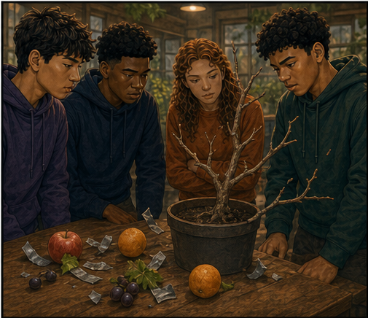
RC3 • LIFE IN CHRIST
FOUND
SESSION 13
WHAT DOES LIVING
IN CHRIST LOOK LIKE?
The New Life Takes Root
and Becomes Visible
Fireproof Studies • James J. Burke
Notes:
Introduce Christian living as life received from Christ and made visible through the Spirit. Keep root before fruit.
[Sources]
- /Volumes/T7 Shield/neocities-fireprooofcommentaries/rc3/09_Youth_Resources/Found/Leader_Guides/RC3-Found-Leader-13-LivingInChrist.pdf
- /Volumes/T7 Shield/neocities-fireprooofcommentaries/rc3/09_Youth_Resources/Found/Video_Plans/Session_13_Assets/Found-13-Root-Before-Fruit-Storyboard-v1.png

Slide 2
OPENING ACTIVITY
Root or fruit?
Which parts supply life—and which parts show that life is present?
1
2
3
4
ROOTS
STEM
BRANCHES
FRUIT
The branch does not create life by producing fruit. It bears fruit because it lives from the vine.
FOUND • SESSION 13
02
Notes:
Draw or name roots, stem, branches, and fruit. Ask which supplies life and which reveals that life is present.
[Sources]
- /Volumes/T7 Shield/neocities-fireprooofcommentaries/rc3/09_Youth_Resources/Found/Leader_Guides/RC3-Found-Leader-13-LivingInChrist.pdf
- /Volumes/T7 Shield/neocities-fireprooofcommentaries/rc3/09_Youth_Resources/Found/Student_Handouts/RC3-Found-Handout-13-LivingInChrist.pdf

Slide 3
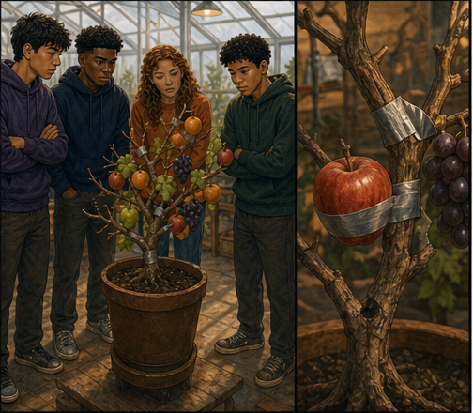
ROOT BEFORE FRUIT
Attached fruit can imitate life for a moment.
Decoration can make a dead branch look productive from a distance.
But taped fruit does not create roots, living connection, growth, or life.
APPEARANCE CANNOT MANUFACTURE LIFE
FOUND • SESSION 13
03
Notes:
Use the taped-fruit illustration to expose appearance without life. Christian activity cannot manufacture spiritual life.
[Sources]
- /Volumes/T7 Shield/neocities-fireprooofcommentaries/rc3/09_Youth_Resources/Found/Video_Plans/Found-13-Illustrative-Video-Plan.md
- /Volumes/T7 Shield/neocities-fireprooofcommentaries/rc3/09_Youth_Resources/Found/Video_Plans/Session_13_Assets/Found-13-Root-Before-Fruit-Storyboard-v1.png
- /Volumes/T7 Shield/neocities-fireprooofcommentaries/rc3/09_Youth_Resources/Found/Leader_Guides/RC3-Found-Leader-13-LivingInChrist.pdf

Slide 4
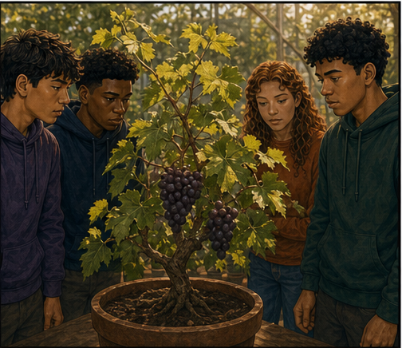
LIVING CONNECTION
Real fruit grows from received life.
The living plant remains connected, receives what it needs, and bears fruit.
Christian growth is active dependence upon Christ through the Spirit—not self-powered reform.
ROOT FIRST • FRUIT FOLLOWS
FOUND • SESSION 13
04
Notes:
Show real fruit emerging from living connection. The analogy prepares for John 15; it does not explain union by itself.
[Sources]
- /Volumes/T7 Shield/neocities-fireprooofcommentaries/rc3/09_Youth_Resources/Found/Video_Plans/Found-13-Illustrative-Video-Plan.md
- /Volumes/T7 Shield/neocities-fireprooofcommentaries/rc3/09_Youth_Resources/Found/Video_Plans/Session_13_Assets/Found-13-Root-Before-Fruit-Storyboard-v1.png
- /Volumes/T7 Shield/neocities-fireprooofcommentaries/rc3/09_Youth_Resources/Found/Leader_Guides/RC3-Found-Leader-13-LivingInChrist.pdf

Slide 5

BIG IDEA
Christ's life takes root and becomes
visible through the Spirit.
The believer lives from Christ and increasingly displays His life as rooted fruit.
Good works are fruit of Christ's life—never the root, price, or means of preserving it.
FOUND • SESSION 13
05
Notes:
State the big idea. Good works are the fruit of Christ's life, never the root, price, or means of preserving salvation.
[Sources]
- /Volumes/T7 Shield/neocities-fireprooofcommentaries/rc3/09_Youth_Resources/Found/Leader_Guides/RC3-Found-Leader-13-LivingInChrist.pdf
- /Volumes/T7 Shield/neocities-fireprooofcommentaries/rc3/09_Youth_Resources/Found/Student_Handouts/RC3-Found-Handout-13-LivingInChrist.pdf

Slide 6
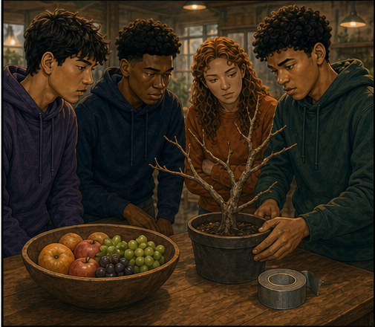
JOHN 15:1-11
Live from Christ, the true Vine.
The believer never graduates from dependence upon Christ.
His Word, love, and life shape the branch so that fruit appears. Fruit reveals received life; it does not create union.
CHRIST REMAINS THE SOURCE
FOUND • SESSION 13
06
Notes:
Read John 15. Abiding means continuing dependence and fellowship with Christ; fruit reveals received life.
[Sources]
- /Volumes/T7 Shield/neocities-fireprooofcommentaries/rc3/09_Youth_Resources/Found/Leader_Guides/RC3-Found-Leader-13-LivingInChrist.pdf
- /Volumes/T7 Shield/neocities-fireprooofcommentaries/rc3/09_Youth_Resources/Found/Student_Handouts/RC3-Found-Handout-13-LivingInChrist.pdf
- /Volumes/T7 Shield/neocities-fireprooofcommentaries/rc3/09_Youth_Resources/Found/Video_Plans/Session_13_Assets/Found-13-Root-Before-Fruit-Storyboard-v1.png

Slide 7
GALATIANS 5:16-25
Walk by the Spirit.
The Spirit opposes the desires of the flesh and produces Christlike character.
Growth is active dependence—not passive waiting and not self-powered improvement.
THE SPIRIT WHO GIVES LIFE ENABLES THE WALK
FOUND • SESSION 13
07
Notes:
Walking by the Spirit is active dependence. Avoid both passive waiting and self-powered moral reform.
[Sources]
- /Volumes/T7 Shield/neocities-fireprooofcommentaries/rc3/09_Youth_Resources/Found/Leader_Guides/RC3-Found-Leader-13-LivingInChrist.pdf
- /Volumes/T7 Shield/neocities-fireprooofcommentaries/rc3/09_Youth_Resources/Found/Student_Handouts/RC3-Found-Handout-13-LivingInChrist.pdf
- /Volumes/T7 Shield/neocities-fireprooofcommentaries/rc3/09_Youth_Resources/Found/Video_Plans/Session_13_Assets/Found-13-Root-Before-Fruit-Storyboard-v1.png

Slide 8
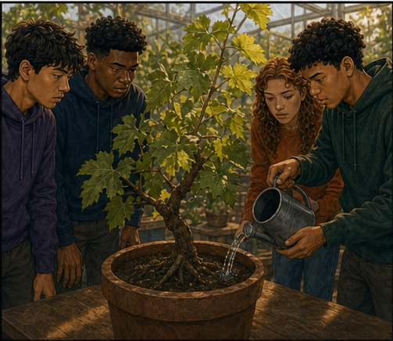
ACTS 2:41-47
Grow with Christ's people.
Scripture, prayer, fellowship, worship, baptism, and the Lord's Supper belong to ordinary Christian life.
New life is personal, but it was never designed to be solitary.
CHURCH LIFE IS ORDINARY—not optional
FOUND • SESSION 13
08
Notes:
Place baptism, Scripture, prayer, fellowship, the Lord's Supper, worship, and mutual care within ordinary church life.
[Sources]
- /Volumes/T7 Shield/neocities-fireprooofcommentaries/rc3/09_Youth_Resources/Found/Leader_Guides/RC3-Found-Leader-13-LivingInChrist.pdf
- /Volumes/T7 Shield/neocities-fireprooofcommentaries/rc3/09_Youth_Resources/Found/Student_Handouts/RC3-Found-Handout-13-LivingInChrist.pdf
- /Volumes/T7 Shield/neocities-fireprooofcommentaries/rc3/09_Youth_Resources/Found/Video_Plans/Session_13_Assets/Found-13-Root-Before-Fruit-Storyboard-v1.png

Slide 9
EPHESIANS 2:8-10
Serve and bear witness.
Grace creates a people prepared for good works.
Service and witness make Christ's life visible and carry His Gospel toward others.
WORKS ARE APPOINTED FRUIT—not grace's purchase price
FOUND • SESSION 13
09
Notes:
Ephesians 2 places good works after grace as God's appointed fruit. Service and witness make Christ's life visible.
[Sources]
- /Volumes/T7 Shield/neocities-fireprooofcommentaries/rc3/09_Youth_Resources/Found/Leader_Guides/RC3-Found-Leader-13-LivingInChrist.pdf
- /Volumes/T7 Shield/neocities-fireprooofcommentaries/rc3/09_Youth_Resources/Found/Student_Handouts/RC3-Found-Handout-13-LivingInChrist.pdf
- /Volumes/T7 Shield/neocities-fireprooofcommentaries/rc3/09_Youth_Resources/Found/Video_Plans/Session_13_Assets/Found-13-Root-Before-Fruit-Storyboard-v1.png

Slide 10
SYNTHESIS
A rooted week receives, expresses, and shares life.
SCRIPTURE
PRAYER
Hear and remember Christ's Word.
Depend upon the Father.
CHURCH
OBEDIENCE
Worship, learn, and share life.
Receive Christ's authority.
SERVICE
WITNESS
Give yourself for others.
Speak of Christ and His Gospel.
FOUND • SESSION 13
10
Notes:
Use the rooted-week practices as ways believers receive, express, and share life in Christ—not ways to purchase it.
[Sources]
- /Volumes/T7 Shield/neocities-fireprooofcommentaries/rc3/09_Youth_Resources/Found/Leader_Guides/RC3-Found-Leader-13-LivingInChrist.pdf
- /Volumes/T7 Shield/neocities-fireprooofcommentaries/rc3/09_Youth_Resources/Found/Student_Handouts/RC3-Found-Handout-13-LivingInChrist.pdf
- /Volumes/T7 Shield/neocities-fireprooofcommentaries/rc3/09_Youth_Resources/Found/Visual_Theology/Found-13-Visual-Theology.png

Slide 11
KEEP THE ORDER CLEAR
Good works are fruit—not root.
Believers obey because they are alive in Christ.
Abiding is continuing dependence and fellowship, not keeping oneself joined to Christ by sufficient effort.
CHRIST REMAINS THE BELIEVER'S LIFE
FOUND • SESSION 13
11
Notes:
Do not turn spiritual disciplines into conditions for creating, purchasing, or preserving salvation. Christ remains the source.
[Sources]
- /Volumes/T7 Shield/neocities-fireprooofcommentaries/rc3/09_Youth_Resources/Found/Leader_Guides/RC3-Found-Leader-13-LivingInChrist.pdf
- /Volumes/T7 Shield/neocities-fireprooofcommentaries/rc3/09_Youth_Resources/Found/Student_Handouts/RC3-Found-Handout-13-LivingInChrist.pdf
- /Volumes/T7 Shield/neocities-fireprooofcommentaries/rc3/09_Youth_Resources/Found/Video_Plans/Session_13_Assets/Found-13-Root-Before-Fruit-Storyboard-v1.png

Slide 12
KEEP THESE DISTINCT
Keep the source and its fruit in the right order.
1
ROOT
Union with Christ and life by the Spirit.
2
PRACTICE
Scripture, prayer, and church help us receive and express life in Christ.
3
GROWTH
The Spirit produces Christlike character through active dependence.
4
FRUIT
Love, obedience, service, and witness make received life visible.
5
GRACE
Fruit never becomes the price of the life from which it grows.
FOUND • SESSION 13
12
Notes:
Keep source, practice, growth, and fruit in order. Fruit confirms life but never becomes its cause or price.
[Sources]
- /Volumes/T7 Shield/neocities-fireprooofcommentaries/rc3/09_Youth_Resources/Found/Leader_Guides/RC3-Found-Leader-13-LivingInChrist.pdf
- /Volumes/T7 Shield/neocities-fireprooofcommentaries/rc3/09_Youth_Resources/Found/Student_Handouts/RC3-Found-Handout-13-LivingInChrist.pdf

Slide 13
DISCUSSION
Let's think it through
1
Why can't a branch manufacture its own life?
2
How is walking by the Spirit both dependent and active?
3
Why does new life belong in a local church?
4
How do good works display grace without earning it?
5
Which practice needs a faithful next step this week?
FOUND • SESSION 13
13
Notes:
Use the questions to help students identify one faithful next step without assigning habits as a substitute for conversion.
[Sources]
- /Volumes/T7 Shield/neocities-fireprooofcommentaries/rc3/09_Youth_Resources/Found/Leader_Guides/RC3-Found-Leader-13-LivingInChrist.pdf

Slide 14
MEMORY VERSE • GALATIANS 5:25
“If we live in the Spirit, let us also walk in the Spirit.”
Because the Spirit gives life, the believer actively walks in dependence and bears Christlike fruit.
THIS WEEK
YOU MAY TALK WITH US
Choose one rooted practice—Scripture, prayer, or church—and one outward fruit: obedience, service, or witness.
If Christian activity is replacing conversion or dependence upon Christ, return to the Gospel rather than assigning more habits.
FOUND • SESSION 13
14
Notes:
Read the memory verse. Close the series with dependence upon Christ, gratitude, church life, service, and witness.
[Sources]
- /Volumes/T7 Shield/neocities-fireprooofcommentaries/rc3/09_Youth_Resources/Found/Leader_Guides/RC3-Found-Leader-13-LivingInChrist.pdf
- /Volumes/T7 Shield/neocities-fireprooofcommentaries/rc3/09_Youth_Resources/Found/Student_Handouts/RC3-Found-Handout-13-LivingInChrist.pdf

