Slide 1
Lab 3 : Analog Signal and Serial Interface
Asst. Prof. Dr.Sumek Wisayataksin
Faculty of Engineering
King Mongkut’s Institute of Technology Ladkrabang

Slide 2
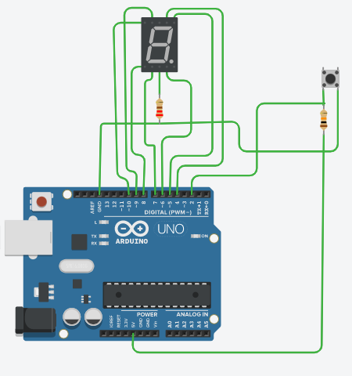
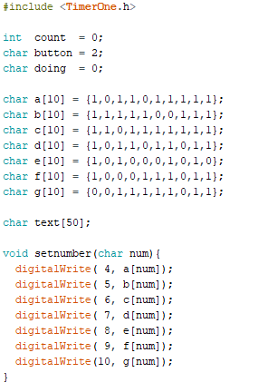
Lab 2.3 : 7-Segment Countdown

Slide 3
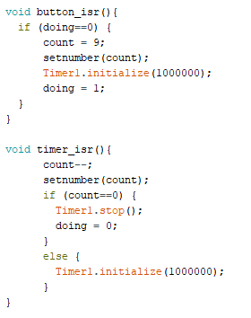
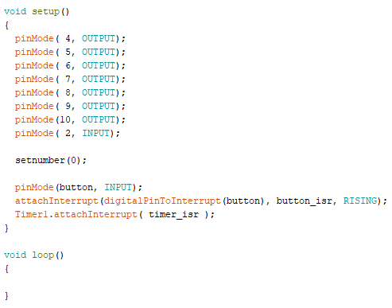
Lab 2.3 : 7-Segment Countdown

Slide 4
Digital Signal
Digital signal has only 2 level of voltages. We represent them as logic 1 and logic 0
logic1
5V
logic0
0V

Slide 5
Analog Signal
Analog signal is a continuous signal that has unlimited level of voltage.
4.35824v
5V
0V
2.5957 v

Slide 6
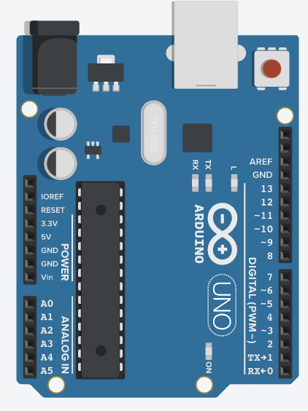
Use Arduino to Read/Write Digital Signal
Arduino has 14 Digital Ports.
WRITE : digitalWrite(PORT, 0/1);
READ : digitalRead(PORT);
5V
logic1
logic0
0V

Slide 7
Use Arduino to Read Analog Signal
Arduino has 5 Digital Ports.
READ : analogRead(PORT);
5V
A0-A5
0V

Slide 8
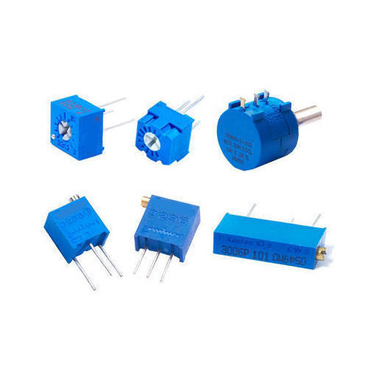
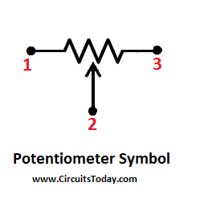
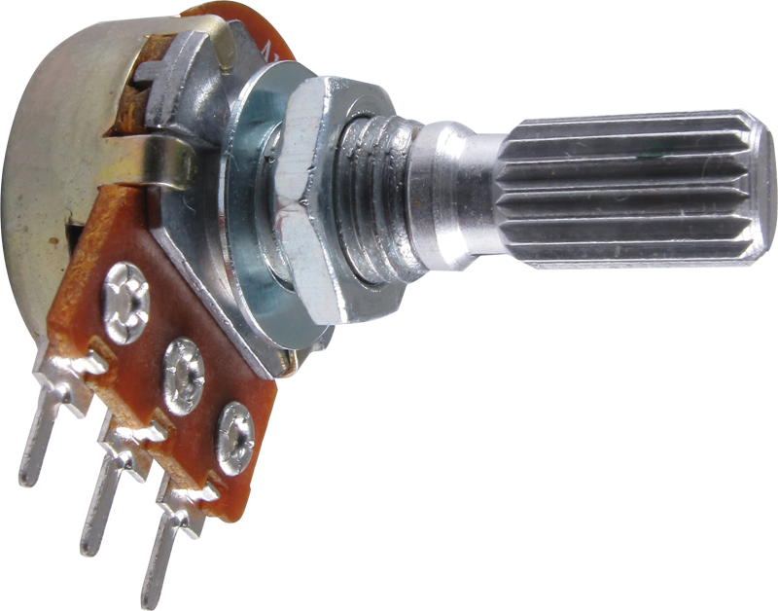
Potentiometer
Potentiometer is an adjustable resistor. You can choose the resistance that you want by moving like a volume.

Slide 9
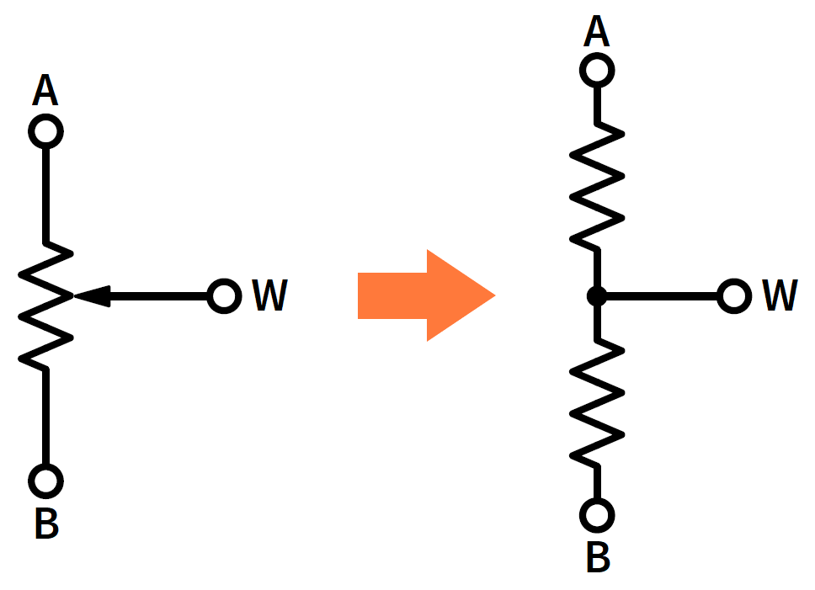
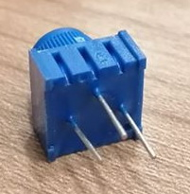

Potentiometer
Potentiometer looks like 2 resistors connected in series.
3
5V
$$V_{2}=5\left(\frac{R_{A}}{R_{A}+R_{B}}\right)$$
3
R_{A}
2
2
R_{B}
1
0V
1
3
1
2

Slide 10
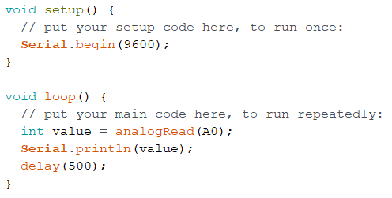
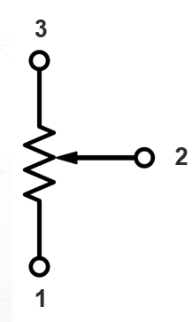
Lab 3.1 : analogRead
3
1
2
5V
A0
GND
Notes:
You can also get at a maximum 10 bit number from using the analogRead() function. If you want a decimal number, use float instead of int.

Slide 11
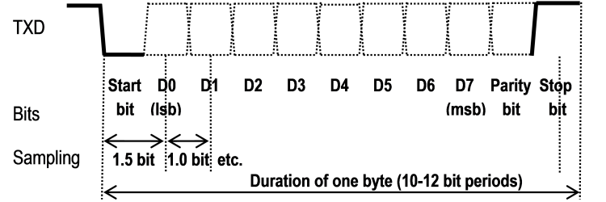
Serial Communication
Universal Asynchronous Receiver-Transmitter (UART)

Slide 12
Serial Communication
Universal Asynchronous Receiver-Transmitter (UART)
Standard BAUD Rate :
110,300,600,1200,2400,4800,9600,
14490,19200,38400,57600,115200,
12800,256000

Slide 13
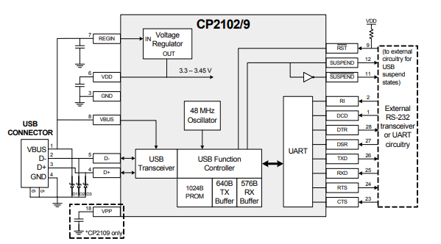
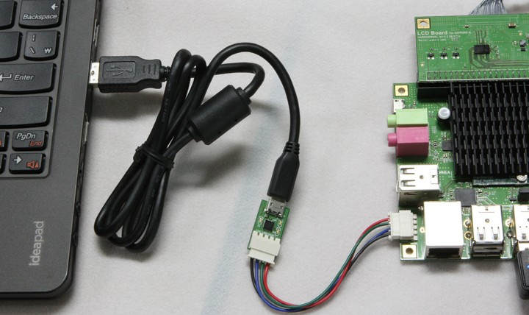
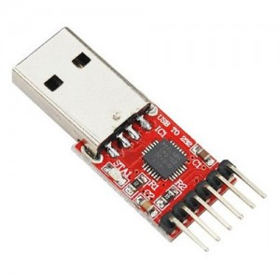
Serial Communication
UART to USB Converter

Slide 14

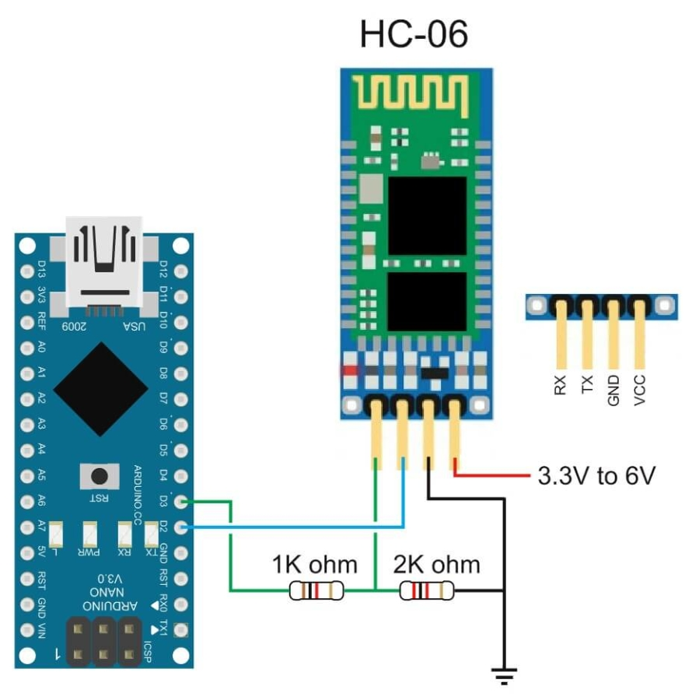

Serial Communication
UART to Bluetooth Module
Bluetooth
Bluetooth

Slide 15
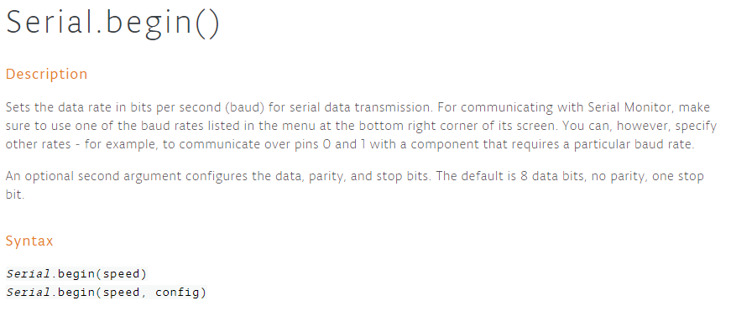
Arduino Serial Monitor
Used for communication between the Arduino board and a computer or other devices. All Arduino boards have at least one serial port (also known as a UART)
9600 means 9600 bit per second
The speed is sometimes called BAUDRATE

Slide 16
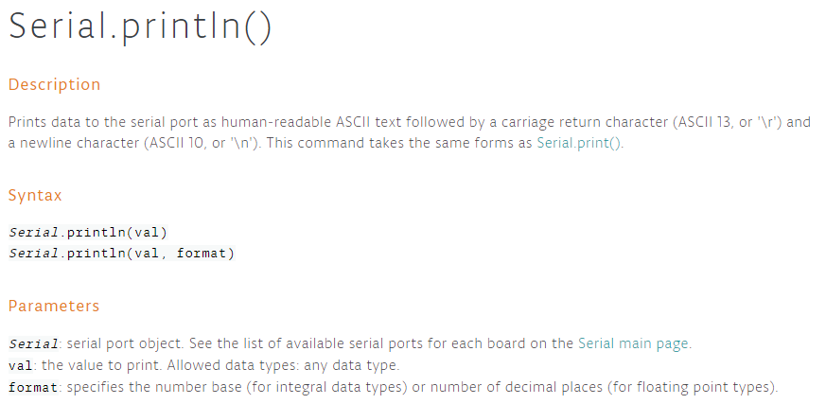
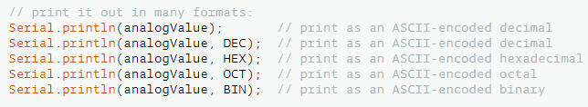
Arduino Serial Monitor

Slide 17
Arduino Serial Monitor
sprintf function : use for create the text.
char text[30]; // 30 character string
int value = 50;
sprintf(text, “This value is %d”, value);
Serial.println(text); // This value is 50
Show value in decimal

Slide 18
Arduino Serial Monitor
sprintf function : use for create the text.
char text[30]; // 30 character string
char name[20] = “Uncle Prayut”;
char value = 3000;
sprintf(text, “I love %s %d”, name,value);
Serial.println(text); // I love Uncle Prayut 3000
Show string
Show decimal

Slide 19
Arduino Serial Monitor
sprintf function : use for create the text.
char text[30]; // 30 character string
float pi = 3.1415;
sprintf(text, “Pi number is %f”, pi);
Serial.println(text); // Pi number is 3.1415
Show string
Show decimal

Slide 20
Arduino Serial Monitor
sprintf format
%d : Decimal
%x : Hexadecimal
%f : floating point
%s : String
%c : 1 character
unsigned char val = 78;
char text[30];
sprintf(text, “%d”, val); // 78
sprintf(text, “%x”, val); // 4E
sprintf(text, “%c”, val); // N
val = ‘a’;
sprintf(text, “%d”, val); // 97
sprintf(text, “%x”, val); // 61
sprintf(text, “%c”, val); // a

Slide 21
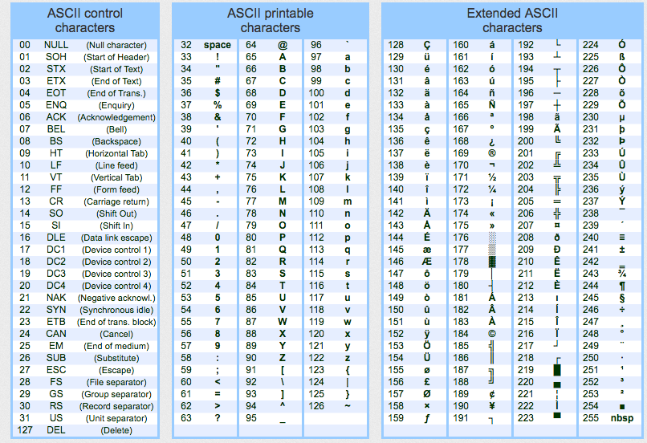
Ascii Table

Slide 22
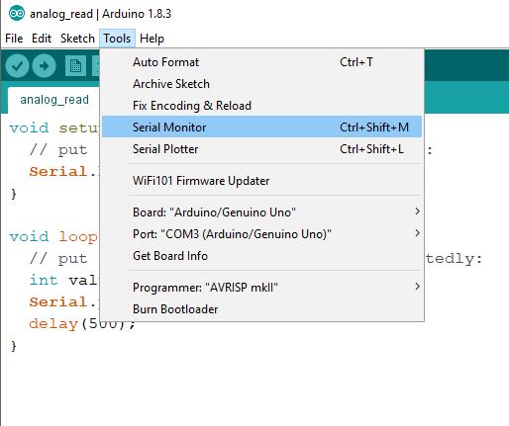
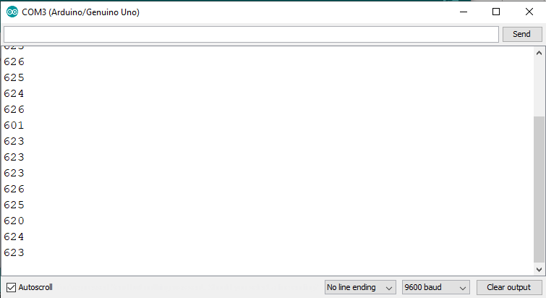
Arduino Serial Monitor
Tool -> Serial Monitor

Slide 23
Lab 3.1 : analogRead
No | Analog Voltage | Digital
1 | 0v | 0
2 | 0.5v | 106
3 | 1v | 195
4 | 1.5v | 302
5 | 2v | 403
6 | 2.5v | 505
7 | 3v | 612
8 | 3.5v | 713
9 | 4v | 820
10 | 4.5V | 924
11 | 5v | 1023
Notes:
Float a = D/1024 * 5.0

Slide 24
Lab 3.1 : analogRead
Plot graph to show the relation between Analog voltage and digital number
Digital Number
1100
1000
900
800
700
600
500
400
300
200
100
0 0.5 1 1.5 2 2.5 3 3.5 4 4.5 5
Analog Voltage

Slide 25
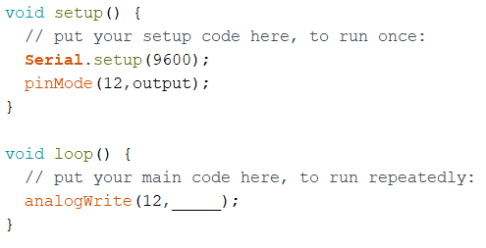
Lab 3.1 : analogWrite
(11,OUTPUT);
+
5V
(11,________);
Voltmeter
A0
-
GND
GND
Notes:
analogWrite(outputPIN,a/4) where a is equal to the serial read value(). This allows the LED to dim according to the value given.

Slide 26
Lab 3.1 : analogWrite
No | analogWrite(11,v) | Port 11 Voltage
1 | 0
2 | 63
3 | 127
4 | 195
5 | 255
6 | 256
7 | 319
8 | 383
9 | 447
10 | 511
11 | 512

Slide 27
Lab 3.1 : analogWrite
Analog Output
5.5
5.0
4.5
4.0
3.5
3.0
2.5
2.0
1.5
1.0
0.5
0 63 127 195 255 319 383 447 511
analogWrite(11,v)

Slide 28

Analog Write
1. Write a program to dim the LED brightness from the potentiometer. When turn the potentiometer to the leftmost, LED off, when turn potentiometer to the right, LED get bright and becomes brightest when potentiometer on the rightmost position.
2. Showing this String on serial monitor
LED brightness level is xxx%
int val = AnalogREAD(A0);
unsigned char dim = map(val,0,1023,0,255);
AnalogWRITE(11,dim);
220
5V
GND
A0
GND

Slide 29
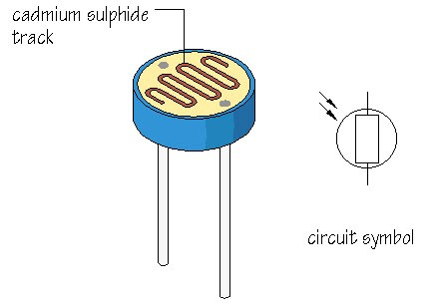
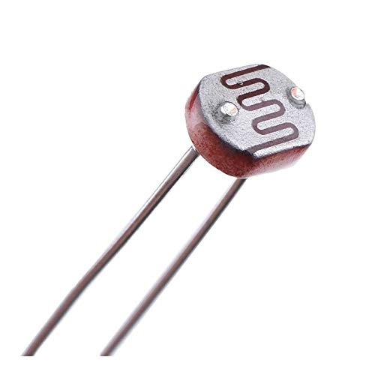
Light Dependent Resistor
An LDR or light dependent resistor is also known as photo resistor, photocell, photoconductor. It is a one type of resistor whose resistance varies depending on the amount of light falling on its surface.

Slide 30
Serial Read
We can use serial to read data from PC.
char val = Serial.read(); // This will read 1 byte data
String text = Serial.readString(); // This will read 1 line text;
text.replace(“\n”,””) // To remove newline
void serialEvent() {
// Rx callback function. It will jump to this function, if
// Arduino receives data from PC.
}

Slide 31
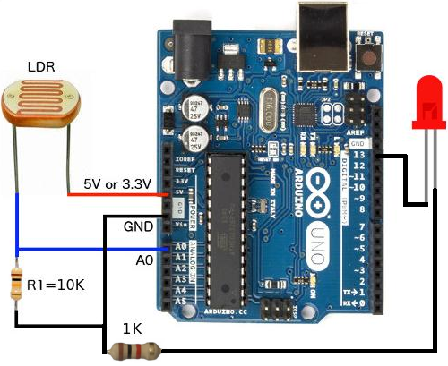
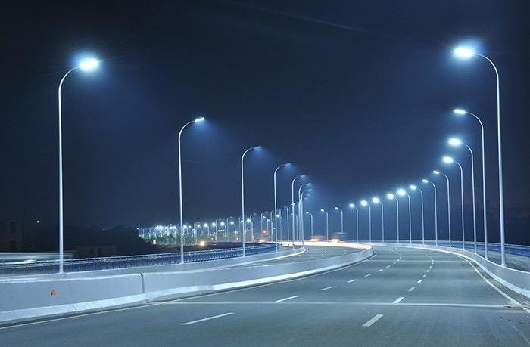
Light Dependent Resistor
Automatic Street Light Control
220
Notes:
Around 600 and 900 (750 threshold)

Slide 32
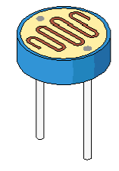
Lab 3.2 : Light Dependent Resistor
Use LDR and Serial Command to control LED
There are 3 Modes
LED on
LED off
LED controlled by LDR
- When it is dark, LED on.
- When it is Bright, LED off.
220
GND
GND
10k
5V

Slide 33
Lab 3.2 : Light Dependent Resistor
--- Control LED mode from PC ---
>> Select LED Mode (on,off,ldr) : on
LED is ON
>> Select LED Mode (on,off,ldr) : off
LED is OFF
>> Select LED Mode (on,off,ldr) : ldr
LED is controlled by LDR
>> Select LED Mode (on,off,ldr) : aaacccffgg
Wrong Commend
>> Select LED Mode (on,off,ldr) :
Notes:
Control the LED on the serial monitor prompt

