Slide 1
Linear Regression with Python
Cognitive Computing Application

Slide 2
Linear Regression
Linear Regression is usually the first machine learning algorithm that every data scientist comes across.
It is a simple model, but everyone needs to master it as it lays the foundation for other machine learning algorithms

Slide 3
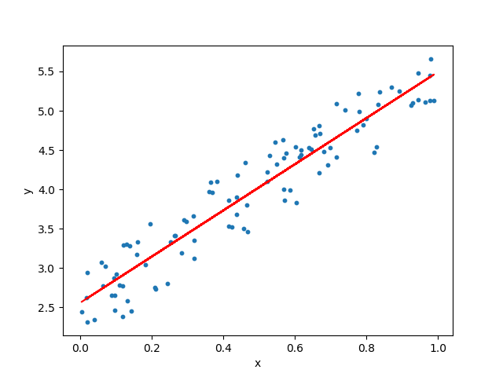
Where Linear Regression can be used?
To understand the factors that influence profitability.
It can be used to forecast sales in the coming months by analyzing the sales data for previous months.
It can also be used to gain various insights about customer behaviour.
Determine a line which best fits the data.

Slide 4
Outline
What is Linear Regression
Hypothesis of Linear Regression
Training a Linear Regression model
Evaluating the model
scikit-learn implementation

Slide 5
What is Linear Regression?
The objective of a linear regression model is to find a relationship between one or more features(independent variables) and a continuous target variable(dependent variable).
When there is only feature it is called Uni-variate Linear Regression and if there are multiple features, it is called Multiple Linear Regression.

Slide 6
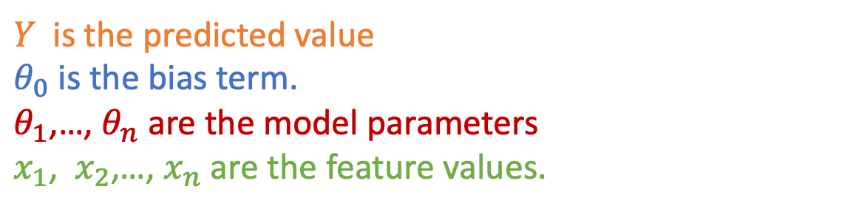
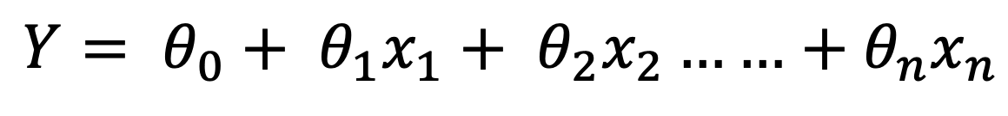

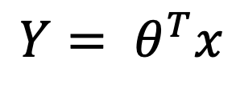

Hypothesis of Linear Regression
The linear regression model can be represented by the following equation:
$Y= θ_{0}+ θ_{1}x_{1}+ θ_{2}x_{2}……$ $+ θ_{n}x_{n}$
$Y$ is the predicted value
$θ_{0}$ is the bias term.
$θ_{1}$,…, $θ_{n}$ are the model parameters
$x_{1}$, $x_{2}$,…, $x_{n}$ are the feature values.
The above hypothesis can also be represented by:
Feature vector with $x_{0}=1$
$$Y= θ^{T}x$$
The model’s parameter vector including the bias term $θ_{0}$

Slide 7
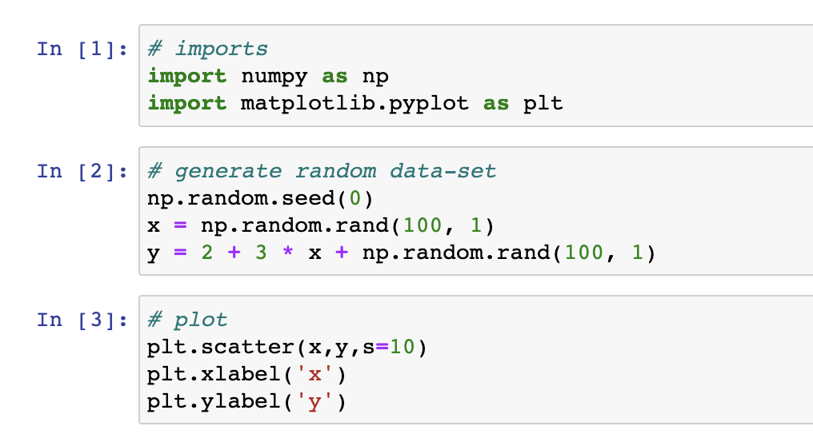
Dataset

Slide 8
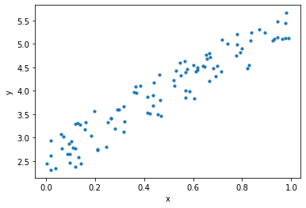
Output

Slide 9
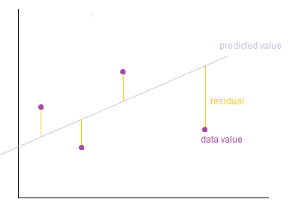
Training a Linear Regression Model
Training of the model here means to find the parameters so that the model best fits the data.
How do we determine the best fit line?
The line for which the the error between the predicted values and the observed values is minimum is called the best fit line or the regression line.
These errors are also called as residuals. The residuals can be visualized by the vertical lines from the observed data value to the regression line.
http://wiki.engageeducation.org.au/further-maths/data-analysis/residuals/

Slide 10

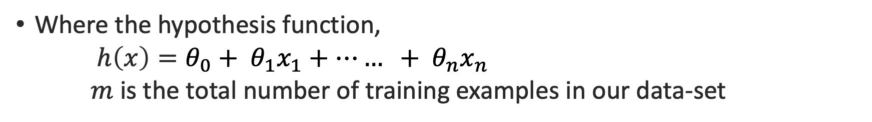
Training a Linear Regression Model
To define and measure the error of our model we define the cost function as the sum of the squares of the residuals. The cost function is denoted by :
Where the hypothesis function,
$h\left(x\right)=θ_{0}+ θ_{1}x_{1}+…… + θ_{n}x_{n}$
$m$ is the total number of training examples in our data-set

Slide 11
Training a Linear Regression Model
Why do we take the square of the residuals and not the absolute value of the residuals ?
We want to penalize the points which are farther from the regression line much more than the points which lie close to the line
Our objective is to find the model parameters so that the cost function is minimum. We will use Gradient Descent to find this!

Slide 12


Gradient Descent
Gradient descent is a generic optimization algorithm used in many machine learning algorithms. It iteratively tweaks the parameters of the model in order to minimize the cost function. The steps of gradient descent is outlined below.
We first initialize the model parameters with some random values. This is also called as random initialization.
Now we need to measure how the cost function changes with change in its parameters. Therefore, we compute the partial derivatives of the cost function w.r.t to the parameters $θ_{0}$,$θ_{1},…,θ_{n}$

Slide 13

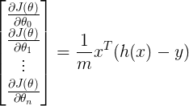
Gradient Descent
Similarly, the partial derivative of the cost function w.r.t to any parameter can be denoted by:
We can compute the partial derivatives for all parameters at once using:
where
$h\left(x\right)=θ_{0}+ θ_{1}x_{1}+…… + θ_{n}x_{n}$

Slide 14


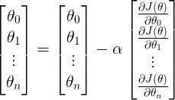
Gradient Descent
After computing the derivative, we update the parameters as given below:
Where $α$ is the learning parameter. We can update all the parameters at once using:

Slide 15
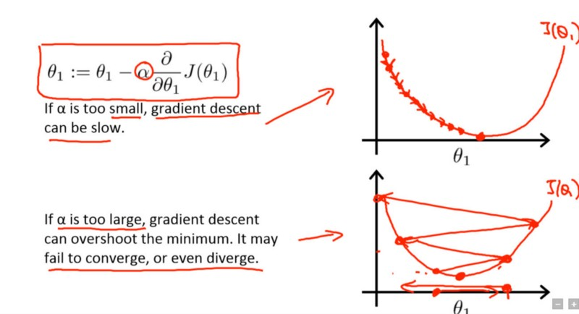
Gradient Descent
We repeat the steps 2,3 until the cost function converges to the minimum value. If the value of α is too small, the cost function takes larger time to converge. If α is too large, gradient descent may overshoot the minimum and may finally fail to converge.
Source: Andrew Ng’s course on Coursera

Slide 16
Gradient Descent: find the best fit line
To demonstrate the gradient descent algorithm, we initialize the model parameters with 0. The equation becomes Y = 0. Gradient descent algorithm now tries to update the value of the parameters so that we arrive at the best fit line.
When the learning rate is very slow, the gradient descent takes larger time to find the best fit line.

Slide 17
Gradient Descent : find the best fit line
When the learning rate is normal:

Slide 18
Gradient Descent : find the best fit line
When the learning rate is arbitrarily high, gradient descent algorithm keeps overshooting the best fit line and may even fail to find the best line:

Slide 19
Learning Yourself
Gradient Descent
Linear Regression more example

Slide 20

Evaluating the model performance: RMSE
We will be using Root mean squared error(RMSE) and Coefficient of Determination(R² score) to evaluate our model.
RMSE is the square root of the average of the sum of the squares of residuals.
RMSE is defined by

Slide 21



Evaluating the model performance: RMSE
R² score or the coefficient of determination explains how much the total variance of the dependent variable can be reduced by using the least square regression.
R² is determined by
SSₜ is the total sum of errors if we take the mean of the observed values as the predicted value.
SSᵣ is the sum of the square of residuals

Slide 22
Scikit-learn implementation: Linear Regression

