Slide 1
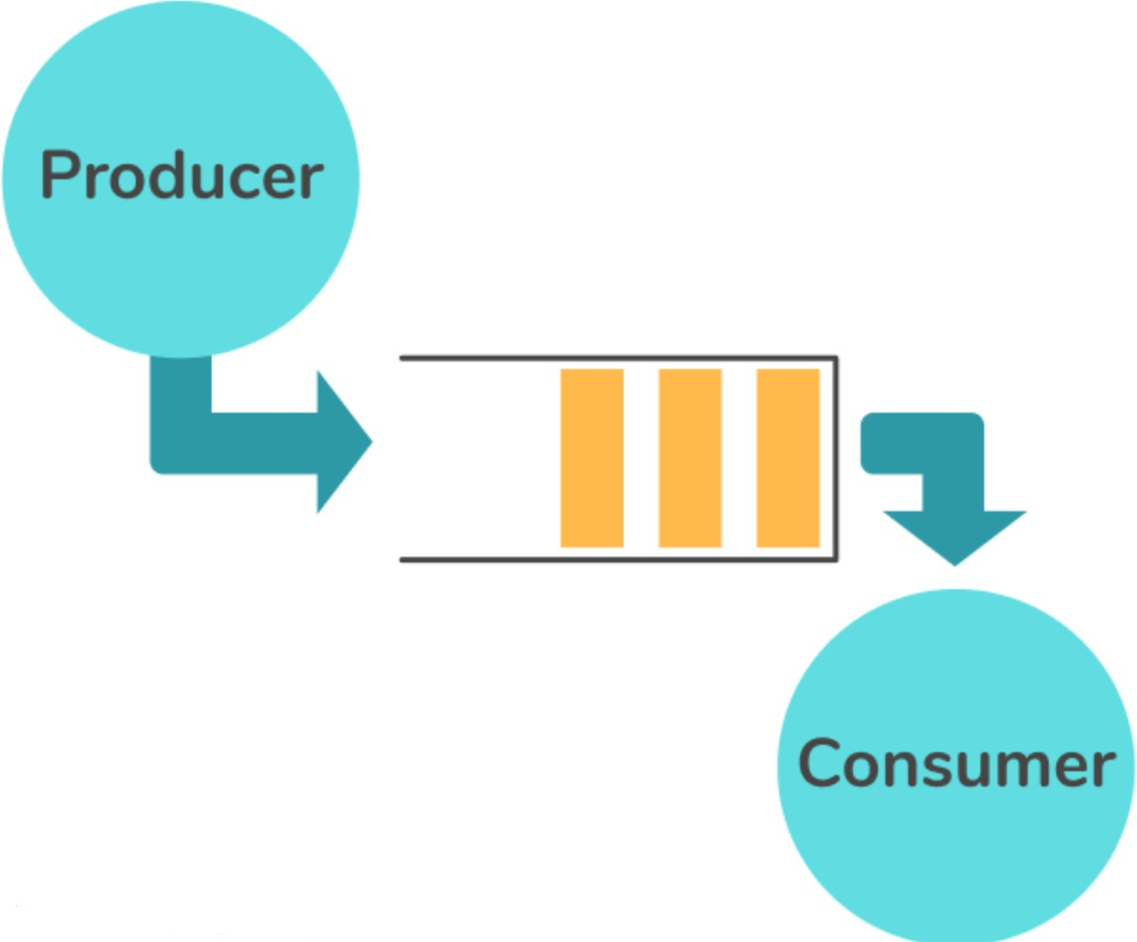
OPERATING SYSTEMS(CI45)
PRODUCER - CONSUMER PROCESS SYNCHRONISATION
USING C
Report: Synchronisation Between Producer- Consumer Processes Using Shared Buﬀer in C
Kailash V Prakash|Harshit Agrawal 1MS23CI052|1MS223CI040

Slide 2
Report: Synchronisation Between Producer-Consumer Processes Using Shared Buffer in C
Objective
This report demonstrates the implementation of the Producer-Consumer problem in C, focusing on synchronization using mutexes and semaphores. It also proposes a solution that fulfills all three requirements of the critical section problem:
Mutual Exclusion
Progress
Bounded Waiting
Problem Statement
Implement a C program with a shared buffer between two processes (producer and consumer), ensuring:
Proper read/write synchronization,
No race conditions or data inconsistency,
Compliance with critical section constraints.

Slide 3
3. Key Concepts
Concept | Description
Producer | Generates data and adds to the shared buffer.
Consumer | Retrieves and processes data from the buffer.
Critical Section | Part of the code where shared resources are accessed.
Mutual Exclusion | Ensures that only one thread accesses the critical section at a time.
Progress | Ensures threads not in critical section do not block others unnecessarily.
Bounded Waiting | Limits the number of times other threads can enter before a waiting thread.
Semaphore | A signaling mechanism to synchronize threads.
Mutex | A mutual exclusion lock to protect critical sections.
Implementation Strategy
Synchronization Tools Used
Tool | Purpose
sem_t full | Counts full buffer slots (consumer waits on it).
sem_t empty | Counts empty slots (producer waits on it).
pthread_mutex_t mutex | Ensures mutual exclusion in buffer access.
4.2 Buffer Setup
Shared circular buffer of size 5.
•
Index variables in and out track producer/consumer positions.

Slide 4
5. C Program Code
#include #include #include #include #include
<stdio.h>
<stdlib.h>
<pthread.h>
<semaphore.h>
<unistd.h>
#define BUFFER_SIZE 5
int buffer[BUFFER_SIZE]; int in = 0, out = 0;
sem_t empty, full; pthread_mutex_t mutex;
void* producer(void* arg) {
int item;
for (int i = 0; i < 10; i++)
{
// Produce an item
// Wait for empty slot
item = rand() % 100; sem_wait(&empty);
pthread_mutex_lock(&mutex); // Enter critical
section
buffer[in] = item;
printf("Producer produced: %d\n", item); in = (in + 1) % BUFFER_SIZE;
section
pthread_mutex_unlock(&mutex); // Exit critical
sem_post(&full); // Signal full slot sleep(1);
}
return NULL;
}

Slide 5
void* consumer(void* arg) { int item;
for (int i = 0; i < 10; i++) { sem_wait(&full); // Wait for item
pthread_mutex_lock(&mutex); // Enter critical
section
item = buffer[out];
printf("Consumer consumed: %d\n", item); out = (out + 1) % BUFFER_SIZE;
section
pthread_mutex_unlock(&mutex); // Exit critical
sem_post(&empty); // Signal empty slot sleep(1);
}
return NULL;
}
int main() {
pthread_t prod_thread, cons_thread;
sem_init(&empty, 0, BUFFER_SIZE);
sem_init(&full, 0, 0); pthread_mutex_init(&mutex, NULL);
pthread_create(&prod_thread, NULL, producer, NULL); pthread_create(&cons_thread, NULL, consumer, NULL);
pthread_join(prod_thread, NULL); pthread_join(cons_thread, NULL);
sem_destroy(&empty); sem_destroy(&full); pthread_mutex_destroy(&mutex);
return 0;
}

Slide 6
6. Synchronization Flow Diagram
+-----------+ sem_wait(empty) sem_post(full)
| Producer | --------------------->
+----------+
| Buffer |
+----------+
<-------------------+
+-----------+
|
^
|
|
| pthread_mutex_lock pthread_mutex_lock
|
|
|
v
pthread_mutex_unlock
|
+-----------<----------------<--------
+-------------------<------+
sem_post(empty) sem_wait(full)
+-----------+
| Consumer |
+—————+

Slide 7
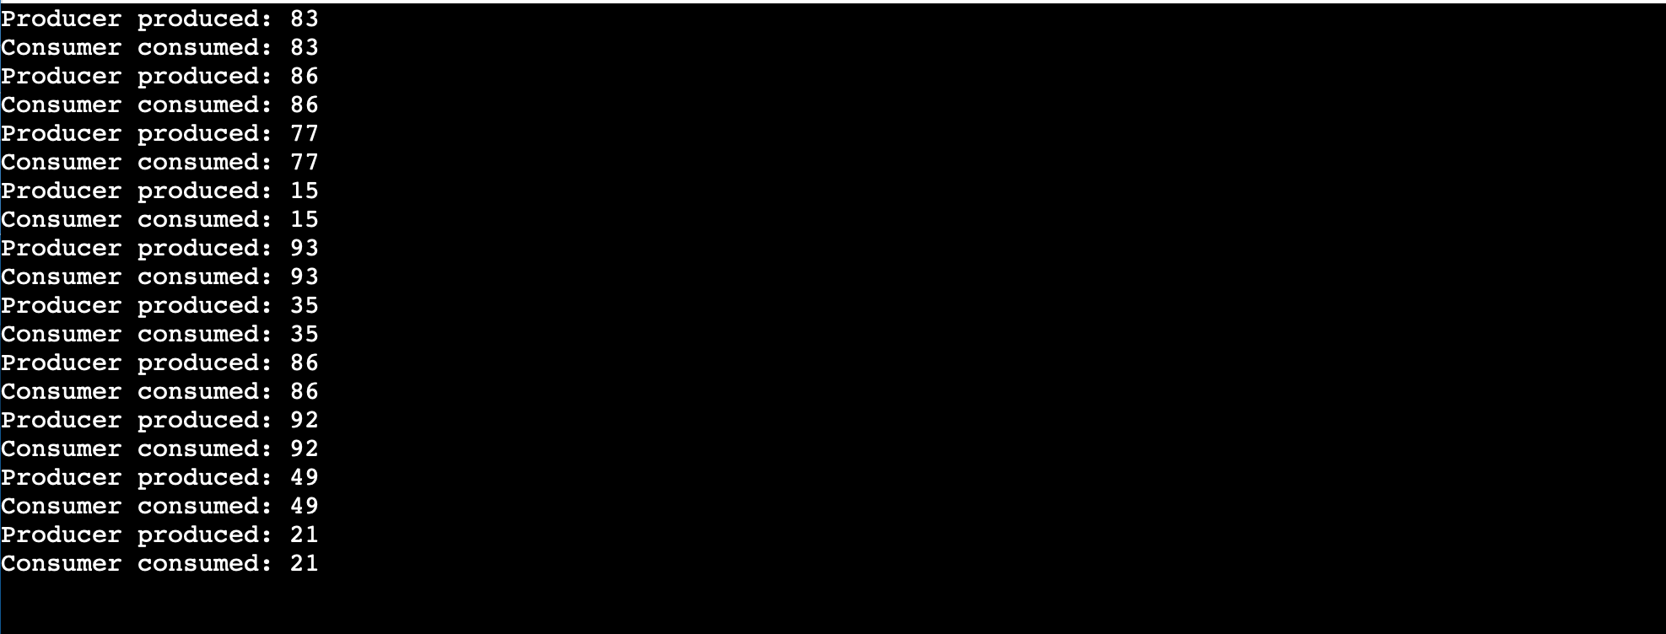
7. Output Sample
8. Satisfaction of Critical Section Problem Requirements
Requirement | Me t? | Explanation
Mutual Exclusion | Yes | pthread_mutex_lock ensures only one thread accesses the buffer at a time.
Progress | Yes | No unnecessary blocking — threads proceed unless the buffer is full/empty.
Bounded Waiting | Yes | Semaphores and fixed iteration ensure fair access and prevent starvation.

Slide 8
9. Advantages of the Approach
•
•
Prevents data corruption via race condition protection.
Demonstrates real-world synchronization tools (semaphores, mutexes).
•
•
Simple and modular — easy to extend to multiple threads.
Meets all critical section criteria.
10. Limitations and Suggestions
Limitation | Suggestion
Single Producer/Consumer | Extend to multiple producers and consumers.
No error handling for syscalls | Add return value checks for pthread_create, sem_init.
Static loop iteration | Use dynamic or event-driven termination.
Sleep-based delay | Use conditional waits or real scheduling mechanisms.

Slide 9
11. Conclusion
This program successfully demonstrates synchronization between producer and consumer processes using mutexes and semaphores, while meeting the three essential conditions of the critical section problem:
•
•
•
Mutual exclusion,
Progress, Bounded waiting.
It is an effective, foundational implementation for learning thread synchronization in C and can be extended to more complex, real- world concurrent systems.

