Slide 1
U.S. Wildfire Analysis
Xingyu Chen, Kaitlyn McGrew, Tittiwat Tonburinthip, Kexin Yu
Thejas Kiran

Slide 2
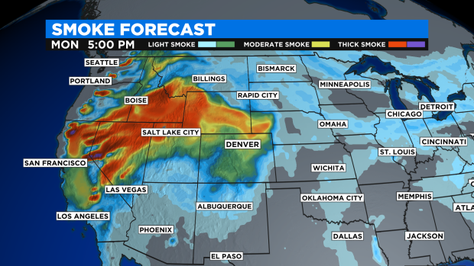
Motivation
The increasing air pollution due to wildfires has been one of the most important and prevalent issues within the American public health.

Slide 3
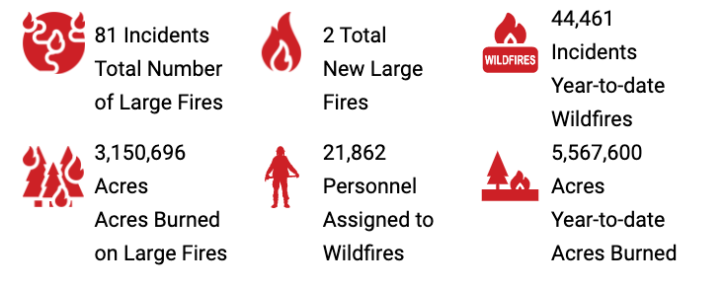
Problem Statement
How is the wildfire frequency and severity trend over time ?
Which state is at most risk for wildfire ?
When is the highest risky for wildfire ?

Slide 4
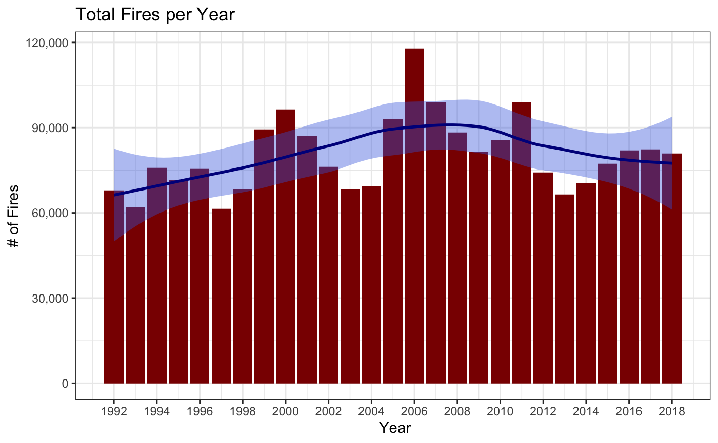
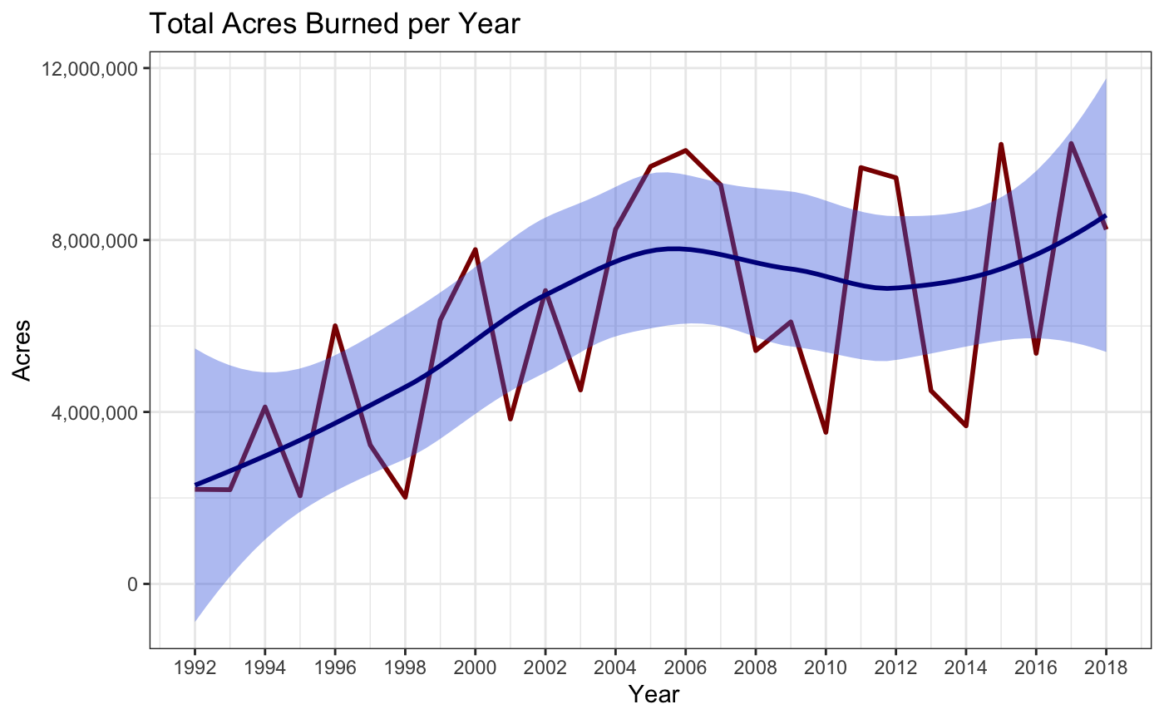
U.S. Wildfire Trend from 1992 to 2018

Slide 5
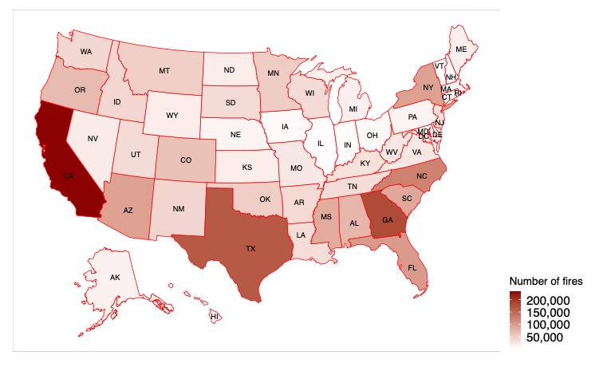
State Wise U.S. Wildfire Scenarios - The Most Risky Area

Slide 6
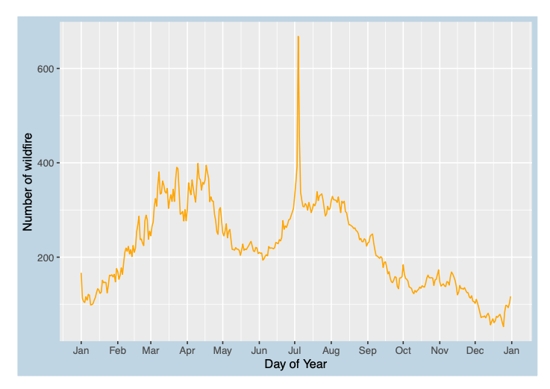
# of U.S. Wildfires Trend by Day of Year

Slide 7
Conclusion
Conclusion 1
Conclusion 2
Conclusion 3

Slide 8
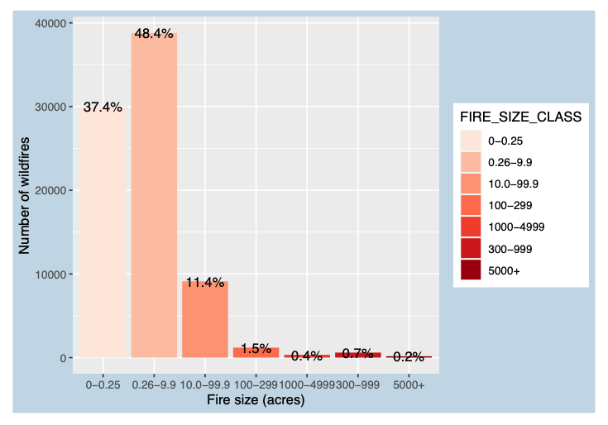
U.S. Wildfire Size Classification Scenarios

Slide 9
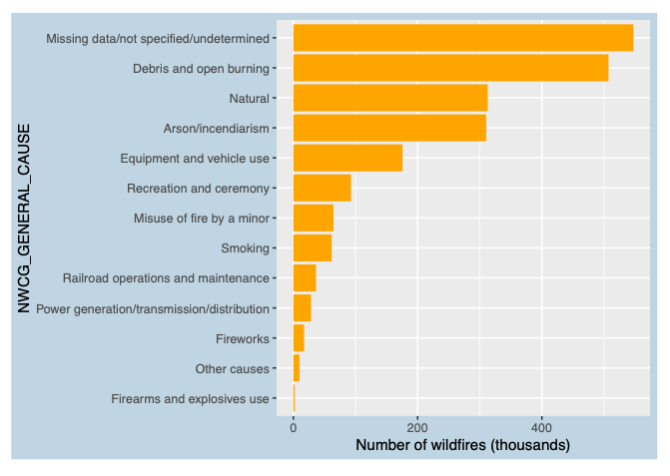
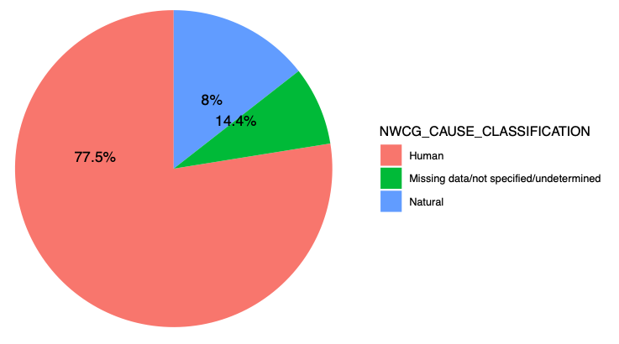
U.S. Wildfire Cause Distribution of Year

Slide 10



Future Extension
Having interactive application:
D3.js
Shiny application
Plotly or Leaflet R package
Using Hadoop and SQL:
External server for data set
Web host for application
Exploratory Data Analysis:
Predict Fire Location/Size/Cause

Slide 11
Questions
Thank you!
Repository:
https://github.com/Firewatch-DTSC5301/wildfire

