Slide 1
U.S. Wildfire Analysis
Xingyu Chen, Kaitlyn McGrew, Tittiwat Tonburinthip, Kexin Yu
Thejas Kiran

Slide 2
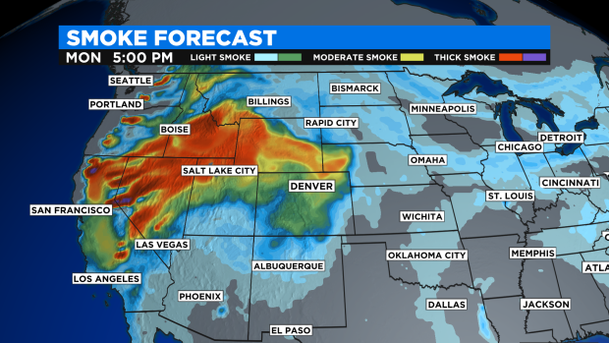
Motivation
The smoke from wildfires in the western United States, had blanket Colorado’s skies in the past couple month

Slide 3
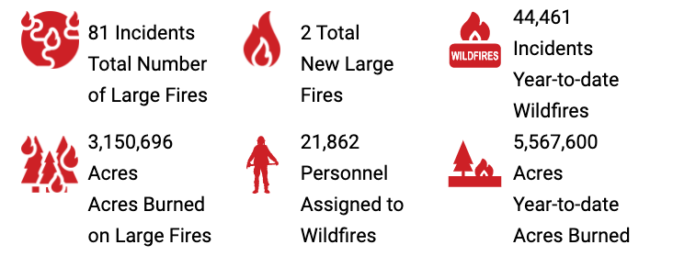
Problem Statement
How are the wildfire frequency and severity trends over time?
What time of the year has a higher risk due to wildfire?
Which state and county are at most risk for wildfire?

Slide 4
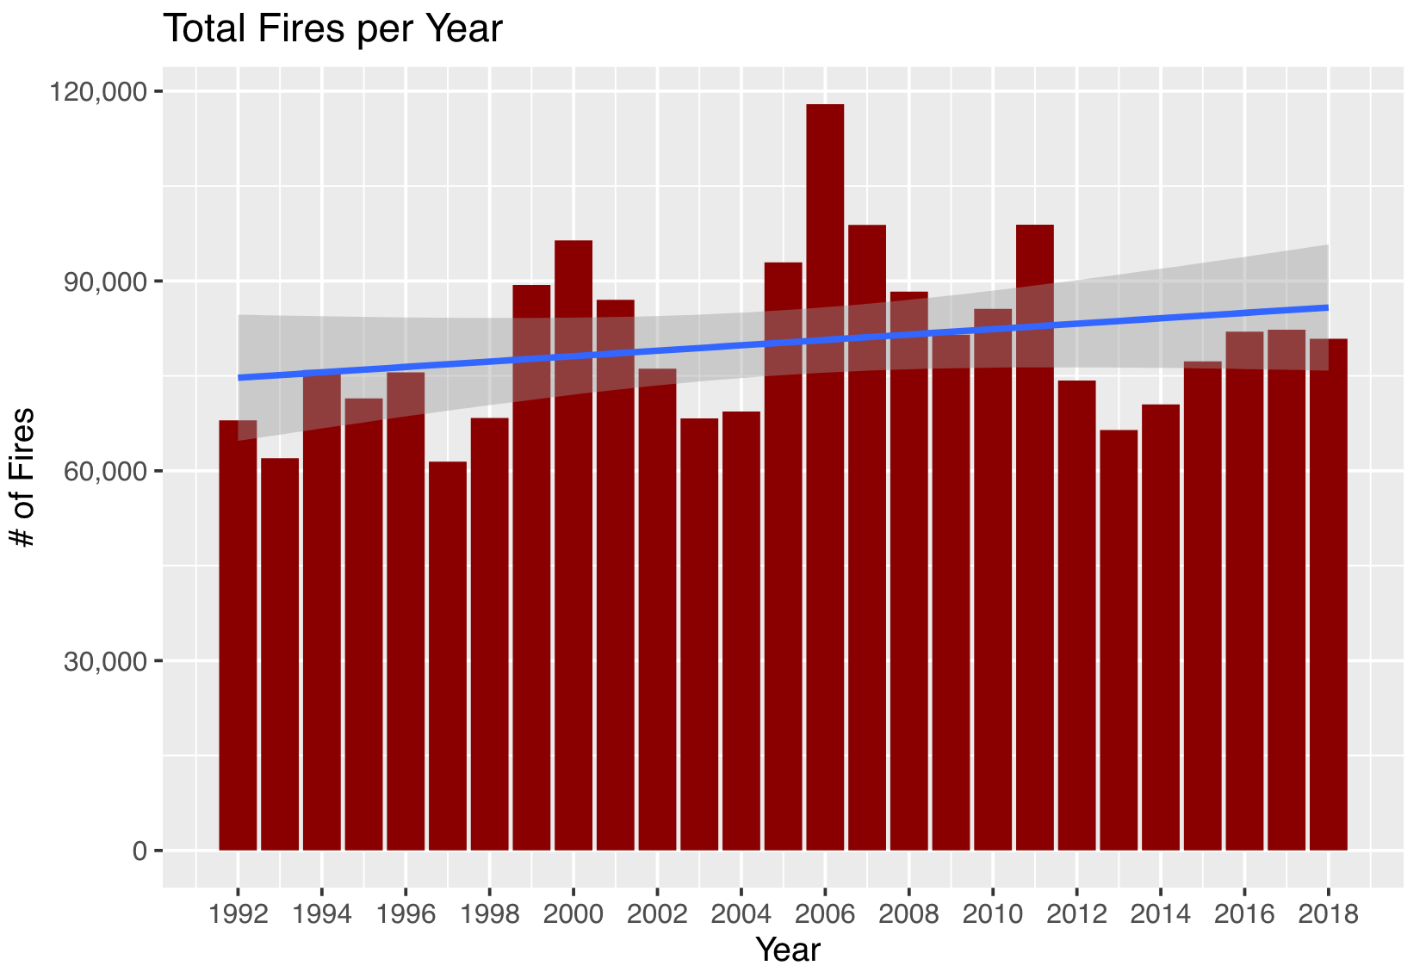
U.S. Wildfire Trend from 1992 to 2018

Slide 5
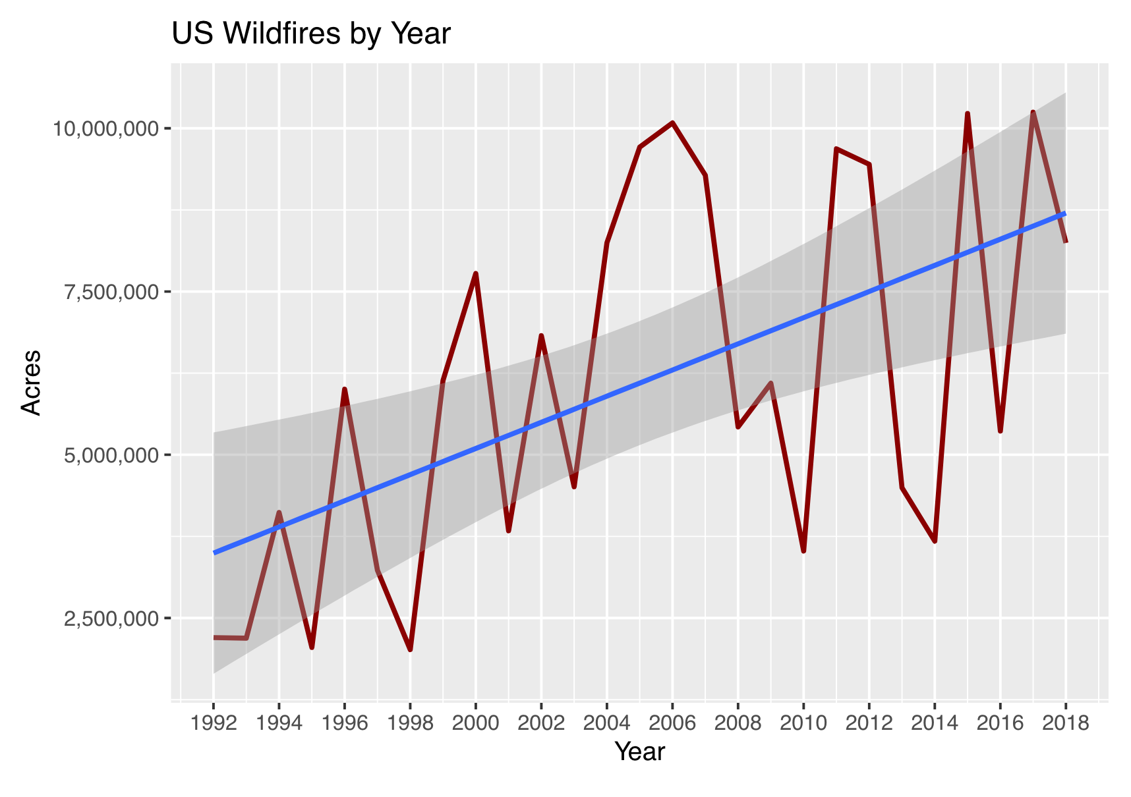
U.S. Wildfire Trend from 1992 to 2018 (Cont.)

Slide 6
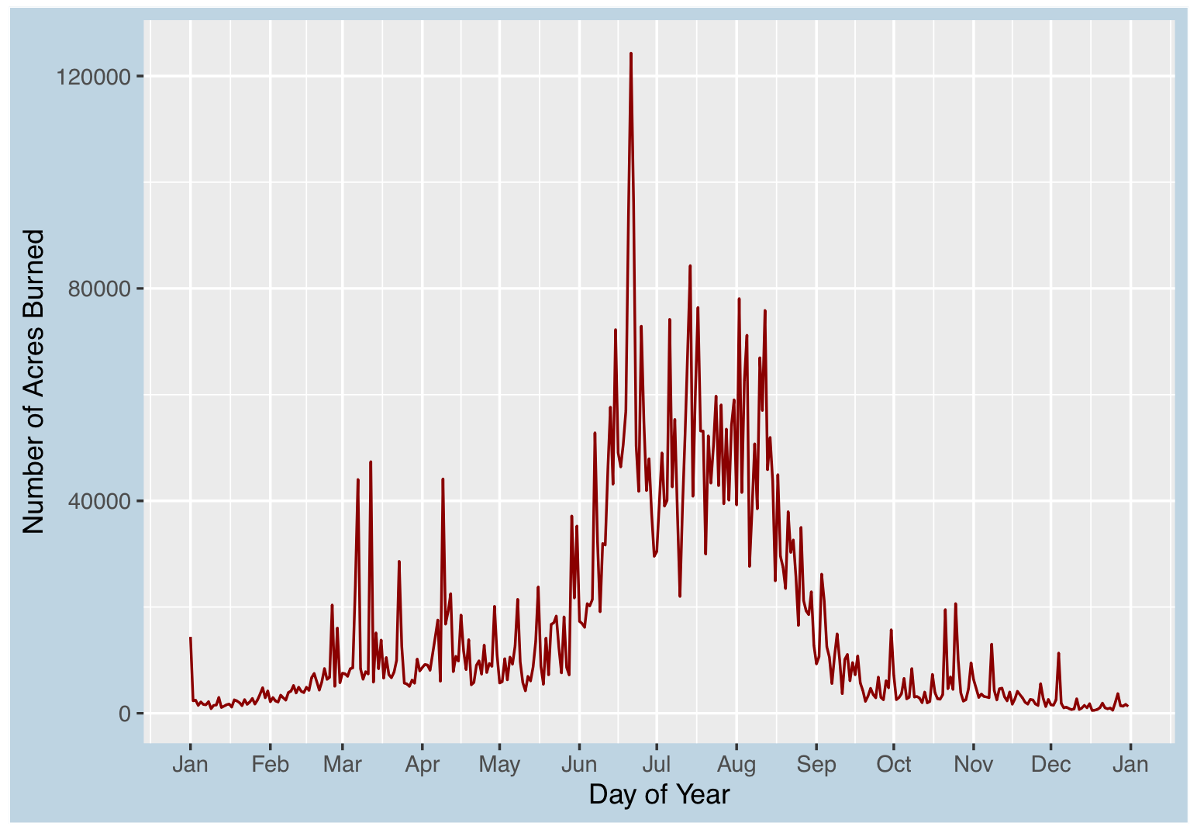
# of U.S. Wildfires Trend by Day of Year

Slide 7
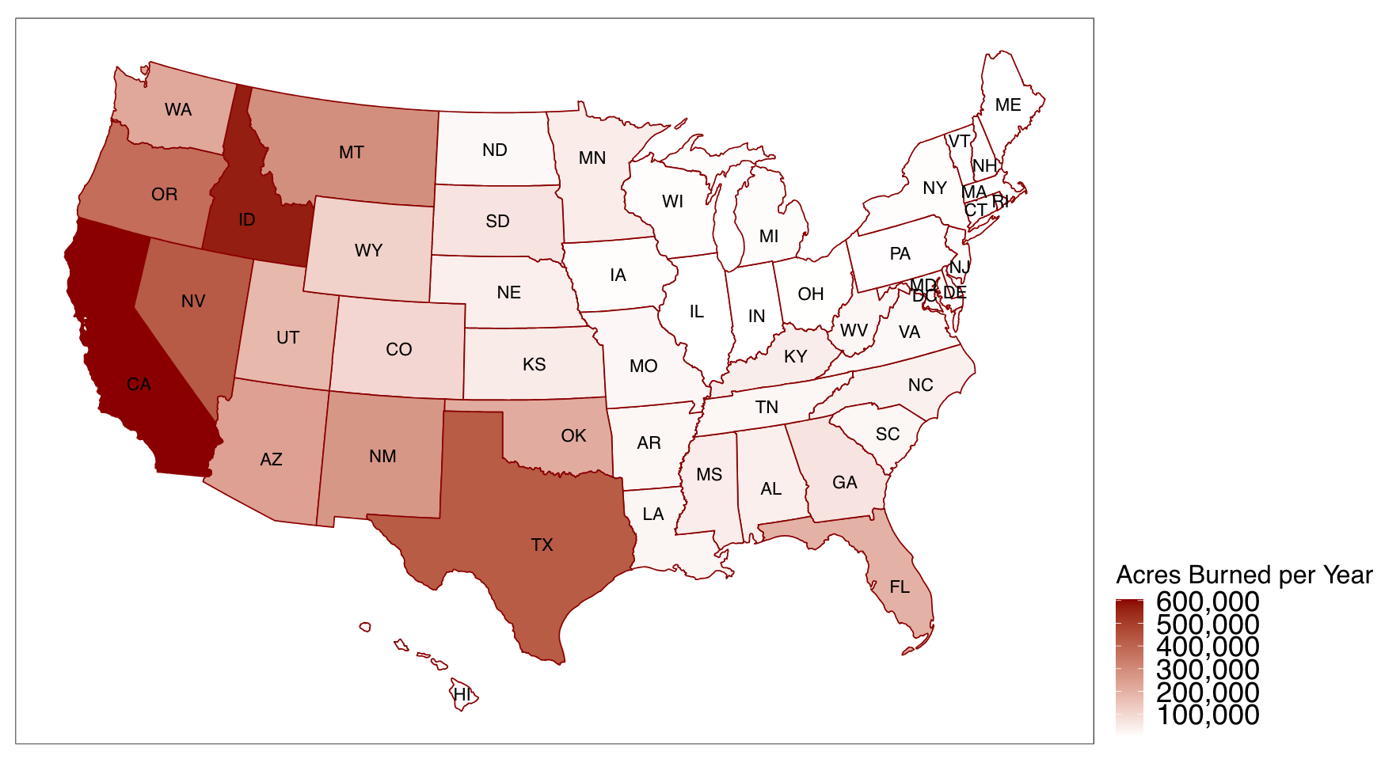
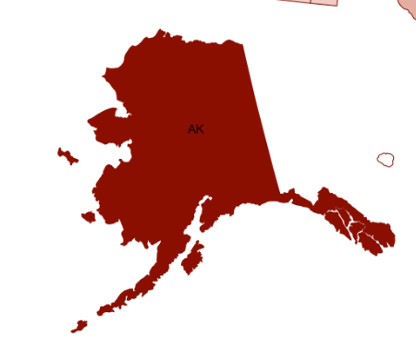
State Wise U.S. Wildfire Scenarios

Slide 8
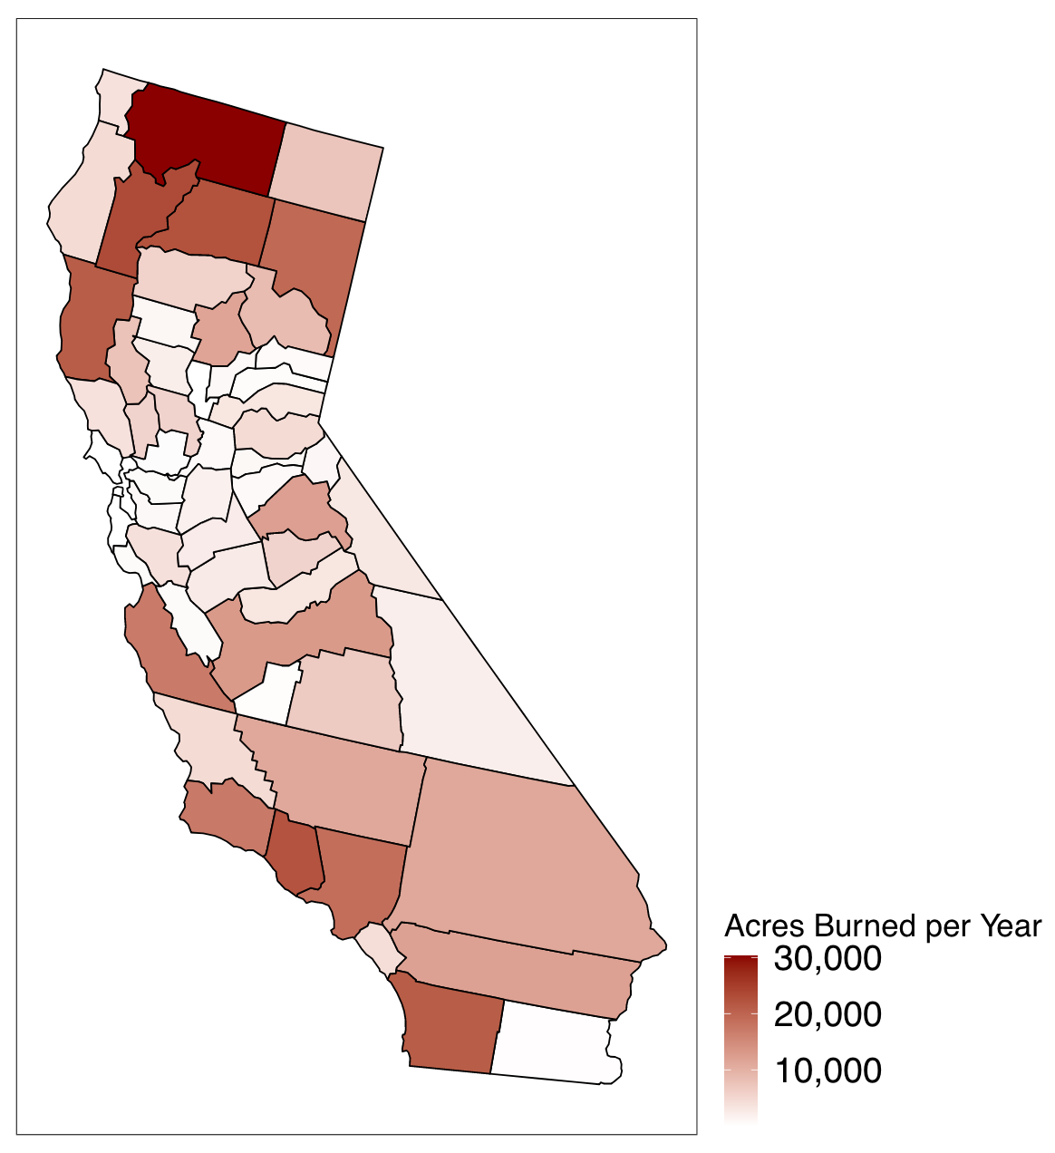
County Wise in California State

Slide 9
Conclusion
The # of wildfires has not increased over time.
The # of acres burned has steadily increased, indicating the severity of the fires has gotten worse over time.
From June to September is the peak of wildfire all year round.
Western U.S. is relatively riskier for wildfires such as California, Idaho, and Texas.
Alaska has the most Acres burned, but it is not risky due to the limited population

Slide 10
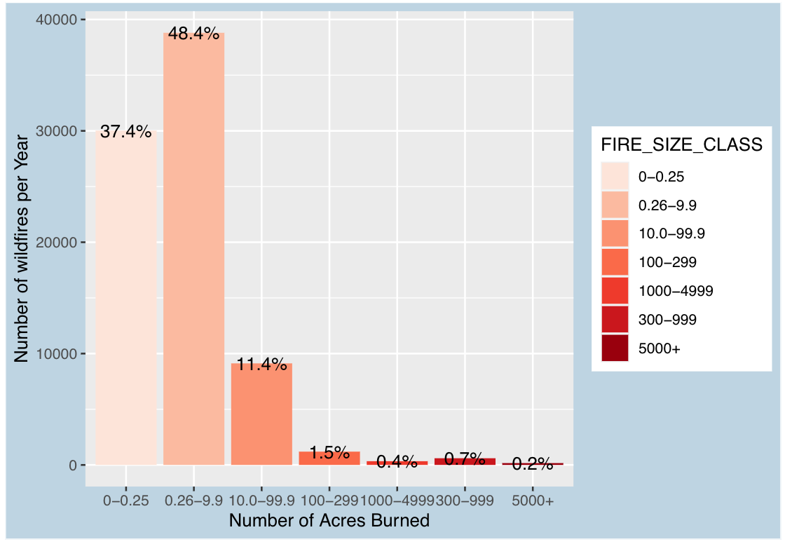
U.S. Wildfire Size Classification Scenarios

Slide 11
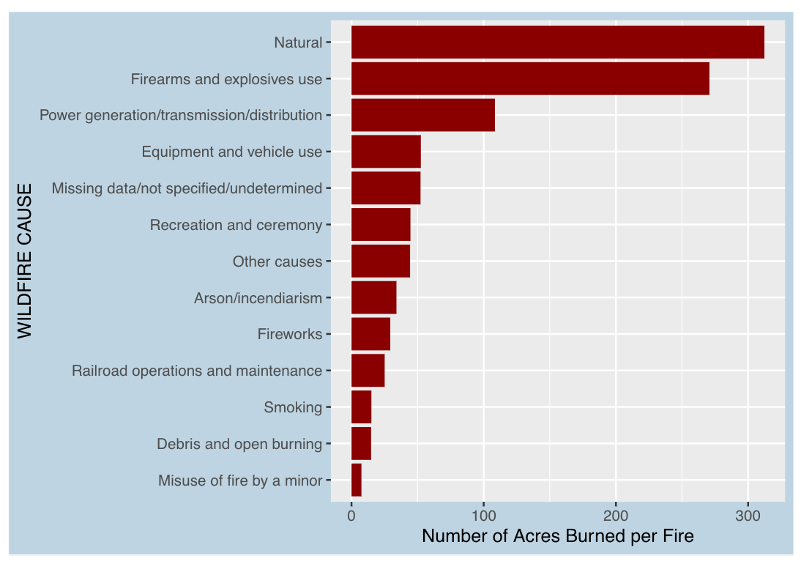
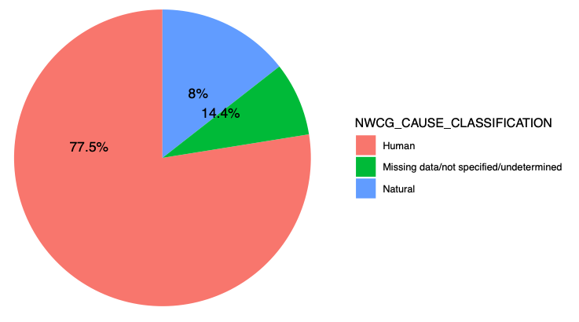
U.S. Wildfire Cause Distribution of Year

Slide 12



Future Extension
Having interactive features:
Shiny application
Plotly R package
Using Hadoop and SQL:
External server for data set
Web host for application
Exploratory Data Analysis:
Predict Fire Location/Size/Cause

Slide 13
Questions
Thank you!
Repository:
https://github.com/Firewatch-DTSC5301/wildfire

