Slide 1
Responsive webpages
Flexbox and grid system

Slide 2
Flexbox grid system
Flexbox provides a more efficient way to layout, align, and distribute space between items in a container (main element), even if their size is unknown and/or dynamic (hence the word "flex")
The main idea behind flex layout is to give the container the ability to change the width/height (and order) of its items to best fill the available space (mostly to accommodate all kinds of display devices and screen sizes). A flex container expands items to fill available free space or shrinks them to prevent overflow

Slide 3
Flexbox grid system
Most importantly, flexbox layouts are direction agnostic unlike regular layouts (block which is vertically based and inline which is horizontally based)
While these work well for classic websites, they lack the flexibility to support large or complex applications (especially when it comes to reorientation, resizing, stretching, shrinking, etc.)

Slide 4
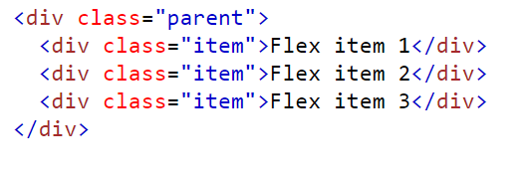
Flexbox
Within flexbox, we work with properties for the parent element as well as properties valid for children
In the next part of the presentation, we will distinguish between elements of the parent type (parent element) and elements of the child type
An example is an element of type parent .container and an element of type child .item

Slide 5
Flexbox - Properties for parent elements

Slide 6
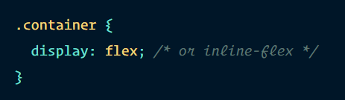
display
Defines a flex container - inline or block depending on the specified value
Activates the flex context (flexbox properties) for all children of the given element

Slide 7
The direction of placing items in the flex container
Creating a flex context creates a main axis, defining the direction in which flex items are placed in the flex container
Flexbox is also a one-way layout concept
The primary layout is either in horizontal rows or in vertical columns - similar to the grid system of the Bootstrap framework

Slide 8
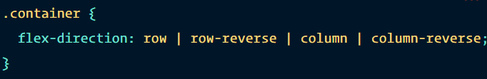
The direction of placing items in the flex container
row (default): left to right
row-reverse: right to left
column: same as row, but from top to bottom
column-reverse: same as row-reverse, but from bottom to top

Slide 9
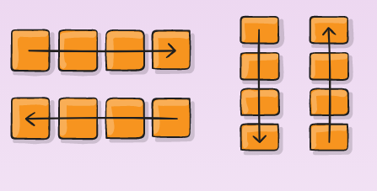
The direction of placing items in the flex container

Slide 10
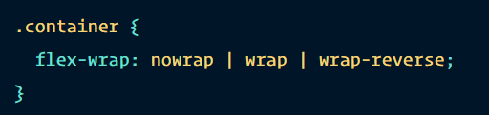
flex-wrap
By default, all items will try to fit on one line
It is possible to change this using the flex-wrap property
  nowrap (default): all flex items will be on one line
  wrap: flex items wrap to multiple lines, top to bottom
  wrap-reverse: flex items wrap to multiple lines from bottom to top

Slide 11
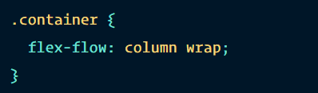
flex-flow
Abbreviation for the flex-direction and flex-wrap properties, which together define the major and transverse axis of the flex container
The default is row nowrap

Slide 12
justify-content
Defines the alignment along the major axis
Helps distribute remaining free space when either all flex items on a line are inflexible or are flexible but have reached their maximum size
It also exerts some control over the alignment of items when they overflow the line

Slide 13
justify-content
flex-start (default): items are aligned towards the start of the flex-direction
flex-end: items are aligned away from the end of the flex-direction
start: items are aligned towards the beginning of the writing-mode property (CSS property - sets whether lines of text are laid out horizontally or vertically, as well as the direction in which blocks advance)

Slide 14
justify-content
end: items are aligned from the beginning of the writing-mode property
left: items are aligned towards the left edge of the container, if it doesn't make sense within flex-direction then behaves like start
right: items are aligned towards the right edge of the container, if it doesn't make sense within flex-direction then behaves like start
center: items are centered

Slide 15
justify-content
space-between: items are evenly spaced in a row; the first item is on the start line, the last item on the end line
space-around: items are evenly spaced in a row with equal space around them. Visually, the spacing is not the same because all items have equal space on both sides. The first item will have one border unit against the edge of the container, but two border units between the next item because the following item has its own border
space-evenly: items are spaced so that the spacing between any two items (and the margin spacing) is equal

Slide 16
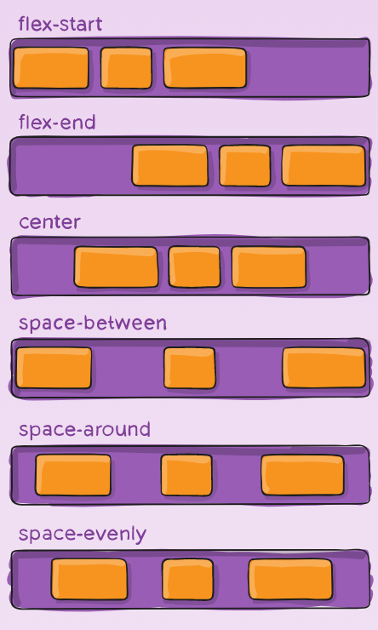
justify-content

Slide 17
align-items
Defines the default behavior for how flex items are laid out along the cross axis on the current line
Think of it as the horizontal axis (perpendicular to the main axis) version of justify-content

Slide 18
align-items
stretch (default): stretch to fill the container (still respects min-width/max-width properties)
flex-start / start / self-start: items are placed at the beginning of the cross axis. The difference between them is subtle and it is about respecting flex-direction rules or writing-mode rules

Slide 19
align-items
flex-end / end / self-end: items are placed at the end of the cross axis. The difference is again subtle and it is about respecting the rules of flex-direction vs. writing-mode rules
center: items are centered on the cross axis
baseline: items are aligned, eg aligned to their baseline

Slide 20
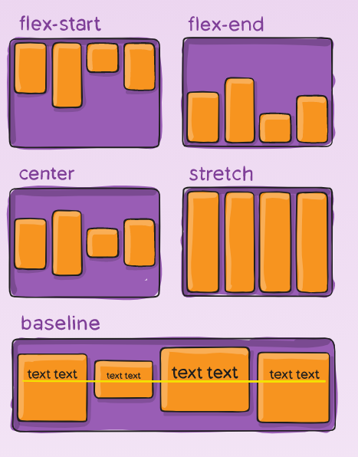
align-items

Slide 21
align-content
Use this property to align the lines of the flex container when there is extra space in the cross axis, similar to how justify-content aligns individual items in the main axis
Note: this property has no effect if there is only one row of flex items

Slide 22
align-content
normal (default): items are aligned to the default position as if no value was set
flex-start / start: items aligned to the beginning of the container. (More supported) flex-start respects flex-direction, while start respects writing-mode direction
flex-end / end: items aligned to the end of the container. (More supported) flex-end respects flex-direction, while end respects writing-mode direction

Slide 23
align-content
center: items centered in the container
space-between: items evenly spaced, first row is at the beginning of the container, last row is at the end of the container
space-around: items spaced evenly with equal space around each line
space-evenly: items are evenly spaced with equal space around them
stretch: lines are stretched to fill the remaining space

Slide 24
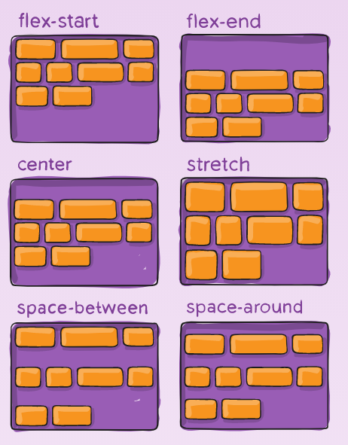
align-content

Slide 25
Flexbox - Properties for child elements

Slide 26
order
By default, flex items are laid out as they are written in the source code
However, the order property controls the order in which they appear in the flex container

Slide 27
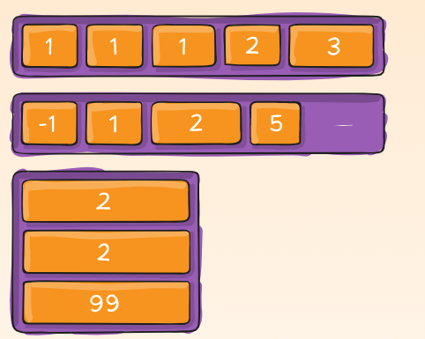
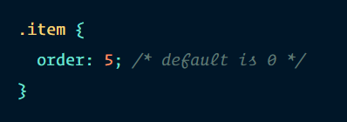
order

Slide 28
flex-grow
Defines the flex item's ability to "grow" when needed
We work with a unitless value that serves as a proportion
Specifies how much available space inside the flex container the item should occupy

Slide 29
flex-grow
If all items are set to flex-grow to 1, the remaining space in the container will be divided equally among all child items
If one of the children has a value of 2, it takes up twice as much remaining space as the other children (or at least tries to)

Slide 30
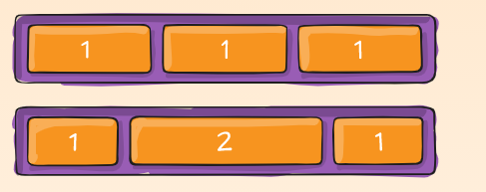
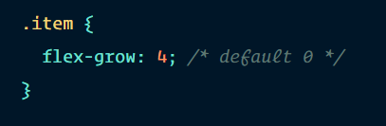
flex-grow

Slide 31
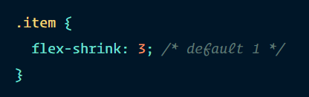
flex-shrink
Defines the flex item's ability to shrink when needed

Slide 32
flex-basis
Defines the default size of the element before distributing the remaining space
It can be a length (eg 20%, 5rem, etc.) or a keyword
The keyword auto means "look at my width or height property„
The content keyword means "size based on the content of the item" - this keyword is not well supported yet, so it's hard to test what this property does with respect to max-content, min-content and fit-content

Slide 33
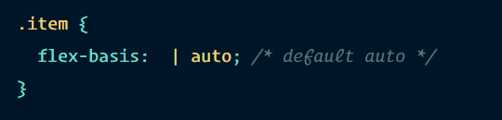
flex-basis

Slide 34
flex
Abbreviation for the combination of flex-grow, flex-shrink and flex-base
The second and third parameters (flex-shrink and flex-base) are optional
The default value is 0 1 auto, but if set with a single numeric value, it will behave as 1 0
It is recommended to use this shortcut property instead of setting individual properties (flex-grow, flex-shrink, flex-base)
The shortcut intelligently sets other properties

Slide 35
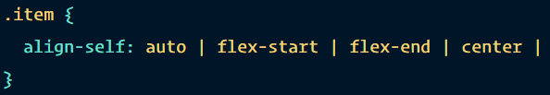

align-self
Allows individual flex items to override the default alignment (or that specified by align-items)
Note: float, clear and vertical-align have no effect on the flex item

Slide 36
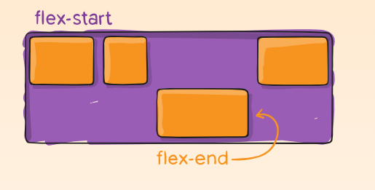
align-self

Slide 37
Flexbox a Bootstrap
Flexbox has been used in the Bootstrap framework since version 4
Flexbox is not supported in IE9 and lower browsers

Slide 38
Classic flexbox container

Slide 39
In-line flexbox container

Slide 40
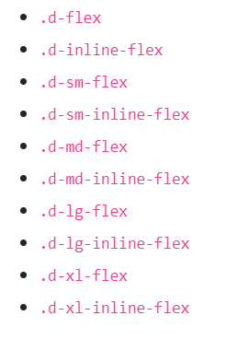
Responsive variants of flex containers

Slide 41
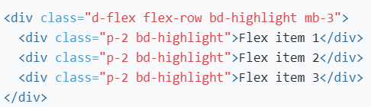
The direction of placing items in the flex container

Slide 42
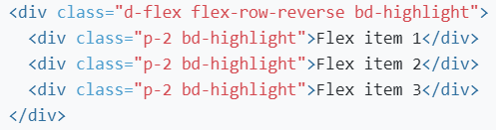
The direction of placing items in the flex container

Slide 43
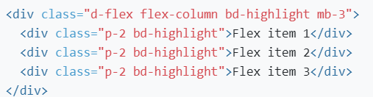
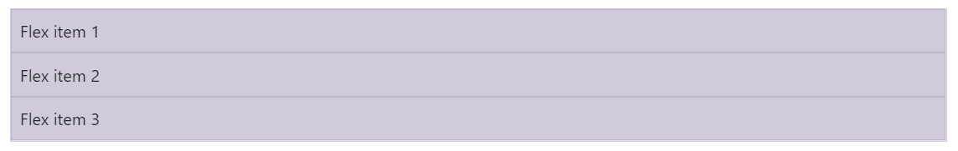
Vertical column alignment

Slide 44
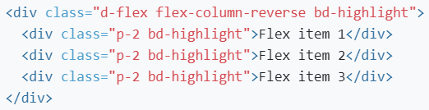
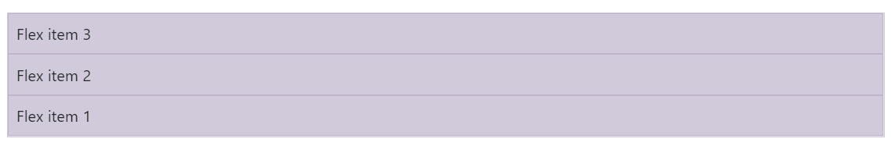
Vertical column alignment

Slide 45
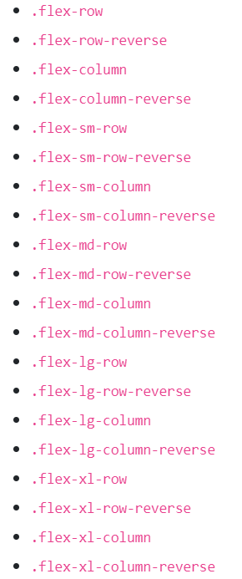
Responsive variants

Slide 46
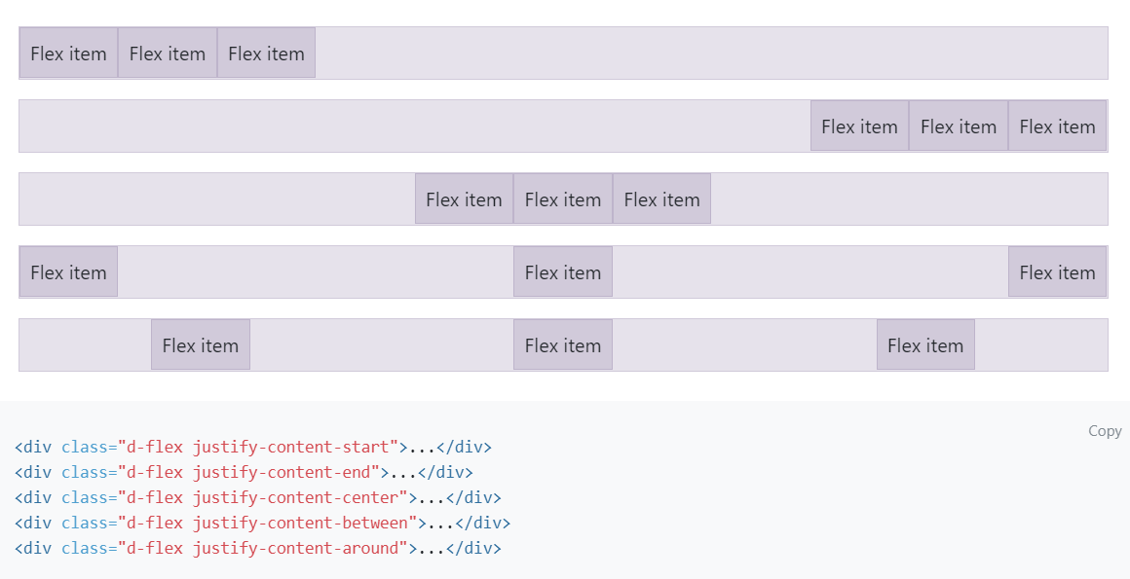
Justify-content

Slide 47
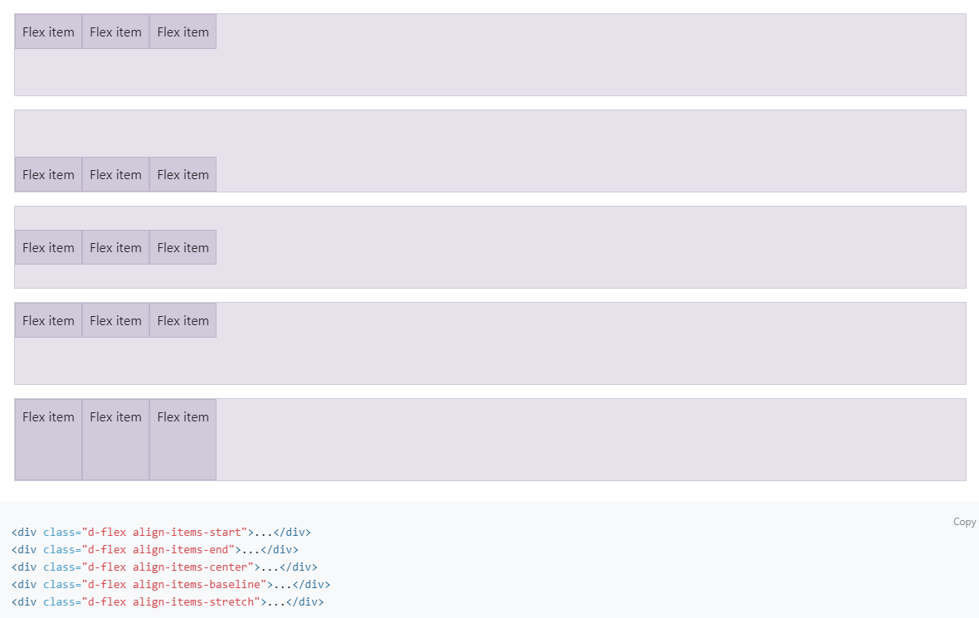
Align-items

Slide 48
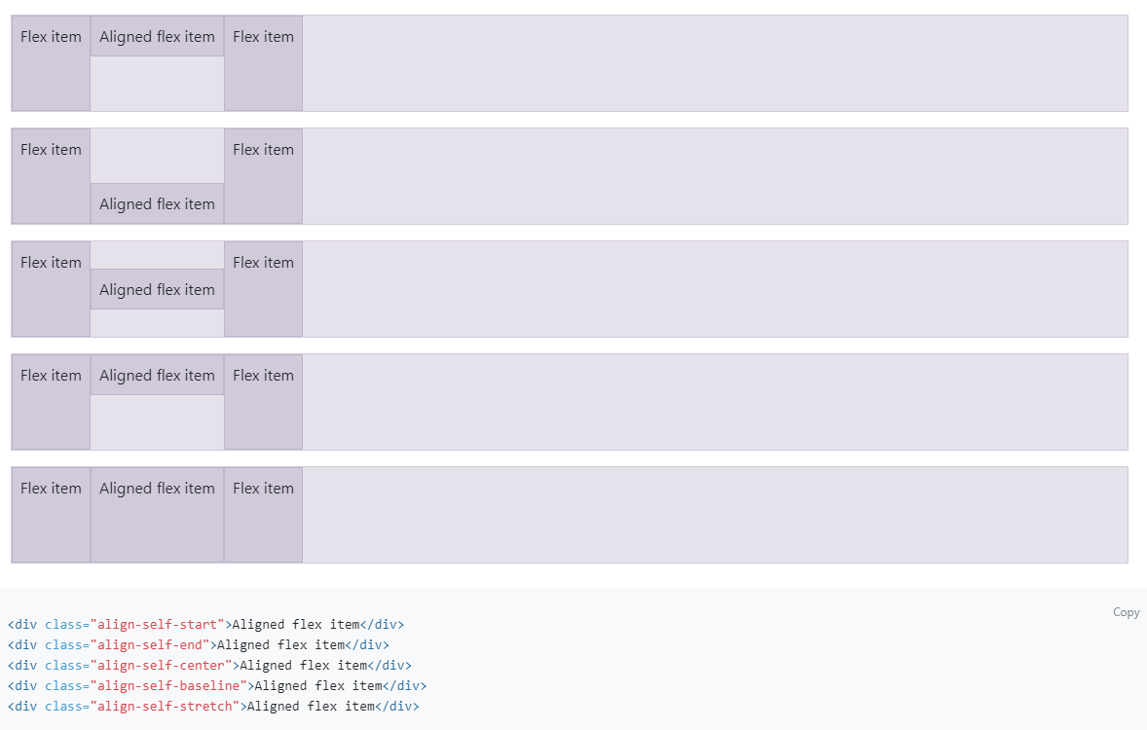
Align-self

Slide 49
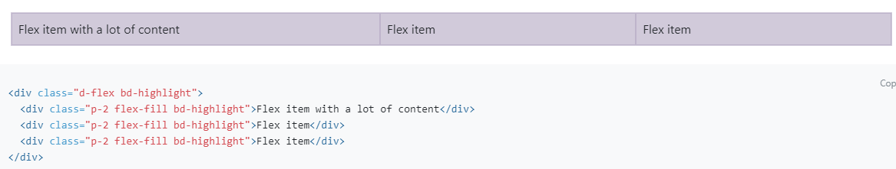
Flex-fill

Slide 50
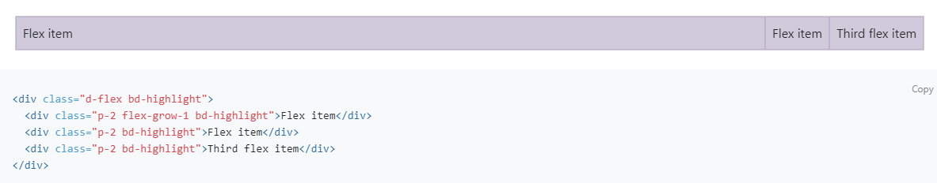
Flex-grow
.flex-grow-1 will use the maximum available space and the remaining two items will only take up the necessary space to display them on the line

Slide 51
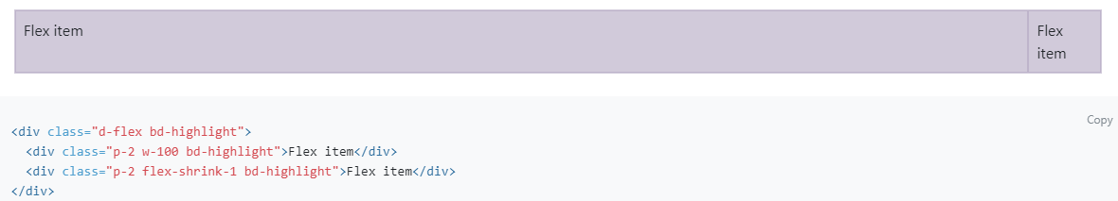
Flex-shrink
The second item with .flex-shrink-1 wraps its content to two lines to give as much space as possible to the first item with .w-100 (width:100%)

Slide 52
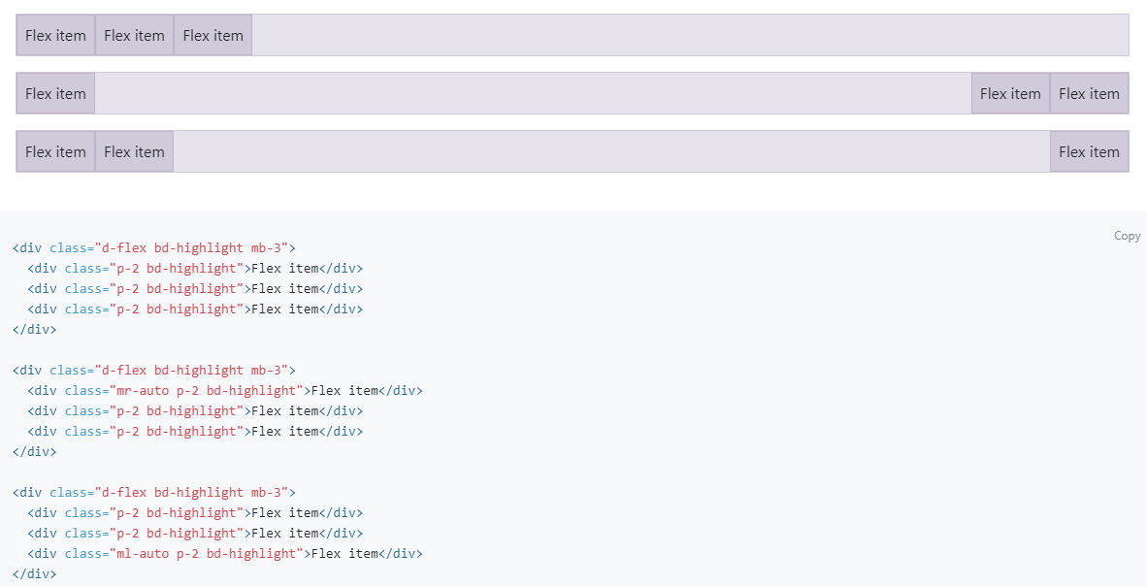
Auto margins
default (no auto margin), shift two items right (.mr-auto), shift two items left (.ml-auto)

Slide 53
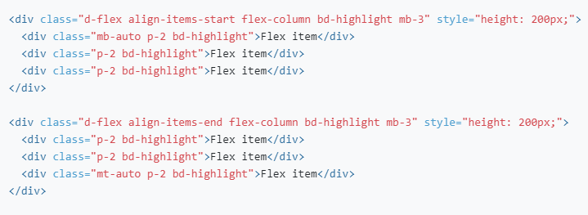
Vertical align-items
Move two items down (.mb-auto), move two items up (.mt-auto)

Slide 54
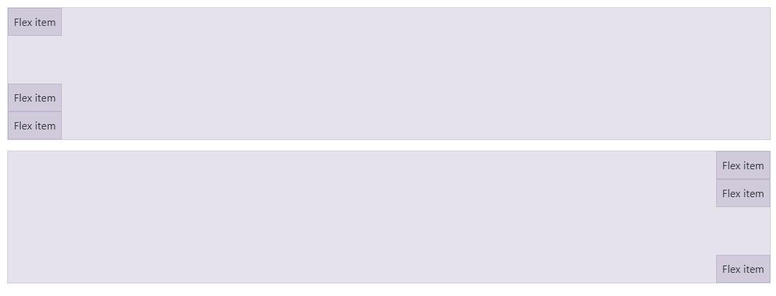
Vertical align-items
Move two items down (.mb-auto), move two items up (.mt-auto)

Slide 55
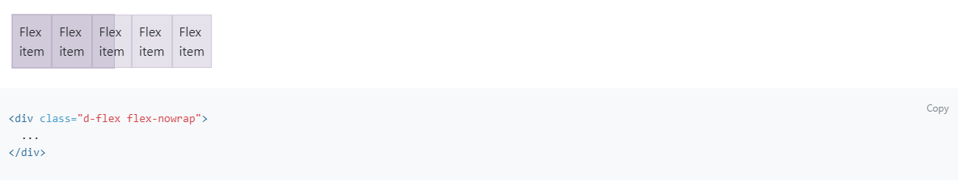
Wrap – wrapping items
No-wrap

Slide 56
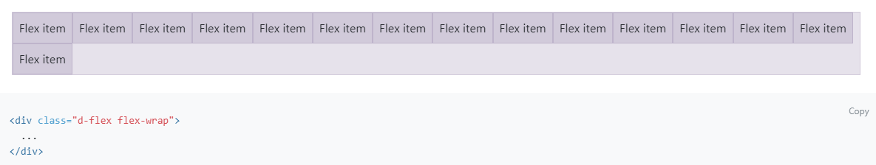
Wrap – wrapping items
Wrap

Slide 57
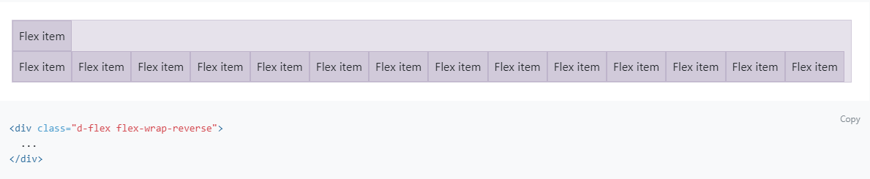
Wrap – wrapping items
Wrap-reverse

Slide 58
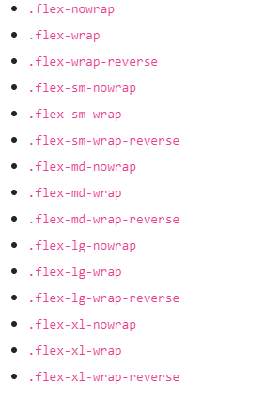
Wrap - responsive variants

Slide 59
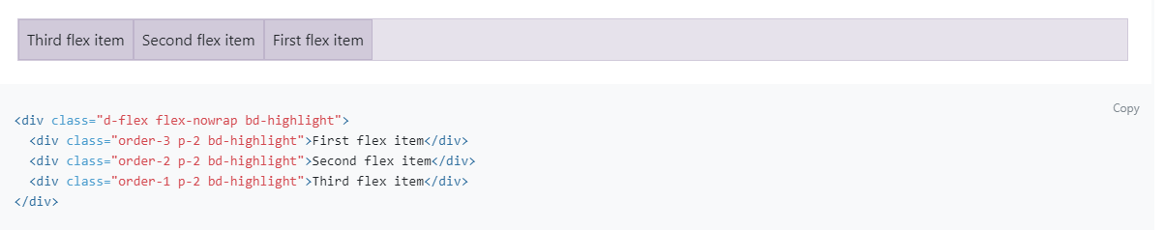
Order

Slide 60
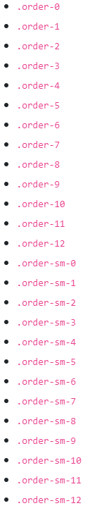
Order – responsive variants

Slide 61
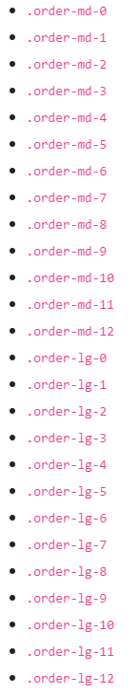
Order – responsive variants

Slide 62
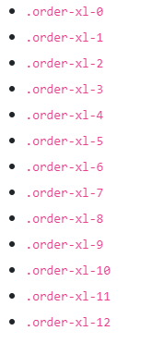
Order – responsive variants

Slide 63
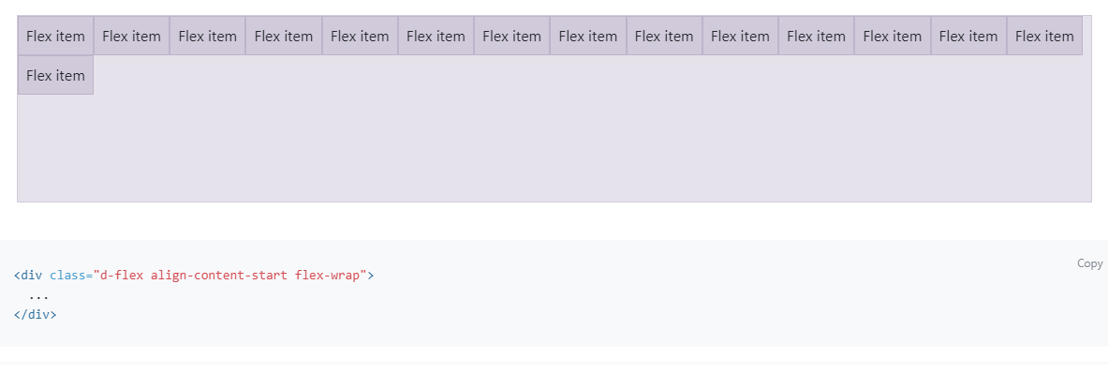
Alignment of content in a container

Slide 64
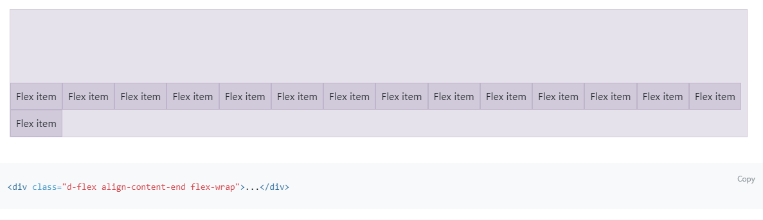
Alignment of content in a container

Slide 65
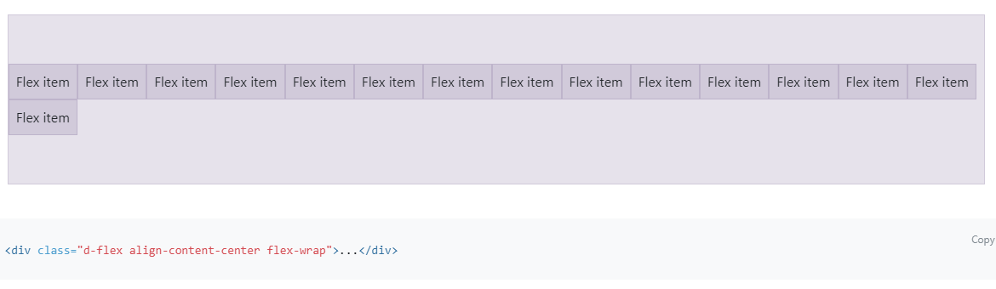
Alignment of content in a container

Slide 66
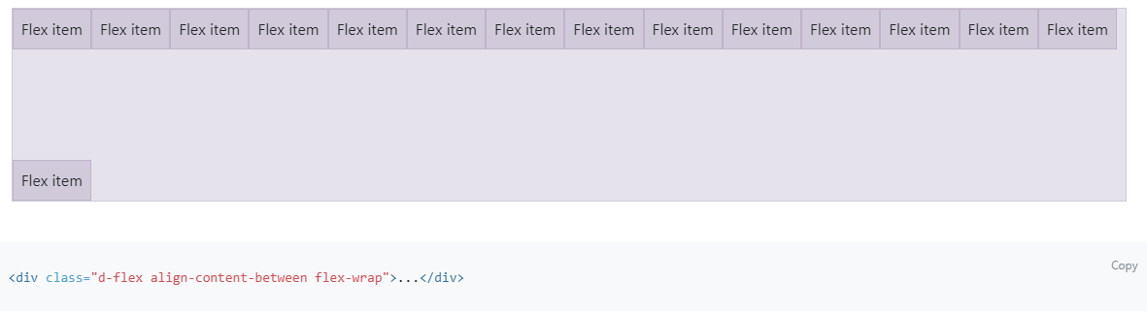
Alignment of content in a container

Slide 67
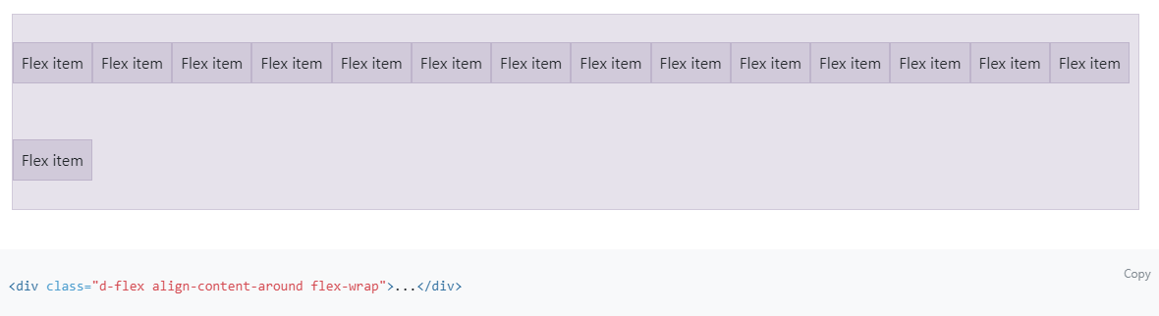
Alignment of content in a container

Slide 68
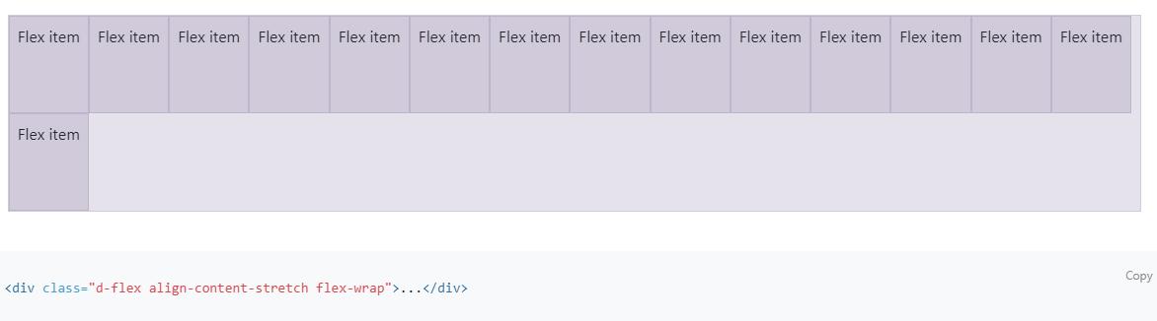
Alignment of content in a container

Slide 69
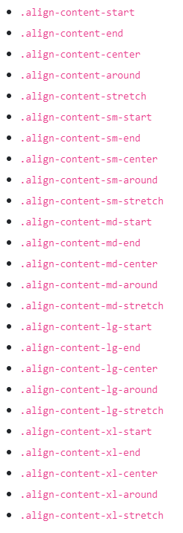
Content alignment in the container - responsive variants

Slide 70
Sources
https://css-tricks.com/snippets/css/a-guide-to-flexbox/
https://getbootstrap.com/docs/5.3/utilities/flex/

