Slide 1
Responsive webpages
Practical usage of the Bootstrap framework – media queries, menu, templates

Slide 2
Media queries - examples

Slide 3
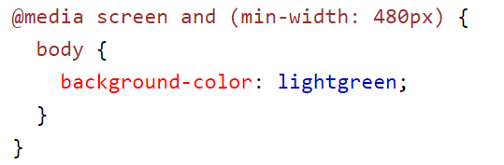
Media queries – device type

Slide 4
Media queries – specification Level 4
Improvements for the ability to insert different ranges from to, better work with min-width, max-width, etc.
There should be support for modern browsers, but it needs to be verified

Slide 5


Media queries – specification Level 4
Classic notation
Level 4 notation

Slide 6
Media queries – specification Level 4
Classic notation
Level 4 notation

Slide 7
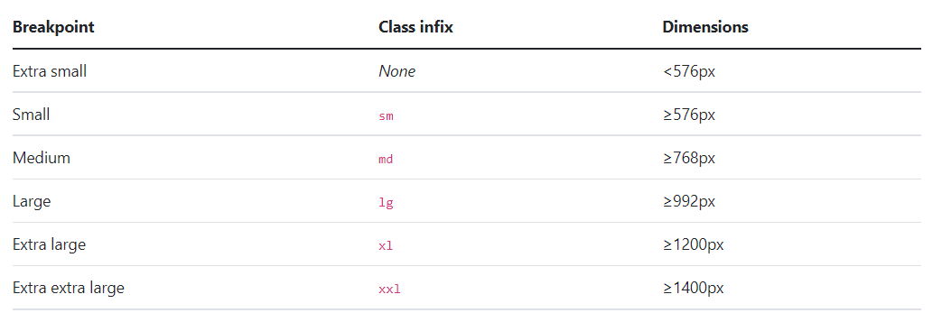
Grid system

Slide 8
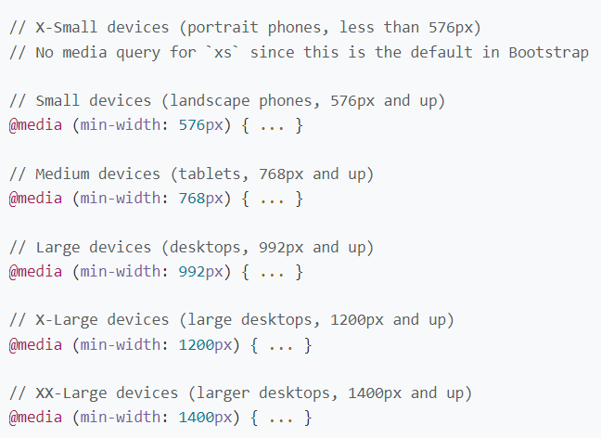
Breakpoints – min-width

Slide 9
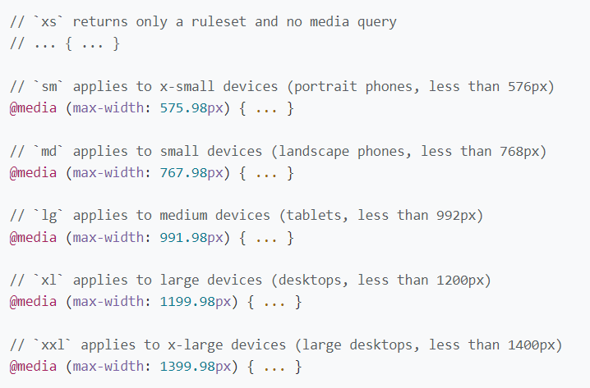
Breakpoints – max-width

Slide 10
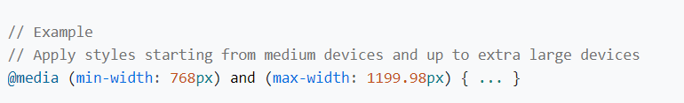
Breakpoints – possibility of definition for multiple breakpoints at once

Slide 11
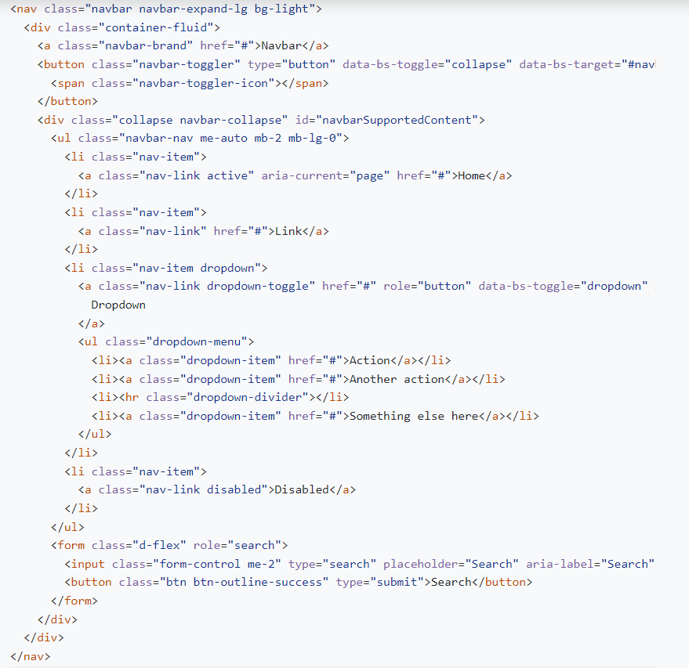
Navbar – complex example

Slide 12

Navbar – complex example

Slide 13
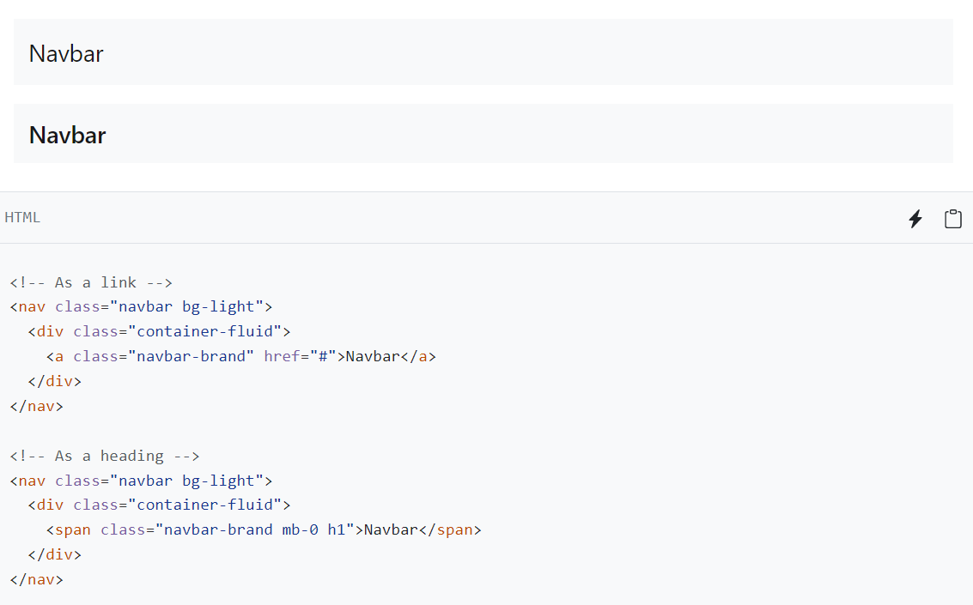
Navbar – brand

Slide 14
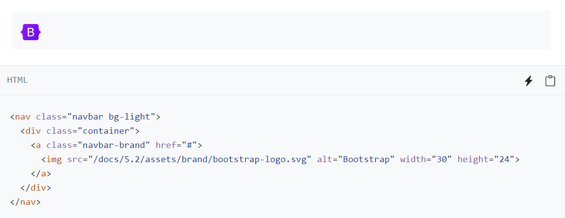
Navbar – brand

Slide 15
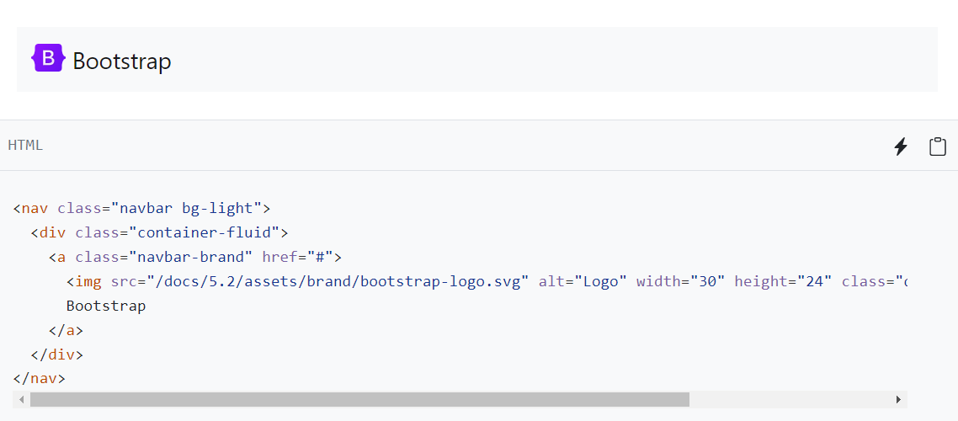
Navbar – brand

Slide 16

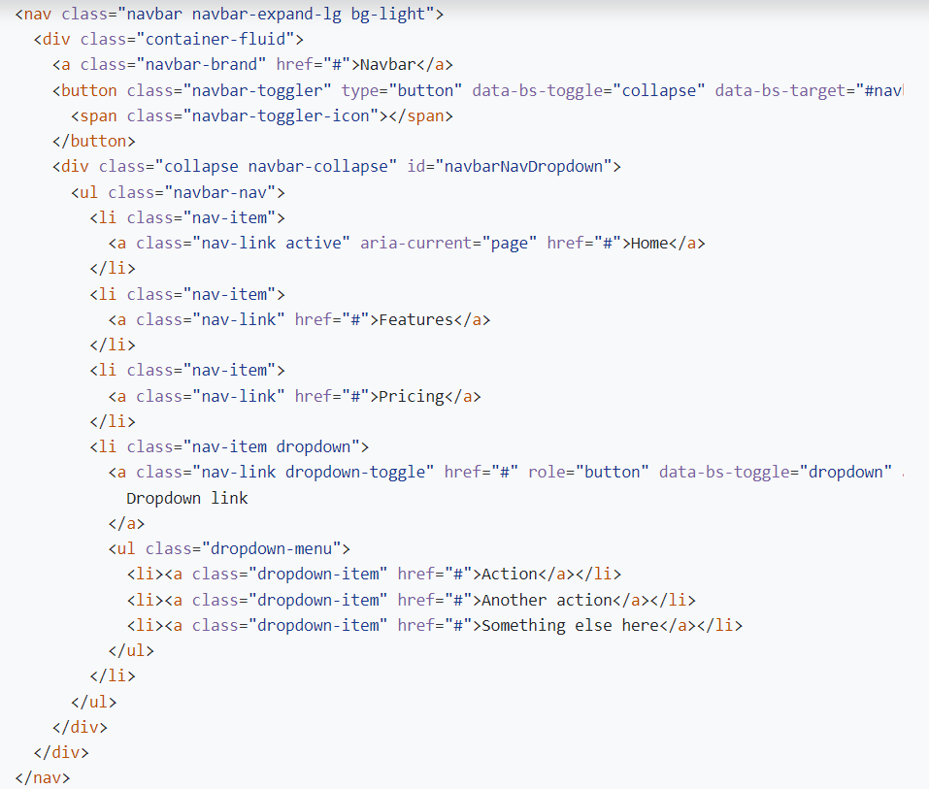

Slide 17
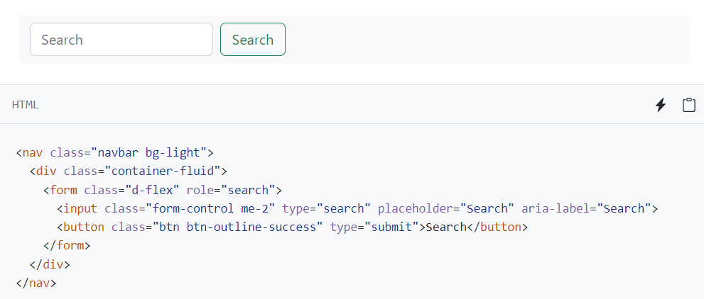
Navbar - search form

Slide 18
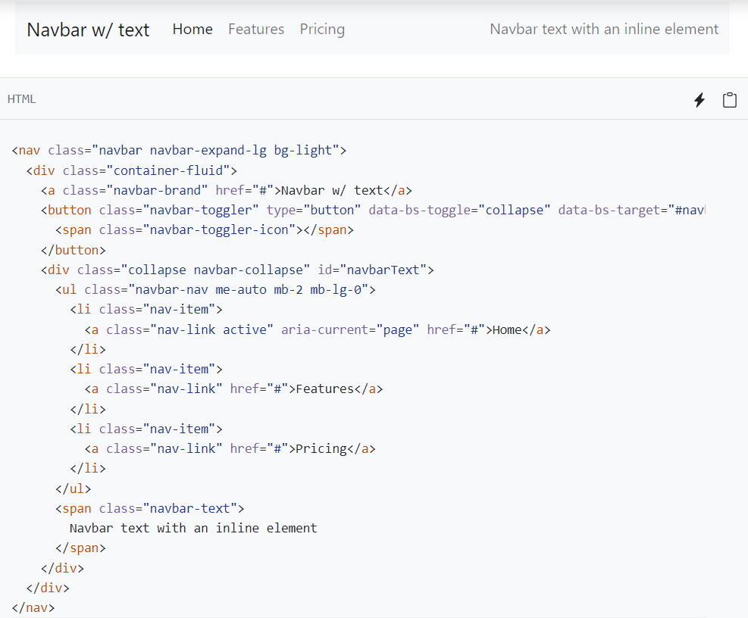
Navbar – text in the right part of the menu

Slide 19
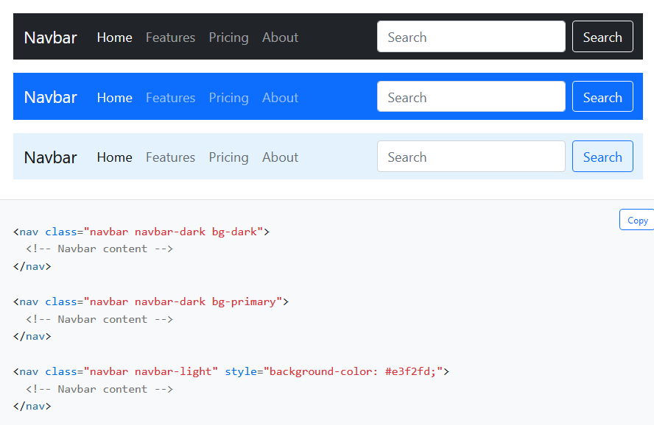
Navbar - Color Schemes

Slide 20
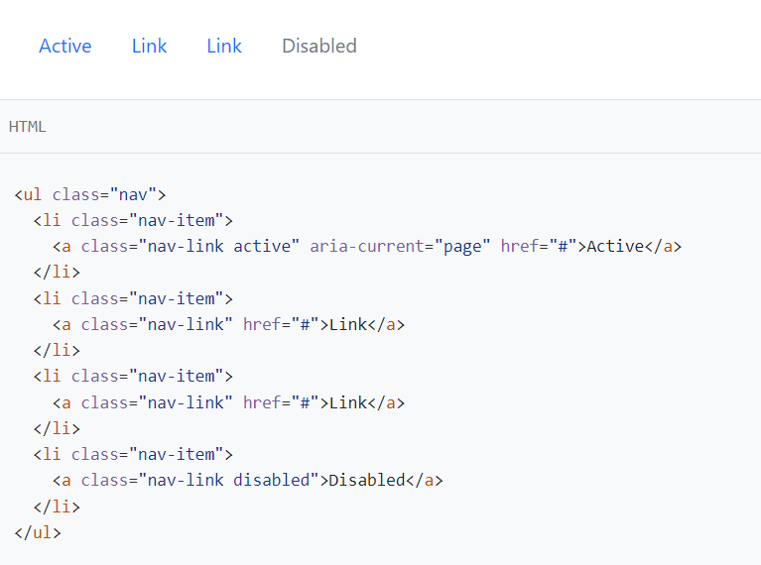
Navs – navigation menu

Slide 21
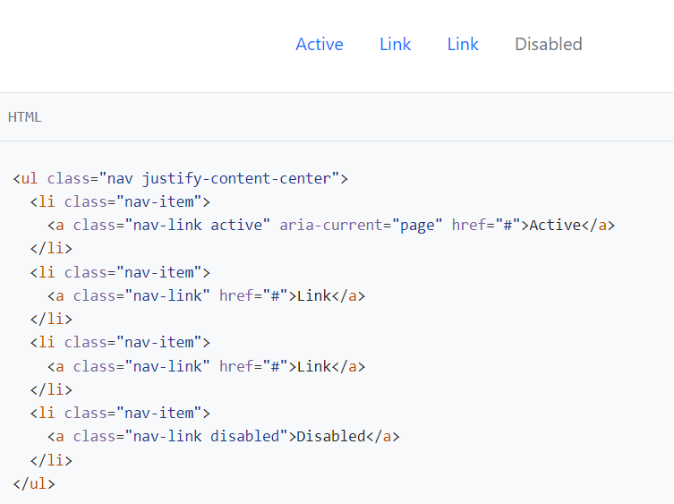
Navs - centering

Slide 22
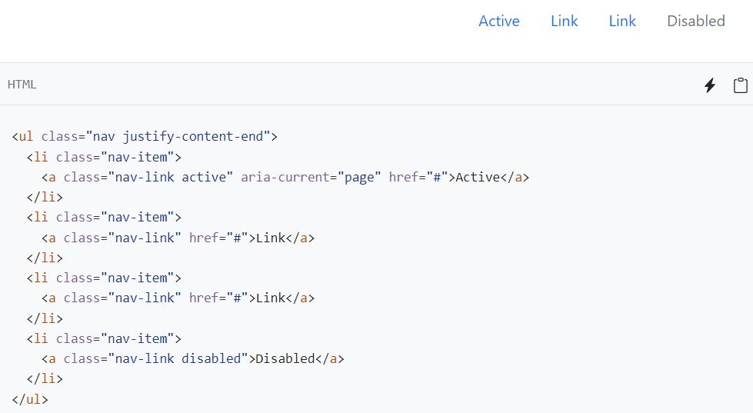
Navs - right alignment

Slide 23
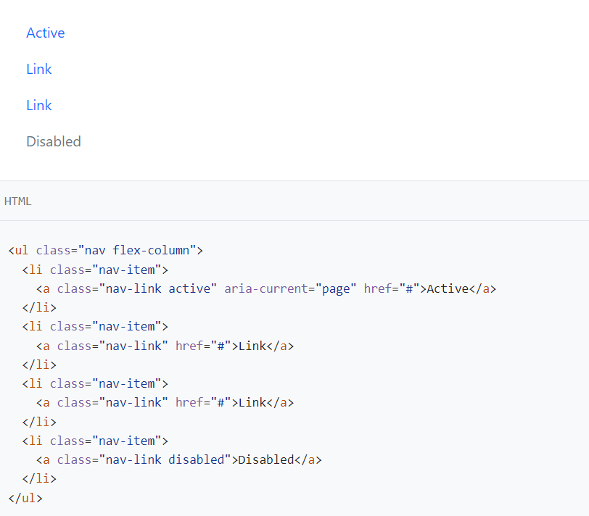
Navs – vertical menu

Slide 24
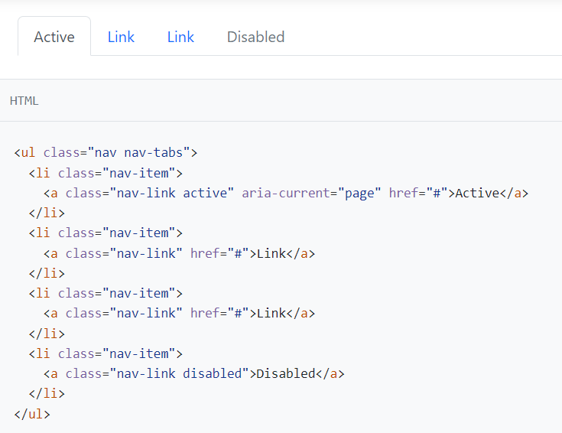
Tabs - bookmarks

Slide 25
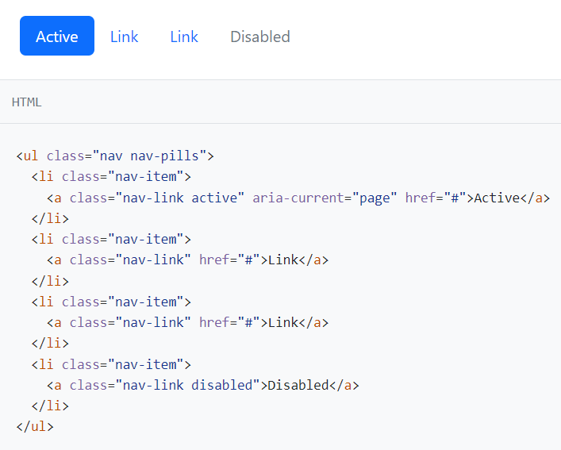
Pills - button display

Slide 26
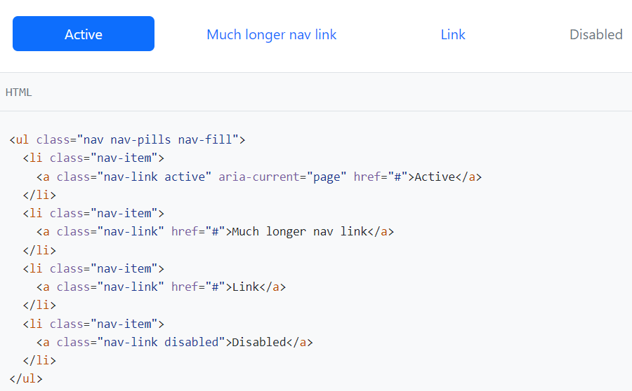
Pills – proportional space filling - fill

Slide 27
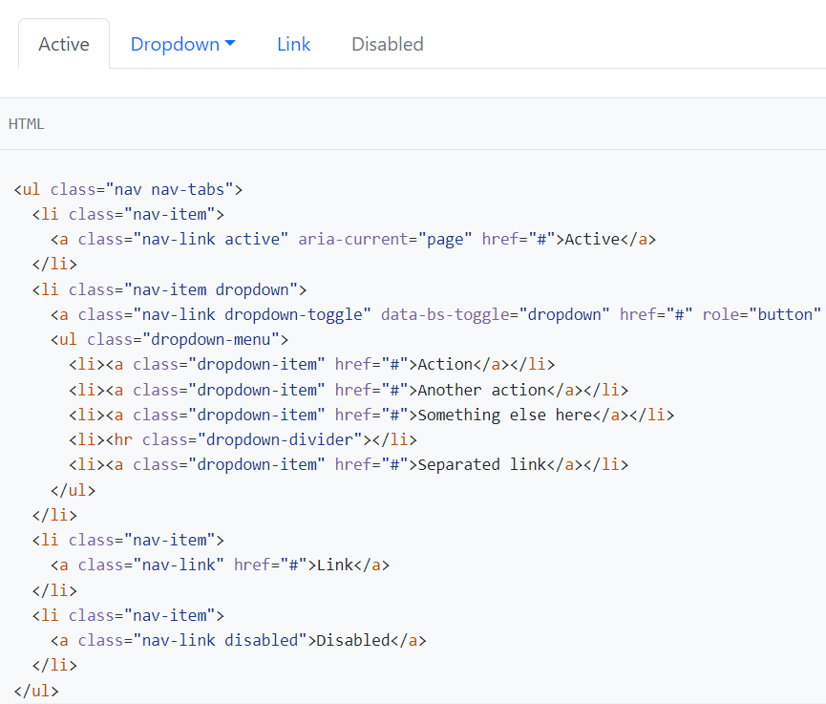
Tabs and dropdown

Slide 28
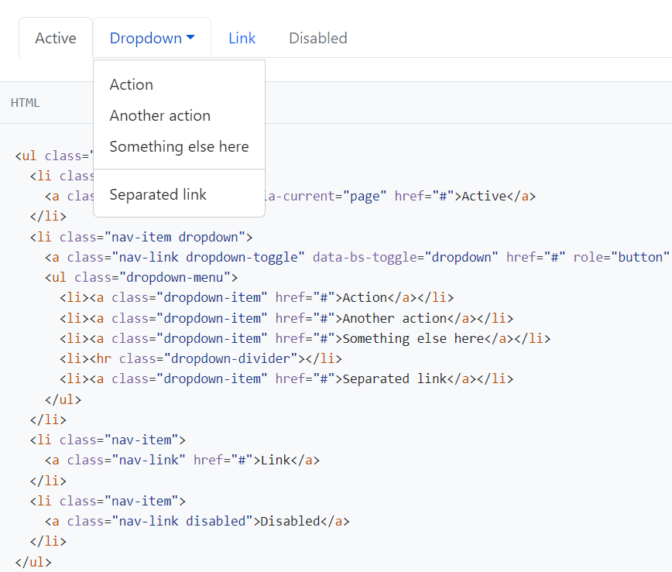
Tabs and dropdown

Slide 29
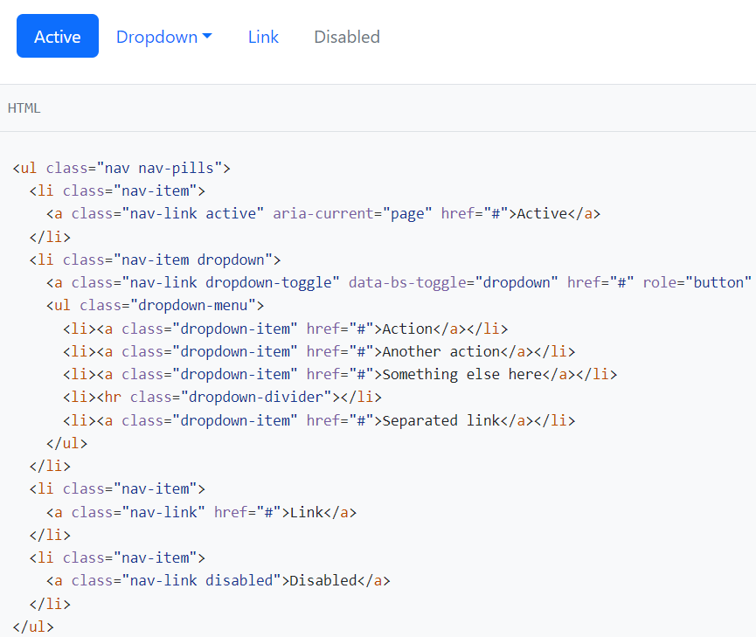
Pills and dropdown

Slide 30
Templates
Free
  https://startbootstrap.com/themes?showPro=false
PRO (paid)
  https://startbootstrap.com/themes?showFree=false

Slide 31

Creative

Slide 32

Creative

Slide 33
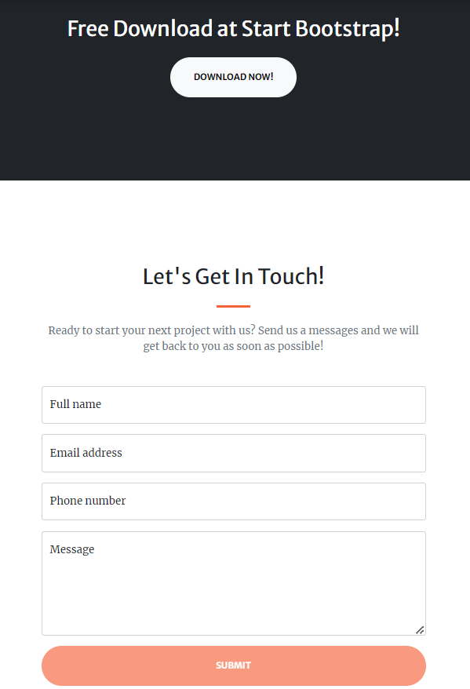
Creative

Slide 34

Freelancer

Slide 35

Freelancer

Slide 36
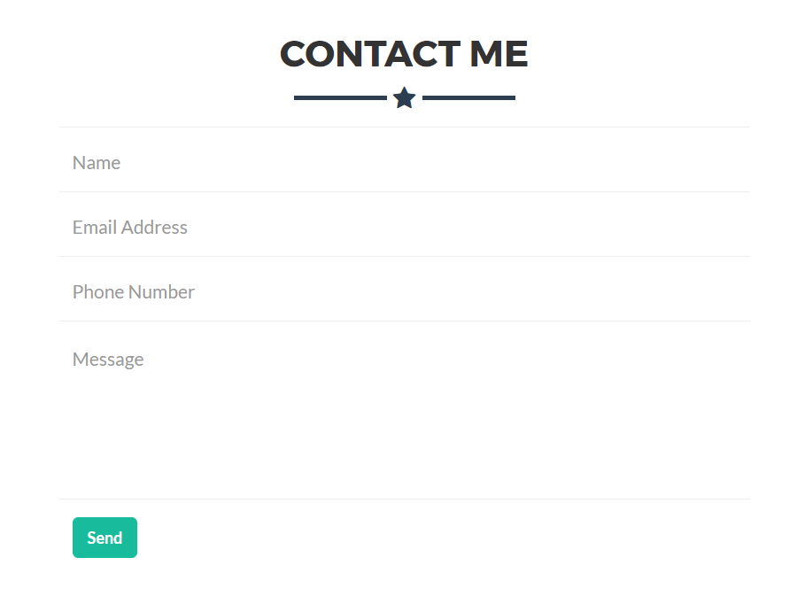
Freelancer

Slide 37
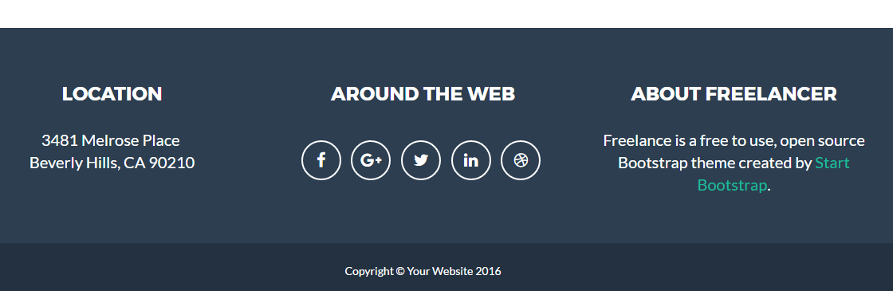
Freelancer

Slide 38

Clean Blog

Slide 39

Clean Blog

Slide 40
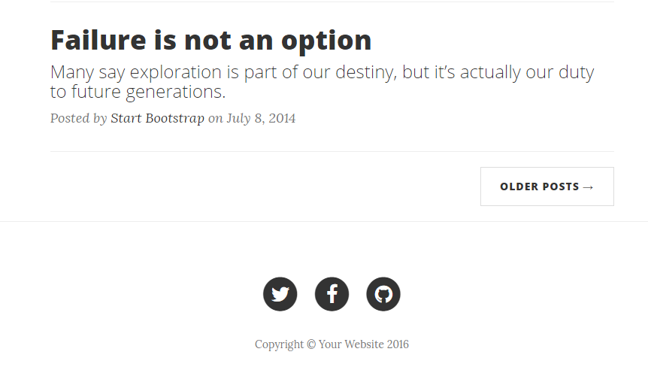
Clean Blog

Slide 41

Portfolio

Slide 42
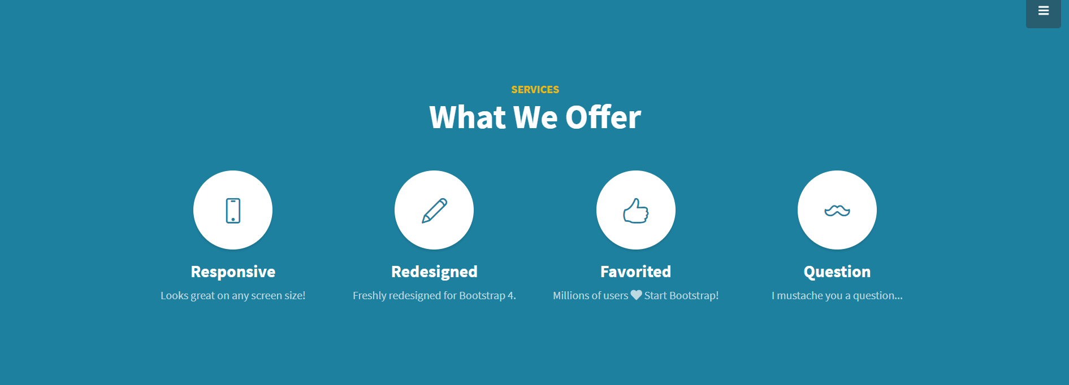
Portfolio

Slide 43

Portfolio

Slide 44

Business Casual

Slide 45
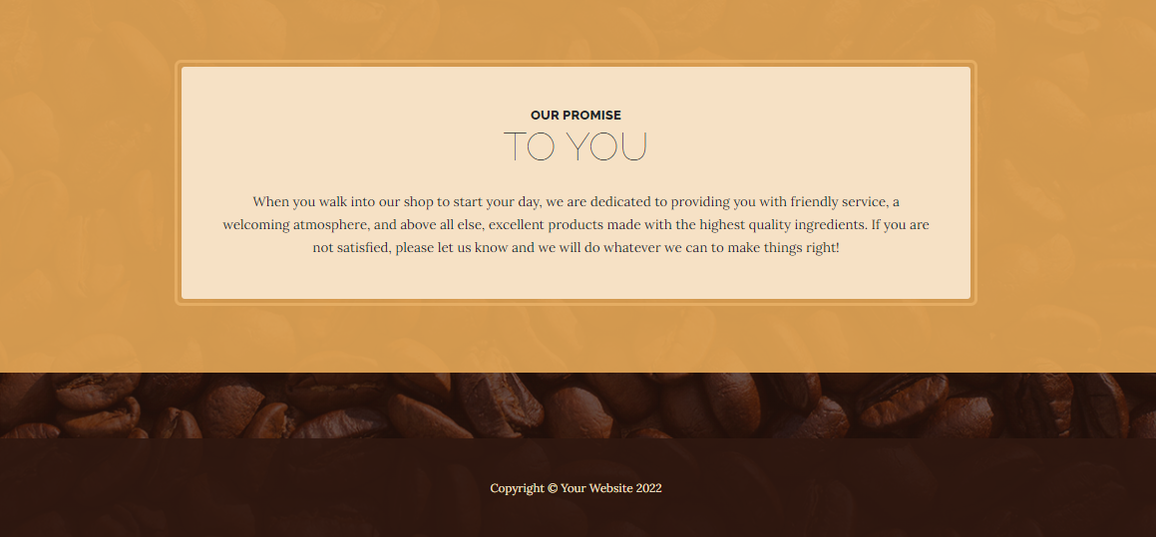
Business Casual

Slide 46
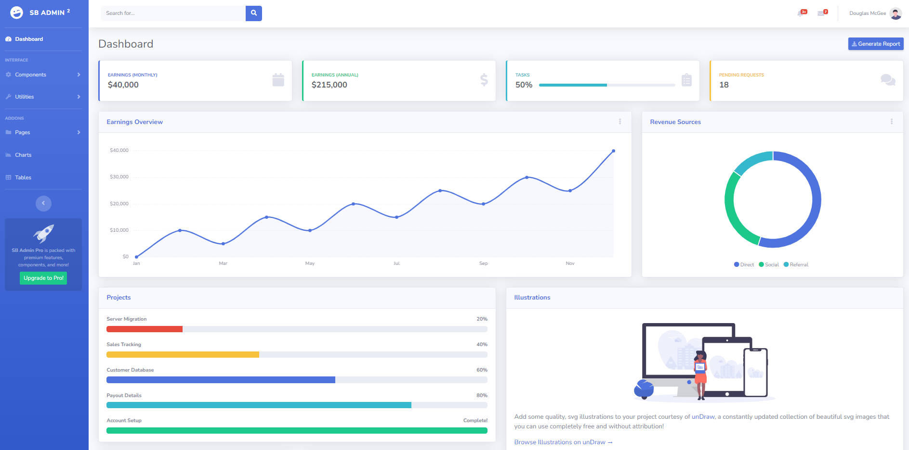
SB Admin 2

Slide 47
Source
https://developer.mozilla.org/en-US/docs/Web/CSS/Media_Queries/Using_media_queries
https://getbootstrap.com/docs/5.3/layout/breakpoints/
https://getbootstrap.com/docs/5.3/components/navbar/
https://getbootstrap.com/docs/5.3/components/navs/

