Slide 1
Responsive webpages

Slide 2
Webpages
Webpages are created using HTML
Current version of language HTML is HTML5

Slide 3
CSS (Cascading Style Sheets)
It allows the separation of the structure of the web page and its content from the graphic form of the page
Using cascading styles in the form of files with the .css extension, it is possible to specify the appearance and visual properties of individual HTML elements

Slide 4
Example
h1
{
margin: 1% /* margin has 1% of device width */
font-size: 80%; /* font size 80% of standard font size in device */
color:blue;
}

Slide 5
Web applications
Websites that contain interactive elements and dynamic information generated through various requests and interactions.
In the course, we will focus mainly on the elements and properties of the web application, which are used primarily in the context of a mobile device

Slide 6
Web application architecture
It consists of 3 layers:
presentation (client, web browser)
application (web server)
database (database to which the application is connected)

Slide 7
Mobile device
A small portable electronic device with its own power supply
Mobile devices are very often equipped with a touch screen

Slide 8
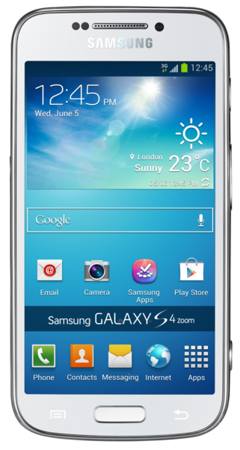
Mobile devices
mobile phones
notebooks,
netbooks, smartbooks
Phablets, tablets
electronic book readers

Slide 9
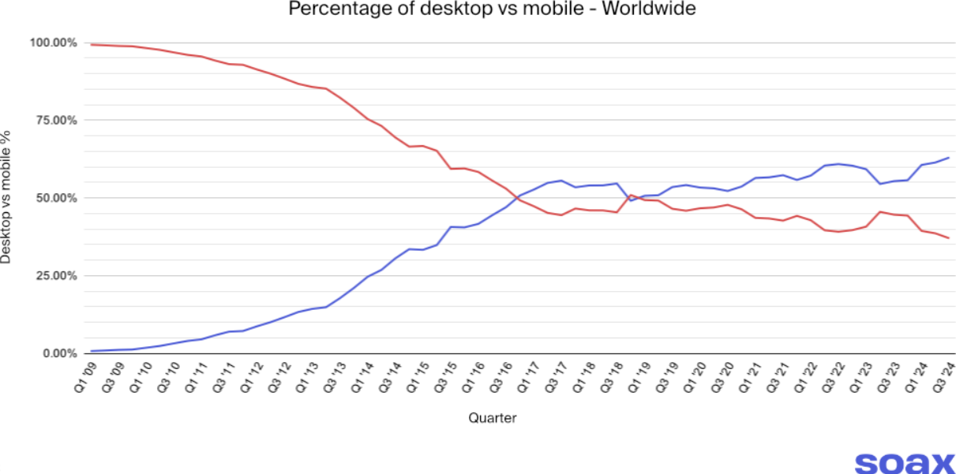
Structure of users accessing the website

Slide 10
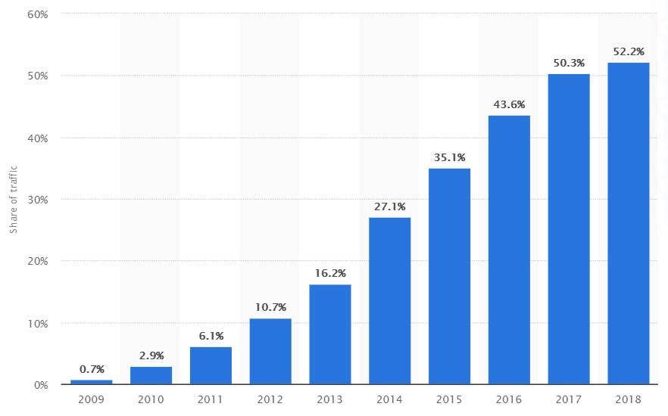
Pages displayed on mobile devices to all displayed web pages

Slide 11

Evolution of web usage on mobile devices over time

Slide 12
Responsive webdesign
A new approach created by American programmer Ethan Marcotte in an article on the A LIST Apart blog in 2010
http://alistapart.com/article/responsive-web-design

Slide 13
Responsive webdesign
A way of styling a website, ensuring that the website will be optimized for all kinds of devices
This is possible via Media Queries property, which is included in the CSS3 specification
This allows to recognize the characteristics of the device on which the website is viewed and adapts the page itself

Slide 14
Responsive design principles
Proportional design – the size of the objects (blocks) of the website is defined relatively, flexibly to its surroundings
Media queries – the appearance of the web page is automatically adjusted based on the resolution size of the device, sometimes referred to as the viewport. The viewport is the area available for rendering a web page

Slide 15


Examples

Slide 16


Examples

Slide 17
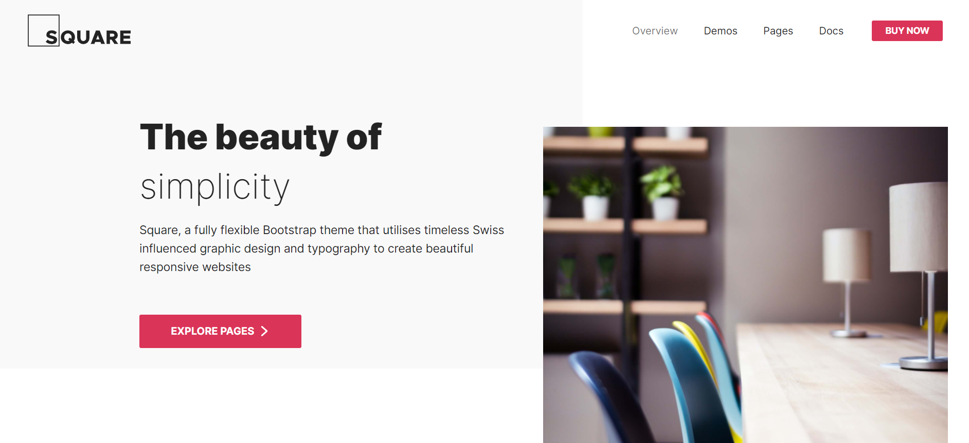
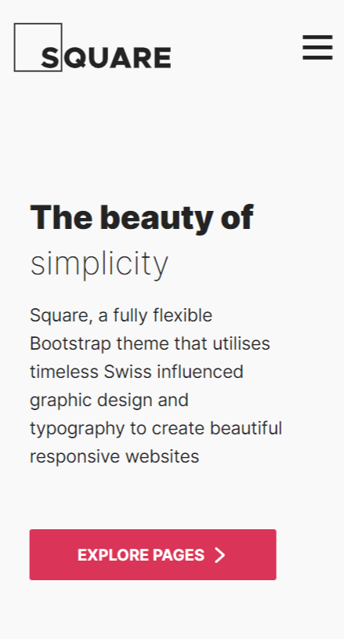
Examples

Slide 18
Proportional design
Individual elements and blocks defined using relative units
Relative units, as opposed to absolute units, allow you to define elements to fit the size of the viewport

Slide 19
Relative units - rem
Font size, outer and inner margins, as well as other properties in the document and components can be set in rem
1rem (1 root em) contains the default font size set by the author for the document and possibly modified by the user or browser, as we have already seen
If we do not change it on the document, then 1rem = 16px

Slide 20

Relative units - rem
With this code, we will set the lower outer margin to the height of the fontFirst level headings will be double the standard font size

Slide 21
Rem - benefits from a developer's perspective
In 1rem you have the basic font size stored and you don't have to remember if it's 12, 14, 16, or how many pixels
The layout width set in rem will keep the optimal text length even if the user enlarges the font
Thanks to rem, it is also possible to enlarge the entire document on specific ranges of the design

Slide 22
Relative units - em
This unit represents the relative size relative to the font size for the given HTML element, based on typography
Sometimes also called a square
It is defined as the area of ​​the letter "M", so em is used as the unit abbreviation
In a 12 point font, the square will be 12w x 12w, approximately 4.5 x 4.5mm

Slide 23
Relative units - em
For a simplified conversion of em to pixels (px), the default font size can be adjusted to a ratio of 1:10
The default web browser font size is 16px
If we reduce the default font size to 10 px, this value will then be assigned a relative size of 1 em

Slide 24
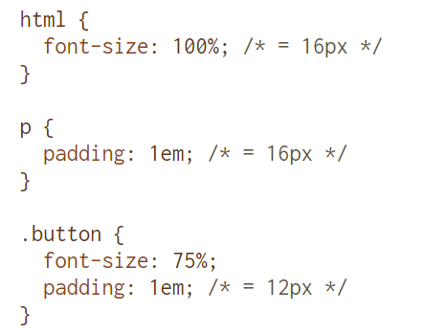
Relative units - em

Slide 25
Relative units - em
You can see that 1em means different things in different places in the document
Sometimes it can be nice: For example, if you code a component whose size should be determined by the font size on the parent element
But of course "em" is a bit harder for developers to work with than "rem"

Slide 26
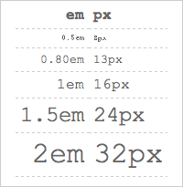
Em vs px differences

Slide 27
Relative units - percentages
Another relative unit are percentages (%)
The percentage value is calculated from the value that was inherited from the parent element
In the case of main elements on a web page, the percentage is then relative to the viewport size

Slide 28
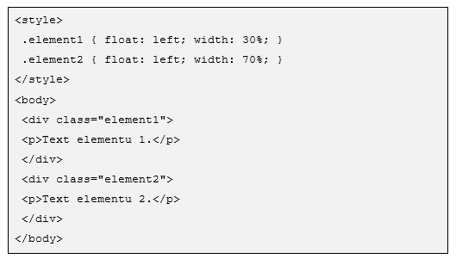
Relative units - example

Slide 29
Relative units – vw or vh
We may also need to increase and decrease the font size according to the width or height of the window
vw (viewport width) or vh (viewport height)
For example, this heading from the example will have a font size of 2rem and always two percent of the width of the window

Slide 30
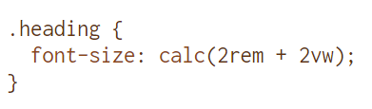
Relative units – vw or vh

Slide 31
Absolute units
For websites that are not created according to the principles of responsive design, the same elements are defined using absolute units
The width of the elements is then very often defined using the px unit

Slide 32
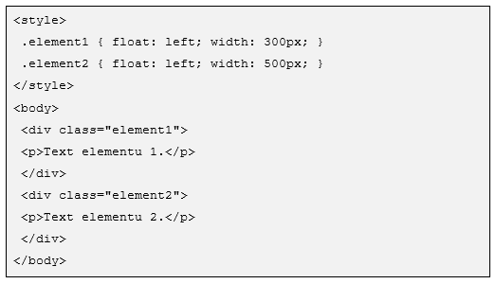
Absolute units - example

Slide 33
Absolute units
For devices with a resolution of 800px and higher, the elements will be displayed in full size
On devices with a lower resolution, these elements will be artificially reduced, as well as the entire page
For viewing, it is often necessary to enlarge the desired part of the page by touching

Slide 34
Media queries
The name of a specification that adds to CSS versions 2 and 3 the ability to define the constructs and conditions under which a CSS style should be applied
These constructions and conditions are mainly device-dependent and serve precisely to adapt the appearance for the given device
Media types - the type of device to which the CSS style should be applied

Slide 35
Media types
Device type | Description
braille | Braille touch device
embossed | braille printer
handheld | mobile device, typically with a small screen, limited internet connection
print | printer
projector | projection
screen | color display
speech | speech synthesizer
tty | devices with a limited number of characters, with a non-proportional font, e.g. teletext
tv | television equipment, equipment with low resolution and limited picture scrollability

Slide 36
Media types
Writing media types is done using the @media rule or the media attribute
Definitions are inserted into the block marked with the @media rule, which are processed only if the target device meets the conditions defined by the @media rule
If the browser does not support @media rule processing, the definitions are ignored

Slide 37
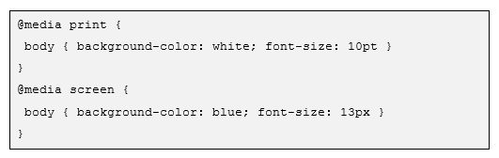
Media types - example

Slide 38

Media types - example

Slide 39
Viewport specification
The specification defines the default width of the viewport and thus allows the web page to be rendered precisely for a specific viewport
The specification is written to the web page using the new viewport meta tag.
In these days, the viewport meta tag is pretty much the standard

Slide 40
Viewport specification
The viewport metatag can define the following properties:
width – specifies the width of the viewport for rendering; the value can be a size in pixels (given without a unit), or the keyword device-width, which represents the width of the display area of ​​a specific device
height – specifies the height of the viewport for rendering
initial-scale – initial zoom; the value expresses the ratio between the width of the rendered web page and the width of the viewport

Slide 41
Viewport specification
maximum-scale – maximum zoom; value is of the same type as for initial-scale
minimum-scale – minimum zoom; value is of the same type as for initial-scale
user-scalable – setting the user zoom option; value is from the list yes, no; by default the user is allowed to zoom in and out, if the value is no the maximum-scale and minimum-scale properties are ignored

Slide 42

Example
• Sets the available viewport width as the default

Slide 43
Sources
https://timerichworryfree.com/how-to-get-your-small-business-noticed-online-tips-for-higher-google-ranking/us-local-mobile-search-vs-desktop-search/
https://everwebmarketing.com/mobile-traffic-monetizing-5-things-to-consider-when-looking-at-publishers-traffic-profile/
https://www.broadbandsearch.net/blog/mobile-desktop-internet-usage-statistics
https://www.statista.com/statistics/241462/global-mobile-phone-website-traffic-share/
https://www.vzhurudolu.cz/prirucka/jednotky

