Slide 1
Responsive webpages
Structure of responsive webpages and rules for their creation

Slide 2

alive.osu.cz

Slide 3
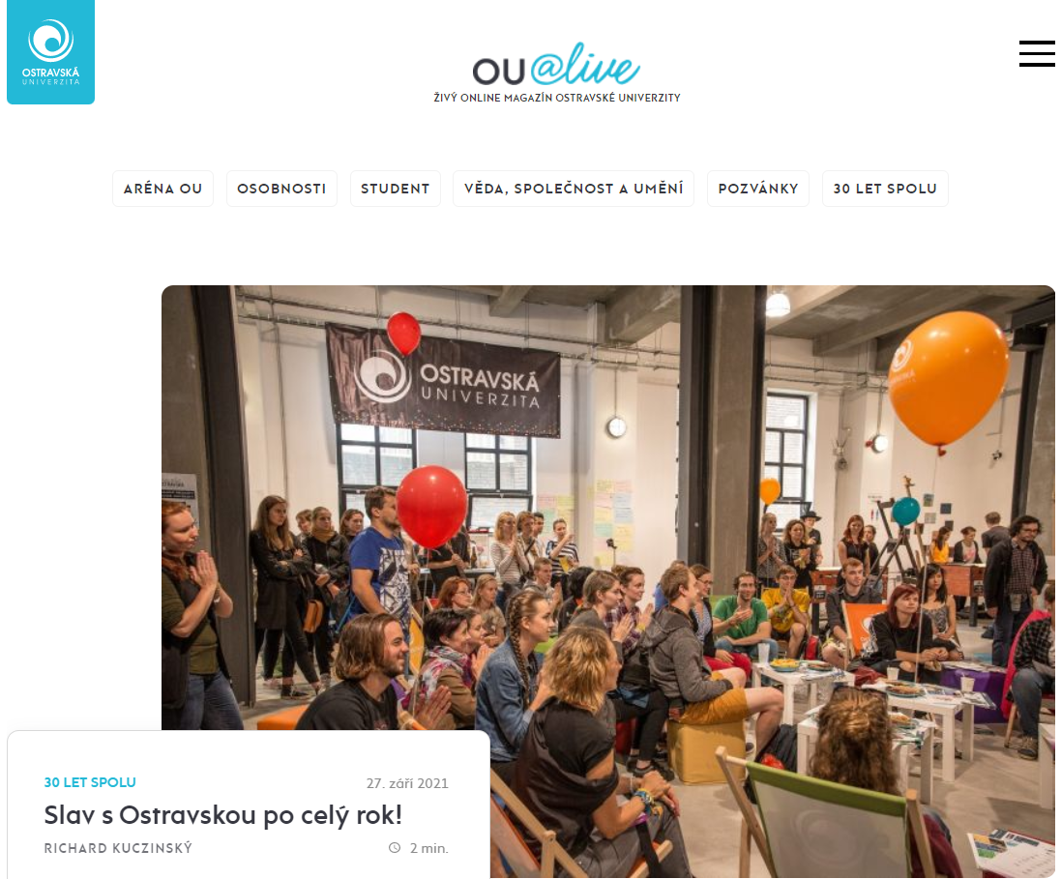
alive.osu.cz

Slide 4


Slide 5


Slide 6

antoinelaoun.com

Slide 7

antoinelaoun.com

Slide 8


Slide 9


Slide 10

annestreetpartners.com.au

Slide 11

annestreetpartners.com.au

Slide 12


Slide 13


Slide 14


Slide 15
Other examples
sheratonlakecomo.com
bxxlght.com
jcfigueiras.fr
gotobrno.cz
mattkersley.com/responsive

Slide 16
Mobile - first
The approach includes rules and guidelines for creating a website that is primarily aimed at mobile devices and secondarily at classic devices
The approach is closely connected with responsive web design, which has the task of automatically adapting the website according to the display size and resolution of the given device

Slide 17
Mobile - first
The method of adapting a website to a given device type and display size was first described by Cameron Adams in 2004
Other pioneers in mobile first and responsive design are Luke Wroblewski and Ethan Marcotte

Slide 18

Classic web development approach

Slide 19

Mobile – first approach

Slide 20
Mobile version of the website
This is a stripped down version of the site that is adapted to display on mobile devices, but does not display on classic devices
Mobile versions of the website are most often displayed on the m subdomain
Např. m.mall.cz

Slide 21
Mobile version of the website
A user accessing via a desktop device will see the classic version of the site
A user who accesses using a mobile device is then automatically redirected to the mobile version of the website

Slide 22
Mobile version vs responsive website
The advantage of the mobile version is the fact that there is no need to rework the entire website and basically create it again, but it is enough to properly design and create a mobile version of the website, which is a separate whole
The disadvantage is precisely the fact that we have two versions of the site (essentially two sites) which, if properly designed, load the same content, but two separate versions of the site are needed to manage and develop

Slide 23
Rules for designing a website structure

Slide 24
Appropriate structure
The most suitable one-column layout, or its modification
It is possible to use a multi-column layout, but it needs to be considered
Most mobile users are used to scrolling while browsing a website

Slide 25
Appropriate structure
Layout of elements on the website, company presentation - main elements:
  logo - in the upper left part
  main menu (+ possibly a signpost for choosing a language mutation) - in the upper right part
  website content – ​​in the middle part
  website footer – contact information, etc. – at the bottom

Slide 26
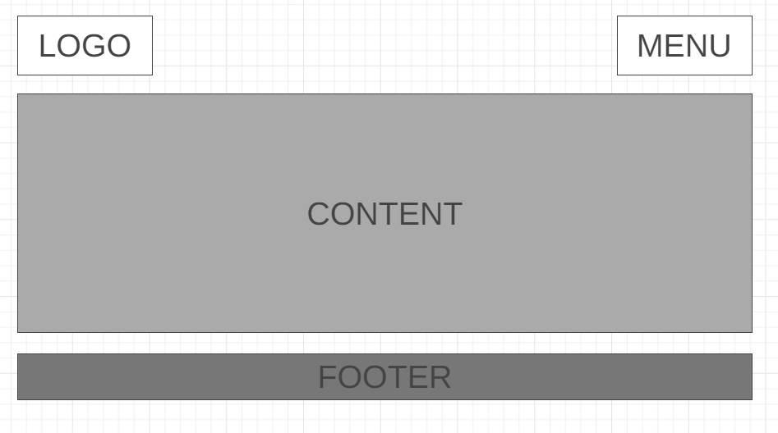
Appropriate structure

Slide 27
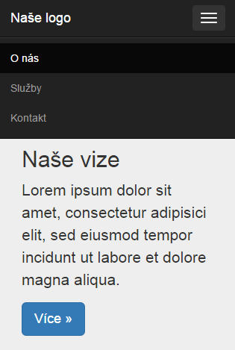
Appropriate structure

Slide 28
Customization of graphic design
The graphic design needs to be adapted mainly to the mobile first approach, i.e. use and display on mobile devices
The graphic elements of the website should be simple, as small as possible in terms of data size, and their number should correspond to the possibilities of the small resolution of the mobile device display

Slide 29
Site and content data size
In the case of source code, it is necessary to use only absolutely necessary external resources due to the speed of loading the website, use tools to reduce the size of loaded CSS and JS files (e.g. using minification)
In the case of published content, it is necessary to ensure the effective reduction of published images and photographs, or other graphic elements, if applicable

Slide 30
CSS optimization for faster loading
When loading a website on a mobile device, before the website is rendered, the server and the network must take action in the browser (the time known as "Time To First Byte" or TTFB)
The browser then receives the HTML, followed by the CSS, and must process them
This is where the first render metrics come into play: First Paint (FP), First Contentful Paint (FCP) or First Meaningful Paint (FMP)

Slide 31
Target metric for first rendering of "meaningful content" on the web
1,3 s
First Contentful Paint

Slide 32
Deleting in CSS file
The CSS code of most projects that have been in development for some time has one specific property – bloat
1. Go through the coverage of the code (Coverage) in Chrome DevTools
We will find out which part of CSS we actually use on the project and which part we don‘t
CSS will never have 100% coverage, but values ​​below half of the unused code are workable
2. Try automatic CSS removers – DropCSS, PurifyCSS

Slide 33
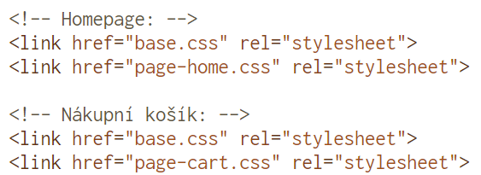
Distribution of CSS according to templates
There is no reason why, for example, the user of the start page of an e-shop should download CSS styles for the entire shopping process
Recommendation: separate the styles intended for specific sections or pages into separate files

Slide 34
Enable HTTP/2
The main advantage of HTTP/2 is the ability to download multiple files simultaneously
This ultimately means that we can afford to send more smaller frontend files to the user
We can find out if we have it turned on, for example, by using the extension for Chrome HTTP/2 and SPDY indicator

Slide 35


Adjusting the cache in the browser
First, we set an instruction for a long storage time in .htaccess or a similar server configuration file. One year:
CSS files will be stored in the browser cache for one year, unless we change them ourselves
You also need to ensure that your deployment process can add a version number to the files:

Slide 36
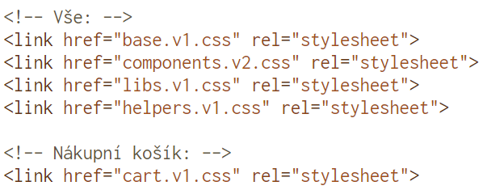
Dividing CSS by type

Slide 37
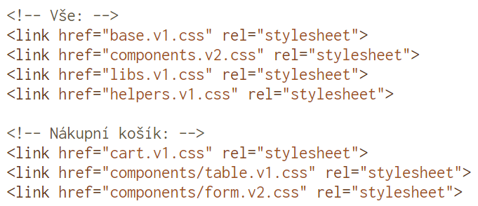
Dividing CSS by component
Let's focus now on components.v2.css. Component files are usually the largest because they contain most of the website design and will therefore be the most data-intensive
The ideal situation is that we only send to specific templates those components that are used in them:

Slide 38
Loading critical CSS
We can take some of the content of the base styles and put them inside the <style></style> tag
Or we can use one of the generators to generate the so-called critical CSS (basic styles), which should be loaded first

Slide 39
CDN
Content delivery network
In practice, it works in such a way that the required data is not located on just one server, but is distributed on several servers around the world
A visitor whose browser starts requesting certain content will be connected to a server that is closer
Better response and faster speed is expected from retrieving data from a closer server
Using a CDN is so interesting especially for websites accessed by people from all over the world

Slide 40
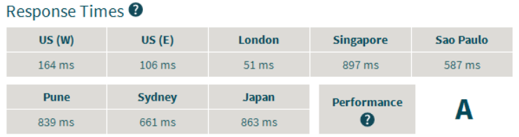
Acceleration of response
The goal should be to speed up the response
This is how the response of this website looks from different parts of the world (it is hosted in the Czech Republic)
It can be seen that the response speed is not ideal outside of Europe and the USA

Slide 41
Advantages
Load distribution
Replication of content to multiple servers can handle spikes in traffic better
Convenient use
Linking external JS/CSS from a CDN is probably more convenient and faster than downloading, copying and including libraries locally in the project
For quick testing, connecting scripts from a CDN is useful
Practically every known library can be found on a CDN
Creators support this because without offering a CDN, a significant number of people will link the library from a location that is used as a preview of that library on their site, and this can be a problem for mass use

Slide 42
Advantages
Content caching
When creating websites, ready-made third-party libraries such as jQuery, CSS framework Bootstrap, various lightbox scripts, etc. are sometimes loaded from the CDN
To use a foreign library in your own project, connecting from a CDN is often more convenient than downloading and copying the necessary files
The idea behind caching is that if popular libraries were connected by everyone from the same URL using a CDN, they wouldn't have to be downloaded again and again on each site, but would already be contained in the browser's cache

Slide 43
Disadvantages
CDN outage
The first disadvantage is that if the CDN fails, the website will display poorly (e.g. CSS won't load) or it won't work properly (JavaScript won't load)
In theory, something could be blocking the address from the CDN as opposed to the site itself
This leads to errors that are difficult to explain
At the same time, connecting external files makes offline development more difficult
If the website/application is to be developed on localhost, the external files will logically be missing in the event of an internet outage

Slide 44
Disadvantages
Link to another domain
In case one does not already have the required content from the CDN cached, creating a connection to the new domain will take longer than fetching the file from the same domain where the HTML code arrived from
Different versions of libraries
Different versions of CSS/JS libraries are used across websites, sometimes very old ones, which no one dares to update to a newer one, because it is not clear whether it would break something
The same file can also be connected from different CDNs
So the savings will not be that significant

Slide 45
Disadvantages
Safety
The last issue is security
By connecting a *.js file from a third-party CDN, content over which the operator has no control gets into the website and can do a lot of damage if someone with malicious intent modifies it in an unwanted way
Firefox, Chrome, and Opera have introduced support for the integrity attribute
This is used to specify the hash for verifying the integrity of the content of the CSS/JS file

Slide 46
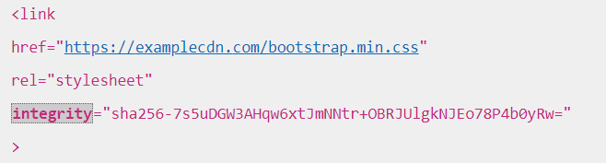
Disadvantages
Safety
In such a case, the browser must calculate its hash and compare it with the value of the integrity attribute before applying the attached CSS/JS
If they do not match, the script or style must not be executed

Slide 47
Image optimization
It is necessary to ensure sufficient quality and size of images for large monitors with high resolution (typically for PCs) and at the same time images should be as small as possible in terms of size in kB so that they load as quickly as possible on mobile devices

Slide 48
Image optimization
A convenient way to display the main image
At all resolutions, the middle part of the image, which carries the main image information, is always displayed
Thus, the image is centered in the center and adapts to the resolution of the given device

Slide 49
Image optimization
It is recommended that images have a width of 1900px
If the monitor has a higher resolution, the image and the entire website will be displayed in the center, with empty space around the edges
Example: size 1900 px x 730 px, the image size in kB is then 177 kB

Slide 50
Image optimization
Images must always be saved in the correct format
SVG, PNG or GIF format is suitable for graphic elements of the website
For images in web content or photography, WebP or JPEG is very often the most appropriate format

Slide 51
Image optimization
A large number of images are scaled down to the wrong size in terms of resolution
Except for one that forms the main image of the website or is in the background, images should always be scaled down to the appropriate size
Example – a 1MB image

Slide 52
Image optimization
A large number of images displayed on responsive websites are not at all optimized for proper compression
Compressing an image will make it possible to reduce its data size while maintaining adequate quality
One of the image compression tools is the online tool CompressNow available at URL: http://compressnow.com/

Slide 53
Image optimization
Images are often stored on different sources
Loading images from different sources, i.e. more than one source, can also cause the site to load slower
Therefore, it is advisable to always store images on one storage (server) and load them from only one source

Slide 54
Sources
https://alive.osu.cz
https://antoinelaoun.com
https://annestreetpartners.com.au
https://www.vzhurudolu.cz/prirucka/css-optimalizace
https://jecas.cz/cdn

