Slide 1
Responsive webpages
Current frameworks for responsive web

Slide 2
Benefits of using the framework
Framework = a well-prepared tool for creating your own responsive website
Beginners in the area of responsive website creation can basically create their first responsive website right away

Slide 3
Benefits of using the framework
Saving time and financial costs
An experienced web designer is able to create a new responsive website
Thanks to this, it is possible to save the time that would be needed to study responsive design or create your own framework
Most frameworks are open-source, so their use is free

Slide 4
Benefits of using the framework
Community of users
Thanks to a large community of users, it is possible to find a large number of solutions and tips on how to solve more demanding functionalities and special elements of a responsive website
Using a discussion forum or other type of communication with the user community, the web designer is able to effectively find solutions to problems

Slide 5
Selected frameworks for responsive web

Slide 6
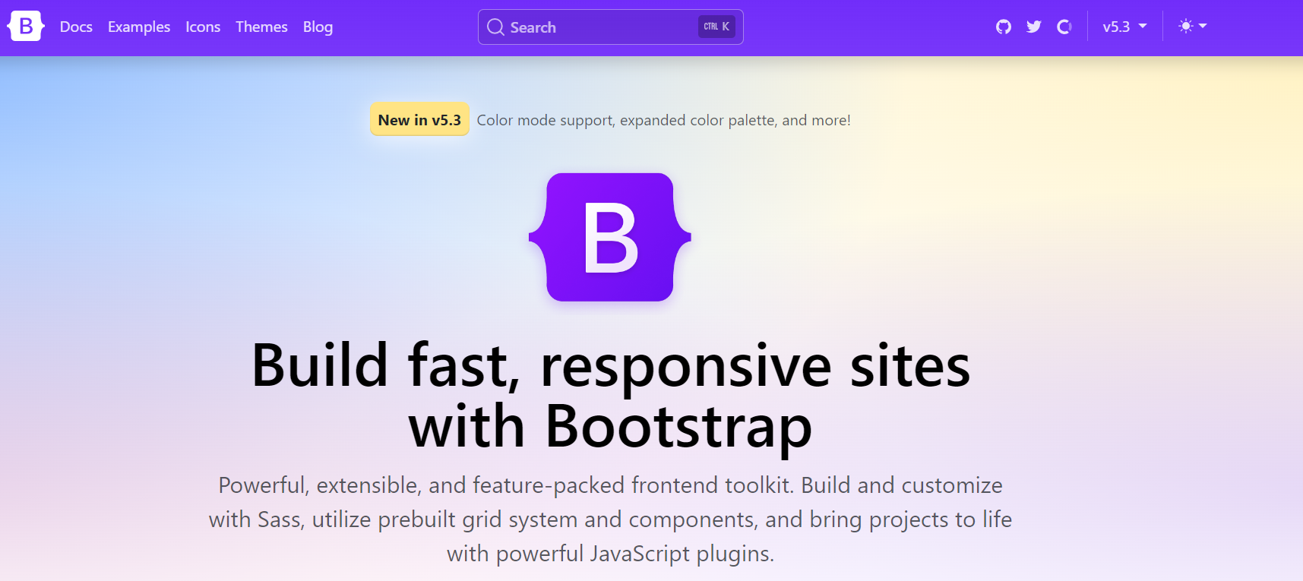
Bootstrap

Slide 7
Bootstrap
It is one of the most popular frameworks for responsive design
The framework uses a method of dividing the web page structure into 12 columns, the term 12-column grid is often used
Bootstrap Core Team consists of 11 core members working on the development
The framework includes extensive documentation

Slide 8
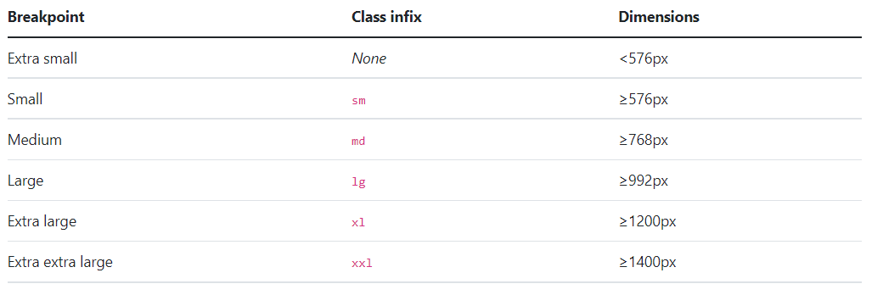
Bootstrap - breakpoints

Slide 9
Bootstrap
On its official website, it presents itself as a framework for developers of all skill levels, for devices of all shapes and projects of all sizes
The framework was built to support mobile-first development
Bootstrap is not only intended for creating responsive design, but also includes pre-made elements and components created using the JavaScript language
Despite the ability to choose content, Bootstrap can be unnecessarily comprehensive for some projects
The framework is available at: http://getbootstrap.com

Slide 10
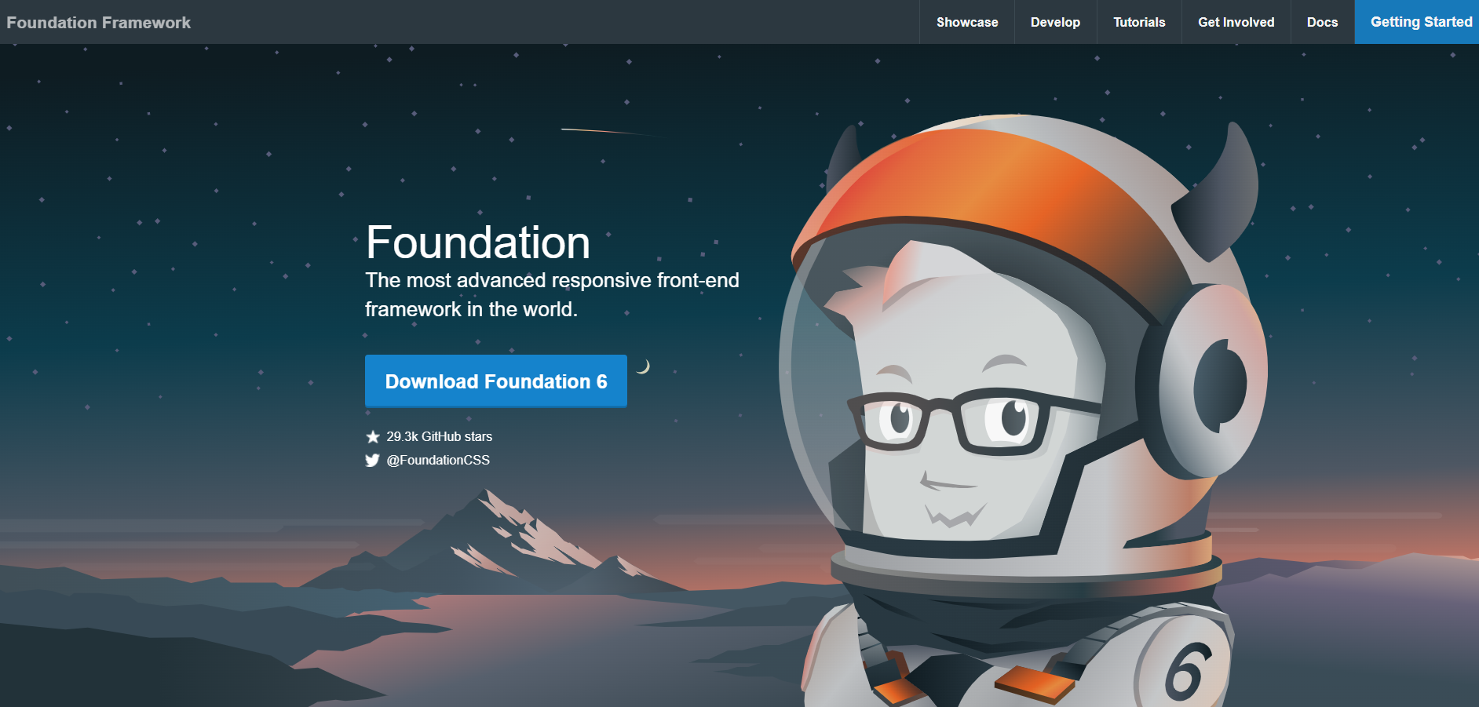
Foundation

Slide 11
Foundation
Framework Foundation is one of the most well-known frameworks for responsive design
Its website states that it is the most developed responsive web framework in the world
Using the framework, it is possible to simply and quickly apply a mobile first approach, i.e. creating websites primarily for mobile devices

Slide 12
Foundation
Breakpoints:
  Small - any screen
  Medium - screen ≥ 640 pixels
  Large - screen ≥ 1024 pixels

Slide 13
Foundation
Foundation for responsive page layout primarily uses the so-called XY Grid, which usually consists of 12 columns and supports stacking, which means that we can insert a grid into another already existing
The XY Grid is inspired by the CSS grid, which at the time of implementation had low browser support, which is why Foundation built its latest grid on flexbox, which is supported by about 98% of browsers
The novelty is that, in addition to the ability to control the layout in the X dimension (horizontal), we can now also control it in the Y dimension (vertical)

Slide 14
Foundation
Foundation offers a large number of components that guarantee responsiveness
It contains both simple button-type components and more complex shortcuts, such as modal windows or a clickable sidebar
As for helper classes, they mainly focus on typography and responsiveness
Foundation has a very extensive documentation, which is divided into logical units according to the functionality of the given components

Slide 15
Foundation
The framework is divided into various subcategories, dedicated to, for example, HTML templates for e-mail clients
For websites, there is Foundation for Sites, which is currently at version 6.7.5 and is considered one of the most comprehensive frameworks
The framework is available at: https://get.foundation/

Slide 16
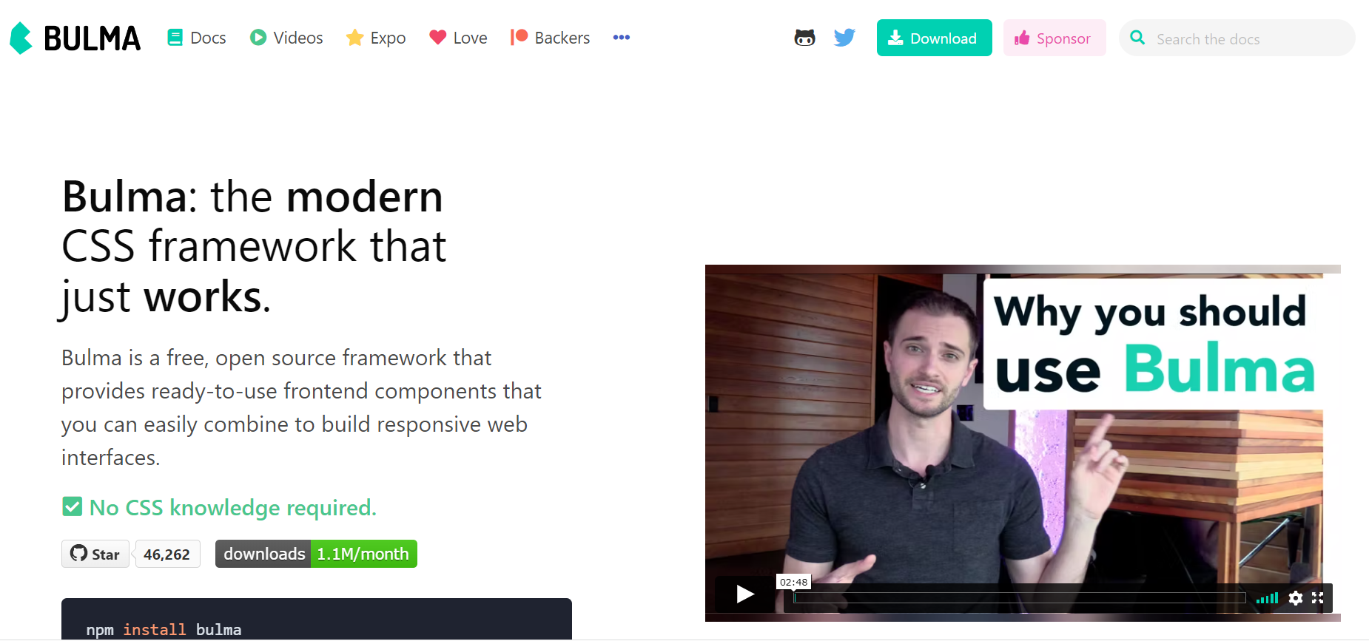
Bulma

Slide 17
Bulma
One of the newer frameworks, which has been on the market since January 24, 2016, is distributed under the MIT license and is currently in version 0.9.4
Considered by many as an alternative to Bootstrap, the big difference is that Bulma is built purely with CSS

Slide 18
Bulma
Bulma uses a twelve-column grid system based on the flexbox principle
It supports stacking, but only if the columns are wrapped in the Columns class
Both numerical and verbal class designations are used to divide the columns
Column labels use different fractions, such as two-fifths or one-third

Slide 19
Bulma
Breakpoints:
  Mobile - screen <768 pixels
  Tablet - screen ≥769 pixels
  Desktop - screen ≥1024 pixels
  Widescreen - screen ≥1216 pixels
  Fullhd - screen ≥1408 pixels

Slide 20
Bulma
The framework offers classic components such as buttons, navigation and tables
However, it supplements them with more advanced elements, such as a modal window that does not require a single line of JavaScript, which makes it different from other frameworks
Bulma is inspired by Bootstrap with its documentation, it is divided into logical units in which installation, framework content, layout system, auxiliary classes and components are described
The framework is available at: https://bulma.io/

Slide 21
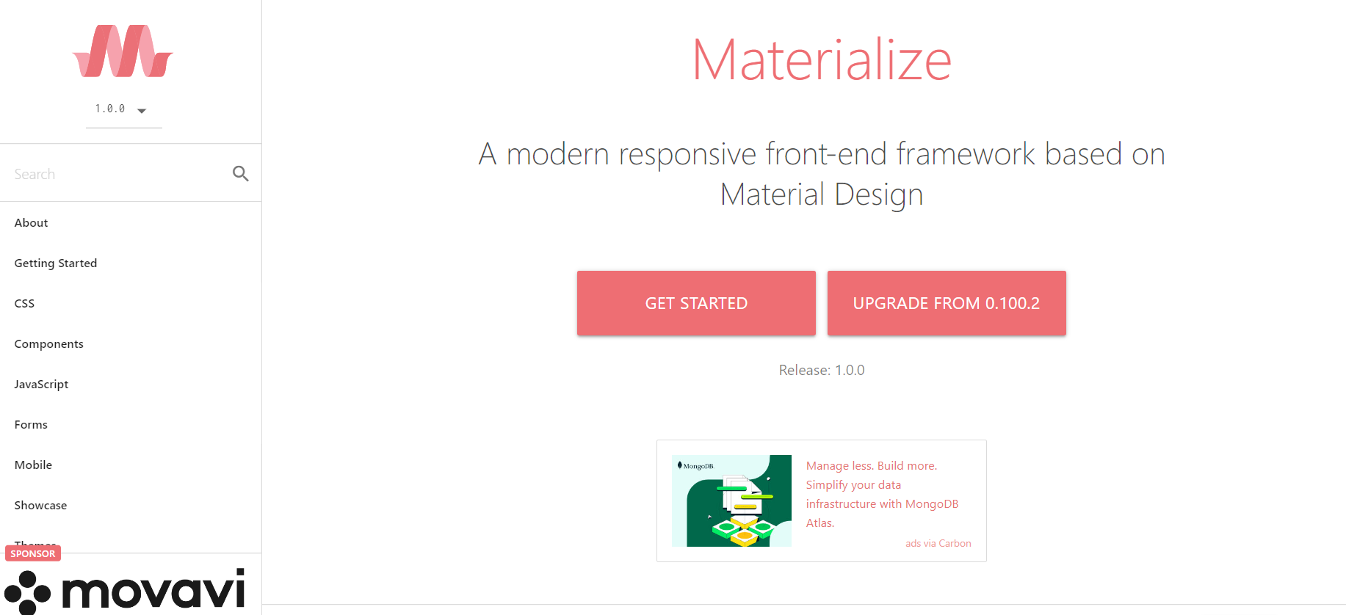
Materialize

Slide 22
Materialize
It is based on the Material Design - design language from Google
It was first released in September 2011 under the MIT license and is currently in version 1.0, where it remains as of 09/10/2018
Behind the development is a group of four students from Carnegie-Mellon University

Slide 23
Materialize
Materialize uses a twelve-column grid, which should be properly wrapped in the Container class
This wrapper is not mandatory, but it is recommended to use it for easier handling and to guarantee responsiveness
The numerical class names are used to divide the columns

Slide 24
Materialize
Breakpoints:
  s - screen ≤ 600 pixels
  m - screen > 600 pixels
  l - screen > 992 pixels
  xl - screen > 1200 pixels

Slide 25
Materialize
Materialize offers most of the traditional components such as buttons, tabs and navigation, but adds novel elements such as their behavior when scrolling the page and special effects when clicking
As the name of the framework suggests, it styles its components using the Material Design design language, which does not give the user much choice and the pages look very similar in design

Slide 26
Materialize
Materialize has clearly and logically divided documentation, it presents us with information about the framework, installation options, layout system, JavaScript options and components with their styling
The component pages include a short description of their usability, followed by a large number of examples that do not always show their codes
The documentation is very inconsistent, for example, it describes the color palette in detail, but for the mobile tab, it only contains two plugins with very vague descriptions
The framework is available at: https://materializecss.com/

Slide 27
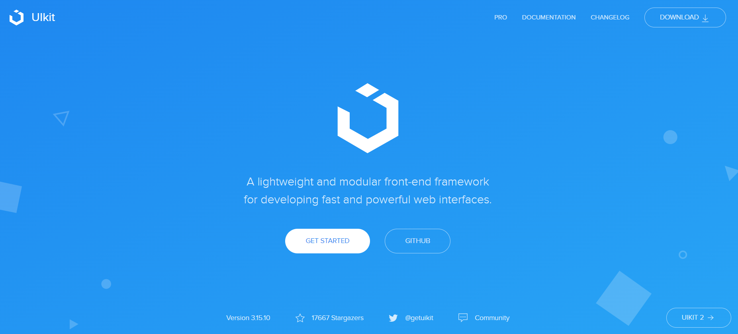
UIKit

Slide 28
UIKit
A comprehensive framework currently at version 3.17.6
It was released on the market under the MIT license on 19/06/2013 and is being developed by YOOtheme, which deals with writing templates for editorial systems
The initial idea for this framework was to facilitate the activity of writing templates for the Joomla and WordPress editorial systems
The developers set themselves the goal of creating a tool that would be easy to modify and its merging with a template would not result in unnecessary code bloat

Slide 29
UIKit
Grid and width - this is UIkit's own system that supports up to 10 columns
The width of individual columns is determined using defined length classes that must be wrapped in the "uk-grid" class
Length classes can be called numerical fractions or the word names of break points
Flex Grid - there is also a classic system based on the flexbox principle

Slide 30
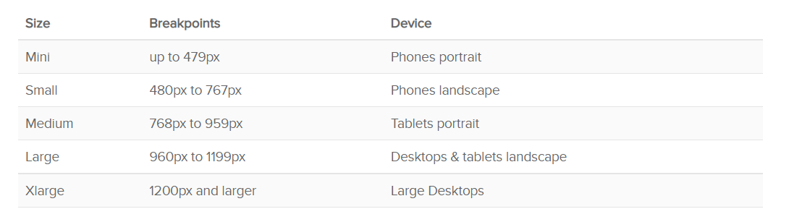
UIKit – breakpoints

Slide 31
UIKit
The range of components of this framework is very rich
In addition to basic components such as a button or a table, it offers more complex elements, for example, we can include a countdown timer, a slideshow, which is the equivalent of a carousel, a so-called image carousel in Czech, and a hero image, which in this framework is called a cover

Slide 32
UIKit
UIkit has documentation divided into two parts, the first is the installation guide and information about the framework, the second part is the components of the framework
This division is very confusing, because in the second part components, grid systems and auxiliary classes are mixed together
The framework is available at: https://getuikit.com/

Slide 33
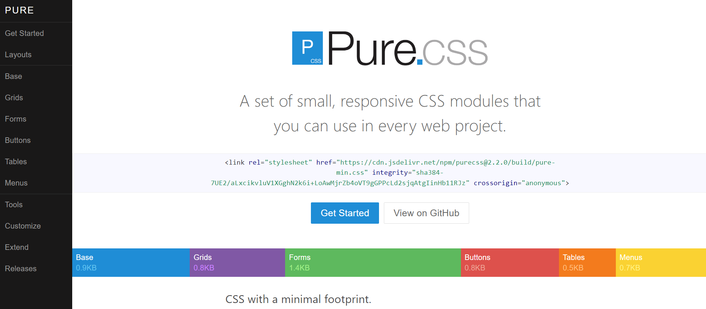
PureCSS

Slide 34
PureCSS
It relies on small size, which is achieved by being built on normalize.css, making it one of the smallest frameworks ever
Its minified version is around 3.5 KB
It has been on the market since May 15, 2013 under Yahoo!'s BSD-3-Clause license, which requires that the framework's copyright information be provided
It is currently in version 3.0.0.

Slide 35
PureCSS
For responsive layouts, it offers its own two grid systems, one offering a five-column layout and the other a 24-column layout
Columns that are denoted by the pure-u class must be wrapped in the puge-g class
The width of a column on a display device is determined using a percentage of the total display area

Slide 36
PureCSS
Breakpoints:
  sm - screen < 568 pixels
  md - screen ≥ 768 pixels
  lg - screen ≥ 1024 pixels
  xl - screen ≥ 1280 pixels

Slide 37
PureCSS
Due to its size, it offers only a few basic components such as buttons, tables and navigation bars
The styling of these components is also minimal and easily overridden with custom styles
Rather than styles, the framework focuses on ensuring responsiveness
For this reason, PureCSS can also be used in combination with other frameworks

Slide 38
PureCSS
PureCSS has simpler documentation, but pleasantly logically divided, each component has its own page
Individual pages contain a detailed description of the given element and an example with code
Although it is not a very complex framework, the documentation is very detailed
The framework is available at: https://purecss.io/

Slide 39
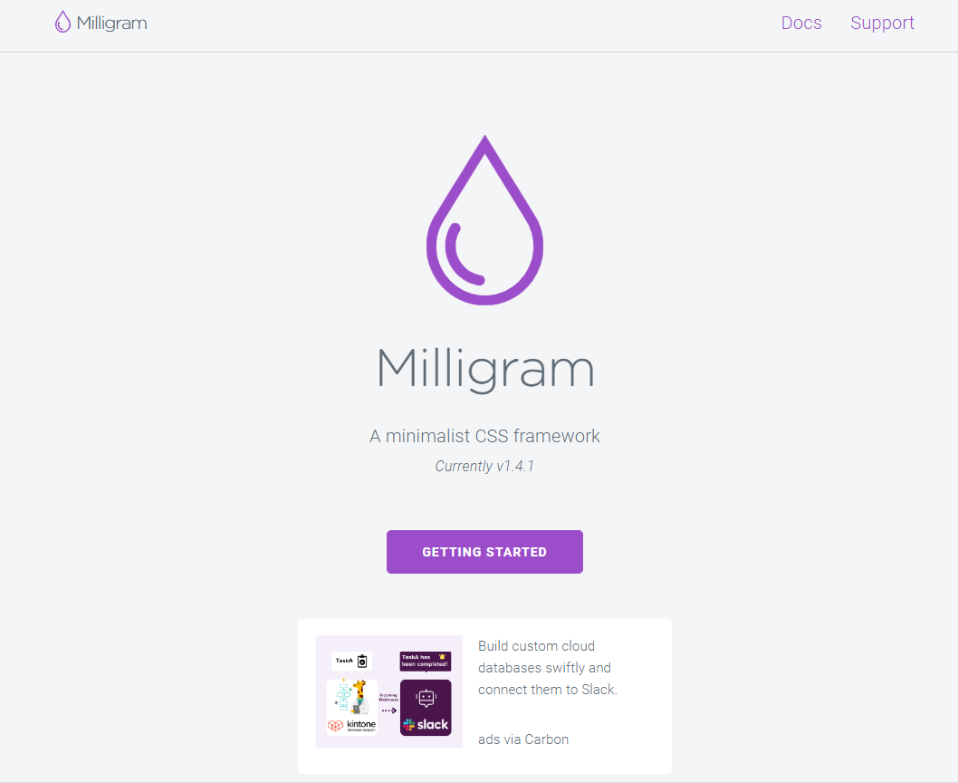
Milligram

Slide 40
Milligram
It is a minimalist framework, which puts its performance, clean code and developer productivity support as its main strengths
It has been on the market since December 2015 with an MIT license
It is currently in version 1.4.1
It is developed by Brazilian coder CJ Patoilo

Slide 41
Milligram
This framework has its grid system based on flexbox
Individual columns must be bounded by the "Row" class
The width of the columns can be set using the numerical percentage value of the display medium

Slide 42
Milligram
Breakpoints:
  Mobile - screen > 640 pixels
  Tablet - screen > 1280 pixels
  Desktop - screen > 1920 pixels

Slide 43
Milligram
Milligram offers basic components such as buttons, quotes, tables and forms
There are no more complex elements in its menu
This framework has no preset styles, it mainly focuses on guaranteeing responsiveness
The absence of stylization offers the user a place to express their creativity, which is what Milligram aims for

Slide 44
Milligram
The documentation of this framework is not divided in any way and basically it is almost all on the start page
For each element you can find a short description and a sample with code
Below the code is text with a link that leads to pages with more examples
However, these pages usually only contain original examples
The framework is available at: https://milligram.io/

Slide 45
Framework Bootstrap

Slide 46
Framework Bootstrap
The great advantage of this framework is the simplicity and speed of its use for common personal or corporate web presentations
Thanks to elaborate documentation and a large number of tutorials for beginners, it is possible to create a fully responsive website in a very short time

Slide 47
Framework Bootstrap
It is possible to download the framework source files, including SaSS source files, JavaScript, documentation, as well as minified files
This package is about 1.5 MB
Current version 5.3.3

Slide 48
Basic terminology
Containers provide a means of centering web content
.container - limited width of the container - in PC view, on mobile devices 100% of the view width
.container-fluid - 100% width on all device sizes
.row - Rows are envelopes for grid system columns
Each column has horizontal padding to control the space between columns
This padding is then aligned on the lines with negative margins
This way, all content in the columns is visually aligned to the left

Slide 49
Grid system
In a grid system, content must be placed in columns, and cols are the immediate subordinate elements of rows
Thanks to flexbox, grid columns without a specified width are automatically laid out as columns of the same width
For example, four instances of .col-sm will each automatically be 25% wide relative to the size of the viewport
Column classes indicate the number of columns you want to use out of a possible 12 per row
So if you want to have three columns of the same width next to each other, you can use .col-4

Slide 50
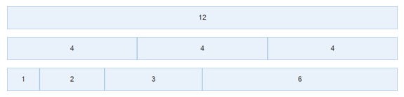
Bootstrap framework
To achieve a responsive website layout, the Bootstrap framework defines a 12-column grid
The number of columns and the size ratio between them is not fixed, but the sum must be a maximum of 12
Bootstrap supports nested grids

Slide 51
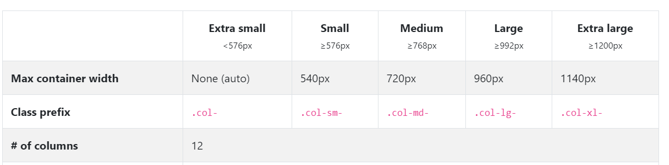
Grid system for different types of devices

Slide 52
Currently used grid system
Bootstrap uses the flexbox grid system
From version 5.1.0 it is possible to use the newer CSS Grid - however, it is still experimental and is disabled by default in Bootstrap (it is possible to turn it on and try it)
https://getbootstrap.com/docs/5.3/layout/css-grid/

Slide 53
Flexbox grid system
Flexbox provides a more efficient way to layout, align, and distribute space between items in a container (main element), even if their size is unknown and/or dynamic (hence the word "flex")
The main idea behind flex layout is to give the container the ability to change the width/height (and order) of its items to best fill the available space (mostly to accommodate all kinds of display devices and screen sizes)
A flex container expands items to fill available free space or shrinks them to prevent overflow

Slide 54
Flexbox grid system
Most importantly, the flexbox layout is direction agnostic unlike regular layouts (block which is vertically based and inline which is horizontally based)
While these work well for classic websites, they lack the flexibility to support large or complex applications (especially when it comes to reorientation, resizing, stretching, shrinking, etc.)

Slide 55
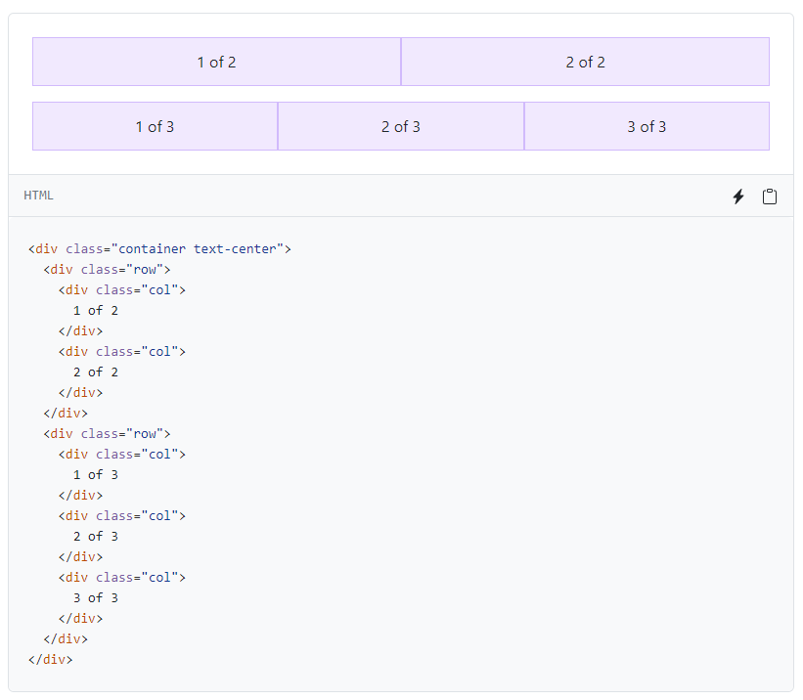
Auto-size columns

Slide 56
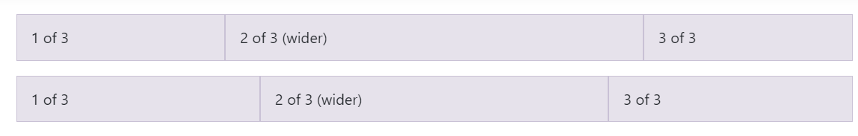
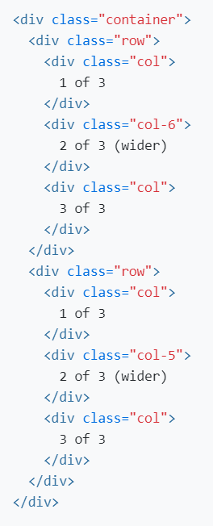
Setting the size of only one column, the rest are automatic

Slide 57
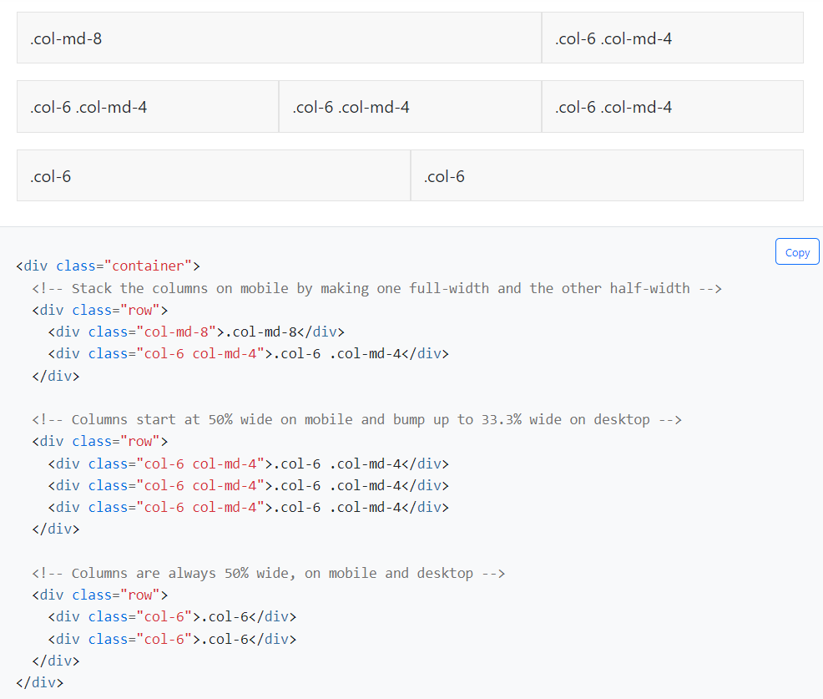
Different column sizes for different breakpoints

Slide 58
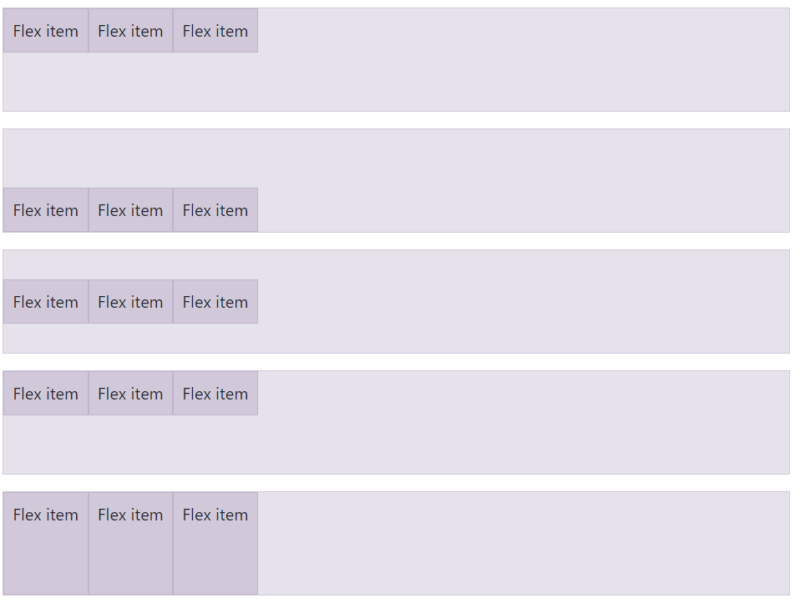
Vertical alignment

Slide 59
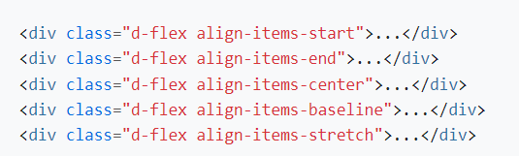
Vertical alignment

Slide 60
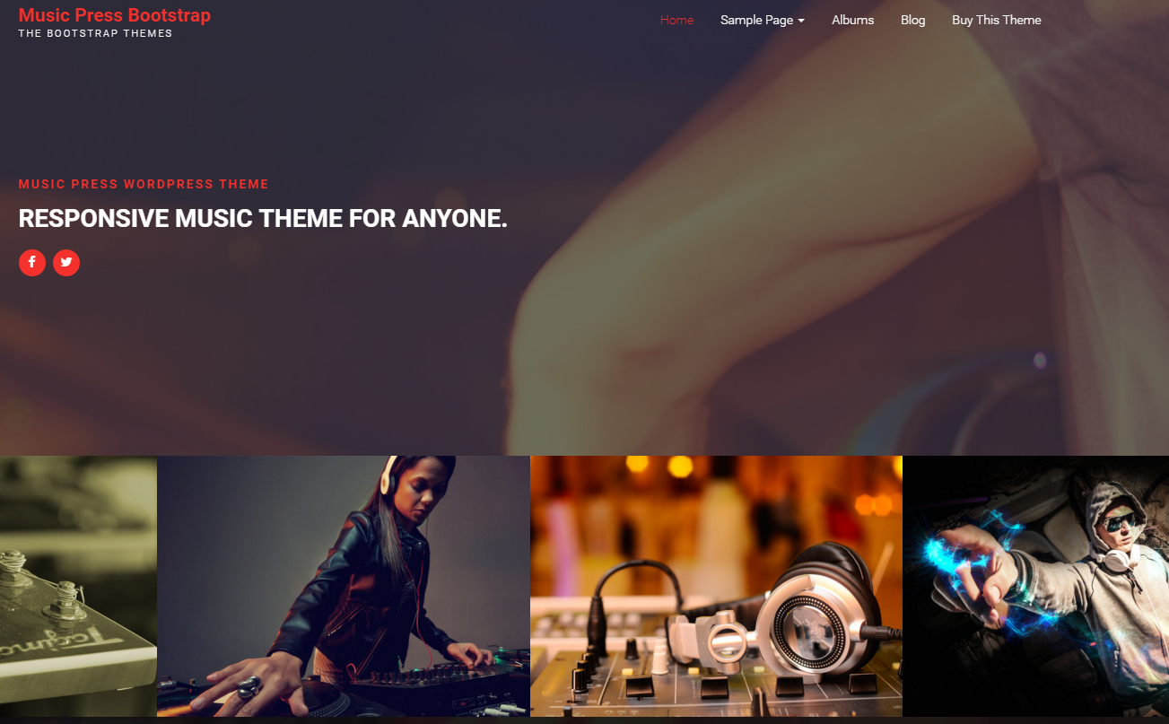
Website examples

Slide 61
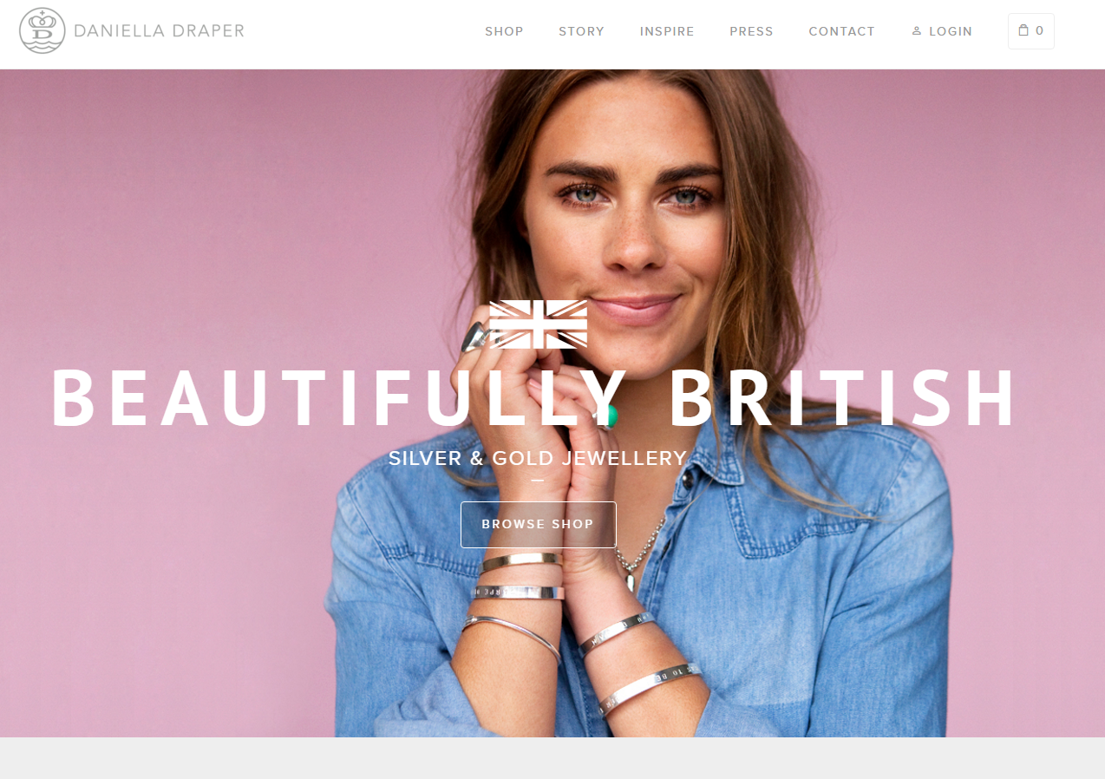
Website examples

Slide 62
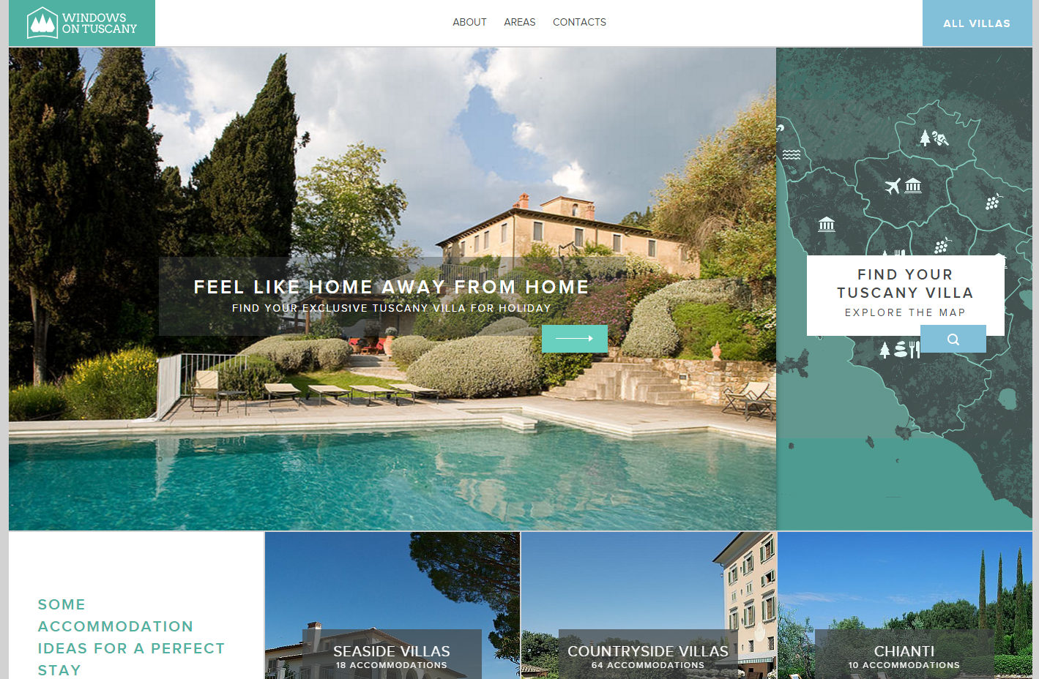
Website examples

Slide 63
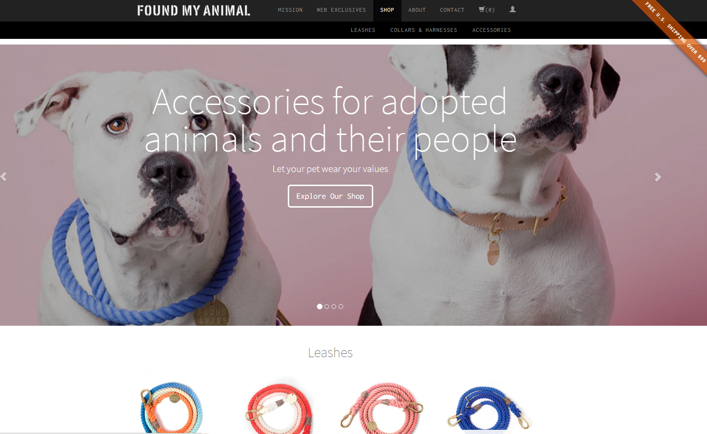
Website examples

Slide 64
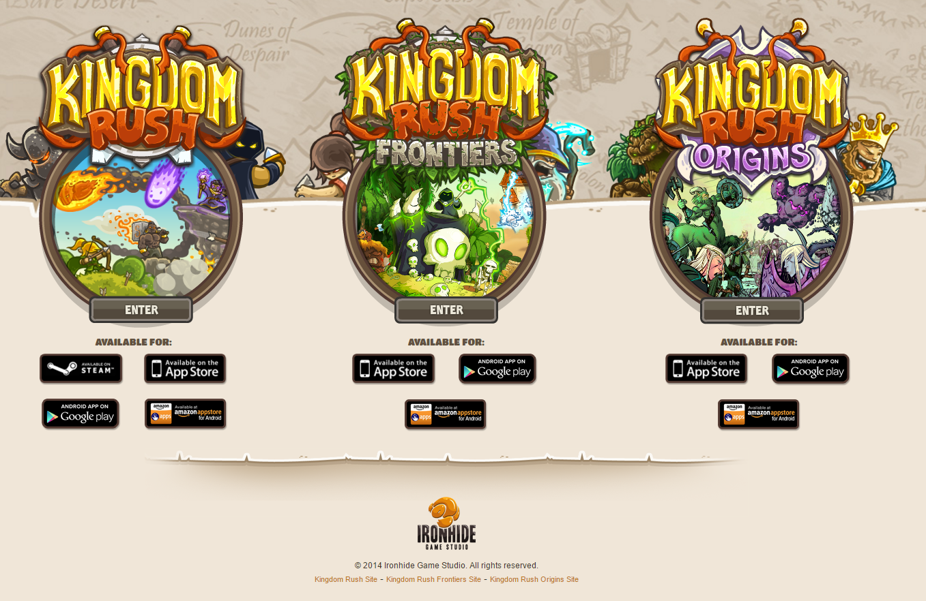
Website examples

Slide 65
Sources
Porovnání současných frameworků pro responzivní web a doporučení pro jejich využití na webu. Marián Macura. Bakalářská práce. 2021
http://getbootstrap.com
https://get.foundation
https://bulma.io/
https://materializecss.com/
https://getuikit.com/
https://purecss.io/
https://milligram.io/

