Slide 1
Responsive webpages
Practical usage of the Bootstrap framework – images, embed, carousel, icons

Slide 2
Images
The main class for responsive images is .img-fluid
The .img-thumbnail class adds a 1px border around the image

Slide 3
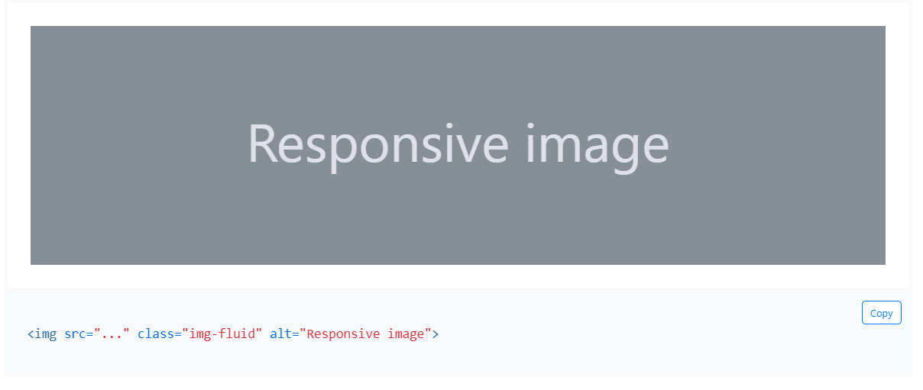
Images

Slide 4
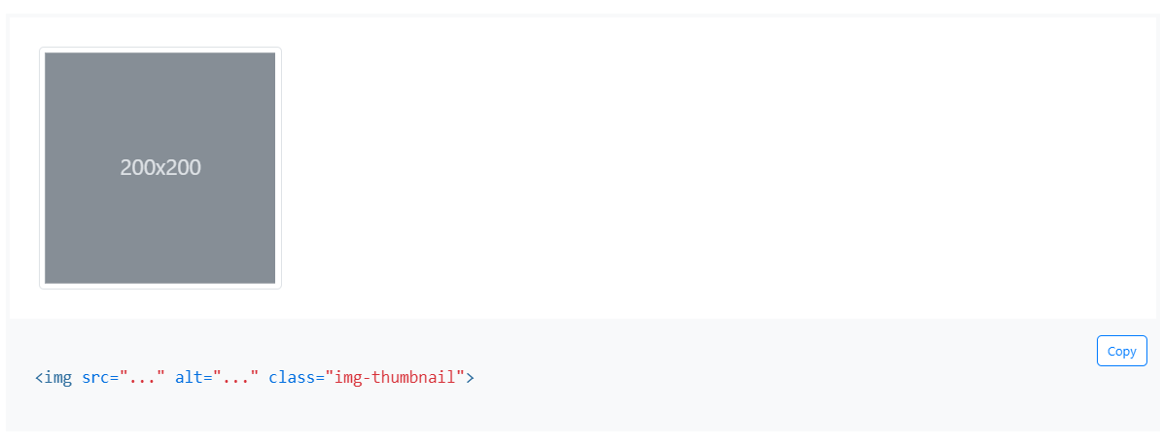
Images

Slide 5
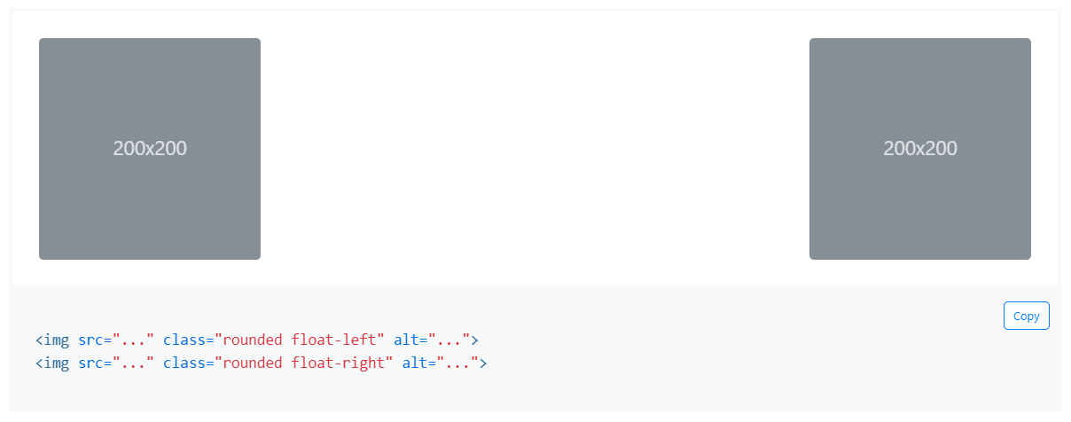
Image alignment

Slide 6
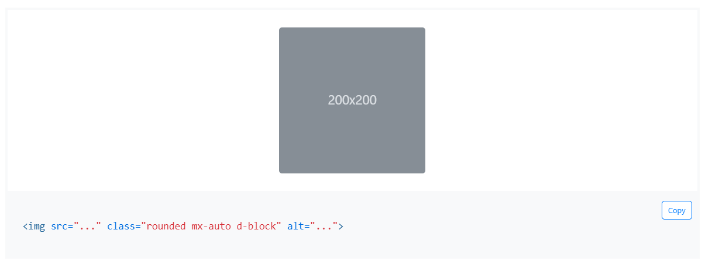
Image alignment

Slide 7
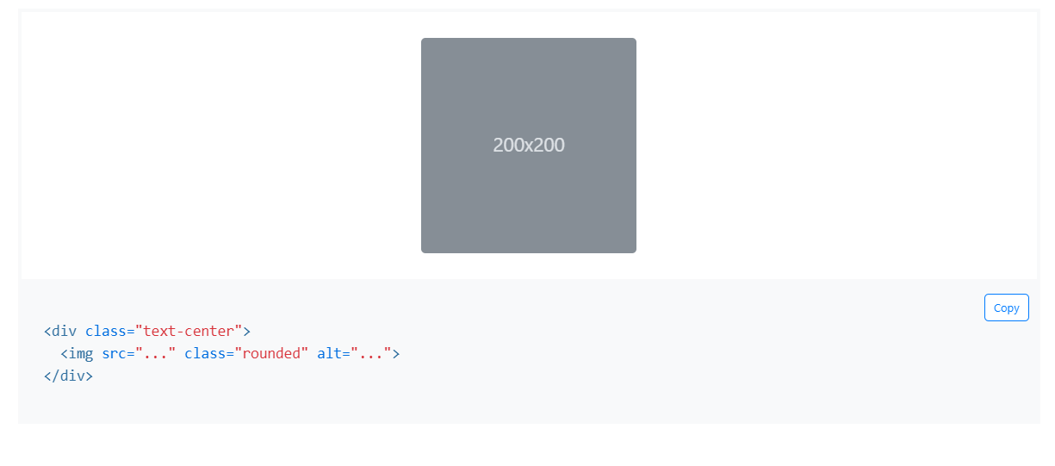
Image alignment

Slide 8
Ratio
Used for embedding responsive videos or slideshows
It is possible to set various display properties in terms of aspect ratio - especially for video
For YouTube videos – you must work with the embed version of the video
Classical URL Youtube videos: https://www.youtube.com/watch?v=dDi4BcHTlqY
Embed version of Youtube videos:
https://www.youtube.com/embed/dDi4BcHTlqY

Slide 9
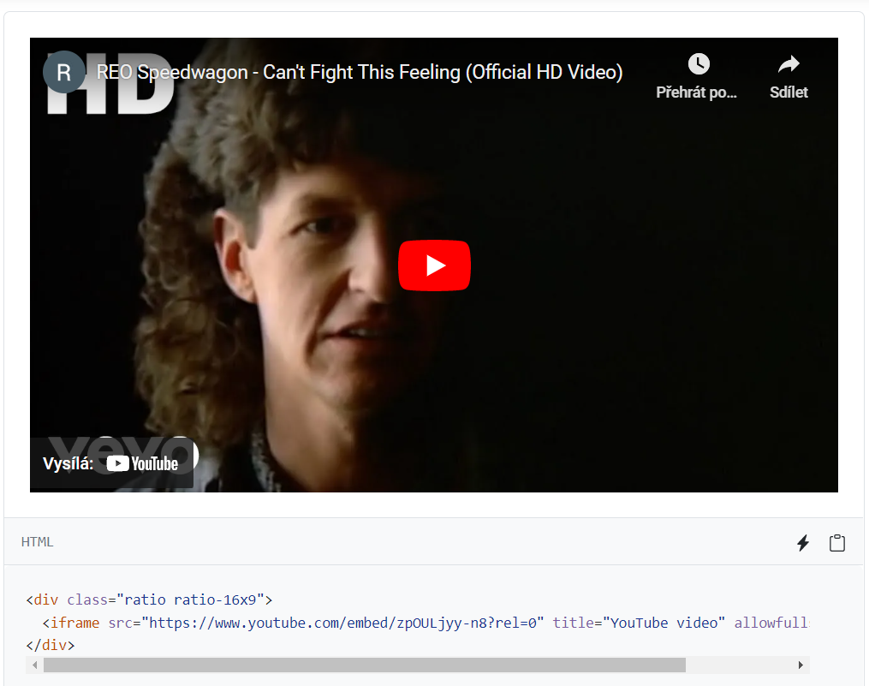
Ratio

Slide 10
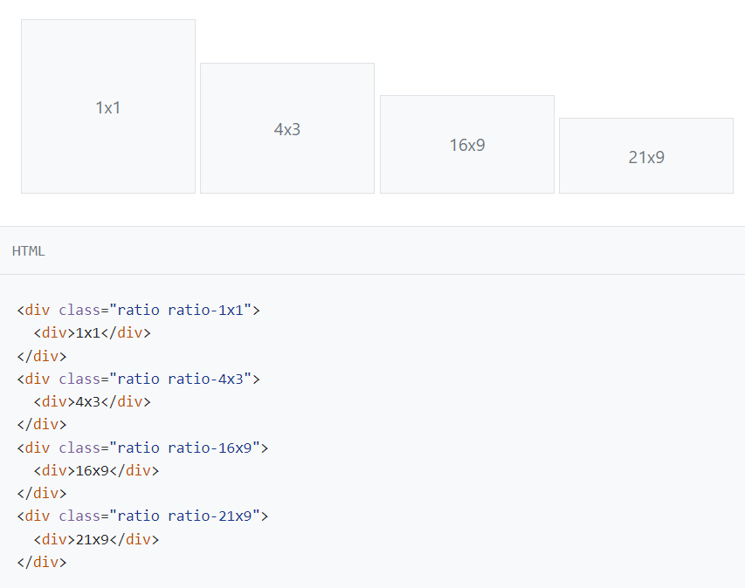
Ratio – different aspect ratios

Slide 11
Carousel
Slideshow component for cyclic rotation of images or other types of content
Various options for displaying and turning off/on controls

Slide 12

Carousel - basic view

Slide 13
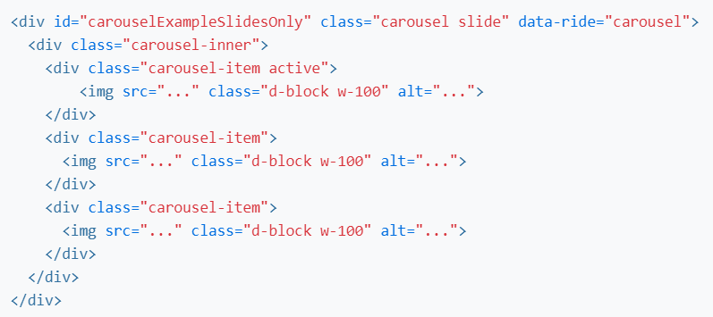
Carousel - basic view

Slide 14

Carousel - display with control arrows

Slide 15
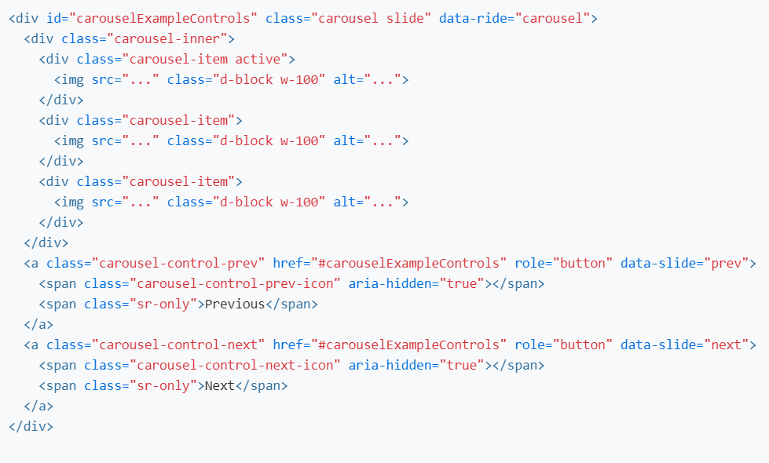
Carousel - display with control arrows

Slide 16
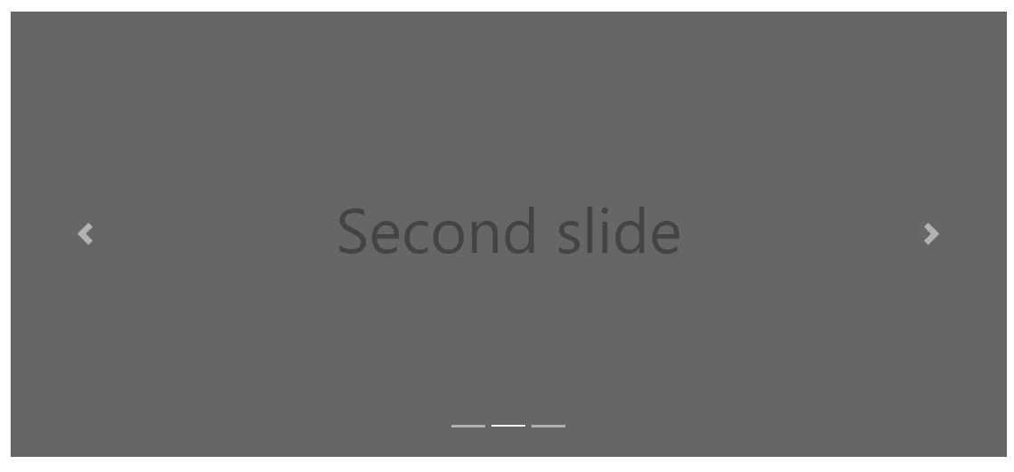
Carousel - a display with a bottom element for controls

Slide 17
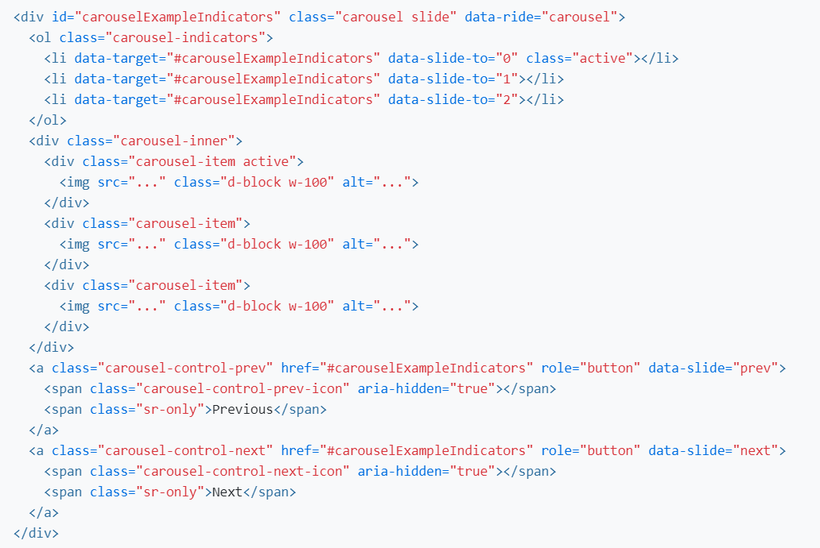
Carousel - a display with a bottom element for controls

Slide 18
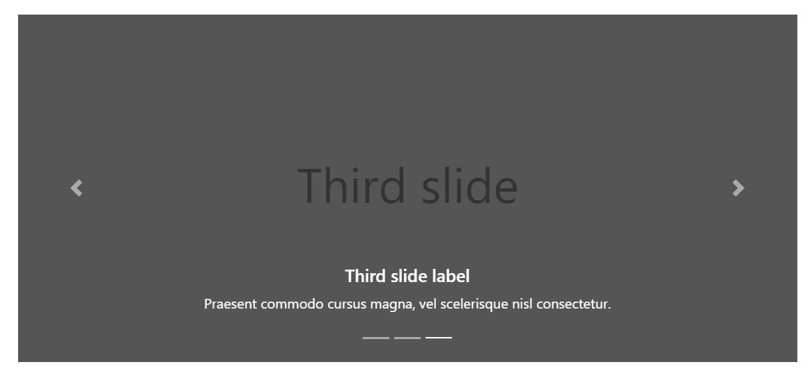
Carousel - display with label (text)

Slide 19
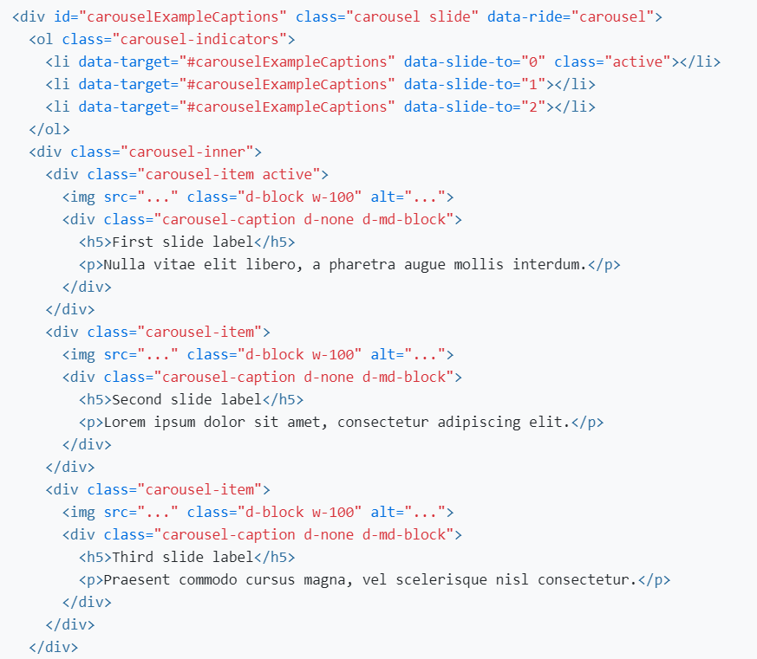
Carousel - display with label (text)

Slide 20
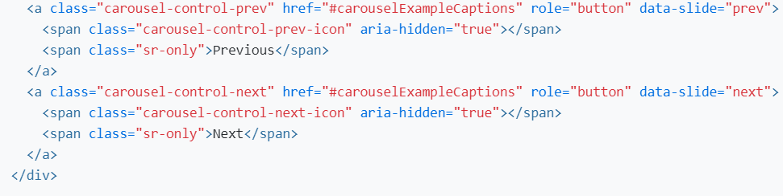
Carousel - display with label (text)

Slide 21
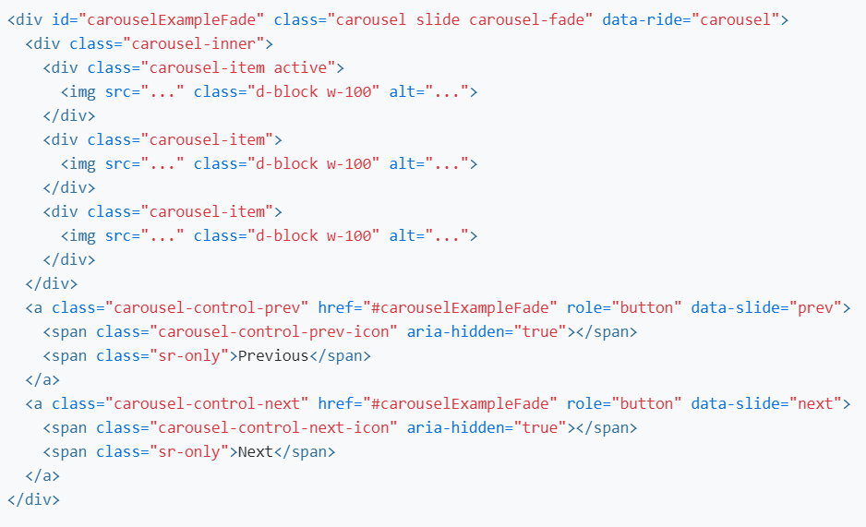
Carousel – fade effect when changing slides

Slide 22
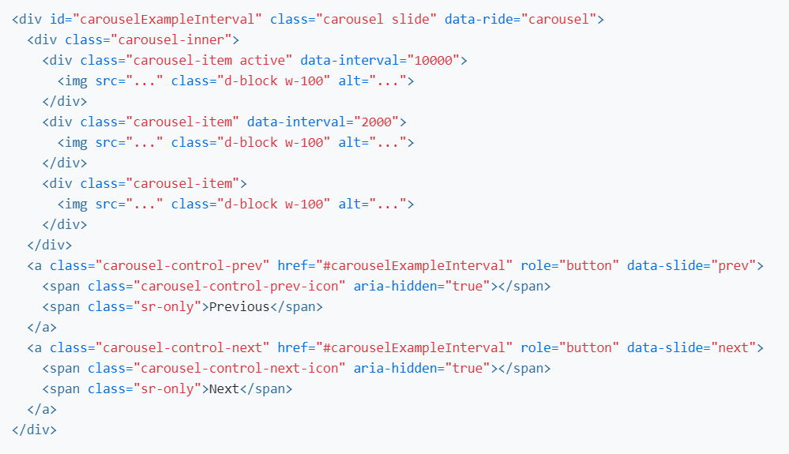
Carousel – changing the time interval for changing the slide

Slide 23
Icons
Bootstrap has a wide range of different icons that can be inserted into a menu item, a button, etc.
Icons are embedded using the <svg> tag - for embedding vector graphics in HTML
SVG - Scalable Vector Graphics
Recommended format by the W3C consortium

Slide 24
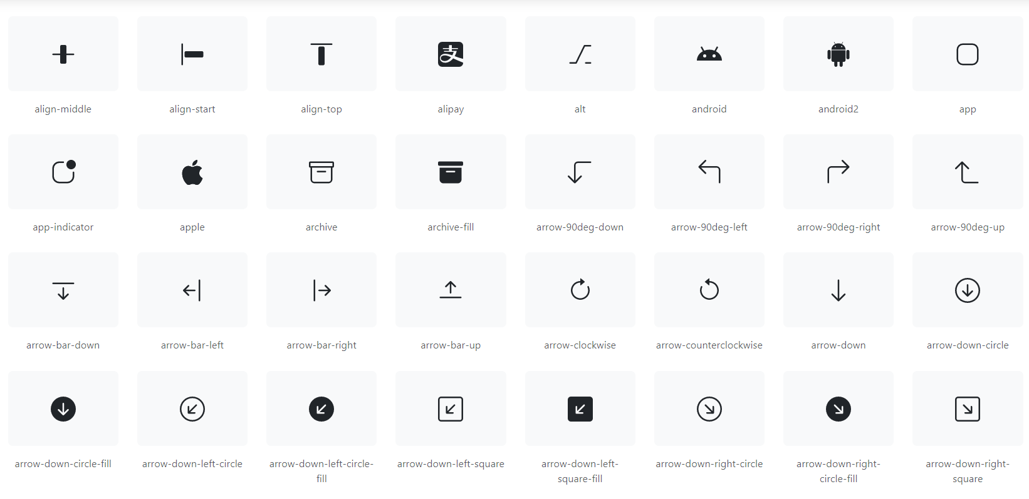
Icons - icons.getbootstrap.com

Slide 25
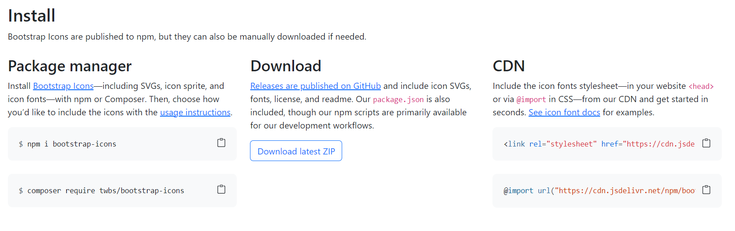
Icons - integration

Slide 26
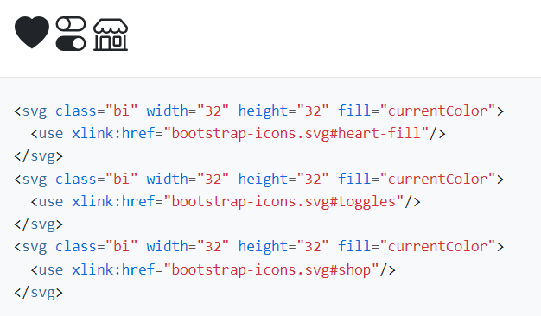
Icons - usage - SVG sprite

Slide 27
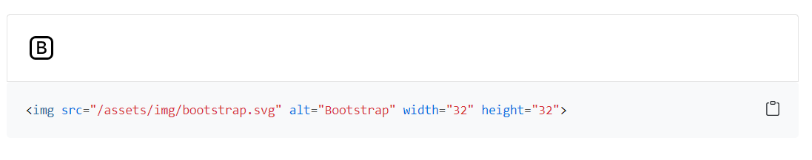
Icons - external image

Slide 28
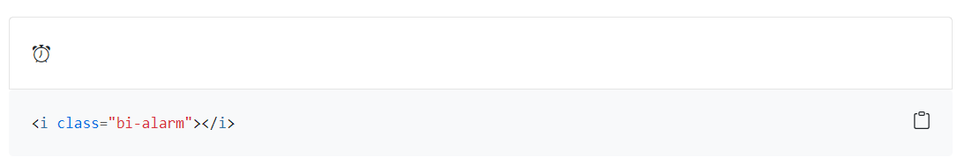
Icons – icon font

Slide 29
Font Awesome icons
A library of icons of various focus and categories
More than 7800 icons
A large part is free, others are paid
Easy integration by loading CSS style and using pre-made simple pieces of HTML code

Slide 30
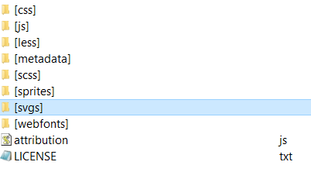
Font Awesome icons - download

Slide 31
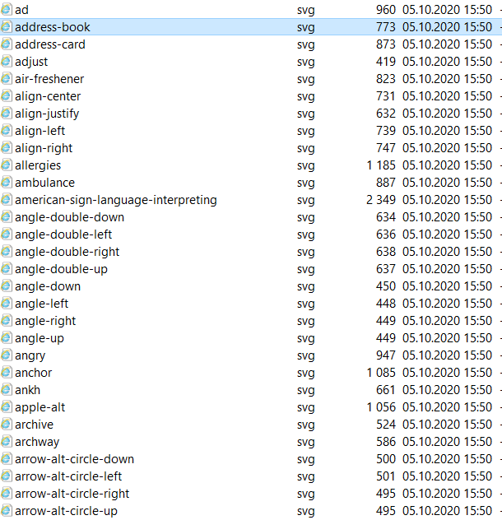
Font Awesome icons - SVG

Slide 32
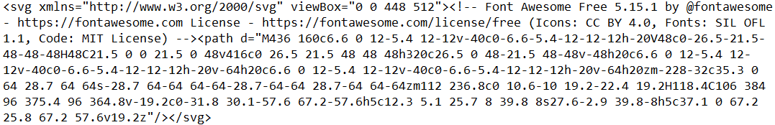
Font Awesome icons – SVG source

Slide 33
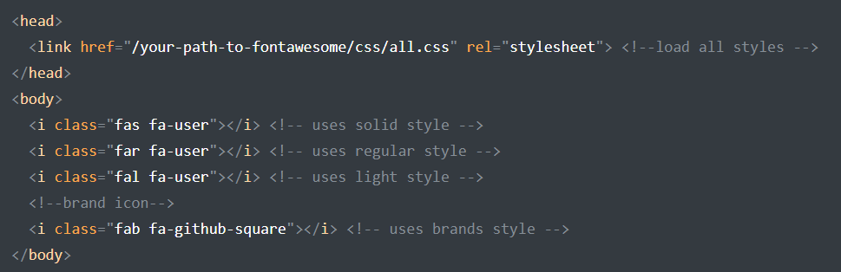
Font Awesome icons - web integration

Slide 34

Font Awesome icons - Education category - black = free, gray = PRO

Slide 35

Font Awesome Icons - icon detail

Slide 36
Font Awesome icons - HTML code for integration

Slide 37
Sources
https://getbootstrap.com/docs/5.3/content/images/
https://getbootstrap.com/docs/5.3/helpers/ratio
https://getbootstrap.com/docs/5.3/components/carousel
https://icons.getbootstrap.com/
https://fontawesome.com/

