Slide 1
Responsive webpages
One HTML document. A layout that fits the screen in front of the student.
01
Mobile first
02
Fluid, not a phone model
03
Accessible by default
Start from the narrow screen. Add space, do not remove it.
Type and columns scale. Break where the content breaks.
Zoom, contrast, and reduced motion are part of the layout.
01 / 50

Slide 2
Webpages
HTML carries the meaning. CSS presents it. JavaScript adds behaviour only where the document cannot.
There is no HTML6. HTML is a living standard, and HTML5 is the vocabulary you still write.
The same document is opened on a phone, a laptop, and by a screen reader.
Responsive design is the set of CSS rules that lets that document change shape without a second website.
Write the content once. Decide the layout with rules, not by drawing a fixed poster.
02 / 50

Slide 3
Same HTML, three widths
Phone
Tablet
Laptop
The markup does not change. Flex, grid, and media queries change the arrangement.
03 / 50

Slide 4
CSS (Cascading Style Sheets)
It allows the separation of the structure of the web page and its content from the graphic form of the page
Using cascading styles in the form of files with the .css extension, it is possible to specify the appearance and visual properties of individual HTML elements
Layout today is Flexbox and Grid. Floats are not how you build a page.
HTML
structure
CSS
presentation
→
Same document. The stylesheet decides how it looks.
04 / 50

Slide 5
Example
A heading that scales with the screen, and stays readable at both ends.
h1 {
margin-block: 1rem;
font-size: clamp(1.75rem, 4vw, 3rem);
text-wrap: balance;
color: #0b1220;
}
05 / 50

Slide 6
Web applications
Websites that contain interactive elements and dynamic information generated through various requests and interactions.
In the course, we will focus mainly on the elements and properties of the web application, which are used primarily in the context of a mobile device
Browser
Server
Page
→
→
The page is generated for this request. It is not one fixed poster.
06 / 50

Slide 7
Web application architecture
It consists of 3 layers:
presentation (client, web browser)
application (web server)
database (database to which the application is connected)
Presentation
browser
Application
server
Database
Every request crosses all three.
07 / 50

Slide 8
Mobile device
A small portable electronic device with its own power supply
Mobile devices are very often equipped with a touch screen
That screen is the constraint this course designs for.
08 / 50

Slide 9
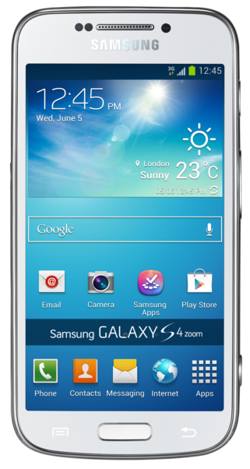
Mobile devices
mobile phones
notebooks,
netbooks, smartbooks
Phablets, tablets
electronic book readers
09 / 50

Slide 10
Who is on the web
96.2%
of internet users go online on a phone at least some of the time
5.83 bn
unique mobile-phone users, 70.4% of the world's population
89%
of phones in use are smartphones, about 7.65 billion connections
DataReportal, Digital 2026 (April 2026), using GSMA Intelligence and Ericsson. People are the point: a phone is normal, not a special case.
10 / 50

Slide 11
Where page views come from
Worldwide share of web pages. September 2026.
Mobile
Desktop
Tablet
59.0%
39.3%
1.8%
the largest share
still essential
a thin slice
Statcounter, worldwide, September 2026. Exact shares: mobile 58.99%, desktop 39.26%, tablet 1.76%.
11 / 50

Slide 12
Mobile leads, but not everywhere
October 2016: phones and tablets together passed desktop worldwide, 51.3% to 48.7%.
Africa
68,7%
Asia
67,0%
World
59,0%
Europe
55,4%
United States
49,1%
Mobile share of page views, Statcounter, September 2026. In the US, desktop is 48.5%: almost a tie. Design for both, and do not copy one country's traffic.
12 / 50

Slide 13
Responsive webdesign
A new approach created by American programmer Ethan Marcotte in an article on the A LIST Apart blog in 2010
http://alistapart.com/article/responsive-web-design
13 / 50

Slide 14
Responsive webdesign
A way of styling a website, ensuring that the website will be optimized for all kinds of devices
This is possible via Media Queries property, which is included in the CSS3 specification
This allows to recognize the characteristics of the device on which the website is viewed and adapts the page itself
14 / 50

Slide 15
Responsive design principles
Proportional design – the size of the objects (blocks) of the website is defined relatively, flexibly to its surroundings
Media queries – the appearance of the web page is automatically adjusted based on the resolution size of the device, sometimes referred to as the viewport. The viewport is the area available for rendering a web page
Relative
the block follows its parent
Media query
layout changes when there is room
15 / 50

Slide 16
Mobile first
Write the narrow layout with no query. That is the default, not a special case.
Use min-width to add columns when there is room. Avoid a stack of max-width overrides.
48rem is only a starting point. Move the breakpoint to where this content actually breaks.
/* phones: stacked, no query */
.layout { display: flex; flex-direction: column; gap: 1rem; }
@media (min-width: 48rem) {
.layout { flex-direction: row; }
}
16 / 50

Slide 17
Layout without a device list
Flexbox lays out one row or one column: a toolbar, a stack, a card footer.
Grid lays out both axes. auto-fit and minmax wrap the cards with no phone names.
Reach for a media query when the arrangement itself must change, not for every width.
.cards {
display: grid;
grid-template-columns: repeat(auto-fit, minmax(16rem, 1fr));
gap: 1.5rem;
}
17 / 50

Slide 18
Type that scales
Do not jump the font size at each phone model. Let it grow with the viewport.
clamp(minimum, preferred, maximum) keeps the heading readable at both ends.
rem follows the reader's default font size. A heading in px does not, so keep px for borders, not for type.
h1 {
font-size: clamp(1.75rem, 1.1rem + 2vw, 3.25rem);
line-height: 1.15;
text-wrap: balance;
}
18 / 50

Slide 19
Container queries
A card in a sidebar is narrow even when the window is wide. @media cannot see that.
@container watches the component, not the viewport. Style the children, not the container itself.
Current browsers support this. It is how you write a component once and drop it anywhere.
.card { container-type: inline-size; }
@container (min-width: 24rem) {
.card-body {
display: grid;
grid-template-columns: 8rem 1fr;
}
}
19 / 50

Slide 20
Images that fit the screen
Send a small file to a small screen. srcset and sizes let the browser choose.
width and height reserve the space, so the page does not jump when the file arrives.
alt describes the content. An empty alt is only for a purely decorative image.
<img
src="hero-800.jpg"
srcset="hero-480.jpg 480w, hero-800.jpg 800w, hero-1200.jpg 1200w"
sizes="(min-width: 64rem) 50vw, 100vw"
width="1200" height="800"
alt="Students reviewing a layout">
20 / 50

Slide 21
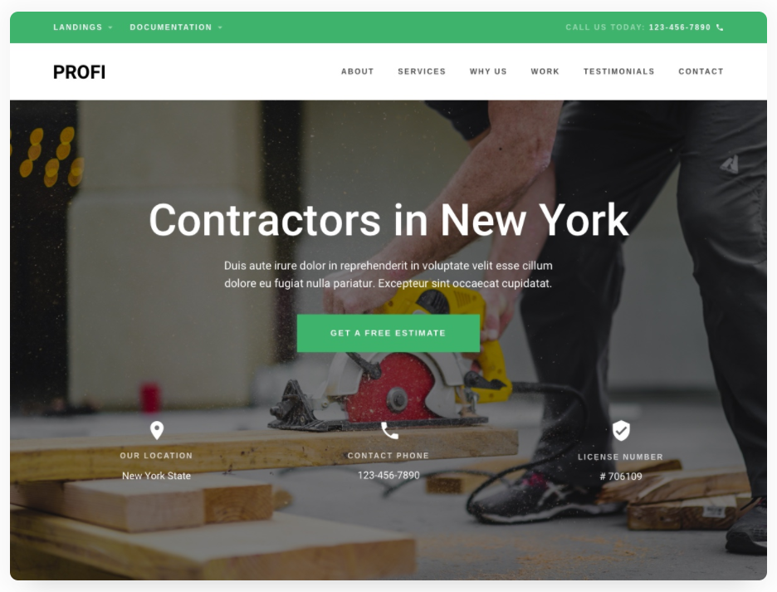

Examples
21 / 50

Slide 22
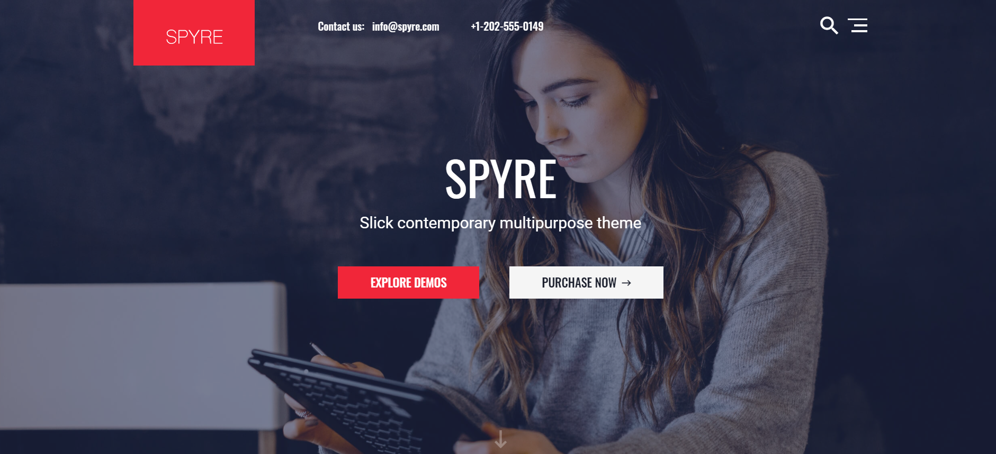

Examples
22 / 50

Slide 23
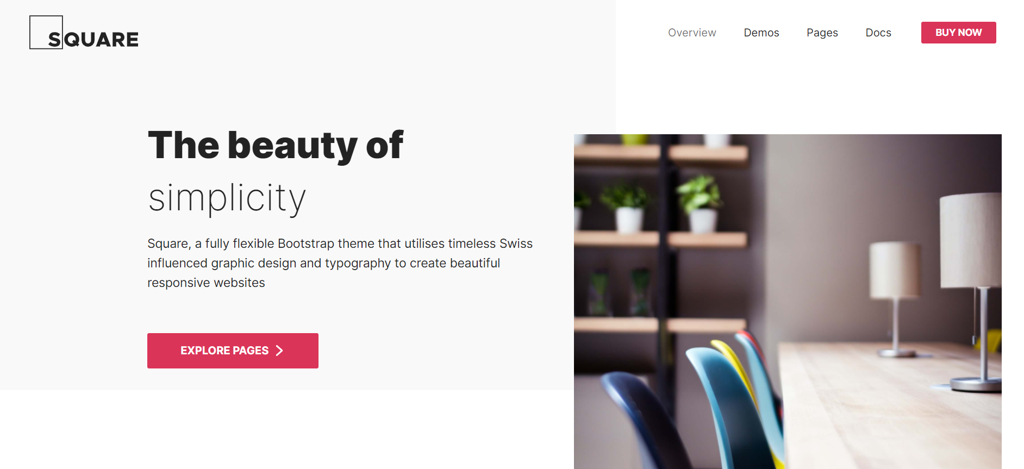
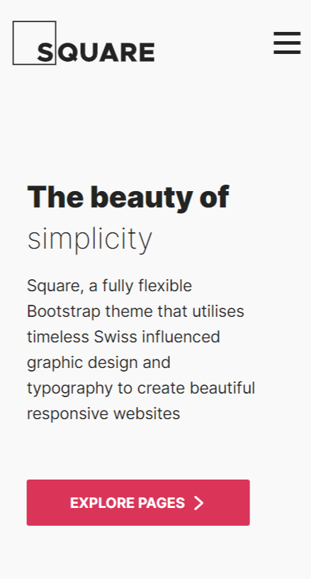
Examples
23 / 50

Slide 24
Proportional design
Individual elements and blocks defined using relative units
Relative units, as opposed to absolute units, allow you to define elements to fit the size of the viewport
70% of the viewport
Shrink the window and this block shrinks with it.
24 / 50

Slide 25
Relative units - rem
Font size, outer and inner margins, as well as other properties in the document and components can be set in rem
1rem (1 root em) contains the default font size set by the author for the document and possibly modified by the user or browser, as we have already seen
If we do not change it on the document, then 1rem = 16px
25 / 50

Slide 26
Relative units - rem
The paragraph keeps a 1rem block-end margin. The heading is 2rem, twice the root font size.
p {
margin-block-end: 1rem;
}
h1 {
font-size: 2rem;
}
26 / 50

Slide 27
Rem - benefits from a developer's perspective
In 1rem you have the basic font size stored and you don't have to remember if it's 12, 14, 16, or how many pixels
The layout width set in rem will keep the optimal text length even if the user enlarges the font
Thanks to rem, it is also possible to enlarge the entire document on specific ranges of the design
27 / 50

Slide 28
Relative units - em
In CSS, 1em is not the width of the letter M.
On font-size, 1em is the parent's font size, so nested headings compound.
On padding, margin, and width, 1em is this element's own font size.
For a size that should follow the page rather than a parent, use rem.
28 / 50

Slide 29
Relative units - em
Do not set the root font size to 10px, or to 62.5%, just to make 1rem equal 10px.
That override fights the reader's own default size, which is usually 16px.
Leave the root alone. Write 1rem for body text and scale headings with rem or clamp().
If a component must follow its own font, that is what em is for.
29 / 50

Slide 30
Relative units - em
Leave the root alone. 1em follows this element's font, so the button's padding is smaller than the paragraph's.
p {
font-size: 1rem;
padding-block: 1em;
}
.button {
font-size: 0.75em;
padding-block: 1em;
}
30 / 50

Slide 31
Relative units - em
You can see that 1em means different things in different places in the document
Sometimes it can be nice: For example, if you code a component whose size should be determined by the font size on the parent element
But of course "em" is a bit harder for developers to work with than "rem"
31 / 50

Slide 32
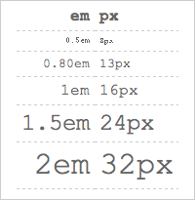
Em vs px differences
32 / 50

Slide 33
Relative units - percentages
Another relative unit are percentages (%)
The percentage value is calculated from the value that was inherited from the parent element
In the case of main elements on a web page, the percentage is then relative to the viewport size
parent
50% of the parent
33 / 50

Slide 34
Relative units - example
A percentage still describes a share of the parent. Give the rest of the row to 1fr, so the gap does not force a sideways scroll.
.split {
display: grid;
grid-template-columns: 30% 1fr;
gap: 1.5rem;
}
.frame {
width: min(100%, 64rem);
margin-inline: auto;
}
34 / 50

Slide 35
Relative units – vw or vh
We may also need to increase and decrease the font size according to the width or height of the window
vw (viewport width) or vh (viewport height)
2vw is two percent of the window width. On its own it has no limit, so the next example wraps it in clamp().
100vh is often taller than the visible phone screen, because it includes the browser toolbar. For a hero, use 100dvh.
35 / 50

Slide 36
Relative units – vw or vh
clamp() keeps the 2vw growth, and adds a floor and a ceiling. dvh is the viewport height you can actually see.
h1 {
/* floor, preferred, ceiling */
font-size: clamp(1.75rem, 1rem + 2vw, 3.25rem);
}
.hero {
min-height: 100dvh;
padding-block: 4rem;
}
36 / 50

Slide 37
Absolute units
For websites that are not created according to the principles of responsive design, the same elements are defined using absolute units
The width of the elements is then very often defined using the px unit
800px of fixed columns
The phone is about 390px wide. The row does not fit.
37 / 50

Slide 38
Absolute units - example
300px + 500px is still an 800px page. Grid does not make a pixel width fluid.
.page {
display: grid;
grid-template-columns: 300px 500px;
}
Same regions. One column until there is room, then a fluid split.
.page {
display: grid;
gap: 1.5rem;
}
@media (min-width: 48rem) {
.page { grid-template-columns: 1fr 2fr; }
}
38 / 50

Slide 39
Absolute units
For devices with a resolution of 800px and higher, the elements will be displayed in full size
On devices with a lower resolution, these elements will be artificially reduced, as well as the entire page
For viewing, it is often necessary to enlarge the desired part of the page by touching
800px and wider
full size
Narrower screen
the whole page shrinks
Reading it then means pinching to zoom.
39 / 50

Slide 40
Media queries
The name of a specification that adds to CSS versions 2 and 3 the ability to define the constructs and conditions under which a CSS style should be applied
These constructions and conditions are mainly device-dependent and serve precisely to adapt the appearance for the given device
Media types - the type of device to which the CSS style should be applied
condition
min-width: 48rem
CSS inside @media
applied only when it matches
→
40 / 50

Slide 41
Media features, not device names
Phones identify as screen. @media handheld does not match them. Query features of the environment.
/* narrow layout is the default */
@media (min-width: 48rem) {
.layout { display: grid; }
}
@media (prefers-reduced-motion: reduce) {
.hero { animation: none; }
}
Also test hover, pointer, and prefers-color-scheme. Pick a breakpoint where this design breaks, not the width of a named phone.
41 / 50

Slide 42
Media types
Writing media types is done using the @media rule or the media attribute
Definitions are inserted into the block marked with the @media rule, which are processed only if the target device meets the conditions defined by the @media rule
If the browser does not support @media rule processing, the definitions are ignored
screen
navigation and the page
print
the page, without the chrome
42 / 50

Slide 43
Print, the type you still use
screen is the default. print is the media type worth a special rule: hide the chrome, and show where a link goes.
@media print {
nav, .no-print { display: none; }
body {
color: black;
background: white;
}
a[href]::after {
content: " (" attr(href) ")";
}
}
43 / 50

Slide 44
One stylesheet
Do not keep a screen file and a print file that both try to be the site. One link, and the queries live inside it.
<link rel="stylesheet" href="styles.css">
/* styles.css */
@media (min-width: 48rem) {
.layout {
display: grid;
grid-template-columns: 16rem 1fr;
}
}
@media print { nav { display: none; } }
44 / 50

Slide 45
Viewport specification
The specification defines the default width of the viewport and thus allows the web page to be rendered precisely for a specific viewport
The specification is written to the web page using the new viewport meta tag.
In these days, the viewport meta tag is pretty much the standard
viewport
the area the page is laid out into
Set with the viewport meta tag.
45 / 50

Slide 46
Viewport specification
The viewport metatag can define the following properties:
width – specifies the width of the viewport for rendering; the value can be a size in pixels (given without a unit), or the keyword device-width, which represents the width of the display area of ​​a specific device
height – specifies the height of the viewport for rendering
initial-scale – initial zoom; the value expresses the ratio between the width of the rendered web page and the width of the viewport
46 / 50

Slide 47
Viewport specification
maximum-scale – maximum zoom; value is of the same type as for initial-scale
minimum-scale – minimum zoom; value is of the same type as for initial-scale
user-scalable – setting the user zoom option; value is from the list yes, no; by default the user is allowed to zoom in and out, if the value is no the maximum-scale and minimum-scale properties are ignored
Do not set maximum-scale to 1 or user-scalable to no. Zoom is an accessibility requirement, not a bug.
47 / 50

Slide 48
The viewport you should ship
Width follows the device. Zoom stays available.
<meta name="viewport"
content="width=device-width, initial-scale=1">
Leave maximum-scale and user-scalable out. Locking the zoom fails WCAG and makes the type you carefully sized impossible to read for some students.
48 / 50

Slide 49
Before you ship
The viewport is width=device-width, initial-scale=1, and the user can still zoom.
Columns come from flex or grid, not from a page width in pixels.
Type uses rem and clamp(), so a larger default font does not break the page.
Images have srcset, sizes, width, height, and an alt that says something.
Anything that only appears on hover also works with a coarse pointer.
Animation is turned off under prefers-reduced-motion.
49 / 50

Slide 50
Sources
https://alistapart.com/article/responsive-web-design
https://gs.statcounter.com/platform-market-share/desktop-mobile-tablet/worldwide
https://datareportal.com/global-digital-overview
https://developer.mozilla.org/en-US/docs/Web/CSS/CSS_containment/Container_queries
https://web.dev/articles/responsive-web-design-basics
50 / 50

