Slide 1
Responsive webpages
Current frameworks for responsive web
01 / 41

Slide 2
Why a framework
A ready set of layout and components for a responsive page.
You skip rebuilding the same grid, buttons, and navigation.
The ones below are open source.
Grid
Parts
Docs
columns
buttons, nav
a known pattern
02 / 41

Slide 3
Two kinds
Component framework
Utility classes
Bootstrap, Bulma
Tailwind CSS
Buttons, nav, and a grid
Small classes you compose
One CSS file
A build keeps only what you use
03 / 41

Slide 4
Named in the 2025 survey
Tailwind CSS
2,041
Bootstrap
1,194
shadcn/ui
766
Bulma
191
State of CSS 2025. A person could name more than one.
04 / 41

Slide 5
Tailwind CSS
05 / 41

Slide 6
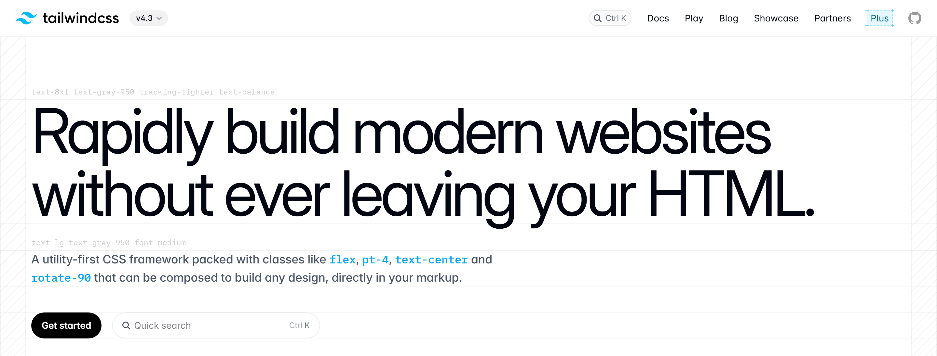
tailwindcss.com
tailwindcss.com
06 / 41

Slide 7
Classes, not components
Tailwind CSS 4.3 has no ready-made button. You style with classes.
A class with no prefix applies at every width. md: applies from that width up.
bg-white
p-6
rounded-2xl
md:grid-cols-2
07 / 41

Slide 8
A card in Tailwind
There is no .card component. Card is created by rounded-.. class
<article class="max-w-sm rounded-2xl bg-white p-6">
<h2 class="text-xl font-semibold">Workshop</h2>
<p class="mt-2 text-slate-600">One evening in Ostrava.</p>
<a class="mt-4 inline-block rounded-lg bg-cyan-600 px-4 py-2 text-white"
href="/join">Join</a>
</article>
08 / 41

Slide 9
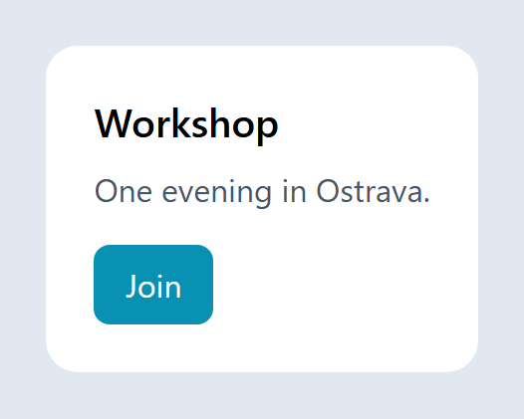
The card on screen
Code
Result
<article class="max-w-sm rounded-2xl
bg-white p-6">
<h2 class="text-xl font-semibold">
Workshop
</h2>
<p class="mt-2 text-slate-600">
One evening in Ostrava.
</p>
<a class="mt-4 inline-block rounded-lg
bg-cyan-600 px-4 py-2 text-white"
href="/join">Join</a>
</article>
09 / 41

Slide 10
One column, then more
One column on a phone, two from md, three from lg.
<div class="grid grid-cols-1 gap-4 md:grid-cols-2 lg:grid-cols-3">
<article class="rounded-lg bg-white p-4">One</article>
<article class="rounded-lg bg-white p-4">Two</article>
<article class="rounded-lg bg-white p-4">Three</article>
</div>
10 / 41

Slide 11
Three columns on screen
Code
<div class="grid grid-cols-1 gap-4 md:grid-cols-2 lg:grid-cols-3">
<article class="rounded-lg bg-white p-4">One</article>
<article class="rounded-lg bg-white p-4">Two</article>
<article class="rounded-lg bg-white p-4">Three</article>
</div>
Result
11 / 41

Slide 12
Default screens
default
every width
lg
64rem
sm
40rem
xl
80rem
md
48rem
2xl
96rem
12 / 41

Slide 13
Bootstrap
13 / 41

Slide 14
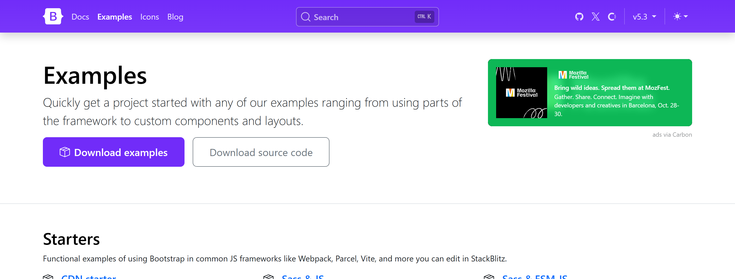
getbootstrap.com
getbootstrap.com/docs/5.3/examples/
14 / 41

Slide 15
Bootstrap 5.3
5.3.8 is the current release. Version 6 is only an alpha.
It ships a 12-column grid, plus buttons, navbars, and other parts.
Mobile first. Version 5 does not use jQuery.
15 / 41

Slide 16
Bootstrap breakpoints
xs
under 576px
lg
≥ 992px
sm
≥ 576px
xl
≥ 1200px
md
≥ 768px
xxl
≥ 1400px
16 / 41

Slide 17
The 12-column grid
col-12 is the full row. col-md-6 is half of it from md up.
<div class="container">
<div class="row">
<div class="col-12 col-md-6">Half from md</div>
<div class="col-12 col-md-6">Half from md</div>
</div>
</div>
17 / 41

Slide 18
A component class
btn btn-primary is one component, not a list of utilities.
<a class="btn btn-primary" href="/join">Join</a>
Join
The same classes, drawn
18 / 41

Slide 19
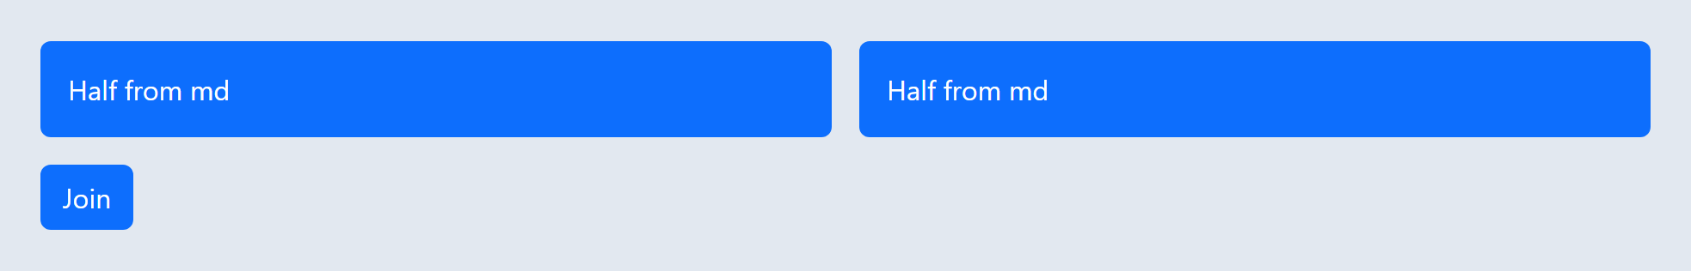
Grid and button on screen
Code
<div class="container">
<div class="row g-3">
<div class="col-12 col-md-6">
<div class="p-3 text-white bg-primary rounded">Half from md</div>
</div>
<div class="col-12 col-md-6">
<div class="p-3 text-white bg-primary rounded">Half from md</div>
</div>
</div>
<a class="btn btn-primary mt-3" href="/join">Join</a>
</div>
Result
19 / 41

Slide 20
ui.shadcn.com
20 / 41

Slide 21
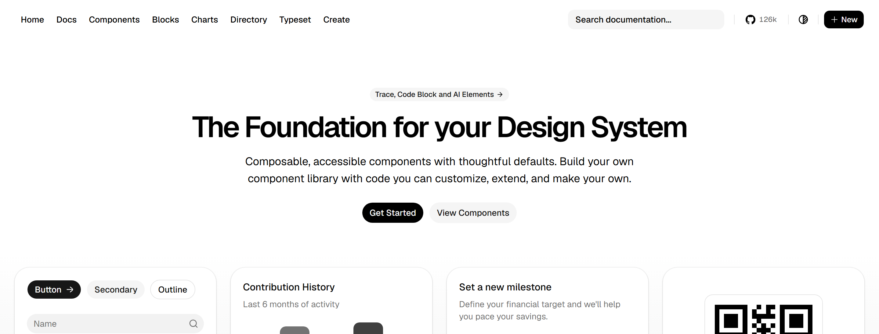
ui.shadcn.com
ui.shadcn.com
22 / 41

Slide 22
shadcn/ui
Not a CSS file. You copy a component into the project.
The markup is styled with Tailwind classes.
766 people named it in the same 2025 survey.
Copy
Tailwind
Your page
21 / 41

Slide 23

The default Button
Code
Result
import { Button } from
"@/components/ui/button"
export function Join() {
return <Button>Join</Button>
}
The Tailwind classes live in the file you copy.
23 / 41

Slide 24
Bulma
24 / 41

Slide 25
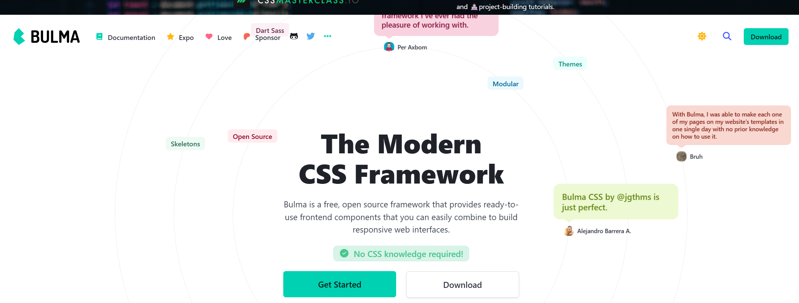
bulma.io
bulma.io
26 / 41

Slide 26
Bulma 1.0
Bulma 1.0.4 is CSS only. A modal does not need JavaScript.
columns and column are a flexbox row. Those names stayed in version 1.
<div class="columns">
<div class="column">One</div>
<div class="column">Two</div>
</div>
<button class="button is-primary">Join</button>
25 / 41

Slide 27
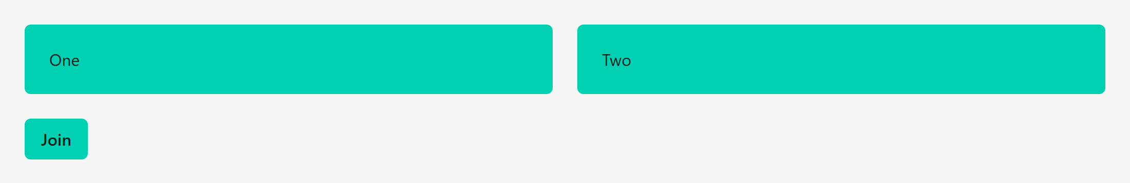
Columns on screen
Code
<div class="columns">
<div class="column">
<p class="notification is-primary">One</p>
</div>
<div class="column">
<p class="notification is-primary">Two</p>
</div>
</div>
<button class="button is-primary">Join</button>
Result
27 / 41

Slide 28
Open Props
28 / 41

Slide 29
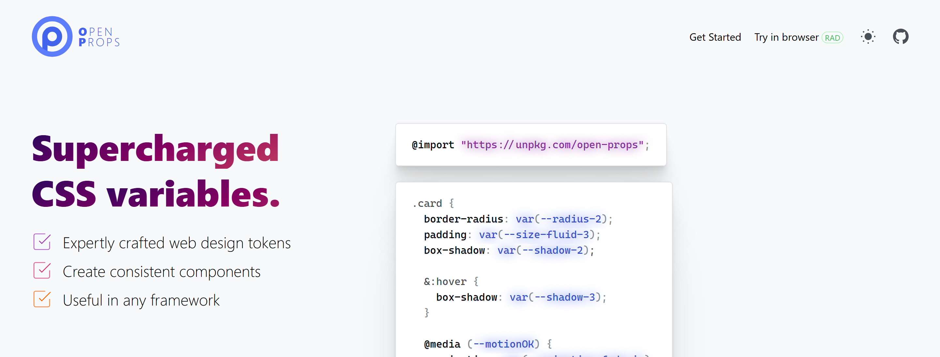
open-props.style
open-props.style
30 / 41

Slide 30
Open Props
Open Props 1.7 is a set of CSS variables, not buttons or a grid.
Colors, sizes, shadows, and type are ready. You still write the CSS.
170 people named it in the same 2025 survey.
button {
background: var(--blue-6);
padding: var(--size-2) var(--size-4);
border-radius: var(--radius-2);
}
29 / 41

Slide 31

The token button
Code
Result
button {
background: var(--blue-6);
color: white;
border: 0;
font: var(--font-size-3)
var(--font-sans);
padding: var(--size-2)
var(--size-4);
border-radius: var(--radius-2);
}
31 / 41

Slide 32
UnoCSS
32 / 41

Slide 33
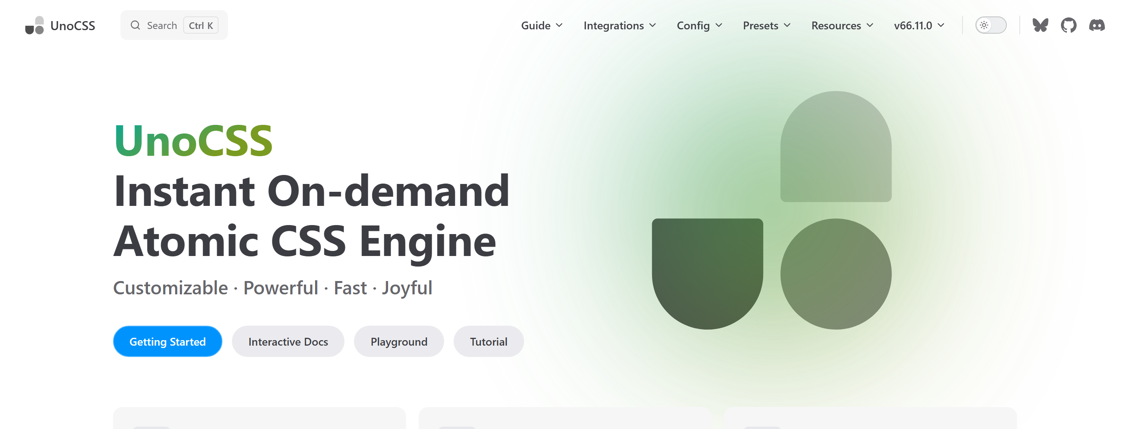
unocss.dev
unocss.dev
34 / 41

Slide 34
UnoCSS
UnoCSS 66.11 generates only the classes you use.
Preset Wind accepts Tailwind-like names. Attributify groups them.
154 people named it in the same 2025 survey.
<button
bg="cyan-600"
p="x-4 y-2"
text="white"
rounded>
Join
</button>
33 / 41

Slide 35

Attributify on screen
Code
Result
<button
bg="cyan-600"
p="x-4 y-2"
text="white"
border="0"
rounded
font="sans">
Join
</button>
35 / 41

Slide 36
Pure.css
36 / 41

Slide 37
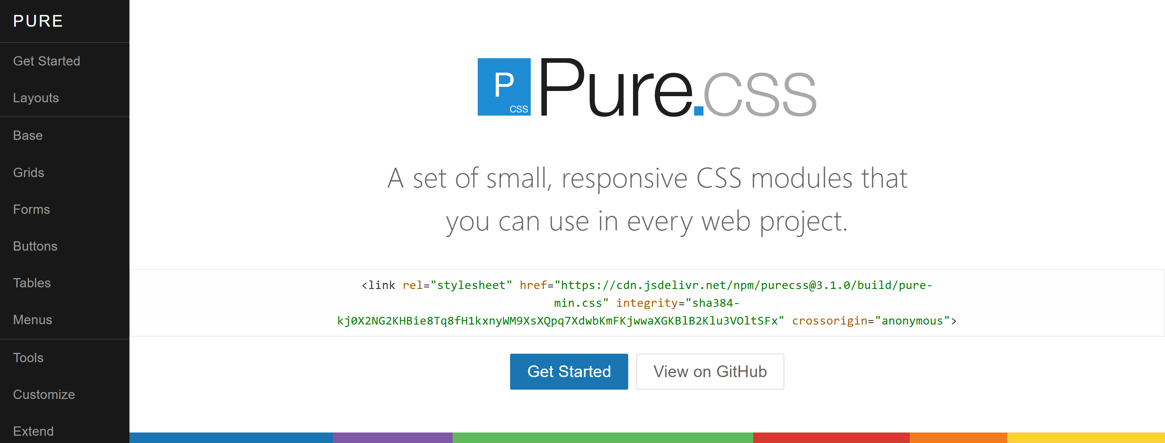
purecss.io
purecss.io
38 / 41

Slide 38
Pure.css
Pure.css 3.1 is a few small modules. The full set is 3.5 KB gzipped.
Load the grid, the buttons, or the menus. Leave out the rest.
The responsive columns live in a separate grids file.
<div class="pure-g">
<div class="pure-u-1 pure-u-md-1-2">One</div>
<div class="pure-u-1 pure-u-md-1-2">Two</div>
</div>
37 / 41

Slide 39
Two columns on screen
Code
.cell {
margin: .5rem; padding: 1.5rem;
background: #1f8dd6; color: #fff;
text-align: center;
}
<div class="pure-g">
<div class="pure-u-1 pure-u-md-1-2"><div class="cell">One</div></div>
<div class="pure-u-1 pure-u-md-1-2"><div class="cell">Two</div></div>
</div>
Result
39 / 41

Slide 40
Not a start for a new site
Foundation
Sites 6.9 is the last feature release. Yeti, the next one, is not stable.
Materialize
Version 1.0 has had no release since 2018.
Milligram
The last release is 1.4.1, from 2020.
40 / 41

Slide 41
Sources
https://2025.stateofcss.com/en-US/other-tools/
https://tailwindcss.com/docs/responsive-design
https://getbootstrap.com/docs/5.3/layout/breakpoints/
https://bulma.io/
https://ui.shadcn.com/
https://open-props.style/
https://unocss.dev/
https://purecss.io/
41 / 41

