Slide 1
Responsive webpages
Flexbox and grid system
01 / 28

Slide 2
What flexbox is for
The container shares free space among its items, even when their size is not fixed.
It can grow, shrink, and reorder those items so the row fits the screen.
1
2
3
02 / 28

Slide 3
Parent and child
Parent
Child
display, direction, and wrap
justify-content on the main axis
align-items and align-content
order
flex, which sets grow, shrink, and basis
align-self
03 / 28

Slide 4
Parent properties
04 / 28

Slide 5
display
flex
inline-flex
The row fills the container.
The row is only as wide as its items.
1
2
3
1
2
3
05 / 28

Slide 6
flex-direction
The main axis is the direction the items follow. The cross axis is perpendicular to it.
row is horizontal. column is vertical. Add -reverse to flip the start.
row
column
1
1
2
3
2
3
06 / 28

Slide 7
flex-wrap and gap
nowrap is the default, so items shrink onto one line.
wrap sends the next item to a new line. gap is the space between items.
flex-flow is the shorthand: flex-flow: row wrap.
1
2
3
4
5
6
07 / 28

Slide 8
justify-content
Alignment on the main axis. space-between is the one used most often.
flex-start
1
2
3
flex-end
1
2
3
center
1
2
3
space-between
1
2
3
space-around
1
2
3
space-evenly
1
2
3
08 / 28

Slide 9
align-items
Alignment on the cross axis. stretch is the default.
stretch
center
flex-end
09 / 28

Slide 10
align-content
This aligns the wrapped lines, not the items inside one line.
It does nothing when there is only one line.
1
2
3
space-between
1
2
3
10 / 28

Slide 11
Child properties
11 / 28

Slide 12
order
Items follow the source order until order changes it. The initial value is 0.
In the source
On screen, with order: -1 on 3
1
2
3
3
1
2
.item { order: 0; }
.third { order: -1; }
12 / 28

Slide 13
The flex shorthand
flex sets grow, shrink, and basis. Prefer it to the three longhands.
flex: 1 means 1 1 0%. flex: none means 0 0 auto.
An item will not shrink under its content unless you set min-width: 0.
flex: 1
flex: 2
none
13 / 28

Slide 14
align-self
One item can leave the line set by align-items.
1
3
flex-end
.two { align-self: flex-end; }
14 / 28

Slide 15
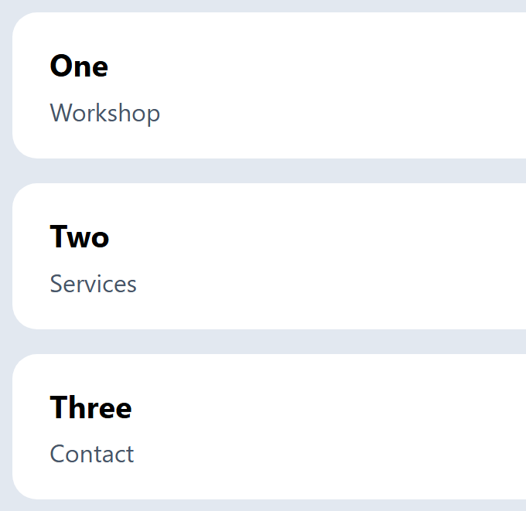
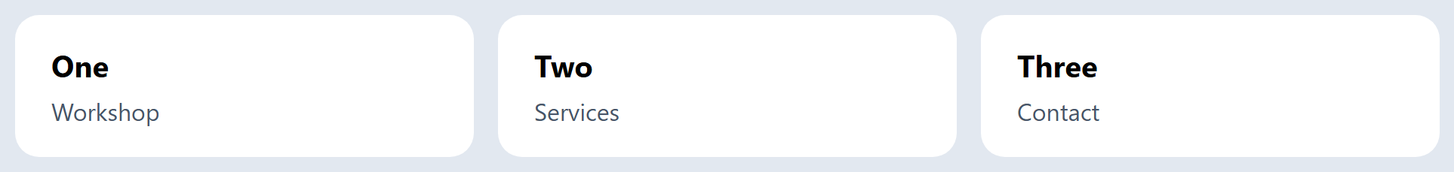
A row that wraps
.cards { display: flex; flex-wrap: wrap; gap: 1rem; }
.cards article { flex: 1 0 12rem; }
Narrow
Wide
15 / 28

Slide 16
Flexbox in Bootstrap
16 / 28

Slide 17
Bootstrap flex utilities
Bootstrap 5 lays the grid out with flexbox. Version 5 does not use jQuery.
d-flex turns it on. flex-column changes the axis. ms-auto replaces ml-auto.
Workshop
About
Join
<div class="d-flex align-items-center gap-3">
<span class="me-auto">Workshop</span>
<a href="/about">About</a>
<a class="btn btn-primary" href="/join">Join</a>
</div>
17 / 28

Slide 18
display in Bootstrap
d-flex is display: flex, so the row fills its parent. d-inline-flex is only as wide as its items.
d-flex
d-inline-flex
1
2
3
1
2
3
<div class="d-flex">...</div>
<div class="d-inline-flex">...</div>
18 / 28

Slide 19
flex-direction in Bootstrap
flex-row is horizontal. flex-column is vertical. The -reverse classes start from the other end.
flex-md-row turns the column into a row from the md breakpoint up.
flex-row
flex-column
1
1
2
3
2
3
<div class="d-flex flex-row">...</div>
<div class="d-flex flex-column flex-md-row">...</div>
19 / 28

Slide 20
flex-wrap and gap
flex-wrap moves the next item onto a new line. flex-nowrap is the default.
gap-3 is the gap property, 1rem. There is no single flex-flow class: combine flex-row and flex-wrap.
flex-wrap gap-3
1
2
3
4
5
6
<div class="d-flex flex-wrap gap-3">
<span>1</span> <span>2</span> <span>3</span>
<span>4</span> <span>5</span> <span>6</span>
</div>
20 / 28

Slide 21
justify-content in Bootstrap
The class drops flex- and space-. space-between becomes justify-content-between.
The other values are start, end, center, around, and evenly.
justify-content-between
1
2
3
<div class="d-flex justify-content-between">
<span>1</span>
<span>2</span>
<span>3</span>
</div>
21 / 28

Slide 22
align-items in Bootstrap
These classes align items on the cross axis. stretch is the default.
align-items-center and align-items-end match center and flex-end. start and baseline exist too.
align-items-stretch
align-items-center
align-items-end
1
2
3
1
2
3
1
2
3
<div class="d-flex align-items-center">...</div>
<div class="d-flex align-items-end">...</div>
<div class="d-flex align-items-stretch">...</div>
22 / 28

Slide 23
align-content in Bootstrap
align-content-between lines up the wrapped rows, the same job as space-between. A single line ignores it.
Values are start, end, center, between, around, and stretch. There is no evenly.
align-content-between
1
2
3
4
5
6
<div class="d-flex flex-wrap align-content-between">
<span>1</span> <span>2</span> <span>3</span>
<span>4</span> <span>5</span> <span>6</span>
</div>
23 / 28

Slide 24
order in Bootstrap
order-first is order: -1, so the third item moves first. order-last is 6.
order-0 through order-5 set that number.
in the HTML
1
2
3
on screen
3
1
2
<div class="d-flex">
<span>1</span>
<span>2</span>
<span class="order-first">3</span>
</div>
24 / 28

Slide 25
flex grow and fill
flex-grow-1 only sets grow. flex-fill is flex: 1 1 auto. flex-shrink-0 will not shrink.
flex: 1 from the earlier slide is 1 1 0%. No utility is exactly that.
free space goes to grow and fill
flex-grow-1
flex-fill
flex-shrink-0
<div class="d-flex">
<div class="flex-grow-1">1</div>
<div class="flex-fill">2</div>
<div class="flex-shrink-0">3</div>
</div>
<!-- flex: 1 is 1 1 0%. No class sets that. -->
25 / 28

Slide 26
align-self in Bootstrap
align-self-end pulls one item off the line set by align-items.
The names match align-items: start, end, center, baseline, and stretch.
align-items-center, item 2 is align-self-end
1
3
2
<div class="d-flex align-items-center">
<span>1</span>
<span class="align-self-end">2</span>
<span>3</span>
</div>
26 / 28

Slide 27
The row is flexbox
The wrapping cards are d-flex flex-wrap gap-3. A .row is also display: flex and flex-wrap: wrap.
.col is flex: 1 0 0%. .g-3 is a 1rem gutter made with padding. .gap-3 is the gap property.
d-flex flex-wrap gap-3
.row .col .g-3
1
2
3
1
2
3
4
5
<div class="d-flex flex-wrap gap-3">...</div>
<div class="row g-3">
<div class="col">1</div>
<div class="col">2</div>
<div class="col">3</div>
</div>
27 / 28

Slide 28
Sources
https://css-tricks.com/snippets/css/a-guide-to-flexbox/
https://developer.mozilla.org/en-US/docs/Web/CSS/flex
https://getbootstrap.com/docs/5.3/utilities/flex/
https://getbootstrap.com/docs/5.3/layout/grid/
https://getbootstrap.com/docs/5.3/utilities/spacing/
28 / 28

