Slide 1
Responsive webpages
Practical usage of the Bootstrap framework - media queries, navbar, examples
01 / 45

Slide 2
Media queries
Match a width, not a device. handheld is not how you style a phone.
The range form is fine in current browsers. min-width still works.
/* Level 4 */
@media (width >= 48rem) {
.cards { display: flex; }
}
/* The older form */
@media (min-width: 48rem) {
.cards { display: flex; }
}
02 / 45

Slide 3
Bootstrap still uses min-width
The range form on the previous slide is valid CSS. Bootstrap 5.3 still compiles each breakpoint as min-width, and the class stays on above that width.
/* md, and every width above it */
@media (min-width: 768px) {
.col-md-6 {
flex: 0 0 auto;
width: 50%;
}
}
03 / 45

Slide 4
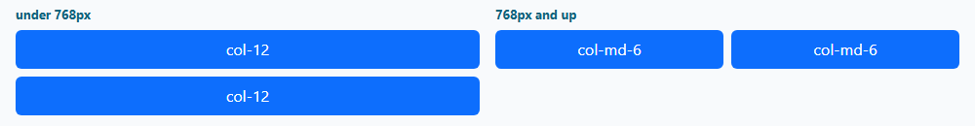
What the breakpoint changes
A class with no infix applies at every width. col-md-6 does nothing until 768px. Below that, only col-12 is in effect.
<div class="col-12 col-md-6">Half from md</div>
<div class="col-12 col-md-6">Half from md</div>
04 / 45

Slide 5
The grid
05 / 45

Slide 6
Breakpoints
Mobile first. A class with no breakpoint applies at every width.
sm
md
lg
xl
xxl
>= 576px
>= 768px
>= 992px
>= 1200px
>= 1400px
xs is simply under 576px. col-12 is the full row. col-md-6 is half of it from md up.
06 / 45

Slide 7
A row on screen
<div class="container">
<div class="row g-3">
<div class="col-12 col-md-6">Half from md</div>
<div class="col-12 col-md-6">Half from md</div>
</div>
</div>
07 / 45

Slide 8
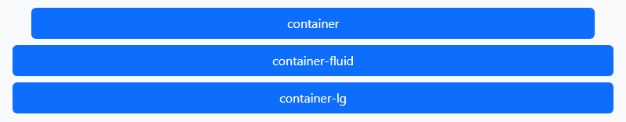
Containers
.container caps the width: 540, 720, 960, 1140, then 1320. .container-fluid is always 100%. .container-lg stays fluid until 992px, so at 800px it matches container-fluid.
<div class="container">...</div>
<div class="container-fluid">...</div>
<div class="container-lg">...</div>
08 / 45

Slide 9
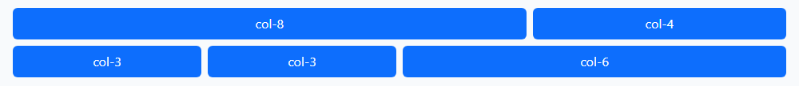
Twelve columns
Each row has 12 columns. The numbers on one row add up to 12.
<div class="row g-2">
<div class="col-8">col-8</div>
<div class="col-4">col-4</div>
</div>
<div class="row g-2">
<div class="col-3">col-3</div>
<div class="col-3">col-3</div>
<div class="col-6">col-6</div>
</div>
09 / 45

Slide 10
One column sets the width
.col shares whatever space is left. col-6 takes half, and the other two columns split the rest.
<div class="row">
<div class="col">col</div>
<div class="col-6">col-6</div>
<div class="col">col</div>
</div>
10 / 45

Slide 11
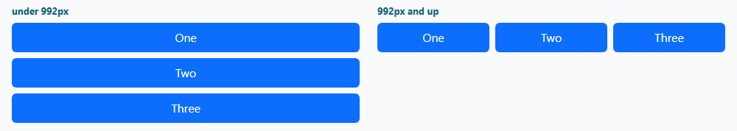
Stack, then split
col-12 is the full row. col-lg-4 is one third from 992px up. Both classes stay on the same element.
<div class="row">
<div class="col-12 col-lg-4">One</div>
<div class="col-12 col-lg-4">Two</div>
<div class="col-12 col-lg-4">Three</div>
</div>
11 / 45

Slide 12
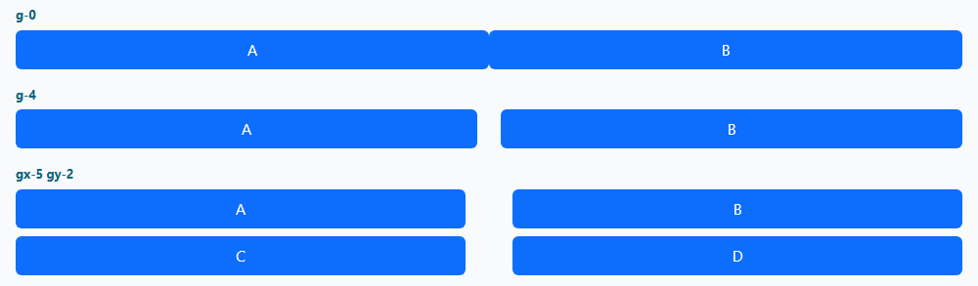
Gutters
A plain row has a 1.5rem horizontal gutter and no vertical gutter. g-0 removes both. g-4 sets both to 1.5rem. gx is horizontal and gy is vertical.
<div class="row g-0">...</div>
<div class="row g-4">...</div>
<div class="row gx-5 gy-2">...</div>
12 / 45

Slide 13
A row inside a column
A nested .row has its own 12 columns. They fill the parent column, not the page.
<div class="col-8">
<div class="row">
<div class="col-6">col-6</div>
<div class="col-6">col-6</div>
</div>
</div>
13 / 45

Slide 14

Offset and order
offset-4 skips four columns. order-1 is drawn before order-2. The order in the HTML does not change.
<div class="row">
<div class="col-4 offset-4">offset-4</div>
</div>
<div class="row">
<div class="col-4 order-2">HTML first</div>
<div class="col-4 order-1">order-1</div>
</div>
14 / 45

Slide 15
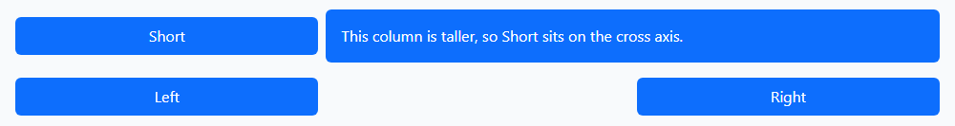
Align the row
The row is a flex container. align-items-center is the cross axis. justify-content-between pushes the columns to the two ends.
<div class="row align-items-center">
<div class="col-4">Short</div>
<div class="col-8">Taller column</div>
</div>
<div class="row justify-content-between">
<div class="col-4">Left</div>
<div class="col-4">Right</div>
</div>
15 / 45

Slide 16
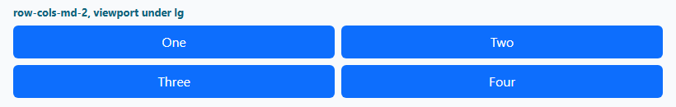
How many columns
The row-cols classes sit on the row, not on each column. One per row at first, two from md, four from lg. The picture is the md step.
<div class="row row-cols-1 row-cols-md-2
row-cols-lg-4">
<div class="col">One</div>
<div class="col">Two</div>
<div class="col">Three</div>
<div class="col">Four</div>
</div>
16 / 45

Slide 17
Navbar and navs
17 / 45

Slide 18
A navbar
<nav class="navbar navbar-expand-lg">
<button class="navbar-toggler"
data-bs-toggle="collapse"
data-bs-target="#nav">
<span class="navbar-toggler-icon"></span>
</button>
</nav>
The toggler uses data-bs-*. There is no jQuery.
18 / 45

Slide 19
The whole navbar
The toggler and the collapse share an id. navbar-nav holds the links. Below lg they stay hidden until the button opens them.
<nav class="navbar navbar-expand-lg bg-body-tertiary">
<div class="container-fluid">
<a class="navbar-brand" href="#">Workshop</a>
<button class="navbar-toggler" type="button"
data-bs-toggle="collapse"
data-bs-target="#nav"
aria-label="Toggle navigation">
<span class="navbar-toggler-icon"></span>
</button>
<div class="collapse navbar-collapse" id="nav">
<ul class="navbar-nav">
<li class="nav-item">
<a class="nav-link active" href="#">About</a>
</li>
<li class="nav-item">
<a class="nav-link" href="#">Schedule</a>
</li>
</ul>
</div>
</div>
</nav>
19 / 45

Slide 20
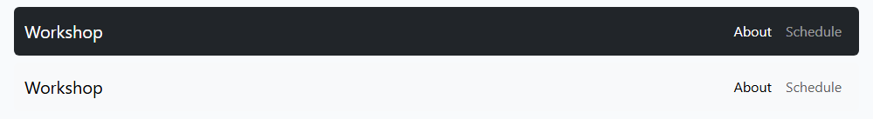
Dark and light navbars
In 5.3, data-bs-theme="dark" replaces navbar-dark. navbar-light is deprecated. A navbar is light unless you set the theme.
<nav class="navbar bg-dark" data-bs-theme="dark">
...
</nav>
<nav class="navbar bg-body-tertiary"
data-bs-theme="light">
...
</nav>
20 / 45

Slide 21
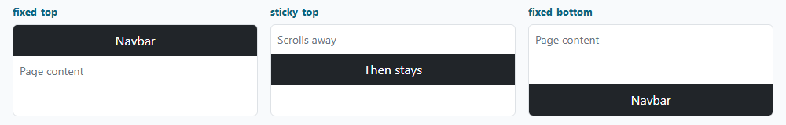
Where the navbar sits
fixed-top and fixed-bottom leave the document flow, so the page needs padding or the bar covers the content. sticky-top scrolls with the page, then stays.
<nav class="navbar fixed-top">...</nav>
<nav class="navbar sticky-top">...</nav>
<nav class="navbar fixed-bottom">...</nav>
21 / 45

Slide 22
A form in the navbar
ms-auto pushes the form to the end of the bar. role="search" and aria-label name the field.
<form class="d-flex ms-auto" role="search">
<input class="form-control me-2" type="search"
placeholder="Search" aria-label="Search">
<button class="btn btn-primary" type="submit">
Search
</button>
</form>
22 / 45

Slide 23
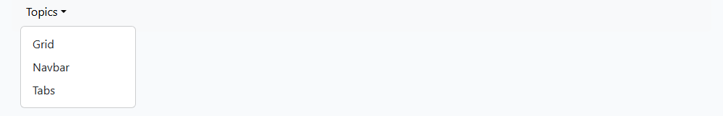
A dropdown in the navbar
data-bs-toggle="dropdown" needs the Bootstrap bundle. Each entry is a dropdown-item.
<li class="nav-item dropdown">
<a class="nav-link dropdown-toggle" href="#"
role="button" data-bs-toggle="dropdown">
Topics</a>
<ul class="dropdown-menu">
<li><a class="dropdown-item" href="#">Grid</a></li>
<li><a class="dropdown-item" href="#">Navbar</a></li>
<li><a class="dropdown-item" href="#">Tabs</a></li>
</ul>
</li>
23 / 45

Slide 24
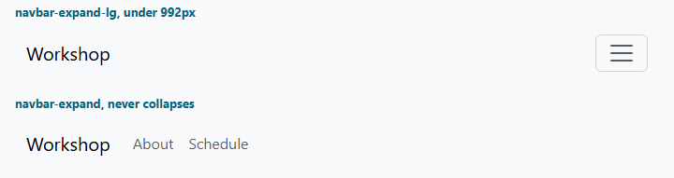
When the navbar collapses
navbar-expand-lg collapses below 992px. navbar-expand never collapses. With no expand class, the bar stays collapsed at every width.
<nav class="navbar navbar-expand-lg">...</nav>
<nav class="navbar navbar-expand">...</nav>
24 / 45

Slide 25
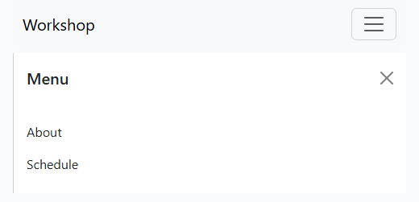
An offcanvas menu
The button sits in the navbar. data-bs-toggle="offcanvas" slides the menu in. With no navbar-expand class it stays a drawer. offcanvas-end comes from the right.
<button class="navbar-toggler" type="button"
data-bs-toggle="offcanvas"
data-bs-target="#menu"
aria-label="Toggle navigation">
<span class="navbar-toggler-icon"></span>
</button>
<div class="offcanvas offcanvas-end" id="menu">
<div class="offcanvas-header">
<h5 class="offcanvas-title">Menu</h5>
<button class="btn-close" type="button"
data-bs-dismiss="offcanvas"
aria-label="Close"></button>
</div>
<div class="offcanvas-body">
<a class="nav-link" href="#">About</a>
</div>
</div>
25 / 45

Slide 26
Tabs
26 / 45

Slide 27
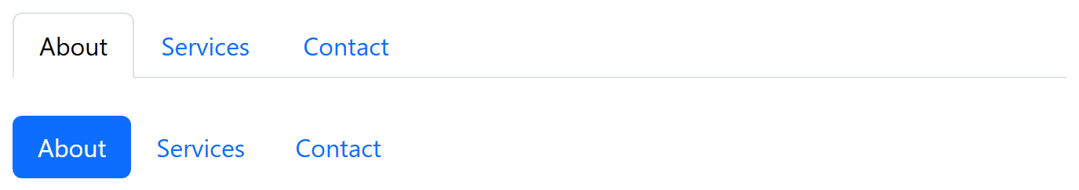
Tabs and pills
<ul class="nav nav-tabs">
<li class="nav-item">
<a class="nav-link active" href="#">About</a>
</li>
</ul>
<ul class="nav nav-pills nav-fill">...</ul>
27 / 45

Slide 28
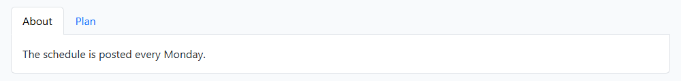
A tab changes the pane
Use a button, not a link: the tab changes a pane in place. data-bs-toggle="tab" needs the Bootstrap bundle. The open pane has show and active.
<ul class="nav nav-tabs" role="tablist">
<li class="nav-item" role="presentation">
<button class="nav-link active" type="button"
data-bs-toggle="tab" data-bs-target="#about"
role="tab">About</button>
</li>
<li class="nav-item" role="presentation">
<button class="nav-link" type="button"
data-bs-toggle="tab" data-bs-target="#plan"
role="tab">Plan</button>
</li>
</ul>
<div class="tab-content">
<div class="tab-pane fade show active" id="about"
role="tabpanel">...</div>
<div class="tab-pane fade" id="plan"
role="tabpanel">...</div>
</div>
28 / 45

Slide 29
Pills
nav-pills is the same nav with a filled active item. This one does not switch panes, so it uses aria-current and no role="tab".
<ul class="nav nav-pills">
<li class="nav-item">
<a class="nav-link active" aria-current="page"
href="#">About</a>
</li>
<li class="nav-item">
<a class="nav-link" href="#">Plan</a>
</li>
<li class="nav-item">
<a class="nav-link disabled" aria-disabled="true">
Archive</a>
</li>
</ul>
29 / 45

Slide 30
Underline nav
nav-underline was added in 5.3. The active link keeps an underline. It is still a flex nav.
<ul class="nav nav-underline">
<li class="nav-item">
<a class="nav-link active" aria-current="page"
href="#">About</a>
</li>
<li class="nav-item">
<a class="nav-link" href="#">Plan</a>
</li>
<li class="nav-item">
<a class="nav-link" href="#">Archive</a>
</li>
</ul>
30 / 45

Slide 31
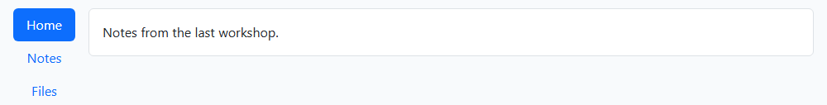
Vertical pills
flex-column stacks the pills. aria-orientation="vertical" belongs on the tab list. data-bs-toggle="pill" uses the same panes as tabs.
<div class="d-flex">
<div class="nav flex-column nav-pills me-3"
role="tablist"
aria-orientation="vertical">
<button class="nav-link active" type="button"
data-bs-toggle="pill"
data-bs-target="#home">Home</button>
<button class="nav-link" type="button"
data-bs-toggle="pill"
data-bs-target="#notes">Notes</button>
</div>
<div class="tab-content">
<div class="tab-pane fade show active"
id="home">...</div>
</div>
</div>
31 / 45

Slide 32
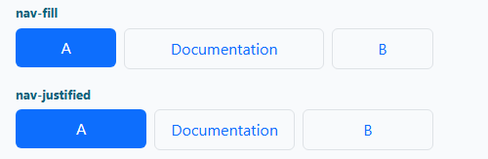
Fill and justified
nav-fill keeps the longer item wider. nav-justified gives every item the same width. The border only shows that width. The same two classes work on tabs.
<ul class="nav nav-pills nav-fill gap-2">
<li class="nav-item"><a class="nav-link active" href="#">A</a></li>
<li class="nav-item"><a class="nav-link border" href="#">Documentation</a></li>
<li class="nav-item"><a class="nav-link border" href="#">B</a></li>
</ul>
<ul class="nav nav-pills nav-justified gap-2">
<li class="nav-item"><a class="nav-link active" href="#">A</a></li>
<li class="nav-item"><a class="nav-link border" href="#">Documentation</a></li>
<li class="nav-item"><a class="nav-link border" href="#">B</a></li>
</ul>
32 / 45

Slide 33
Examples for 5.3
33 / 45

Slide 34
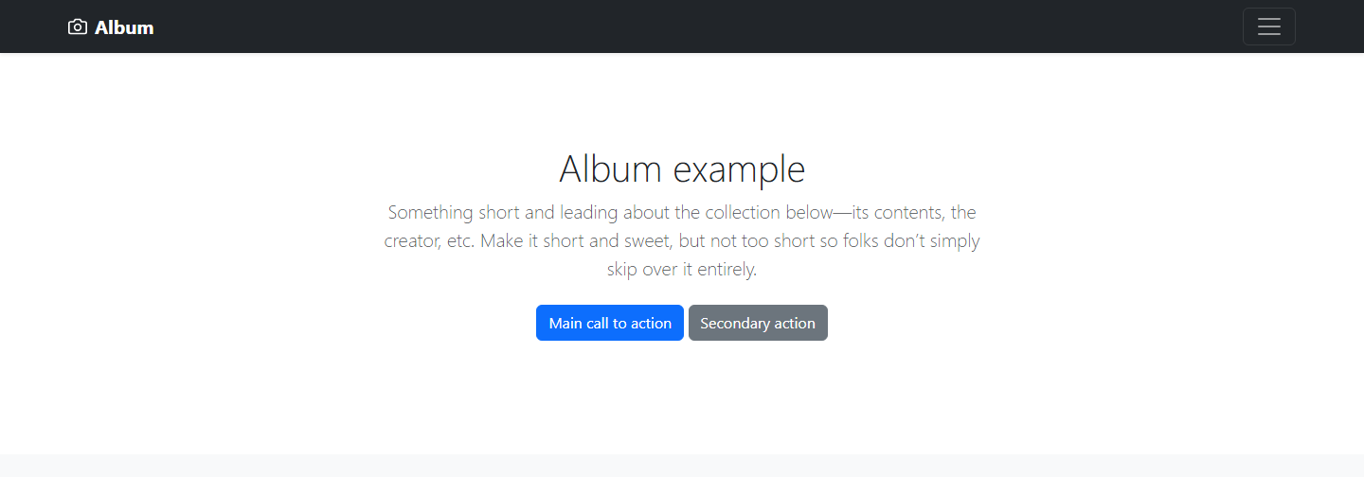
Album
getbootstrap.com/docs/5.3/examples/album/
34 / 45

Slide 35
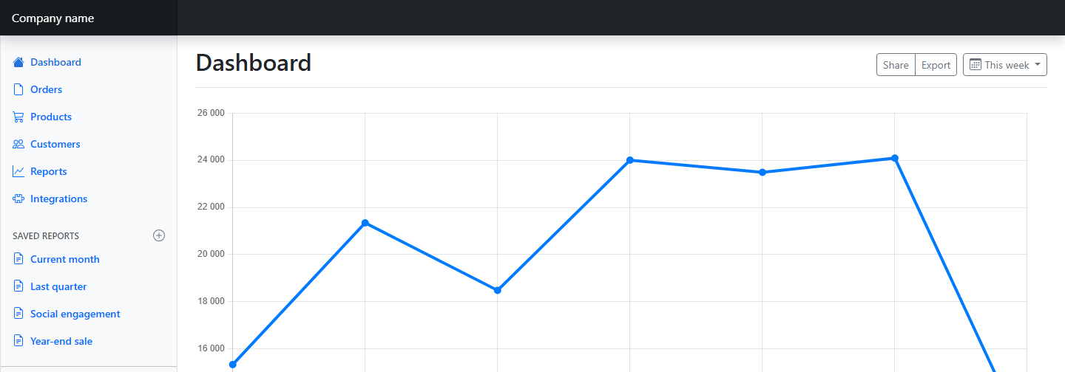
Dashboard
getbootstrap.com/docs/5.3/examples/dashboard/
35 / 45

Slide 36
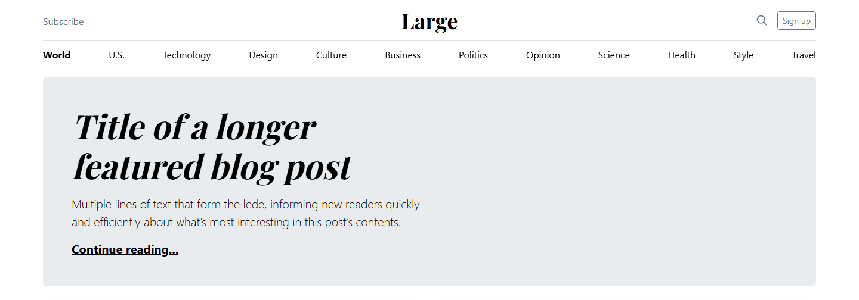
Blog
getbootstrap.com/docs/5.3/examples/blog/
36 / 45

Slide 37
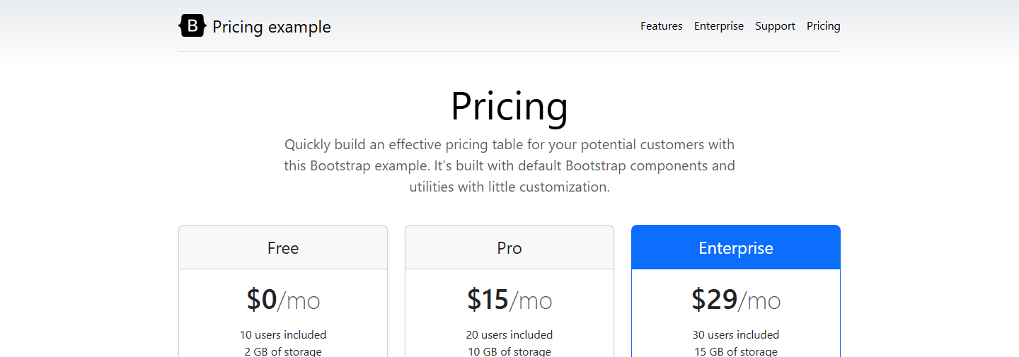
Pricing
getbootstrap.com/docs/5.3/examples/pricing/
37 / 45

Slide 38
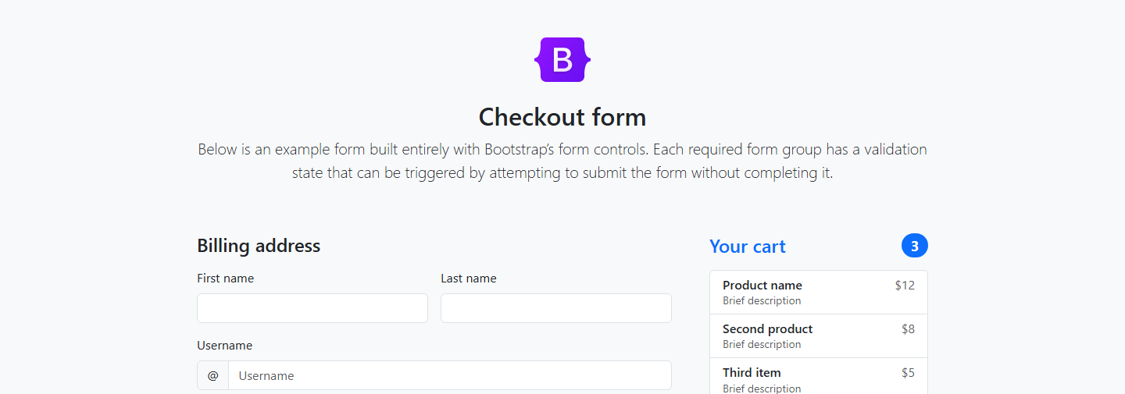
Checkout
getbootstrap.com/docs/5.3/examples/checkout/
38 / 45

Slide 39
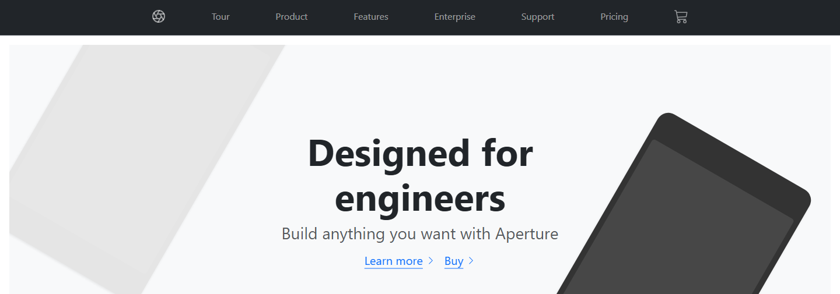
Product
getbootstrap.com/docs/5.3/examples/product/
39 / 45

Slide 40
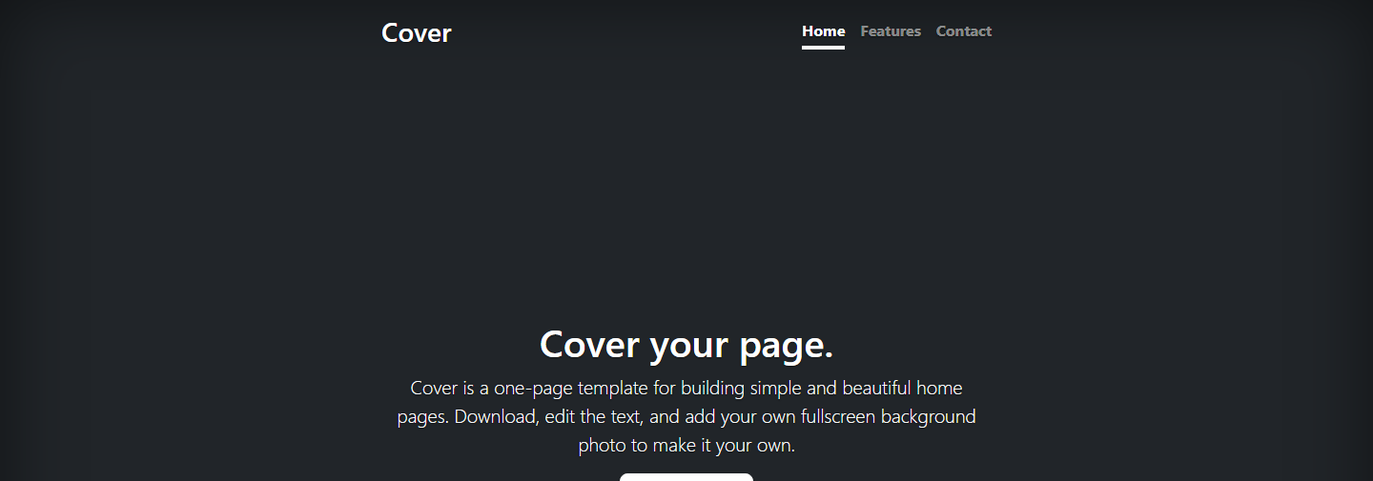
Cover
getbootstrap.com/docs/5.3/examples/cover/
40 / 45

Slide 41

Sign-in
getbootstrap.com/docs/5.3/examples/sign-in/
41 / 45

Slide 42
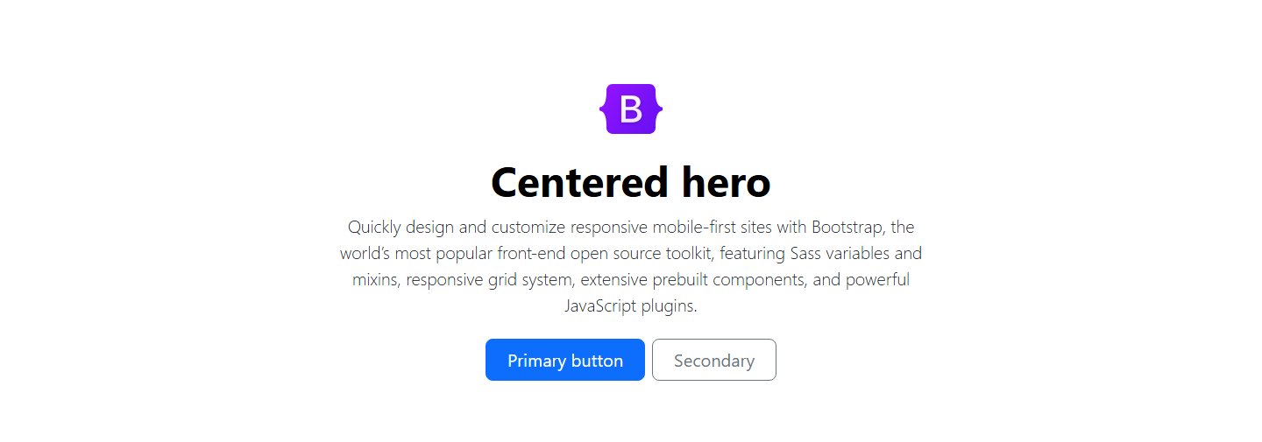
Heroes
getbootstrap.com/docs/5.3/examples/heroes/
42 / 45

Slide 43
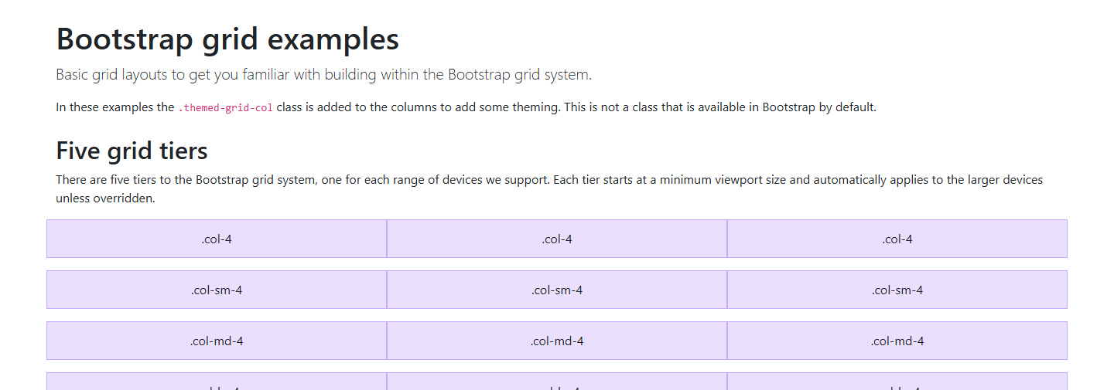
Grid example
getbootstrap.com/docs/5.3/examples/grid/
43 / 45

Slide 44
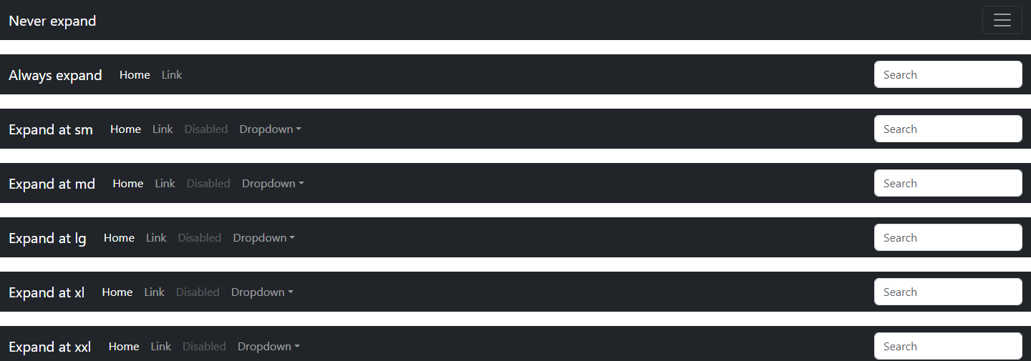
Navbar examples
getbootstrap.com/docs/5.3/examples/navbars/
44 / 45

Slide 45
Sources
https://developer.mozilla.org/en-US/docs/Web/CSS/CSS_media_queries/Using_media_queries
https://getbootstrap.com/docs/5.3/layout/breakpoints/
https://getbootstrap.com/docs/5.3/components/navbar/
https://getbootstrap.com/docs/5.3/components/navs-tabs/
https://getbootstrap.com/docs/5.3/examples/
https://getbootstrap.com/docs/5.3/layout/grid/
https://getbootstrap.com/docs/5.3/layout/containers/
https://getbootstrap.com/docs/5.3/components/offcanvas/
45 / 45

