Slide 1
Responsive webpages
Practical usage of the Bootstrap framework - images, ratio, carousel, icons
01 / 20

Slide 2
Images
img-fluid makes the picture follow the width of its column.
img-thumbnail adds a small frame. rounded softens the corners.
float-start only lets text wrap a picture. A page row stays flex or grid.
<img class="img-fluid rounded" src="photo.jpg"
alt="Workshop in Ostrava" width="800" height="500">
02 / 20

Slide 3

Thumbnail and circle
img-thumbnail adds padding and a border. rounded-circle makes a round portrait. Give the circle equal width and height.
<img class="img-thumbnail me-4" src="campus.jpg"
alt="Campus" width="240" height="160">
<img class="rounded-circle" src="portrait.jpg"
alt="Speaker" width="120" height="120">
03 / 20

Slide 4

A figure
figure groups the picture and its caption. figure-img is the picture. figure-caption is the line under it.
<figure class="figure">
<img class="figure-img img-fluid rounded"
src="campus.jpg" alt="Campus">
<figcaption class="figure-caption">
Campus in Ostrava
</figcaption>
</figure>
04 / 20

Slide 5
Ratio
The frame keeps its shape while the iframe fills it.
1x1
4x3
16x9
<div class="ratio ratio-16x9">
<iframe src="https://www.youtube.com/embed/VIDEO_ID"
title="Workshop" allowfullscreen></iframe>
</div>
05 / 20

Slide 6
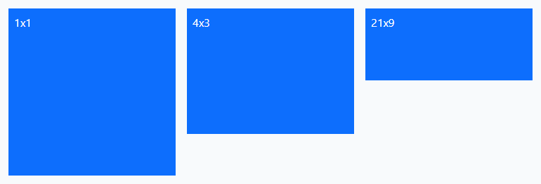
Other ratios
ratio-1x1, ratio-4x3 and ratio-21x9 share the helper with 16x9. The child fills the frame. align-items-start keeps each ratio its own height.
<div class="d-flex gap-3 align-items-start">
<div class="ratio ratio-1x1 w-25">
<div class="bg-primary text-white p-2">1x1</div>
</div>
<div class="ratio ratio-4x3 w-25">
<div class="bg-primary text-white p-2">4x3</div>
</div>
<div class="ratio ratio-21x9 w-25">
<div class="bg-primary text-white p-2">21x9</div>
</div>
</div>
06 / 20

Slide 7
Carousel
07 / 20

Slide 8
One carousel
data-bs-ride starts it. The visible slide has carousel-item and active.
carousel-fade swaps the slide. data-bs-interval sets the pause, in milliseconds.
The page needs the Bootstrap JavaScript bundle. There is no jQuery.
<div id="slides" class="carousel slide" data-bs-ride="carousel">
<div class="carousel-inner">
<div class="carousel-item active" data-bs-interval="8000">
<img class="d-block w-100" src="photo.jpg" alt="Campus">
<div class="carousel-caption"><h2>Workshop</h2></div>
</div>
</div>
<button class="carousel-control-prev" data-bs-target="#slides"
data-bs-slide="prev" aria-label="Previous"></button>
</div>
08 / 20

Slide 9
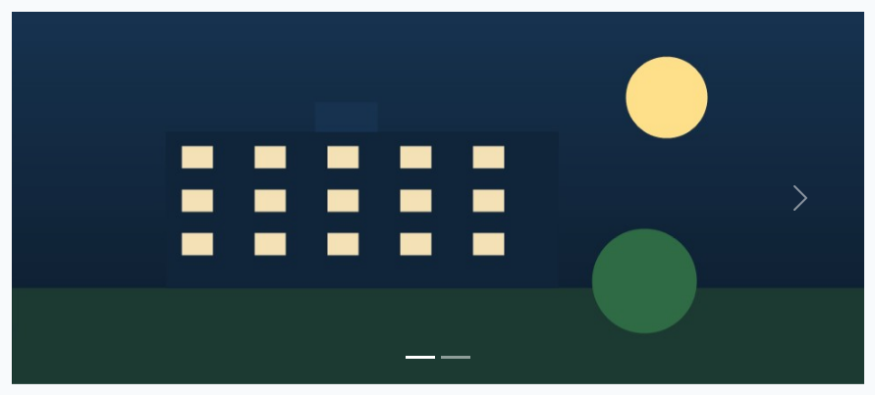
Indicators and arrows
Each dot is a button. data-bs-slide-to is the item index, from 0. The arrow icon is carousel-control-next-icon. Previous is the same pattern with prev.
<div id="slides" class="carousel slide">
<div class="carousel-indicators">
<button type="button" class="active"
data-bs-target="#slides" data-bs-slide-to="0"
aria-label="Slide 1"></button>
<button type="button" data-bs-target="#slides"
data-bs-slide-to="1" aria-label="Slide 2"></button>
</div>
<div class="carousel-inner">
<div class="carousel-item active">
<img class="d-block w-100" src="dusk.jpg"
alt="Campus">
</div>
<div class="carousel-item">
<img class="d-block w-100" src="hall.jpg"
alt="Workshop">
</div>
</div>
<button class="carousel-control-next" type="button"
data-bs-target="#slides" data-bs-slide="next">
<span class="carousel-control-next-icon"></span>
</button>
</div>
09 / 20

Slide 10

Dark controls
data-bs-theme="dark" turns the arrows and the dots dark, for a light picture. The old class carousel-dark is deprecated in 5.3.
<div id="light" class="carousel slide"
data-bs-theme="dark">
<div class="carousel-indicators">
<button type="button" class="active"
data-bs-target="#light" data-bs-slide-to="0"
aria-label="Slide 1"></button>
</div>
<div class="carousel-inner">
<div class="carousel-item active">
<img class="d-block w-100" src="day.jpg"
alt="Campus">
</div>
</div>
<button class="carousel-control-prev" type="button"
data-bs-target="#light" data-bs-slide="prev">
<span class="carousel-control-prev-icon"></span>
</button>
<button class="carousel-control-next" type="button"
data-bs-target="#light" data-bs-slide="next">
<span class="carousel-control-next-icon"></span>
</button>
</div>
10 / 20

Slide 11
Icons
11 / 20

Slide 12

Bootstrap Icons 1.13
Open source, MIT, and more than 2,000 icons.
The short form is the icon font. A sprite file stays on your own site.
<link rel="stylesheet" href="bootstrap-icons.min.css">
<i class="bi bi-alarm" aria-hidden="true"></i>
12 / 20

Slide 13

Font Awesome 7.3
7.3 is the current release. Free icons, and a larger Pro set.
The style is a class: fa-solid, fa-regular, or fa-brands.
<link rel="stylesheet" href="fontawesome-free/css/all.min.css">
<i class="fa-solid fa-user" aria-hidden="true"></i>
13 / 20

Slide 14

Icon size and color
fs-1 is the largest type step and fs-4 is smaller. text-primary and text-danger color the glyph. The same utilities color a Font Awesome icon.
<i class="bi bi-alarm fs-1 text-primary me-3"
aria-hidden="true"></i>
<i class="bi bi-heart-fill fs-2 text-danger me-3"
aria-hidden="true"></i>
<i class="bi bi-geo-alt-fill fs-4 text-success"
aria-hidden="true"></i>
14 / 20

Slide 15
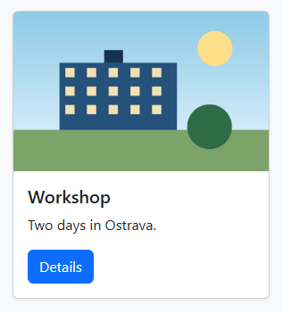
A card
card is the box. card-img-top is the picture. card-body holds the title, the text, and a button.
<div class="card shadow-sm" style="width: 18rem">
<img class="card-img-top" src="campus.jpg"
alt="Campus">
<div class="card-body">
<h5 class="card-title">Workshop</h5>
<p class="card-text">Two days in Ostrava.</p>
<a class="btn btn-primary" href="#">Details</a>
</div>
</div>
15 / 20

Slide 16

Buttons
btn-primary fills the button. btn-outline-secondary keeps the border. btn-group puts choices in one row, and active marks the chosen one.
<button class="btn btn-primary me-2" type="button">
Save</button>
<button class="btn btn-outline-secondary me-2"
type="button">Cancel</button>
<button class="btn btn-success btn-lg me-2"
type="button">Publish</button>
<div class="btn-group" role="group" aria-label="Range">
<button class="btn btn-outline-primary active"
type="button">Day</button>
<button class="btn btn-outline-primary"
type="button">Week</button>
</div>
16 / 20

Slide 17
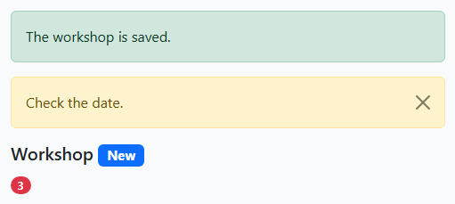
Alerts and badges
alert-success is a full-width note. btn-close dismisses it once the bundle is loaded. A badge uses text-bg-primary. rounded-pill makes the count a capsule.
<div class="alert alert-success" role="alert">
The workshop is saved.
</div>
<div class="alert alert-warning alert-dismissible" role="alert">
Check the date.
<button type="button" class="btn-close"
data-bs-dismiss="alert" aria-label="Close"></button>
</div>
<h2 class="h5">Workshop <span class="badge text-bg-primary">New</span></h2>
<span class="badge rounded-pill text-bg-danger">3</span>
17 / 20

Slide 18
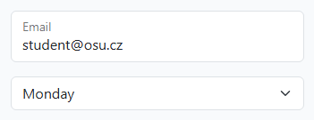
A floating label
Put the label after the input. A placeholder is required, or the label stays inline. form-select is the matching list.
<div class="form-floating mb-3">
<input class="form-control" id="email"
type="email" placeholder="name@osu.cz"
value="student@osu.cz">
<label for="email">Email</label>
</div>
<select class="form-select" aria-label="Day">
<option selected>Monday</option>
<option>Tuesday</option>
</select>
18 / 20

Slide 19
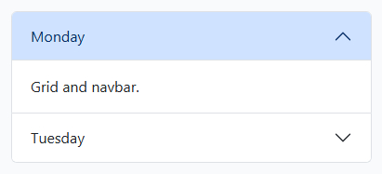
An accordion
The open item has show, and its button has no collapsed. data-bs-parent closes the others. The bundle handles the click.
<div class="accordion" id="days">
<div class="accordion-item">
<h2 class="accordion-header">
<button class="accordion-button"
type="button" data-bs-toggle="collapse"
data-bs-target="#one">Monday</button></h2>
<div class="accordion-collapse collapse show"
id="one" data-bs-parent="#days">
<div class="accordion-body">Grid and navbar.</div>
</div>
</div>
<div class="accordion-item">
<h2 class="accordion-header">
<button class="accordion-button collapsed"
type="button" data-bs-toggle="collapse"
data-bs-target="#two">Tuesday</button></h2>
<div class="accordion-collapse collapse" id="two"
data-bs-parent="#days">
<div class="accordion-body">Forms.</div>
</div>
</div>
</div>
19 / 20

Slide 20
Sources
https://getbootstrap.com/docs/5.3/content/images/
https://getbootstrap.com/docs/5.3/helpers/ratio/
https://getbootstrap.com/docs/5.3/components/carousel/
https://icons.getbootstrap.com/
https://fontawesome.com/
https://getbootstrap.com/docs/5.3/content/figures/
https://getbootstrap.com/docs/5.3/components/card/
https://getbootstrap.com/docs/5.3/components/buttons/
https://getbootstrap.com/docs/5.3/components/alerts/
https://getbootstrap.com/docs/5.3/components/badge/
https://getbootstrap.com/docs/5.3/forms/floating-labels/
https://getbootstrap.com/docs/5.3/components/accordion/
https://getbootstrap.com/docs/5.3/utilities/text/
https://getbootstrap.com/docs/5.3/utilities/colors/
20 / 20

