Slide 1
Partial-Input Baselines Reveal Construction Artifacts in Fake News Benchmarks
WSMA LAB PROJECT · CSE_3132
I built a fake news detector, got 98%, then proved the 98% is fake.
Abhishek Ghosh · Reg. No. 245816186
Dept. of CSE (Data Science), Manipal Institute of Technology, Bengaluru · Submitted to Dr. Yashaswini K A
Notes:
Hook (about 20 seconds). “Fake news detectors trained on the ISOT benchmark report 98 to 99 percent accuracy. I built one and got 98.4 percent. Then I tested whether that number actually means anything.” Pause, then move to the dataset.

Slide 2
ISOT’s two classes come from two newsrooms
THE BENCHMARK
21,417
23,481
real articles
fake articles
All from Reuters, a wire agency with a strict house style
From partisan websites flagged as unreliable
So a model can get the label right by recognising who wrote the article, without judging whether it is true.
Like a cancer detector that learns which hospital took the scan, then fails at a new hospital.
Notes:
The flaw (about 30 seconds). “Every real article in ISOT comes from Reuters; every fake one comes from a set of flagged websites. So a model could be recognising the newsroom instead of the lie.” Then the analogy: if every cancer scan came from Hospital A and every healthy scan from Hospital B, a model reaches 99% by recognising the hospital, and fails at Hospital C.

Slide 3
Is the detector recognising lies, or the newsroom?
THE QUESTION
Partial-input baselines (Gururangan et al., 2018): train models that are not allowed to see the article’s content. If they still score far above chance, the dataset is leaking the answer.
Notes:
The method (about 30 seconds). “To test this I used partial-input baselines, from Gururangan et al. 2018: I trained models that are not allowed to see the content. If they still score high, the dataset is leaking the answer.” Add: it is an established method from the dataset-artifacts literature, not something I invented.

Slide 4
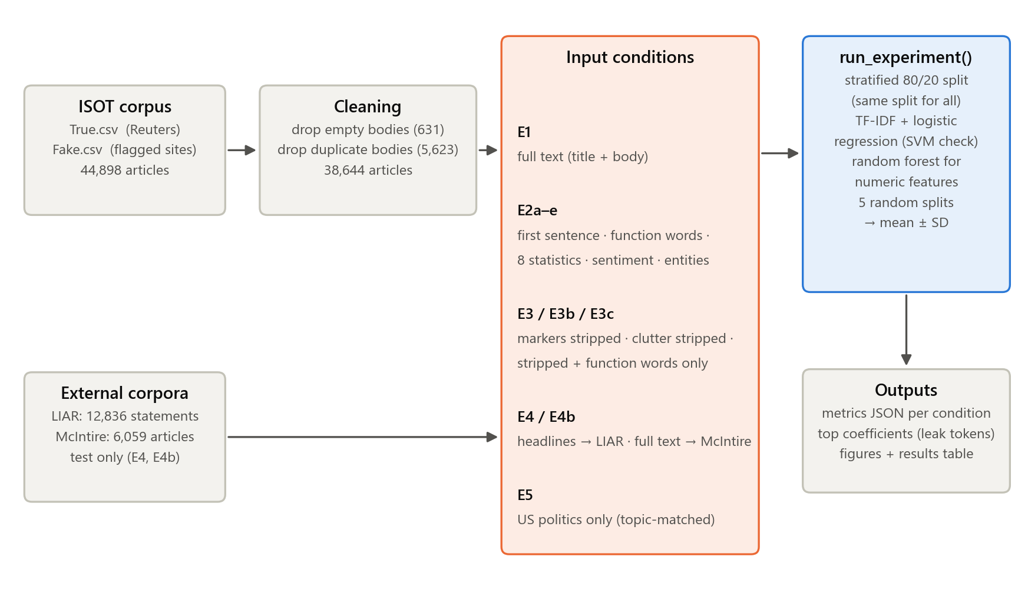
One harness, so only the input changes
METHOD
Cleaned ISOT: 38,644 articles (631 empty and 5,623 duplicate bodies removed)
Same stratified 80/20 split, seed 42, for every condition
TF-IDF + logistic regression; random forest for numeric features
Five random splits per condition, reported as mean ± SD
Chance measured, not assumed: 54.8%
Notes:
Fig. 1 in the report. Every condition goes through one function, run_experiment(), with the same split and the same classifier, so the only thing that differs between experiments is the input. Duplicates were removed because a copy in train and a copy in test would let the model be tested on something it memorised; 630 of the 631 empty bodies were fake, so keeping them would have been a leak I created. Chance is 54.8% because the cleaned data is 54.8% real. Transition: “So what happens when I take the content away?”

Slide 5
Without the content, models still score 86–99%
EVIDENCE 1 · TAKE THE CONTENT AWAY
98.4%
99.1%
Full text: the detector itself (E1)
First sentence only: higher than the full article (E2a)
96.8%
86.2%
Function words only: “the of a and to , the -” (E2b)
Eight numbers, no words: length, “?”, “!”, capitals (E2c)
Chance (always guessing the larger class) is 54.8%. Every probe is far above it.
Notes:
Fig. 2 in the report (about 45 seconds). “The first sentence alone: 99.1, higher than the full article. Only words like ‘the, of, a’ and punctuation: 96.8. Eight numbers like word count and question marks: 86.2. Chance is 54.8.” If asked why the first sentence wins: in Reuters copy it holds the dateline, “WASHINGTON (Reuters) -”, an almost pure source label. The headline result is function words: no nouns, verbs or names, still 96.8%.

Slide 6
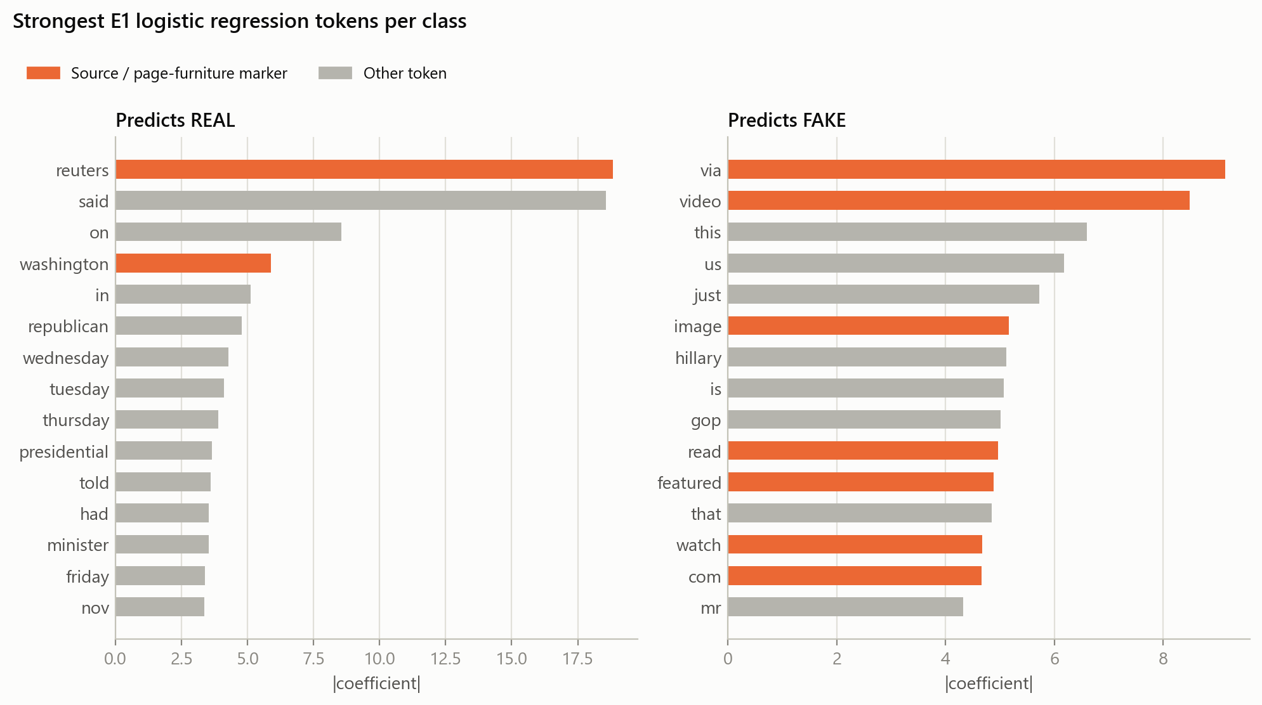
Its strongest clues name the publisher
EVIDENCE 2 · WHAT THE DETECTOR LEARNED
Orange bars are source and page-clutter markers.
Real: “reuters”, “washington”, weekdays, “said”.
Fake: “via”, “image”, “featured”, “video”, “read”.
Who wrote it, not whether it is true.
Notes:
Fig. 3 in the report (about 30 seconds). “The strongest clues are ‘Reuters’, ‘Washington’, days of the week, ‘featured image via’. Publisher markers, not truth.” I chose logistic regression because each word gets one readable weight; that is how these markers were found. A neural model would not show this so directly.

Slide 7
Strip every marker from both classes: 97.3%
EVIDENCE 3 · REMOVE THE GIVEAWAYS
Accuracy as markers are removed
What still separates the classes
Condition | Accuracy
Full text (E1) | 98.4%
Dateline, lead and “Reuters” removed (E3) | 97.7%
+ credits, links, tags, quote marks (E3b) | 97.3%
Stripped, function words only (E3c) | 90.7%
REAL: WIRE REPORTING
said · told · reporters · spokesman · would
FAKE: BLOG VOICE
this · just · you · here · ! · ?
The source is not in a few words. It runs through the whole writing style.
Notes:
Figs. 4 and 8 in the report (about 45 seconds). “I removed every marker from both classes: the dateline, the first sentence, every ‘Reuters’, image credits, links, handles, media tags, and every quote mark. Still 97.3.” Why it barely matters: wire reporting attributes every claim (“said”, “told reporters”), partisan blogs talk to the reader (“this”, “just”, “you”, “!”). Removing the label on the bottle doesn’t change what’s in it. Honesty point if asked: the quote-mark rule was extended once, after E5c’s coefficients showed it; that lowered my own numbers and both versions are reported. Transition: “But maybe it’s just topic, or just my classifier, or just this dataset.”

Slide 8
Not the topic, and not the classifier
CHECKS · TOPIC AND CLASSIFIER
Topic: US politics only, both classes
Classifier: linear SVM instead
90.3%
Input | Log. reg. | SVM
Full text | 98.4% | 99.3%
First sentence | 99.1% | 99.7%
Function words | 96.8% | 97.5%
All stripped | 97.3% | 98.1%
Every marker stripped, function words only (E5c), against 60.9% chance on this subset.
Real world-news articles removed, so topic cannot separate the classes.
A stronger model exploits the shortcut slightly more.
Notes:
Figs. 6 and 7 in the report (about 45 seconds). Topic: real ISOT articles are about half world news, while fake ones are all US politics, so “world news = real” could explain part of it. Keeping only US-politics articles, stripping everything and keeping only function words still gives 90.3 against 60.9 chance (chance rises because fake is now the majority). Classifier: “a linear SVM does slightly better on every condition, not worse.” So the signal is writing style.

Slide 9
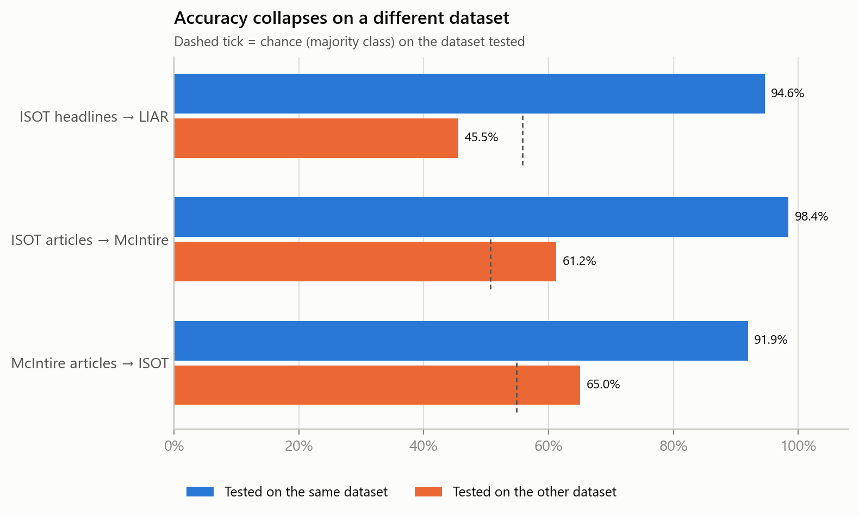
On other datasets, the detector collapses
CHECKS · OTHER DATASETS
45.5%
on LIAR fact-checked statements, below its 55.8% chance
61.2%
on McIntire full articles (50.7% chance); 68% of genuine articles called fake
McIntire’s own model scores 91.9%, so the task there is learnable.
Notes:
Fig. 5 in the report (about 45 seconds). “Trained on ISOT, tested elsewhere: 45.5 on LIAR, below chance; 61.2 on a dataset of real articles from other outlets, calling two-thirds of genuine news fake.” Why below chance: the model learned “not written like Reuters = fake”, and politicians’ statements aren’t written like Reuters. LIAR is only short statements, which is why the full-article McIntire test exists, with its own in-domain control (91.9%).

Slide 10
The 98% measures the newsroom, not the truth.
THE VERDICT
1
2
3
Report partial-input baselines next to every accuracy figure
Test on an independently built corpus, or on unseen publishers
Measure chance on the actual test set instead of assuming 50%
Notes:
Conclusion (about 30 seconds). “The 98 percent measures the newsroom, not the truth. ISOT’s labels coincide with two publishing pipelines, and models learn to recognise the pipeline. So fake news detectors should be tested across sources and alongside partial-input baselines, not on a single benchmark split.” Say clearly: this does not mean fake news detection is impossible, only that ISOT accuracy cannot show it.

Slide 11
What this does not show, and what comes next
LIMITATIONS AND FUTURE WORK
Limitations
Future work
Probes run in depth on ISOT only
Classical models only, no transformers
Hand-written stripping rules, extended once and disclosed
Test sets from publishers never seen in training
Benchmarks with true and false news from the same outlets
The same probes on transformer models and other corpora
Code, data and results, reproducible in one command (about 5 minutes):
github.com/FirezTheGreat/fake-news-partial-input-baselines
Questions?
Notes:
State the limitations before being asked; it reads as more credible. The topic, classifier, label-mapping and full-article objections were tested, not just mentioned. If asked “why no BERT?”: logistic regression shows exactly which words it uses, and the SVM result suggests stronger models exploit the shortcut at least as well; transformers are future work. Close with: “Thank you, I’m happy to take questions.”

