Slide 1
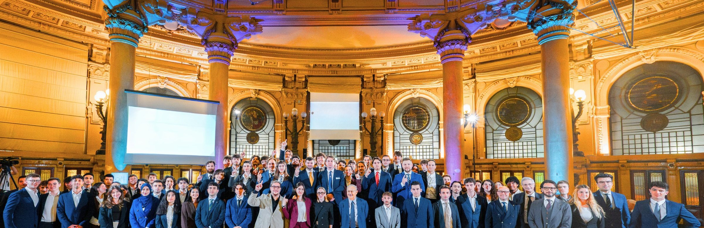
DEEP-TECH ECOSYSTEM
Humans Keep Purpose
DOPE Hubs (Non-Profit)
Firmamento Technologies
Excellence training and applied research.
The product is the people.
Deep-Tech Cooperative
Industrialization and Venture Building.
The product is digital sovereignty.
20 → 120
9
6th worldwide
Institutional
active researchers in 10 months
parallel projects, Aerospace, Health, AI, Cyber, EO
UAS Challenge 2025 + Best Newcomer Award
University of Genoa, Liguria Region, RINA, Legacoop
FIRMAMENTO TECHNOLOGIES SOCIETA' COOPERATIVA . P.IVA IT03038500991 . PEC firmamentotechnologies@pec.it

Slide 2
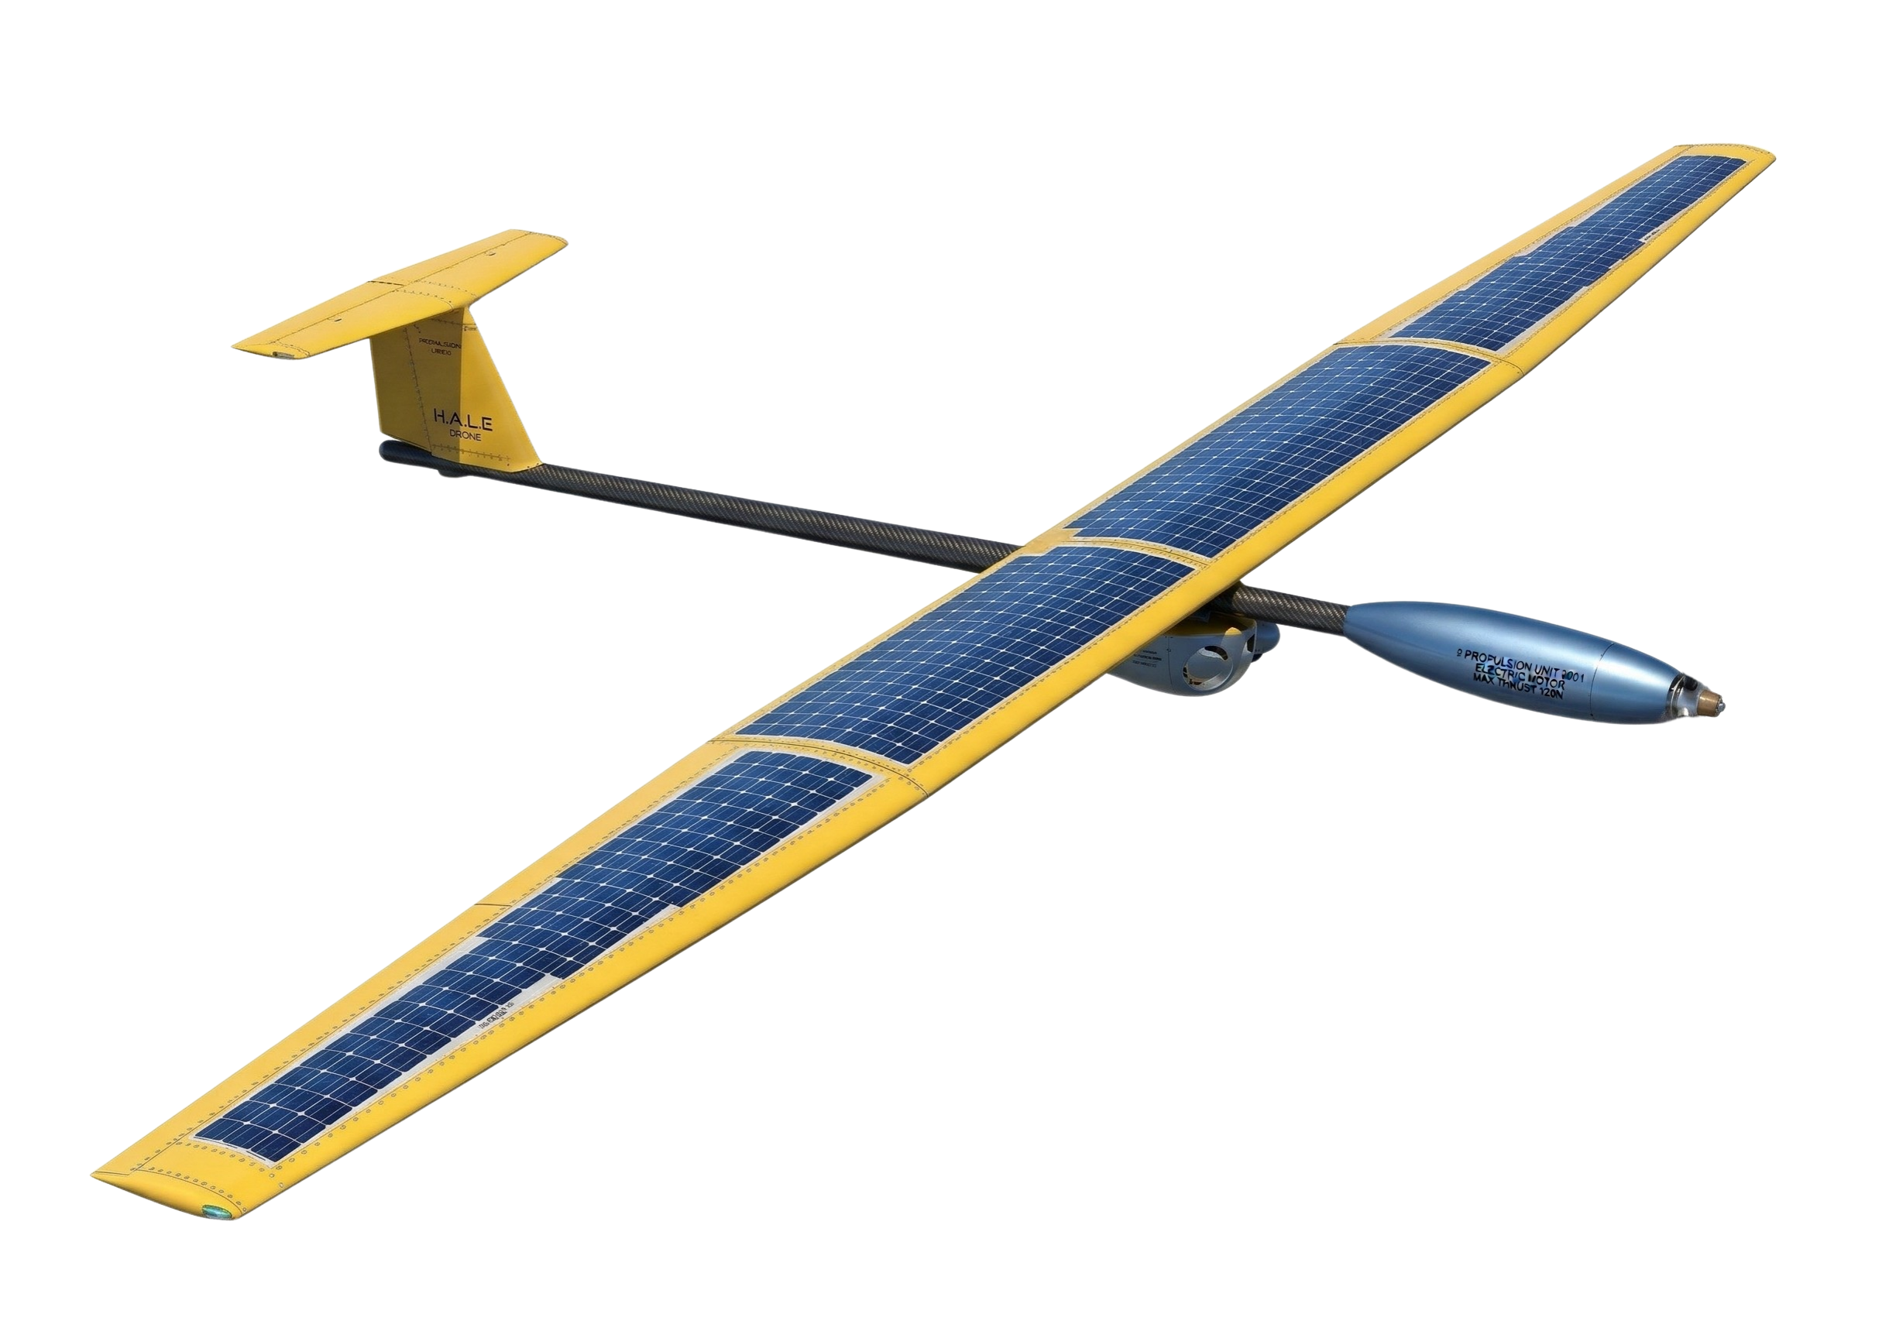
Project H.A.L.E.
(High Altitude Long Endurance)
The cooperative pseudo-satellite
for national resilience.
Operating altitude 20 km
Macro-regional coverage > 500 km
Latency < 20 ms
Propulsion Solar-electric
Endurance target 30+ days perennial (Y3)
Public value, four mission profiles
Disaster Response
Environmental Monitoring
Telemedicine
Civic Connectivity
Rapid network restoration after floods and landslides.
Wildfire alert and hydrogeological surveillance (multispectral / thermal).
Ultra-reliable links for remote health posts.
Smart agriculture and local e-governance support.
FIRMAMENTO TECHNOLOGIES
Pentema pilot . Liguria SNAI . H.A.L.E. Stratospheric Layer

Slide 3
Beyond the Drone
Three structural pillars defining the strategic positioning.
Data
Sovereignty
Dual-Use
Resilience
Seasonal
Persistence
European data residency. Consent management and sovereign cloud integration. Full GDPR + NIS2 compliance, AgID/PSN hosting for PA-grade data.
Support and backup to critical infrastructure. Persistent regional coverage for civil protection, disaster recovery and emergency telecom.
Architecture optimized for the 44 deg N energy balance, with continuous monitoring March-October and seasonal-only fallback as Plan A.
Pilot site . Pentema, Torriglia (Genova), Liguria, Italy . SNAI Inner Area
€700k - €2M CapEx Y1
Network . 10 Legacoop cooperatives . lead Fabrica
Tender . Coopfond Cooding Prototypes (Legacoop)
€1.18M/y OpEx Y2 reconciled (incl. regulatory team)
Compliance . Italian PFTE art. 41 D.Lgs. 36/2023 + NASA SE Handbook Rev 2
€260k Revenue Y1 baseline (range €220-300k)
FIRMAMENTO TECHNOLOGIES SOCIETA' COOPERATIVA
P.IVA IT03038500991 . PEC firmamentotechnologies@pec.it

